Slide 1
Introduction to Accelerators
Outline:
Accelerators - from discovery machines to everyday tool
Electrostatic (DC) Linear Accelerator
RF Field Linear Accelerator
Circular accelerators: cyclotron & betatron
Circular accelerators: synchrotron
Beam optics and particle tracing
Transverse beam dynamics: betatron oscillations
Synchrotron radiation
Colliders and luminosity
Limits for future high-energy colliders
References: (selection)
F. Hinterberger: Physik der Teilchenbeschleuniger und Ionenoptik
K. Wille, Physik der Teilchenbeschleuniger und Synchr.strahl.
www.classe.cornell.edu/~liepe/webpage/education4456.html

Slide 2
1. Accelerators: From discovery machines to everyday tool
Progress in experimental Particle Physics strongly driven by the progress in accelerator physics: Higher energy and higher beam currents allowed discoveries.
Selection of machines enabling discoveries:
e-accelerators
Year | Energy | Name / Laboratoy | Physics
1951 | 22 MeV | Betatron / Illinois | Electron Nucleus scattering
1953 | 225 MeV | Linac /Stanford | Nucleus form factors
1955 | 500 MeV | Linac Stanford | Proton form factor
1966 | 20 GeV | 2 miles Linac / Stanford | Partons & Scaling
e⁺e⁻ colliders
1961 | 225 MeV | AdA / Frascati | 1st particle-antiparticle collider
1972 | 4 GeV | SPEAR / Stanford | ψ-Meson, τ
1978 | 46 GeV | PETRA / DESY | Gluon
1989 | 100 GeV | LEP / CERN | Precision Z and W parameter

Slide 3
p/A-accelerators
A = ion
Year | Energy | Name / Laboratoy | Physics
1953 | 3.3 GeV | Cosmotron / BNL | Kaon & meson production
1955 | 6.2 GeV | Bevatron / Berkley (weak) | Antiproton
1960 | 30 GeV | AGS / BNL (strong focus) | CPV, Ω, J/ψ, Muon neutrino
1976 | 570 GeV | SPS / CERN | See SppS
pp (pp) AA colliders
1983 | 540 GeV | ppbar: SppS / CERN | W, Z Boson
1986 | 1.8 TeV | ppbar: Tevatron / Femilab | Top
2009 | 13.6 TeV | LHC / CERN | Higgs
Everyday tool: In 2016 - 30000 accelerators world wide¹⁾²⁾
1% research w/ energy >1GeV 44% are for radiotherapy
41% for ion implantation 9% for industrial process
4 % for biomedical and other low-energy research
¹⁾ http://www.acceleratorsamerica.org/
²⁾ T. Feder, Physics Today 63 (2) . (2010).

Slide 4
2. Electrostatic (DC) Linear Accelerator
Idea: Use E-field of very high-voltage to accelerate particles.
e.g. Cockcroft-Walton accelerators (still used as injectors), van de Graaff accel.
+
Van de Graaff accelerator:
1930 v. d. Graaff builds 1st 1.5 MeV voltage generator.
High voltage resistance improved if generator and acceleration structure are inside a pressured vessel filled with inert gas (SF₆ , N₂ (80)CO₂ (20).
In air, discharge limit at ~100kV/cm (E ~ U/r )
avoid sharp edges
Accelerator tube evacuated (< 10⁻⁶ mbar ):
Secondary electrons from rest gas leads to additional current and
when the electrons hit the positive electrodes to emission of x-rays

Slide 5
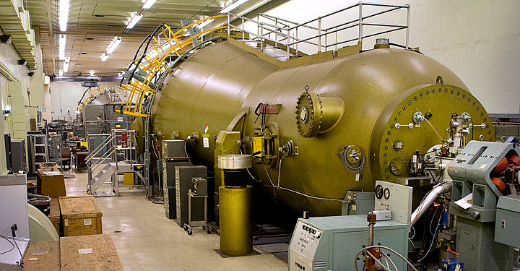
Tandem-van-de-Graaff accelerator:
Accelerating voltage is used two times by recharging the particles.
Step 1: negative ions (-e) accelerated to HV electrode
Step 2: charge transfer by stripping off electrons
Step 3: positive ions (+qe) are accelerated towards end
Depending on the ion species, large kin. Energies T can be reached.
Study of nuclear reaction with very high energy resolution.
Tandem v. d. Graaff at MPI-Kernphysik
BNL tandem v.d.Graaff accelerator:
Max. terminal voltage of 15 MV

Slide 6
3. Radio-frequency (RF) Linear Accelerator
LINAC:
used only for RF linear accelerators
RF linear accelerator (= LINear ACcelerator = LINAC):
Particle acceleration using an AC voltage.
Wideröe linear accelerator: 1927, progenitor of high-energy accelerators
AC voltage
Drift tubes: field free, become longer as particle gets faster
Operation in π-mode:
E-field in neighboring acceleration gaps
has opposite sign: phase difference = π
Important development towards powerful accelerators:
Klystron (1937): vacuum tube used for power amplification of RF signals
(micro wave)

Slide 7
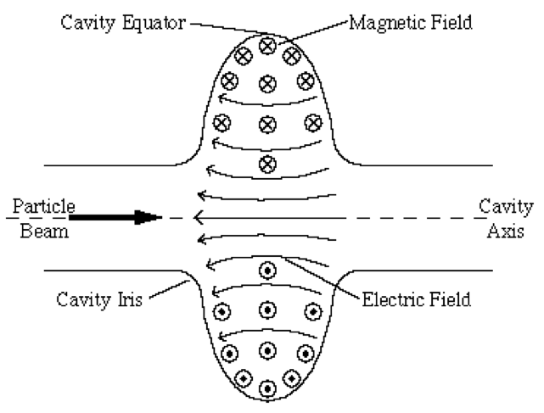
For the acceleration of electrons, protons and ions;
depending on the velocity β different RF-accelerating structure are used:
Wideröe structure: β≈0.005 – 0.05
RFQ structure: β≈0.005 – 0.05
Single RF-cavity: β≈0.04 – 0.2
Alvarez-structure: β≈0.04 – 0.6
RF cavities: β≈1
Protons, ions
← electrons
(already relativistic at very moderate energies)
Alvarez-Structure:
Series of coupled oscillator cavities w/ drift-tubes.
RF cavity
(2π mode)
RF cavities:
Travelling or standing wave.
Mostly used today, will be discussed here.

Slide 8
RF cavities: Travelling or standing wave accelerating structures
Energy win of particle travelling with the electromagnetic wave:
phase velocity
Particle “surfs” on the e.m. wave:
E-field of wave
Energy win given by the phase ϕ_{s} of the particle:
Phase focusing:
(Veksler, McMillian, 1945)
Non-relativistic particles:
Particle too fast w/r to “stable” particle:
It arrives earlier and will see less volts.
LINAC
Particle too slow w/r to “stable” particle:
It arrives later and will see higher volts.
Phase focusing will keep particles together: → oscillation around stable phase.

Slide 9
E.m. wave inside an RF cavity and its phase velocity:
E_{z}
Travelling wave inside a wave guide: → need to solve the wave equation w/ boundary conditions
z
free e.m. wave:
In cavity:
(otherwise damping)
and
→ different solutions w/ different transverse modes defined by geometry
“transversal electric”
“transversal magnetic”
x
a
TX_{mn} mode
b
z
cavities:TM₀₁ mode
(electrical field in z)

Slide 10
Problem:
phase velocity v_{ϕ}>c for propagation in z
→ cannot be used for particle acceleration.
Dispersion relation:
Solution: iris aperture (disk loaded wave guide: Runzelröhre ☺)
K. Wille
Cavity iris aperture: SLAC structure (Stanford)
Copper cavity w/ 2b=8.4 cm, 2a=2.6 cm, d=3.5 cm = λ/3, c=0.58 cm, L=3.05 m , ν=2.856 GHz
(travelling wave cavity)
Cavities are build as travelling wave and as standing wave cavities
(today mostly standing wave cavities used).

Slide 11
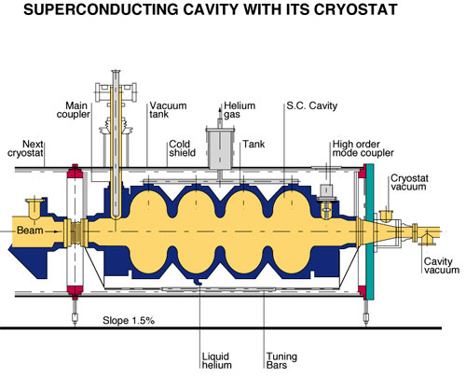
Modern RF cavities: 2 examples
LHC cavity (8 per beam):
Superconductive, gradient of 5.5 MV/m, ν=400.8 MHz.
ILC / TESLA test cavity :
Superconductive, gradient of 32 MV/m

Slide 12
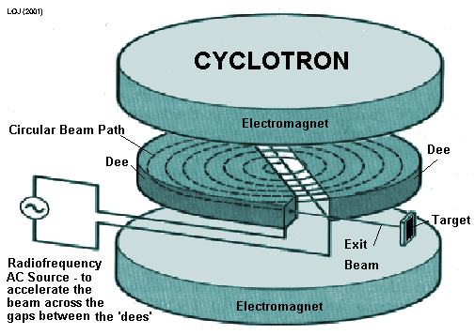
4. Circular accelerators: Cyclotron & Betatron (not discussed)
Classical cyclotron
1930 idea by E.O. Lawrence, 1st realization: M.S Livingston
1931 1st cyclotron in Berkeley by Lawrence and Livingston
(protons at T=1.2 MeV)
(Constant B field)
Frequency of applied electrical field (O(10kV)) should be equal to cyclotron frequency:
= typically 5 – 20 MHz for B=1T:
Protons: 15.2 MHz
Deuterons: 7.6 MHz
large energies with only few (50) turns
Energy win depends on the phase: For max. acceleration close to 0.
Problems:
Relativistic mass increase
Field gradient (weakening at outside, next slide) necessary for axial stability. → particle phase shifts towards +90º (no effective RF field)

Slide 13
Radial and axial stability:
Classical cyclotron needs field gradient
Effective Lorentz force:
Particles outside the middle plane experience a focusing force
→ axial focusing
Pole shaping provides slight gradient
Radial focusing:
Effective force as difference between Lorentz force and centripetal force
→ Radial field gradient necessary for axial focusing should not be too large:
field index n
Classical cyclotron
→ axial and radial oscillations: “betatron oscillations”:
Theory developed for betatrons, oscillation are important for synchrotrons.

Slide 14
Synchro cylcotrons:
B field correction
Cyclotron w/ radially dependent RF frequency:
relativistic correction
→ no continuous operation:
typical duty cycle of only 1%
(modulation typ. 50 – 2000 Hz)
→ allows many turns (10000 – 50000):
typical energies of 500 – 800 MeV (p, d, He) with moderate max. voltage (10 kV)

Slide 15
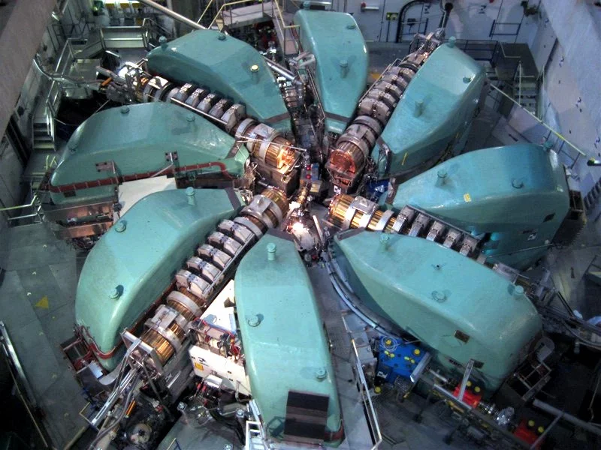
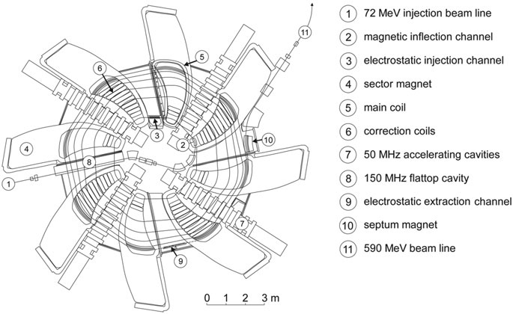
PSI Ring cyclotron generates 1.4 MW proton beam at 590 MeV kinetic energy

Slide 16
5. Circular accelerators: Synchrotrons
Circular accelerator w/ B-field limited to a narrow ring area: → increase of R and thus the energy!
Transversal focusing using B field gradients along the ring:
→ betatron (transverse) oscillations
extraction
Ramp-up of B-field synchronously to particles momentum: Synchrotron
Acceleration using RF cavities
→ synchrotron (longitudinal) oscillations around ϕ_{s}
injection
Constant gradient
Two principle types:
Constant gradient synchrotrons - all dipoles have the same gradient: weak focusing
Alternating gradient synchrotrons – 2 type of dipoles w/ different gradients (modern accelerators) OR additional quadrupoles: strong focusing

Slide 17
Phase stability and synchrotron oscillation
Phase focusing to keep single particles inside bunches with a finite phase widths
For synchrotrons, relation between revolution frequency and momentum is important:
η depends on particle’s γ
Phase focusing requires η≠0
ΔE
Depending on momentum
> 0 : v<c → momentum increase leads to higher revolution frequency
< 0: v≈c → momentum increase leads to longer paths and lower frequency

Slide 18
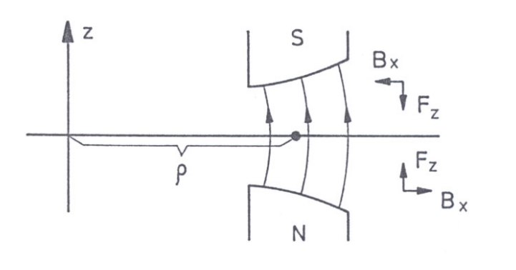
Weak Focusing: Constant Gradient Synchrotrones:
Problem:
How to limit the beam in the transverse plane to reasonable aperture? (if aperture to large the dipole magnets become huge)
Weak focusing: see cyclotrons
Dipole magnets with radial field gradient:
Field index:
For focusing in H-plane: n ≤ 1
For focusing in V-plane: n > 0
Hence condition for double focusing
0 < n < 1
(Kerst and Serber, 1941)
Typical n chosen between 0.2 and 0.3
Problem: large deviations of particle in transverse plane → large apertures

Slide 19
Cosmotron (3.3 GeV, BNL, 1953-1966): first >1 GeV proton-synchrotron
Gap aperture:
0.6 m × 0.22 m
1st synchrotron providing particle beam for experiments
away from accelerator.
Larger energies seemed unaffordable – magnets become too large!

Slide 20
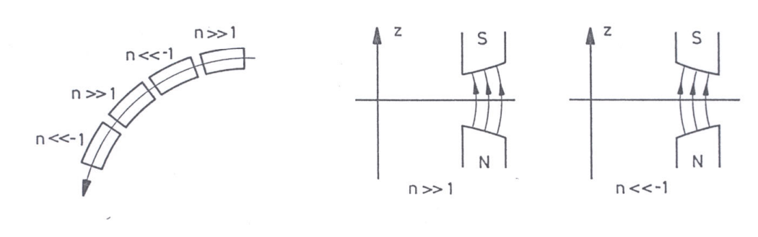
Principle of Strong Focusing (1950 Cristofilos, 1952 Courant, Livingston & Snyder)
Transverse fields defocus in one plane and focus in the other plane. But two successive elements, one focusing the other defocusing, can focus in both planes:
use strong gradients
Optics:
Condition: large field gradient |n|>>1 (typ. ≈20) - strong alternating gradients.
1st machine: 1959, CERN PS (Proton Synchrotron), 28.3 GeV, still in use. (C=628m)
2nd machine: 1960, AGS (BNL), 33 GeV, still in use. (C=810 m)

Slide 21
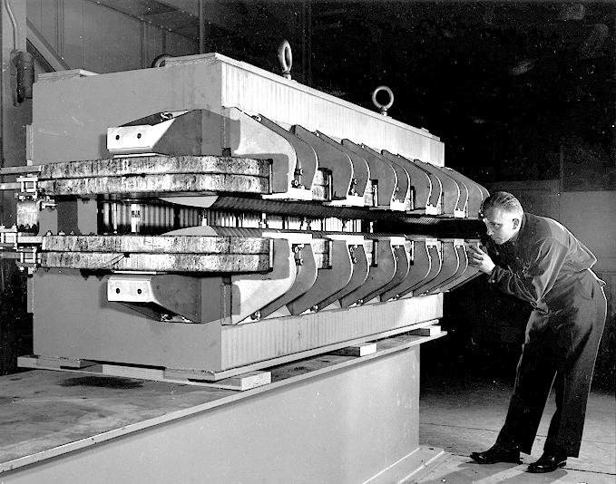
AGS magnet
(PS magnets similar)
2nd type with different pole orientation
Special pole form to create large gradient.
Comparison: Cosmotron and AGS magnet
AGS and PS magnets are called combined function magnets (dipole & focusing).

Slide 22
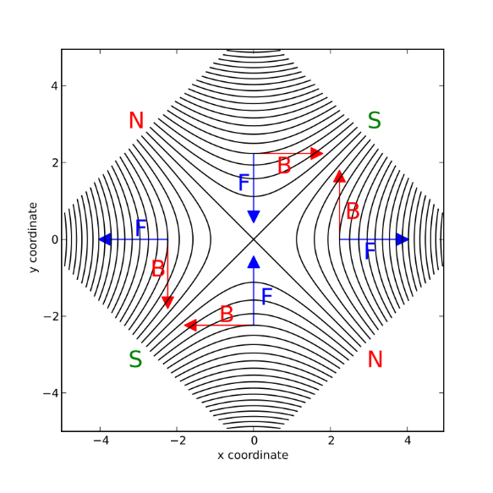
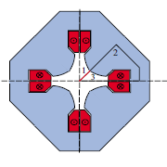
Quadrupoles and FODO cells
Magnetic quadrupoles focus in one plane and defocus in the
other plane.
FODO cells:
Important:
Focusing and Defocusing quadrupoles are alternated and interleaved with bending dipole magnets.
Beam envelope
x
y
Modern accelerators consist of FODO cells.

Slide 23
6. Beam optics and particle tracing
Linear beam optical elements
Dipole field:
Quadrupole:
Particle track inside quadrupole:
for k < 0 (focusing)
(dipole field)
Solution w/ initial conditions x₀ and x’₀
Using matrix description:

Slide 24
k < 0
(focusing)
k = 0
drift
General quadrupole transfer matrix:
k > 0
(defocusing)
Dipole transfer matrix:
(no gradient)
For several linear (drift, dipole, quadrupole) optical elements transfer matrix is the product of the single optical components
→ allows ray-tracing for particle w/ different initial conditions x₀, x₀’

Slide 25
7. Transverse beam dynamics: betatron oscillation
Ray-tracing allows to calculate the orbit for given particle, however does not tell much about the collective properties of the beam.
“effective dynamics”:
Transverse orbit function x(s) describes an oscillation around the ideal orbit with an amplitude and a phase which depend on the position s of the orbit.
Ansatz for betatron oscillation to solve the differential equation:
Constants A and ϕ are integration constants
Using this ansatz one obtains a non linear equation for u(s) which can be solved only numerically. Matrix method allows to consider the complete beam optics and allow to determine the so called β function (method not discussed):
with
and emittance

Slide 26
Betatron oscillation
The particles perform inside the synchrotrons magnet structure betatron oscillation which are described by a location s dependent amplitude E(s):
envelope
K. Wille

Slide 27
Phase ellipse and Liouville theorem
General form of orbit equations in phase space:
Parametric representation of an ellipse in (x, x’) space: can be seen by eliminating the (ψ(s)+φ) dependence, e.g.:
Coordinate representation:
or with
Ellipse with an area of πε

Slide 28
Liouville theorem:
Occupied phase space element stays constant when particle follow canonical equations of motion.
Phase space ellipse can be rotated or deformed when particles travel along the beam line or if they are focused but the area stays constant!
A = πε.
Significance of emittance:
Up to π equal to phase space area: A = πε.
Emittance often given as πε [rad m].
e.g. LHC: πε = 1.68 × 10⁻⁹ rad m
Particles have no sharp boundaries.
Assume Gaussian distribution in x:
defined by particle injection.
ε and β(s) important for luminosity
Define emittance ε as 1σ contour:

Slide 29
8. Synchrotron Radiation
Due to the angular acceleration charged particles (electrons) in a synchrotron emit bremsstrahlung: synchrotron radiation
e
Classical electromagnetic theory gives power loss for a relativistic electron:
with
E_{beam} = energy of beam
R = nominal radius
e = elementary charge m_{e}= mass
ε₀ = electrical field const.
Energy loss per turn:
For nominal particle on nominal orbit
Positive: emission of synchrotron radiation leads to damping of betatron and synchrotron oscillations.
(natural units)

Slide 30
Radiation spectrum
with
Spectral function
Major fraction emitted around ω_{c} with
Example:
e-beam @ 3.5 GeV
w/ R₀ = 13.3 m, I_{e} = 1A
Effect of relativistic kinematics:
w/ increasing electron energy photons are boosted forward
Synchrotron is also emitted in focusing magnets and other beam optic elements.

Slide 31
9. Colliders and luminosity
To achieve maximum CMS energies collider experiments are preferred over fix target configurations.
2 separate synchrotrons:
single synchrotrons:
n_{b} bunches
Same particles (pp, AA) require two separate rings: e.g. LHC (A = (heavy) ions: e.g. Au, Pb)
Particles and anti-particles can be stored and accelerated in one ring (pp, e+e⁻): LEP (e+e⁻), SppS + Tevatron (pp)

Slide 32


Luminosity
$${\dot{N}}_{B} \text{beam} \text{particle} \text{s}\text{−1}$$
Original luminosity definition:
Extracted beam on fixed target.
A area, N_{T}=numb. targets
$\frac{N_{T }}{A}$ target area density
Collider w/ two beams:
f revolution frequency
n_{b} number of bunches
N₁ particles per bunch
A_{eff} = effective interaction area
For a beam Gaussian beam profile:
Reminder: The Gaussian width is given by the emittance and the betatron value β at the IA point (β*):

Slide 33
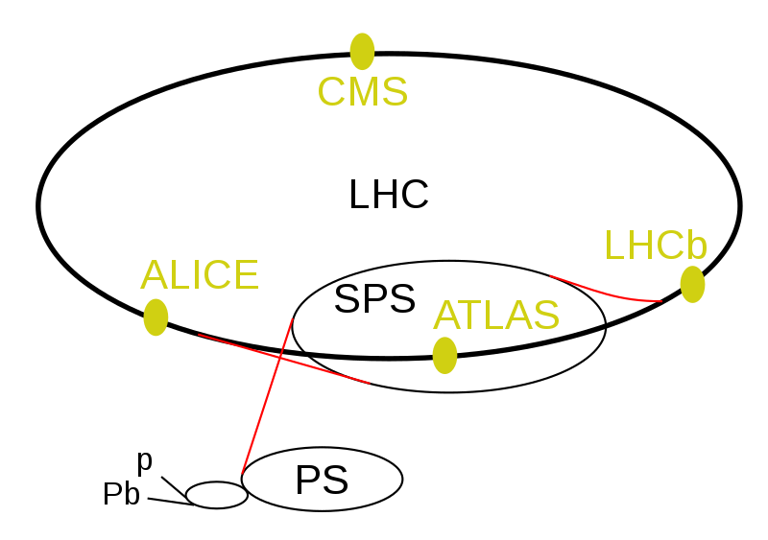
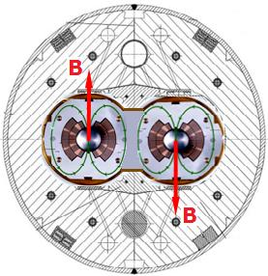
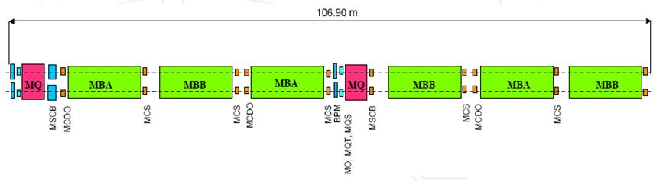
Example: Large Hadron Collider pp:
https://www.lhc-closer.es/taking_a_closer_look_at_lhc/
Beam parameters:
C = 26659 m
n_{b} = 2808 / beam
N_{b} = 1,15·10¹¹
I_{B} = 0,54 A / beam
πε = 1.68 × 10⁻⁹ rad m
β* = 0.55 (0.33) m
L = 10³⁴ cm⁻² s⁻¹
26.7 km
RF Cavities: 8 per beam
400.8 MHz
2 MV per cavity (5 MV/m field)
→ 16 MV in total
8 arcs (octants,2450 m): 23 arc cells (FODO)
1232 dipoles:
I = 11800 A
B = 8.33 T
R = 2804 m
L = 14.3 m
Stored energy:
7 MJ / dipole
FODO: 2 Quadrupoles + 6 dipoles + multipoles

Slide 34
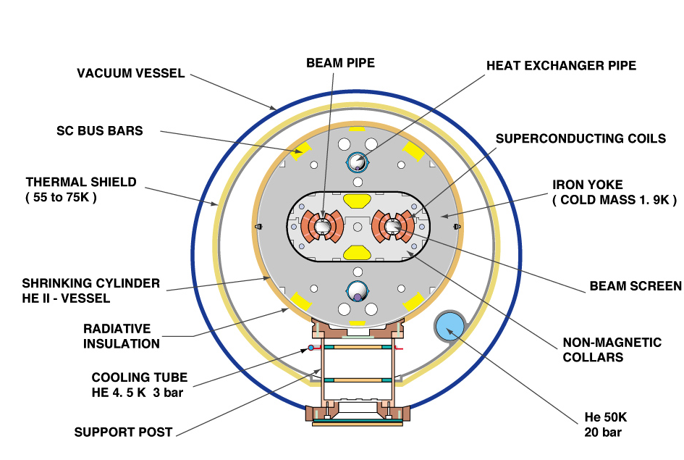

Dipole cross section:
LHC tunnel:

Slide 35
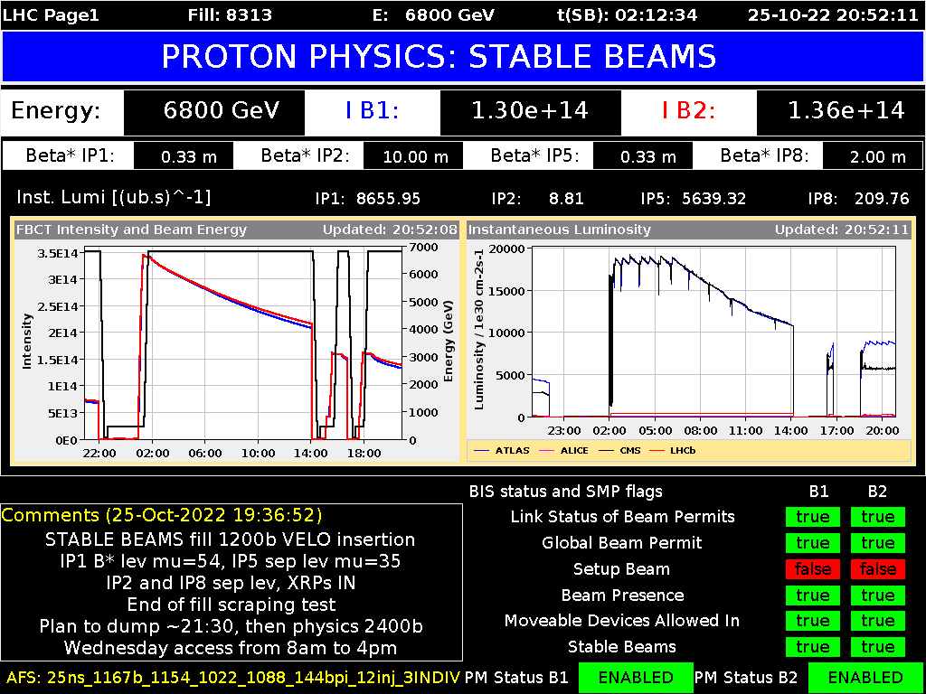
https://op-webtools.web.cern.ch/vistar/vistars.php

Slide 36
10. Limits for future high-energy colliders
Proton-Proton synchrotron:
B field strength of dipole magnets:
LHC magnets B≈8.3 T → future: ~16 T
Limitation:
Ring radius:
2πR_{LHC} =26.7km → future: ~100 (91) km
100 TeV (CMS energy) machine:
Requires 4 time more magnets w/ double field strength
FCC
= Future circular collider
W/ new super conducting magnets

Slide 37
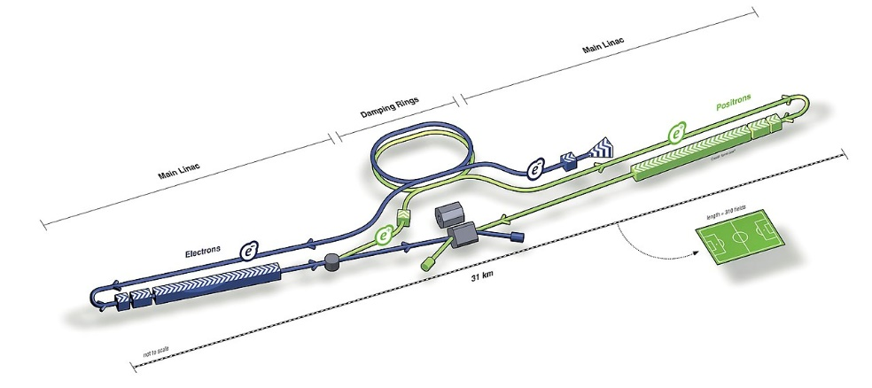
Electron-positron colliders:
(point like electrons collide)
Physics processes require in general smaller beam energy than pp colliders.
Synchrotrons: Beam energy limited by synchrotron radiation
Limitation:
Huge electrical power needed to compensate synchrotron loss.
Design study: FCC-ee w/ 2πR=~100 km and √s=350 GeV
Synchrotron power loss per beam: 50 MW
Linear collider: Beam energy limited by accelerating structure
ILC Design study:
Maximal achievable field gradient in accelerating cavities: ~35 MV/m
√s=500 GeV (250 GeV / beam):
→ 2×7.2 km of accelerating cavities
Total size of 500 GeV machine ~30km , total AC power 250 MW
New concept for acceleration: plasma acceleration → gradients of up to GV/m

