Slide 1
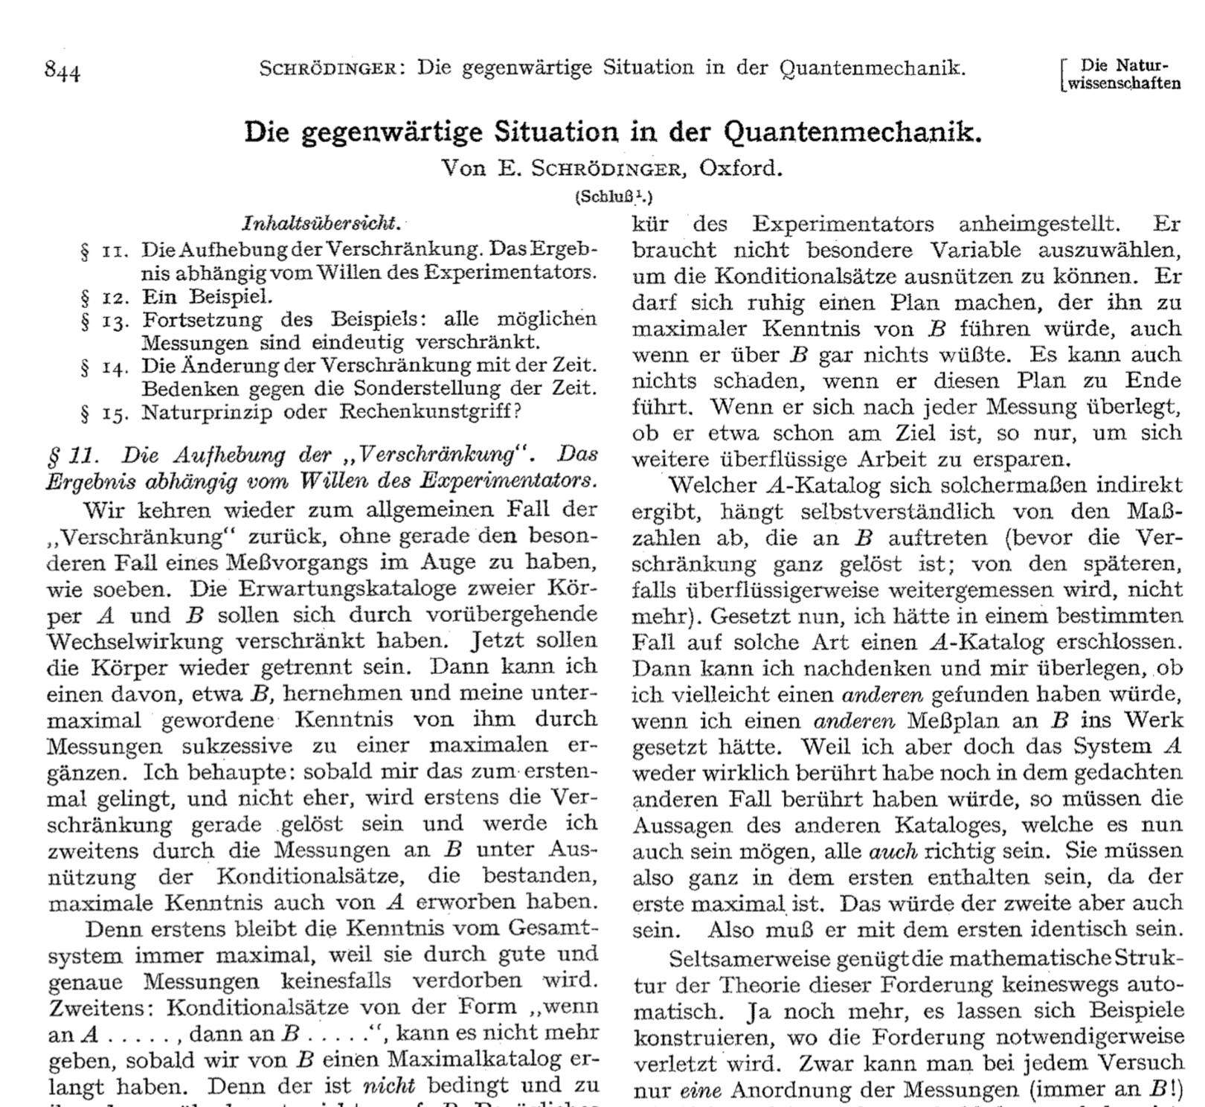



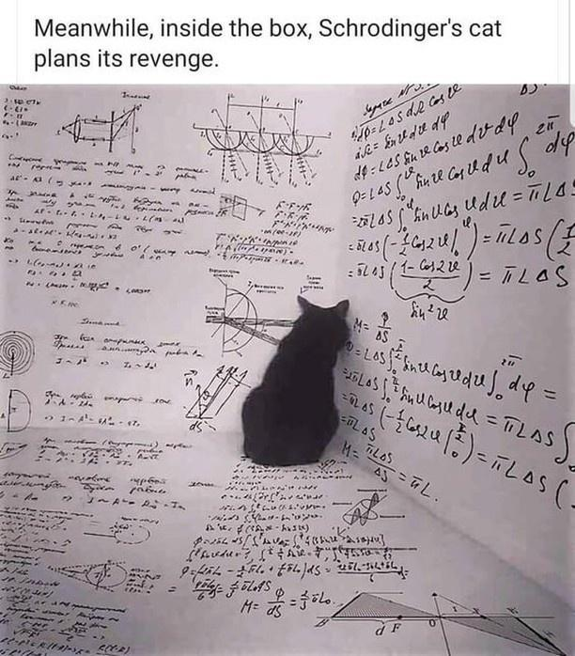
Meanwhile, inside the box, Schrödinger’s cat plans its revenge
This poster is indeterminably funny or not until observed.

Slide 2

The measurement problem
Niclas Göring
Your passion for physics: What are you curious about?
Prof. Dr. Thomas Pfeifer
21 December 2021

Slide 3
Content
The measurement problem
Copenhagen interpretation – a satisfying solution?
GRW theory
  Overview
  How it solves the measurement problem
  Experimental test
Bohmian mechanics
  Overview
  How it solves the measurement problem
  Experimental test
Conclusion & outlook

Slide 4
Content
The measurement problem
Copenhagen interpretation – a satisfying solution?
GRW theory
  Overview
  How it solves the measurement problem
  Experimental test
Bohmian mechanics
  Overview
  How it solves the measurement problem
  Experimental test
Conclusion & outlook

Slide 5
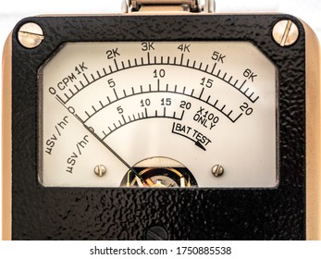
1.1 Schrödinger‘s cat
Specification of the measurement device
Time evolution of superposition
yes
0
no
Fig. 1
yes
0
no
Macroscopic superposition
Fig. 2

Slide 6
1.2 Rigorous formulation
(A)
The wave function completely describes the system.
The wave function always evolves according to Schrödinger‘s equation.
Measurements have unique outcomes described by Born's rule.
(B)
(C)
yes
0
no
QM
yes
0
no
Experiment
yes
0
no
yes
0
no
or
or
Fig. 3

Slide 7
1.3 Possible solutions
(A)
The wave function completely describes the system.
The wave function always evolves according to Schrödinger‘s equation.
Measurements have unique outcomes described by Born's rule.
(B)
(C)
¬(A)
¬(B)
¬(C)
Bohmian mechanics (Bohm, de Broglie)
Nelson mechanics (Nelson)
Double solution (de Broglie)
Cellular automata (‘t Hooft)
Copenhagen (Bohr, Heisenberg)
GRW theory (Ghirardi, Rimini, Weber)
GRWm/f theory (Ghirardi, Rimini, Weber)
CSL theory (Pearle, Ghirardi)
Many worlds (Everett)
Modal (Rovelli)
¬(?)
Decoherent histories
Qbism
Transactional

Slide 8
Content
The measurement problem
Copenhagen interpretation – a satisfying solution?
GRW theory
  Overview
  How it solves the measurement problem
  Experimental test
Bohmian mechanics
  Overview
  How it solves the measurement problem
  Experimental test
Conclusion & outlook

Slide 9
2.1 The Copenhagen interpretation
Collapse postulate: During measurement wave function collapses
measurement
<
There cannot exist an observer for the universe
QM cannot be applied to whole universe
One needs an observer 2, to observe observer 1 + system
QM cannot be applied to observers / measuring devices
…
System
=
Universe
Observer
Observer 2
Fig. 4
Observer 1
System
Fig. 5
In Copenhagen, QM is not a fundamental theory

Slide 10
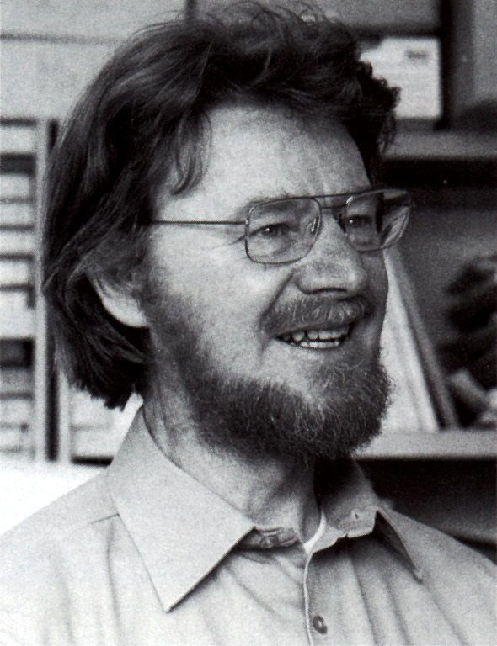
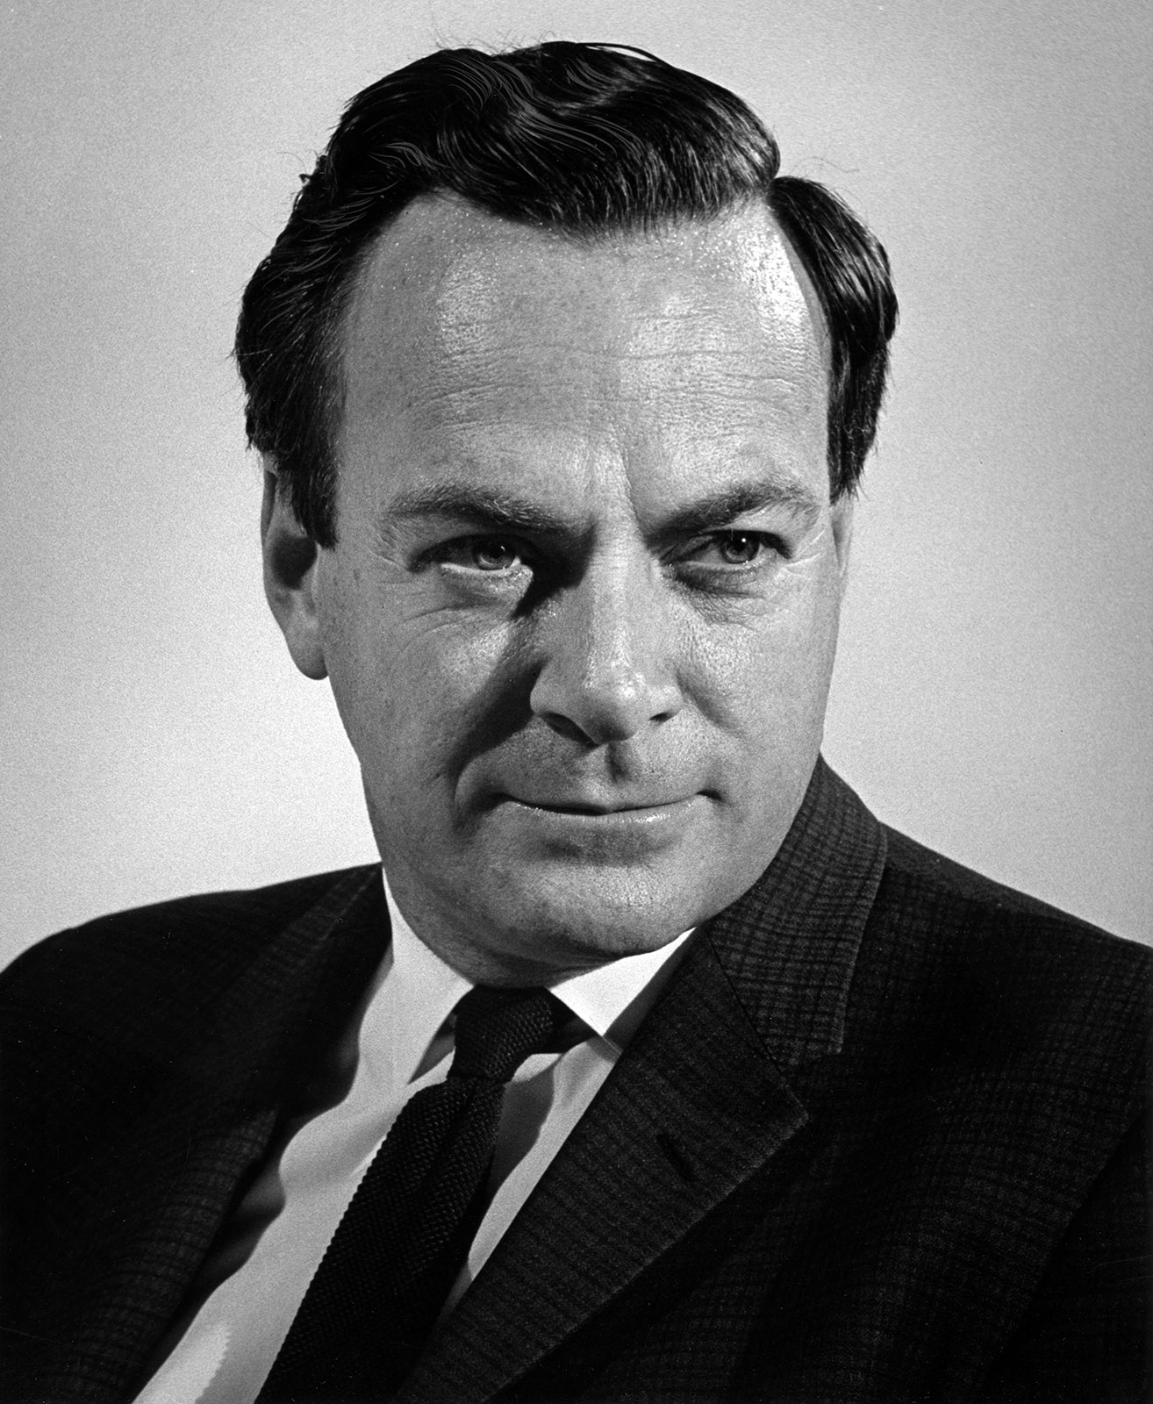
2.1 The Copenhagen interpretation
What exactly qualifies some physical systems to play the role of 'measurer'? Was the wave function of the world waiting to jump for thousands of millions of years until a single-celled living creature appeared? Or did it have to wait a little longer, for some better qualified system ... with a PhD? Against ’measurement’ (1990)
John S. Bell
Fig. 6
This is a horrible viewpoint.
Do you seriously entertain the thought that without observer there is no reality? Which observer? Any observer?
Is a fly an observer? Is a star an observer? Was there no reality before 109 B.C. before life began? Feynman lectures on gravity (1961)
Richard P. Feynman
Fig. 7

Slide 11
2.2 Possible solutions
(A)
The wave function completely describes the system.
The wave function always evolves according to Schrödinger‘s equation.
Measurements have unique outcomes described by Born's rule.
(B)
(C)
¬(A)
¬(B)
¬(C)
Bohmian mechanics (Bohm, de Broglie)
Nelson mechanics (Nelson)
Double solution (de Broglie)
Cellular automata (‘t Hooft)
Copenhagen (Bohr, Heisenberg)
GRW theory (Ghirardi, Rimini, Weber)
GRWm/f theory (Ghirardi, Rimini, Weber)
CSL theory (Pearle, Ghirardi)
Many worlds (Everett)
Modal (Rovelli)
¬(?)
Decoherent histories
Qbism
Transactional

Slide 12
Content
The measurement problem
Copenhagen interpretation – a satisfying solution?
GRW theory
  Overview
  How it solves the measurement problem
  Experimental test
Bohmian mechanics
  Overview
  How it solves the measurement problem
  Experimental test
Conclusion & outlook

Slide 13
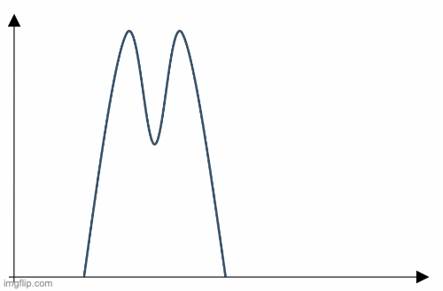
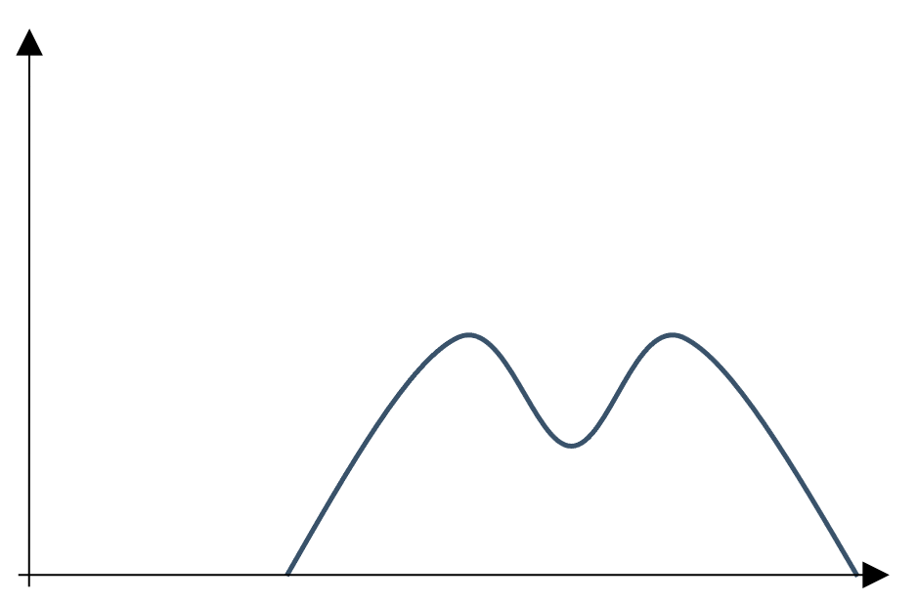
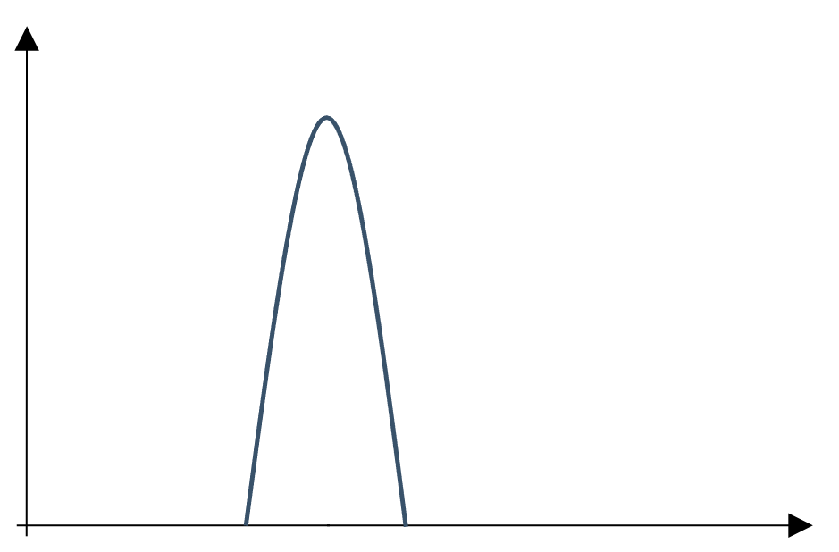
3.1 Overview
Idea: Take wave function collapse seriously
Between two collapses
Collapse at
After collapse, Schrödinger evolution of
Collapse probability in time
collapse
a
Fig. 8

Slide 14
3.1 Overview
Properties
Collapse rate:
  1-particle:
  10²³-particles:
Possibly collapse induced by gravity
No energy conservation for easy models (dark energy?)
Fundamentally indeterministic
Example
collapse
a
Fig. 9

Slide 15
3.2 How the measurement problem is solved
How do entangled wave function behave when collapsing?
Particle y collapses at b
b
b
b
b
b
b
Fig. 10
Collapse at y=b
→

Slide 16
3.2 How the measurement problem is solved
QM
yes
0
no
Fig. 11
GRW
One particle in
collapses
One particle in
collapses
yes
0
no
or
Fig. 12
<
Collapse of one particle kills (macroscopic) superpositions

Slide 17
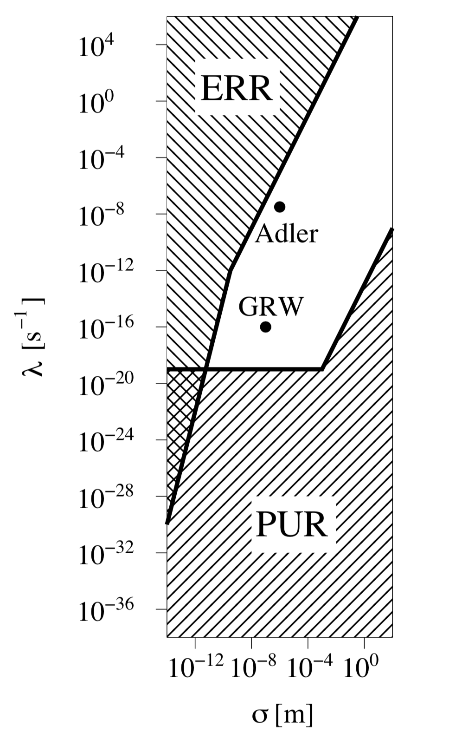
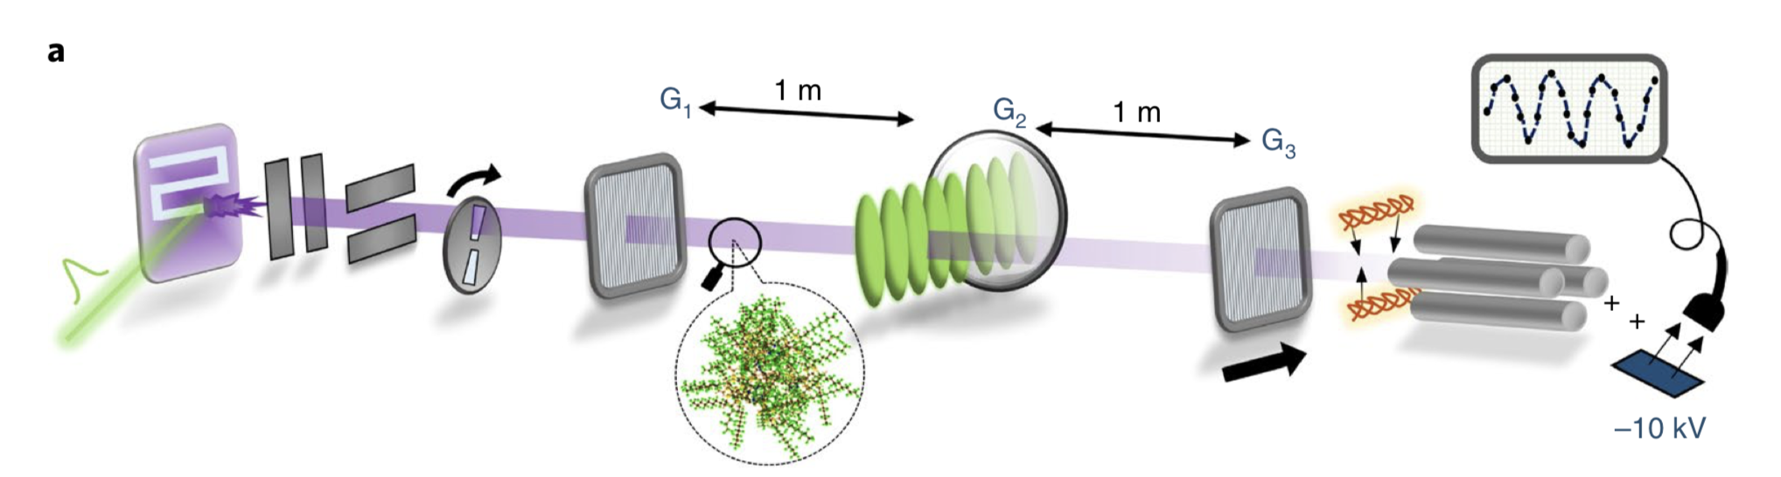
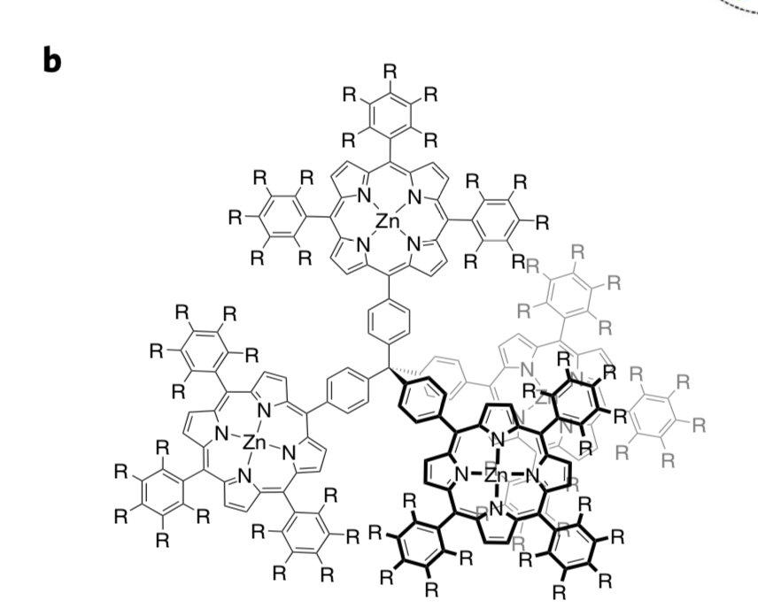
3.3 Experimental tests
Philosophically unsatisfactory region (PUR)
A priori excluded region
Does not solve measurement problem and gives clearly implausible predictions
Experimental refuted region (ERR)
Collapse
Diffraction experiments
Fig. 14: Fein, Geyer, Zwick, et al. Quantum superposition of molecules beyond 25 kDa., Nat. Phys. 15 (2019)
Energy conservation violation
Spontaneous warming of the intergalactic medium
Spontaneous X-ray emission
Decay of supercurrents
QM
Superposition possible independent of N
Superposition collapses after
GRW
Fig. 13

Slide 18
3.3 Experimental tests
Philosophically unsatisfactory region (PUR)
A priori excluded region
Does not solve measurement problem and yields implausible predictions
Experimental refuted region (ERR)
Collapse
Diffraction experiments
Energy conservation violation
Spontaneous warming of the intergalactic medium
Spontaneous X-ray emission
Decay of supercurrents
Fig. 13

Slide 19
Content
The measurement problem
Copenhagen interpretation – a satisfying solution?
GRW theory
  Overview
  How it solves the measurement problem
  Experimental test
Bohmian mechanics
  Overview
  How it solves the measurement problem
  Experimental test
Conclusion & outlook

Slide 20
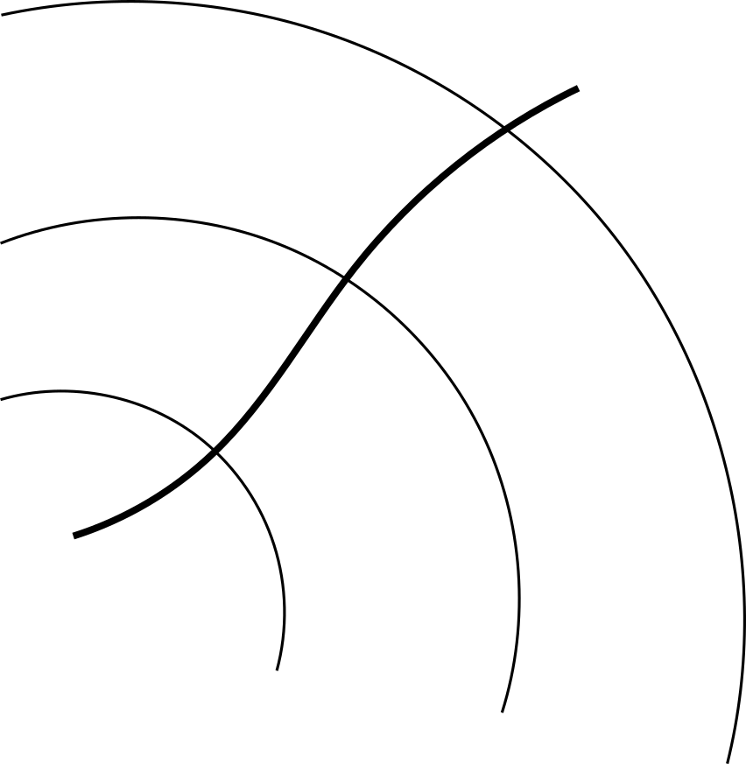
4.1 Overview
Idea: Take wave-particle duality seriously
System is fully described by a tuple
The dynamics of is given by
The particles are initially distributed according to
Fig. 15
Fig. 16

Slide 21
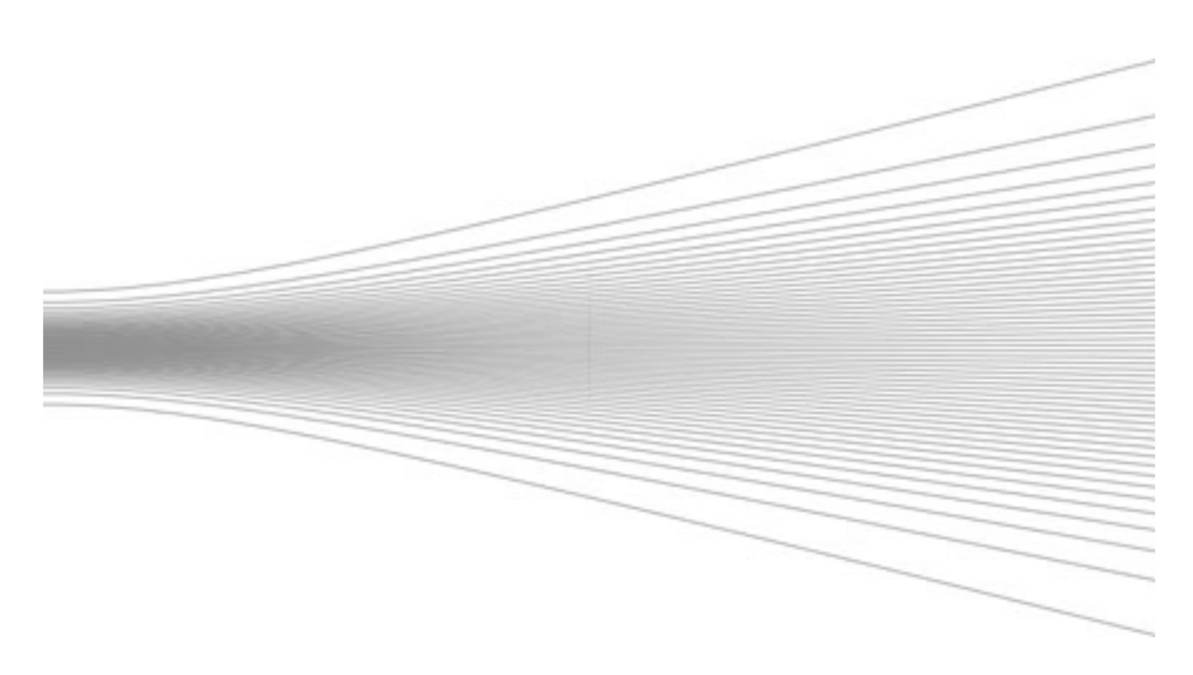
4.1 Overview
Properties
Particle positions / momenta always well-defined
Deterministic (probability only due to uncertainty in initial conditions)
Highly non-local
Wave function never collapses
Example
Initial distribution:
Final distribution:
Fig. 17

Slide 22
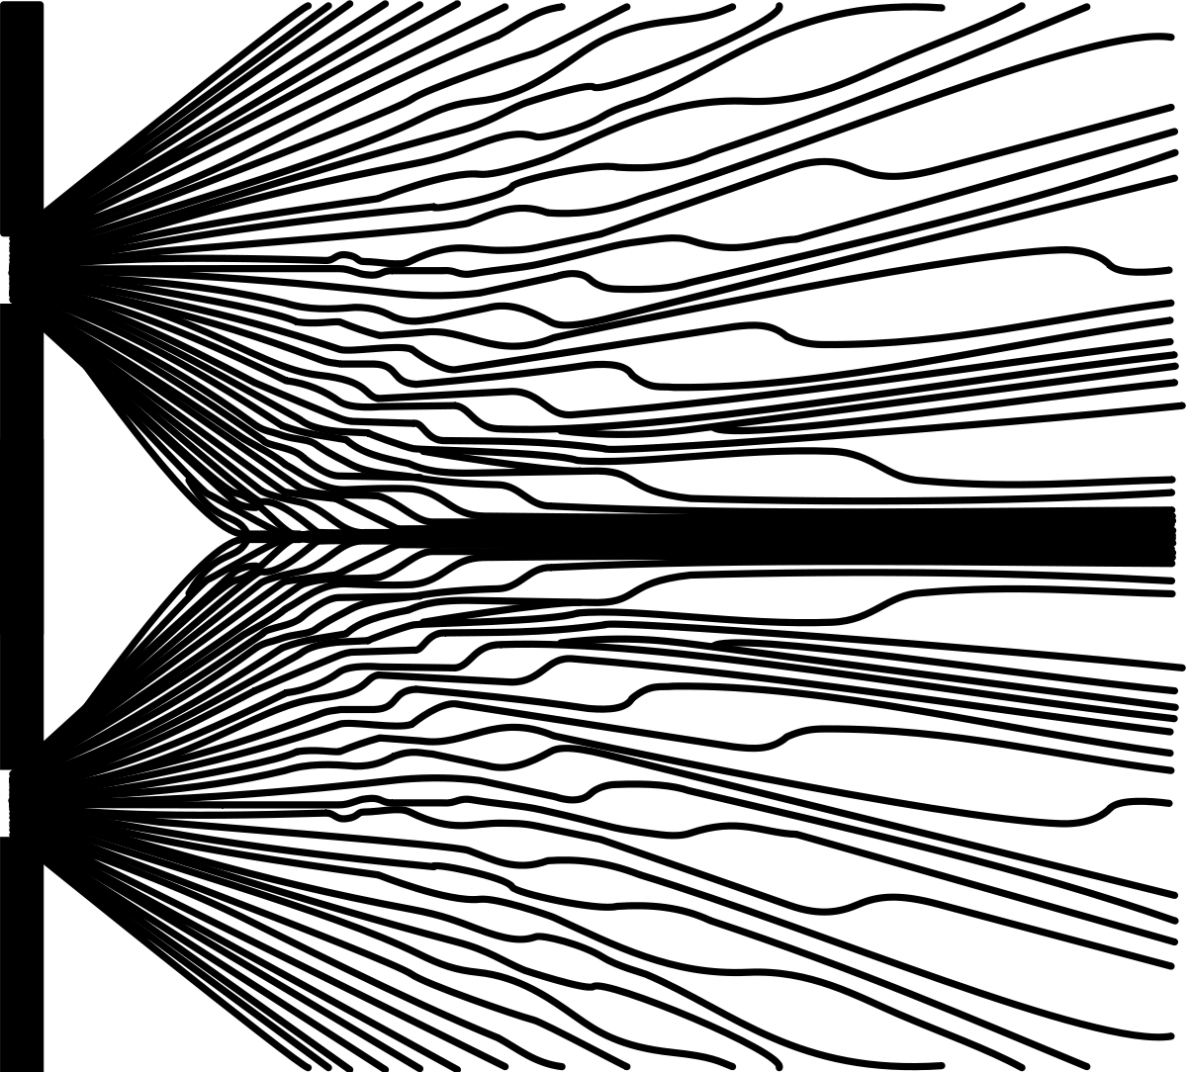
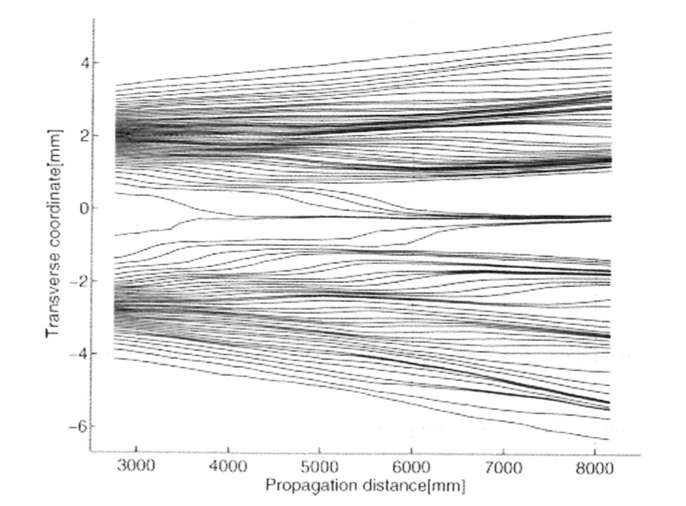
4.1 Overview
Properties
Particle positions / momenta always well-defined
Deterministic (probability only due to uncertainty in initial conditions)
Highly non-local
Wave function never collapses
Example
Theory
Experiment
Fig. 18
Fig. 19: Kocsis, Braverman et. al., Observing the Average Trajectories of Single Photons in a Two-Slit Interferometer, Science, (2011)

Slide 23
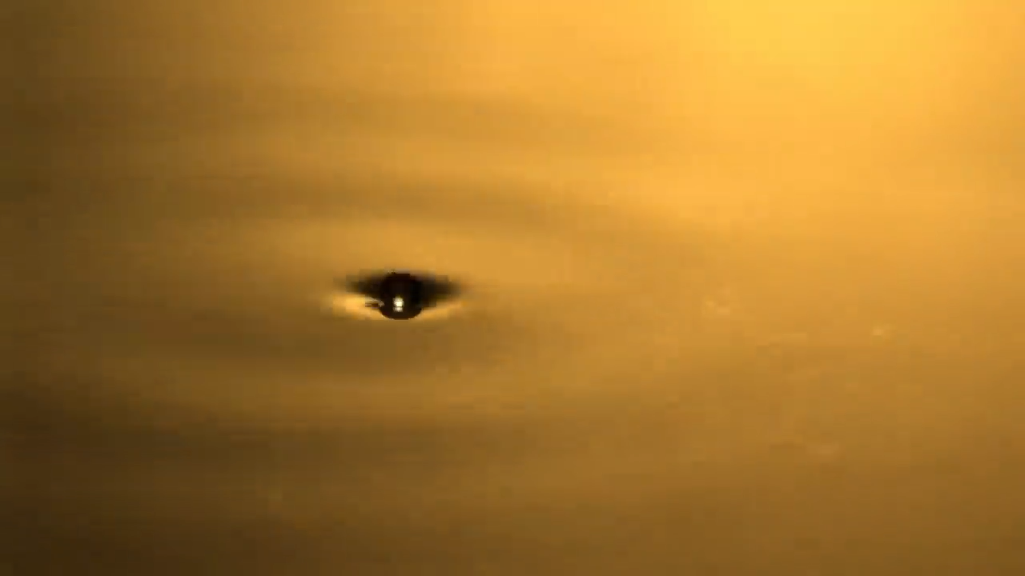

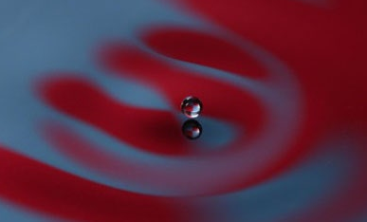
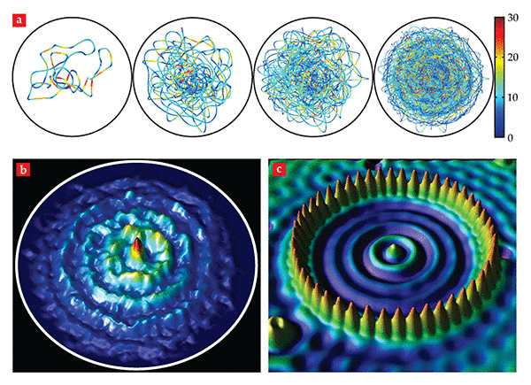
4.1 Bohmian mechanics in real life
Fig. 20
Fig. 21
Fig. 22 & 23: Bush & Oza, Hydrodynamic quantum analogs, Reports on Progress in Physics, (2020)

Slide 24
4.2 How the measurement problem is solved
yes
0
no
QM
Fig. 24
Bohm
yes
0
no
Particle positions single out a state
or
yes
0
no
Fig. 25
<
Measurement devices are made out of particles which have definite positions

Slide 25
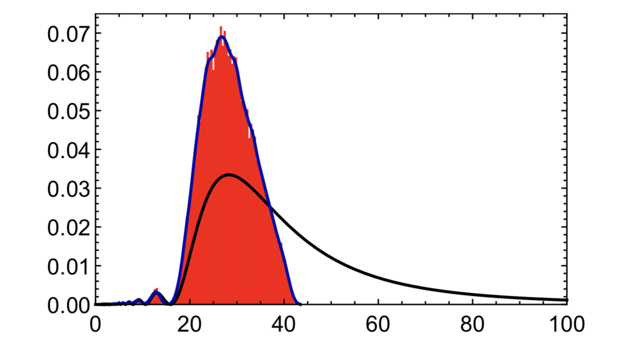
4.3 Experimental test – arrival time
Experimental setup
Prediction
y
Potential walls
Detector
z
x
Fig. 26
Rate
Bohm
QM
t
Fig 27.: Das & Dürr, Arrival Time Distributions of Spin-1/2 Particles, Master‘s Thesis, (2017)

Slide 26
4.3 Experimental test – arrival time
Experimental setup
Prediction
y
Potential walls
Detector
z
x
Fig. 26
Rate
Bohm
QM
t
Fig 27.: Das & Dürr, Arrival Time Distributions of Spin-1/2 Particles, Master‘s Thesis, (2017)

Slide 27




4.3 Experimental test – arrival time
Experimental setup
Prediction
y
Potential walls
Detector
z
x
Fig. 26
Rate
Bohm
QM
t
Fig 27.: Das & Dürr, Arrival Time Distributions of Spin-1/2 Particles, Master‘s Thesis, (2017)

Slide 28
4.3 Experimental test – arrival time
Arrival time for Copenhagen & Bohm
  +N
Copenhagen – ‘First‘ arrival
Bohm – First arrival
?
<
<
Fig. 28
Fig. 29

Slide 29
4.3 Experimental test – arrival time
Arrival time for Copenhagen & Bohm
  +N
Copenhagen – ‘First‘ arrival
Bohm – First arrival
?
<
Rate
<
Bohm
QM
t
Fig. 27
Different predictions
Fig. 28
Fig. 29

Slide 30
Content
The measurement problem
Copenhagen interpretation – a satisfying solution?
GRW theory
  Overview
  How it solves the measurement problem
  Experimental test
Bohmian mechanics
  Overview
  How it solves the measurement problem
  Experimental test
Conclusion & outlook

Slide 31
5.1 Conclusion
(A)
The wave function completely describes the system.
The wave function always evolves according to Schrödinger‘s equation.
Measurements have unique outcomes described by Born's rule.
(B)
(C)
¬(A)
I am a quantum engineer, but on sundays I have principles. (1983)
¬(B)
Bohmian mechanics
Take wave particle duality serious
Copenhagen
QM with observer is ‘unsatisfactory’
GRW theory
Take wave function collapse seriously
John S. Bell
Fig. 30
‘Shut up and calculate‘ works fine for all practical purposes
Interpretation of QM not purely philosophical question anymore

Slide 32


5.2 Outlook
Theory
Experiment
  No-go theorem (Bell 1964, Kochen-Specker 1967, Malament 1996, Gisin^{[23]} 2011, PBR^{[16]} 2012)
  Relativisitc QM & QFT^{[9,11]}
  Quantum gravity
  ...
  Arrival time measurement
  TEQ collaboration^{[26]}
  MAQRO^{[18]}
  ...
No-go theorems
Fig. 31
Go-theorems
Fig. 32

Slide 33
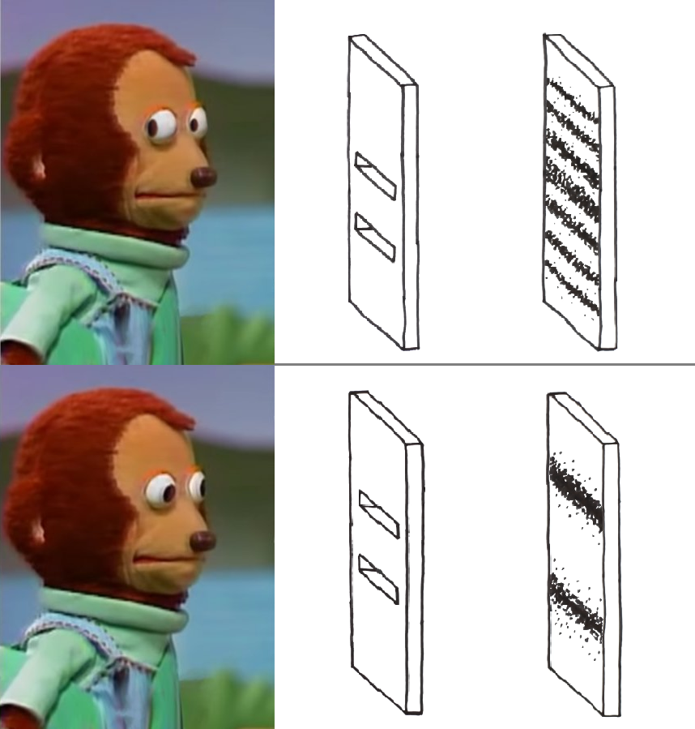
Questions?
Thank you very much
for your attention!

Slide 34
References - Figures
First slide: left: https://www.quora.com/What-is-the-best-Schrödingers-Cat-joke, middle: https://memesforages.tumblr.com/post/659549480942731264/schrödingers-cat, right: https://awwmemes.com/i/life-death-schrödingers-cat-large-pp-meme-7d5cc7cb1cd14360bf134cbfa81f8f5e, background: Schrödinger, Die gegenwärtige Situation der Quantenmechanik, Naturwissenschaften 23, 844–849 (1935) https://doi.org/10.1007/BF01491987
Fig. 1,2,3,11,12,24,25: https://www.shutterstock.com/image-photo/count-per-minute-scale-radiation-contamination-1750885538
Fig. 4,5,8,9,10,15,16,26,28,29,30: own figure
Fig. 6,30: https://mathshistory.st-andrews.ac.uk/Biographies/Bell_John/
Fig. 7: https://www.britannica.com/biography/Richard-Feynman
Fig. 13: Feldmann, Tumulka, Parameter Diagrams of the GRW and CSL Theories of Wave Function Collapse, Journal of Physics A (2012)
Fig. 14: Fein, Geyer, Zwick, et al. Quantum superposition of molecules beyond 25 kDa., Nat. Phys. (2019)
Fig. 17: Norsen, Foundations of Quantum Mechanics (An Exploration of the Physical Meaning of Quantum Theory), Springer (2017)
Fig. 18: https://de.wikipedia.org/wiki/De-Broglie-Bohm-Theorie#/media/Datei:Doppelspalt.svg
Fig. 19: Kocsis, Braverman et. al., Observing the Average Trajectories of Single Photons in a Two-Slit Interferometer, Science, (2011)
Fig. 20,21: https://www.youtube.com/watch?v=WIyTZDHuarQ&t=302s also http://dualwalkers.com/ and https://www.youtube.com/channel/UCQBKkDxFp-nclC-v_kpjqxA
Fig. 22,23: Bush & Oza, Hydrodynamic quantum analogs, Reports on Progress in Physics, (2020)
Fig. 27: Das & Dürr, Arrival Time Distributions of Spin-1/2 Particles, Master‘s Thesis, (2017)
Fig. 31: https://pixabay.com/de/illustrations/search/sandwiches/
Fig. 32: https://www.tequantum.eu
Last slide: https://i.redd.it/pz6s3irlge861.png
Title picture: https://www.eon.com/de/investor-relations/praesentationen.html#2020

Slide 35
References - Literature
Bassi, Lochan, et.al., Models of wave-function collapse, underlying theories, and experimental tests, Rev. Mod. Phys. 85, 471 (2013), DOI: https://doi.org/10.1103/RevModPhys.85.471
Bell, Against measurement, Phys. World 3 (8) 33 (1990), DOI: https://doi.org/10.1088/2058-7058/3/8/26
Bell, Sechs mögliche Welten der Quantenmechanik, De Gruyter (2012), ISBN: 9783486713893
Bush, Oza, Hydrodynamic quantum analogs, Reports on Progress in Physics, (2020)
Carlesso, Bassi, et.al., Experimental bounds on collapse models from gravitational wave detectors, Phys. Rev. D 94, 124036 (2016), DOI: https://doi.org/10.1103/PhysRevD.94.124036
Das, Arrival Time Distributions of Spin-1/2 Particles, Master’s Thesis (2017), https://bohmian-mechanics.net/files/theses/das_thesis.pdf
Das, Dürr, Arrival Time Distributions of Spin-1/2 Particles, Sci Rep 9, 2242 (2019), DOI: https://doi.org/10.1038/s41598-018-38261-4
Daumer, Dürr, et al., On the Quantum Probability Flux Through Surfaces, Journal of Statistical Physics 88, 967–977 (1997), DOI: https://doi.org/10.1023/B:JOSS.0000015181.86864.fb
Dürr, Goldstein et.al., Can Bohmian mechanics be made relativistic?, Proc. R. Soc. A. 470: 20130699 (2014), DOI: http://doi.org/10.1098/rspa.2013.0699
Dürr, Goldstein et.al., Quantum Physics without Quantum Philosophy, Springer (2013), DOI: https://doi.org/10.1007/978-3-642-30690-7
Dürr, Goldstein, et.al., Bohmian Mechanics and Quantum Field Theory, Phys. Rev. Lett. 93, 090402 (2004), DOI: https://doi.org/10.1103/PhysRevLett.93.090402
Dürr, Lazarovici, Verständliche Quantenmechanik (Drei mögliche Weltbilder der Quantenphysik), Springer (2018), DOI: https://doi.org/10.1007/978-3-662-55888-1
Fein, Geyer, Zwick, et al. Quantum superposition of molecules beyond 25 kDa., Nat. Phys. 15 (2019), DOI: https://doi.org/10.1038/s41567-019-0663-9
Feldmann, Tumulka, Parameter Diagrams of the GRW and CSL Theories of Wave Function Collapse, J. Phys. A: Math. Theor. 45 065304 (2012), DOI: https://doi.org/10.1088/1751-8113/45/6/065304
Friebe, Kuhlmann et.al., The Philosophy of Quantum Mechanics, Springer (2018), DOI: https://doi.org/10.1007/978-3-319-78356-7

Slide 36
References - Literature
Leifer, Is the Quantum State Real? An Extended Review of ψ-ontology Theorems, Quanta 2014; 3: 67–155 (2014), DOI: https://doi.org/10.12743/quanta.v3i1.22
Lewis, Quantum Ontology: A Guide to the Metaphysics of Quantum Mechanics, Oxford Scholarship Online (2016), DOI: 10.1093/acprof:oso/9780190469825.001.0001
MAQRO: http://maqro-mission.org
Maudlin, Three measurement problems, Topoi 14, 7–15 (1995), DOI: https://doi.org/10.1007/BF00763473
Nikolić , Quantum Foundations II: Three no-go theorems, unpublished (2020), http://thphys.irb.hr/phygeo/files/Nikolicqfound2.pdf
Norsen, Foundations of Quantum Mechanics (An Exploration of the Physical Meaning of Quantum Theory), Springer (2017), DOI: https://doi.org/10.1007/978-3-319-65867-4
Oldofredi, Primitive Ontology and Beyond: How Theories Meet the World, Quantum Mechanics and Fundamentality: Naturalizing Quantum Theory between Scientific Realism and Ontological Indeterminacy, Springer (unpublished), https://arxiv.org/abs/2104.13859
Oldofredi,. No-Go Theorems and the Foundations of Quantum Physics, J Gen Philos Sci 49, 355–370 (2018), DOI: https://doi.org/10.1007/s10838-018-9404-5
Schrödinger, Die gegenwärtige Situation der Quantenmechanik, Naturwissenschaften 23, 844–849 (1935) https://doi.org/10.1007/BF01491987
Stanford Encyclopedia of Philosophy (https://plato.stanford.edu/index.html)
TEQ collaboration: https://www.tequantum.eu
Vona, Hinrichs, et.al., What Does One Measure When One Measures the Arrival Time of a Quantum Particle?, Phys. Rev. Lett. 111, 220404 (2013), DOI: https://doi.org/10.1103/PhysRevLett.111.220404

