Slide 1
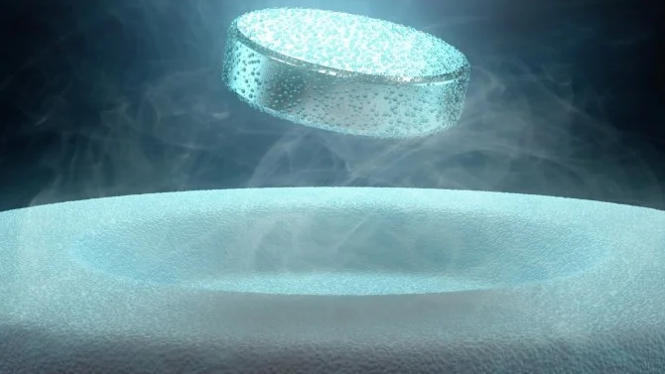
BCS theory
- The microscopic theory of superconductivity
Marie Hofmann
Source: https://www.sciencealert.com/superconductivity

Slide 2
Outline
1 Introduction
2 Microscopic theory of superconductivity
2.1 BCS Hamiltonian
2.2 Mean-field decoupling
2.3 Bogoliubov transformation
2.4 The gap function and BCS ground state
3 Outlook and Summary

Slide 3
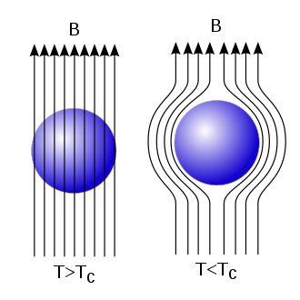
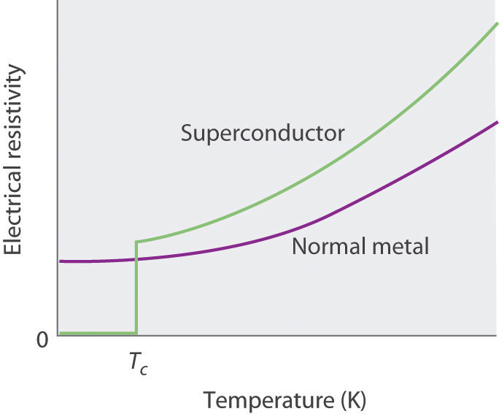
Superconductivity
1 Introduction
1911: Discovery of superconductivity by Onnes
Zero resistivity at $T_{c} = 4.2 K$ in Hg
Perfect conductor
1933: Meissner effect
Repulsion of magnetic flux below $T_{c}$
Perfect diamagnet
1957: BCS theory (Bardeen, Cooper, Schrieffer)
First microscopic theory of superconductivity
Source: https://files.mtstatic.com/site_4334/44020/0?Expires=1638445605&Signature=nL8zb2pgurexUQ9IPzsWYcFLs9gT-aPyVYg0dEvFHpa7c2vEO1YYimagj4hTxucp1rWbn-rM-g~aXq16GQ~LBKaI82wijsZ5P15NHY1eg8RIvIfKwqwHcZJRAXFYFYpsWdBb6MOkLkASN02cRieZ7r2pS-GDRyVfDxK90wDS5nE_&Key-Pair-Id=APKAJ5Y6AV4GI7A555NA
Source: https://upload.wikimedia.org/wikipedia/commons/thumb/b/b5/EfektMeisnera.svg/330px-EfektMeisnera.svg.png
Notes:
mercury

Slide 4
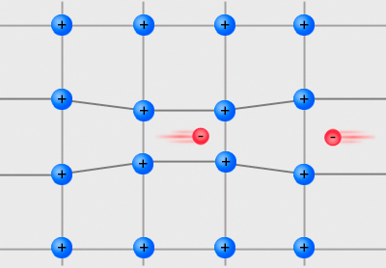
Superconductivity – Cooper pair
1 Introduction
Deformation of background of positively charged ions by electron
Attraction of another electron by trace of higher density of positively charged ions
Effective attractive interaction (size: $\sim v_{F}⋅τ \sim v_{F}⋅\frac{1}{ω_{D}} \sim 0.1−1 μm$)
Source: https://commons.wikimedia.org/wiki/File:Cooper_pairs.jpg
Notes:
Took quite a long time, since idea that it is based on, seems at first to be a little bit counterintuitive…
PHONONS
Cooper pair

Slide 5
1 Introduction
2 Microscopic theory of Superconductivity
2.1 BCS Hamiltonian
2.2 Mean-field decoupling
2.3 Bogoliubov transformation
2.4 The gap function and BCS ground state
3 Outlook and Summary

Slide 6
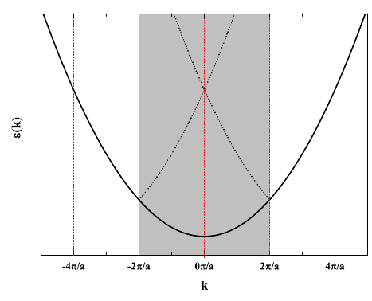
BCS Hamiltonian
2.1 BCS Hamiltonian
$$H=\sum_{k, σ}{ε_{k}c_{kσ}^{†}}c_{kσ}^{}+\frac{1}{N}\sum_{k,k´}{V_{k,k´}c_{k↑}^{†}}c_{−k↓}^{†}c_{−k´↓}^{}c_{k´↑}^{}$$
$c_{kσ}^{†}$: creation of electron with momentum $k$ and spin $σ$
Energies relative to $E_{F}$
Cooper pairs: opposite spin and momentum
free electrons
attractive interaction between two electrons
(phonon mediated)
Source: https://www.physicsforums.com/threads/dispersion-relation-for-the-free-electron-model.808710/
Notes:
Long derivation

Slide 7
Solving the BCS Hamiltonian
2.1 BCS Hamiltonian
BCS Hamiltonian
$$H=\sum_{k, σ}{ε_{k}c_{kσ}^{†}}c_{kσ}^{}+\frac{1}{N}\sum_{k,k´}{V_{k,k´}c_{k↑}^{†}}c_{−k↓}^{†}c_{−k´↓}^{}c_{k´↑}^{}$$
Decoupling of the quartic term
via
mean-field approximation
Effective Hamiltonian
$$H_{eff}=\sum_{k,σ}{E_{k}}γ_{kσ}^{†}γ_{kσ}^{}+E_{0}$$
Diagonalization
via
Bogoliubov transformation

Slide 8
Mean-field decoupling
2.2 Mean-field decoupling
Goal: Hamiltonian suitable for Bogoliubov transformation
Idea: dynamics of two electrons coupled (Cooper pair)
Ansatz: $c_{k↑}^{†}$ $c_{−k↓}^{†}= \left\langle c_{k↑}^{†} c_{−k↓}^{†}\right\rangle +δ\left(c_{k↑}^{†} c_{−k↓}^{†}\right)$
(annihilation operators treated analogously)
$$δ\left(c_{k↑}^{†} c_{−k↓}^{†}\right) δ\left(c_{−k´↓}^{}c_{k´↑}^{}\right)=0$$

Slide 9
Mean-field decoupling
2.2 Mean-field decoupling
$$c_{k↑}^{†} c_{−k↓}^{†}= \left\langle c_{k↑}^{†} c_{−k↓}^{†}\right\rangle +δ\left(c_{k↑}^{†} c_{−k↓}^{†}\right)$$
$$δ\left(c_{k↑}^{†} c_{−k↓}^{†}\right) δ\left(c_{−k´↓}^{}c_{k´↑}^{}\right)=0$$
$$H=\sum_{k, σ}{ε_{k}c_{kσ}^{†}}c_{kσ}^{}+\frac{1}{N}\sum_{k,k´}{V_{k,k´}\left(c_{k↑}^{†}c_{−k↓}^{†}\right)}\left(c_{−k´↓}^{}c_{k´↑}^{}\right)$$
$$H≈\sum_{k, σ}{ε_{k}c_{kσ}^{†}}c_{kσ}^{} −\sum_{k}{(Δ_{k} c_{k↑}^{†}c_{−k↓}^{†}}+Δ_{k}^{∗} c_{−k↓}^{}c_{k↑}^{})+\sum_{k}{Δ_{k}\left\langle c_{k↑}^{†} c_{−k↓}^{†}\right\rangle }$$
with gap function $Δ_{k}=−\frac{1}{N}\sum_{k´}{V_{kk´}}\left\langle c_{−k´↓}^{}c_{k´↑}^{}\right\rangle$
$$≈\left\langle c_{−k´↓}^{}c_{k´↑}^{}\right\rangle c_{k↑}^{†} c_{−k↓}^{†}+\left\langle c_{k↑}^{†} c_{−k↓}^{†}\right\rangle c_{−k´↓}^{}c_{k´↑}^{}−\left\langle c_{−k´↓}^{}c_{k´↑}^{}\right\rangle \left\langle c_{k↑}^{†} c_{−k↓}^{†}\right\rangle$$

Slide 10
Solving the BCS Hamiltonian
2.2 Mean-field decoupling
BCS Hamiltonian
$$H=\sum_{k, σ}{ε_{k}c_{kσ}^{†}}c_{kσ}^{}+\frac{1}{N}\sum_{k,k´}{V_{k,k´}c_{k↑}^{†}}c_{−k↓}^{†}c_{−k´↓}^{}c_{k´↑}^{}$$
Decoupling of the quartic term
via
mean-field approximation
Effective Hamiltonian
$$H_{eff}=\sum_{k,σ}{E_{k}}γ_{kσ}^{†}γ_{kσ}^{}+E_{0}$$
Diagonalization
via
Bogoliubov transformation
Notes:
10 min

Slide 11
Bogoliubov transformation (Bogoljubov 1958)
2.3 Bogoliubov transformation
Goal: transform into diagonal operator basis
$$c_{k↑}^{} =u_{k}^{∗} γ_{k↑}^{}+v_{k} γ_{−k↓}^{†}$$
$c_{−k↓}^{†}=u_{k}^{} γ_{−k↓}^{†}−v_{k}^{∗} γ_{k↑}^{}$
New operators should also satisfy fermionic (anti)commutation relations
$\left\{γ_{kσ}^{} ,γ_{k´σ´}^{†}\right\}=δ_{kk´}δ_{σσ´}$
$\left\{γ_{kσ}^{} ,γ_{k´σ´}^{}\right\}=0$ → ${\left|u_{k}\right|}^{2}+{\left|v_{k}\right|}^{2}=1$

Slide 12
Bogoliubov transformation
2.3 Bogoliubov transformation
$$H_{1}=\sum_{k, σ}{ε_{k}c_{kσ}^{†}}c_{kσ}^{} −\sum_{k}{(Δ_{k} c_{k↑}^{†}}c_{−k↓}^{†}+Δ_{k}^{∗} c_{−k↓}^{}c_{k↑}^{})+\sum_{k}{Δ_{k}\left\langle c_{k↑}^{†} c_{−k↓}^{†}\right\rangle } \\ H_{1}=H_{0}+H_{1}+H_{2}$$
$$H_{0}=\sum_{k}{\left[2ε_{k}{\left|v_{k}\right|}^{2}−Δ_{k}u_{k}v_{k}^{∗}−Δ_{k}^{∗}u_{k}^{∗}v_{k}^{}+Δ_{k}\left\langle c_{k↑}^{†} c_{−k↓}^{†}\right\rangle \right]}=const.$$
$$H_{1}=\sum_{k}{\left[ε_{k}\left({\left|u_{k}\right|}^{2}−{\left|v_{k}\right|}^{2}\right)+Δ_{k}u_{k}v_{k}^{∗}+Δ_{k}^{∗}u_{k}^{∗}v_{k}^{}\right]}\left(γ_{k↑}^{†}γ_{k↑}^{}+γ_{−k↓}^{†}γ_{−k↓}^{}\right)$$
$$H_{2}=\sum_{k}{\left[2ε_{k}u_{k}v_{k}^{}−Δ_{k}u_{k}^{2}+Δ_{k}^{∗}v_{k}^{2}\right]}γ_{k↑}^{†}γ_{−k↓}^{†}+\left[2ε_{k}u_{k}^{∗}v_{k}^{∗}−Δ_{k}^{∗}{\left(u_{k}^{∗}\right)}^{2}+Δ_{k}^{}{\left(v_{k}^{∗}\right)}^{2}\right] γ_{k↑}^{}γ_{−k↓}^{}$$
$$c_{k↑}=u_{k}^{∗} γ_{k↑}+v_{k} γ_{−k↓}^{†}$$
$$c_{−k↓}^{†}=u_{k}^{} γ_{−k↓}^{†}−v_{k}^{∗} γ_{k↑}$$
Notes:
H0: const. Terms (normal ordering)
Diagonalization: look at H2

Slide 13
Diagonalization condition
2.3 Bogoliubov transformation
$$H_{2}=\sum_{k}{\left[2ε_{k}u_{k}v_{k}^{}−Δ_{k}u_{k}^{2}+Δ_{k}^{∗}v_{k}^{2}\right]}\left(γ_{k↑}^{†}γ_{−k↓}^{†}\right)+h.c.$$
$$c_{k↑}=u_{k}^{∗} γ_{k↑}+v_{k} γ_{−k↓}^{†}$$
$$c_{−k↓}^{†}=u_{k}^{} γ_{−k↓}^{†}−v_{k}^{∗} γ_{k↑}$$
$$=0$$
Choice! (diagonalization condition)
→ $\frac{v_{k}}{u_{k}}=\frac{\sqrt{ε_{k}^{2}+{\left|Δ_{k}\right|}^{2}}−ε_{k}}{Δ_{k}^{∗}}$
$${\left|u_{k}\right|}^{2}+{\left|v_{k}\right|}^{2}=1$$
${\left|u_{k}\right|}^{2}=\frac{1}{2}\left(1+\frac{ε_{k}}{\sqrt{ε_{k}^{2}+{\left|Δ_{k}\right|}^{2}}}\right)$ and ${\left|v_{k}\right|}^{2}=\frac{1}{2}\left(1−\frac{ε_{k}}{\sqrt{ε_{k}^{2}+{\left|Δ_{k}\right|}^{2}}}\right)$

Slide 14
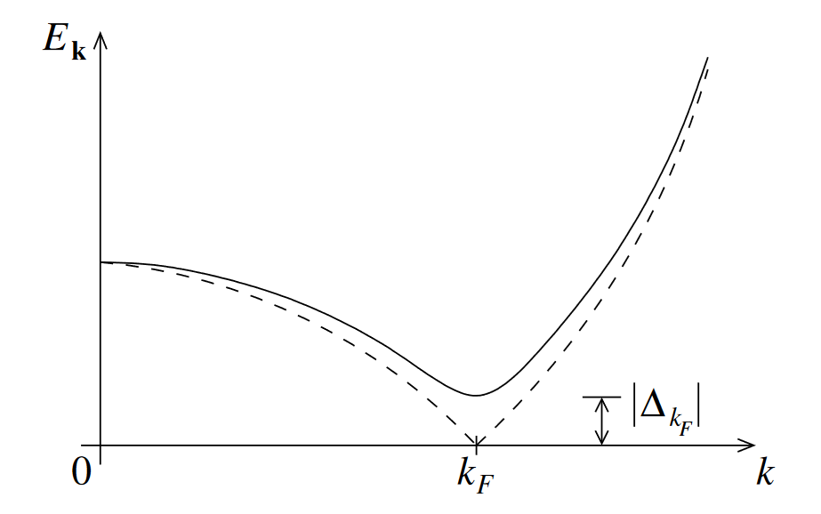
Bogoliubov Hamiltonian
2.3 Bogoliubov transformation
$$H_{eff}=\sum_{k}{E_{k}}\left(γ_{k↑}^{†}γ_{k↑}^{}+γ_{−k↓}^{†}γ_{−k↓}^{}\right)+E_{0}$$
with $E_{k}=\sqrt{ε_{k}^{2}+{\left|Δ_{k}\right|}^{2}}$ and $E_{0}=\sum_{k}{\left(ε_{k}^{}−E_{k}+Δ_{k}\left\langle c_{k↑}^{†} c_{−k↓}^{†}\right\rangle \right)}$
Diagonal in terms of new fermionic operators (not Cooper pairs!)
$γ_{kσ}^{†}γ_{kσ}^{}$: Bogoliubons $\hat{=}$ quasi-particles (superposition of electrons and holes)
$E_{0}$: ground state energy
$E_{k}$: excitation energy
$Δ_{k}$: gap function (= gap size at Fermi level, i.e. $ε_{k}^{}=0$)
(Timm 2021)
Notes:
20 min

Slide 15
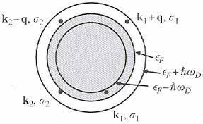
Gap equation
2.4 The gap function and BCS ground state
(Eremin)
$$Δ_{k}=−\frac{1}{N}\sum_{k´}{V_{kk´}}\left\langle c_{−k´↓}^{}c_{k´↑}^{}\right\rangle$$
Assuming $V_{kk´}=\left\{\begin{aligned}−V_{0} \left|ε_{k}\right|,\left|ε_{k´}\right|≤ℏω_{D} \\ 0 otherwise \end{aligned}\right.$ → $Δ_{k}=\left\{\begin{aligned} Δ \left|ε_{k}\right|,\left|ε_{k´}\right|≤ℏω_{D} \\ 0 otherwise \end{aligned}\right.$
we get, using Fermi-Dirac distribution: $\left\langle γ_{k↑}^{†}γ_{k↑}^{}\right\rangle =\left\langle γ_{−k↓}^{†}γ_{−k↓}^{}\right\rangle =\frac{1}{exp\left(βE_{k}\right)+1}$
Solution 1:
$$Δ=\frac{V_{0}}{N}\sum_{k≤k_{D}}{\frac{Δ}{2\sqrt{ε_{k}^{2}+{\left|Δ\right|}^{2}}}}tanh\left(\frac{1}{2}β\sqrt{ε_{k}^{2}+{\left|Δ\right|}^{2}}\right)$$
$$Δ=0⇒E_{0}^{\left(nc\right)}=0$$
Normal conducting state

Slide 16
Gap equation at T = 0
2.4 The gap function and BCS ground state
$tanh\left(\frac{1}{2}β\sqrt{ε_{k}^{2}+{\left|Δ\right|}^{2}}\right)→1$ for $T→0$
Solution 2: $\left(T=0\right)$
$Δ≈2ℏω_{D}\exp\left(−\frac{1}{V_{0}ρ_{F}}\right)⇒E_{0}^{\left(sc\right)}<0$
$ρ_{F}$: density of states at the Fermi level
$$1=\frac{V_{0}}{N}\sum_{k≤k_{D}}{\frac{1}{2\sqrt{ε_{k}^{2}+{\left|Δ\right|}^{2}}}}tanh\left(\frac{1}{2}β\sqrt{ε_{k}^{2}+{\left|Δ\right|}^{2}}\right)$$
$$1=\frac{V_{0}}{N}\sum_{k}{\frac{1}{2\sqrt{ε_{k}^{2}+{\left|Δ\right|}^{2}}}}$$
BCS self-consistency equation
Superconducting state

Slide 17
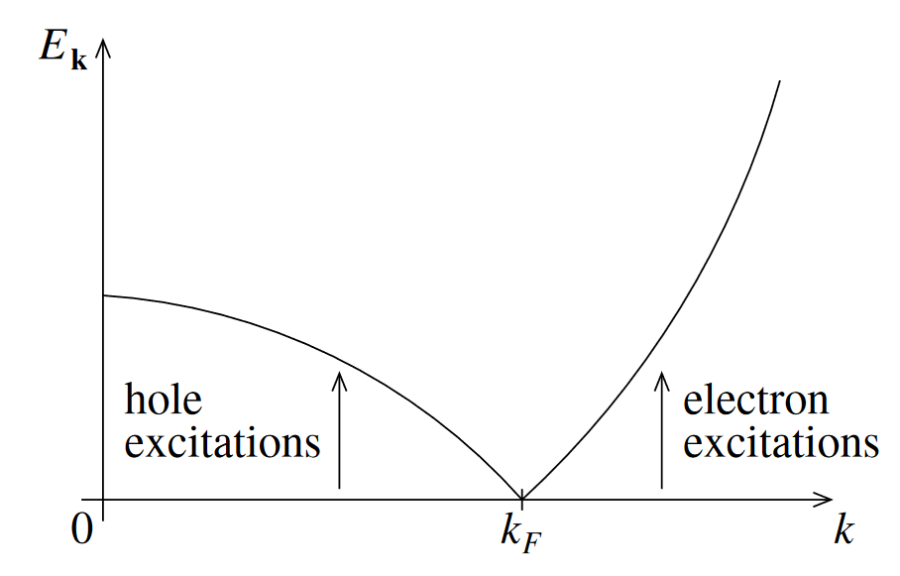
Energy dispersion and gap
2.4 The gap function and BCS ground state
Change of dispersion
$$E_{k}=\sqrt{ε_{k}^{2}+{\left|Δ_{k}\right|}^{2}}$$
$Δ_{k}=0$ (normal conducting state)
$Δ_{k}≠0$ (superconducting state)
(Timm 2021)

Slide 18
BCS ground state $\left.{|Ψ}_{BCS}\right\rangle$
2.4 The gap function and BCS ground state
= vacuum of Bogoliubons
$γ_{k↑}^{}\left.{|Ψ}_{BCS}\right\rangle =0$
$⇔$ $u_{k}c_{k↑}^{}$ $\left.{|Ψ}_{BCS}\right\rangle =\left.{v_{k}c_{−k↓}^{†}|Ψ}_{BCS}\right\rangle$
Solution: arbitrary combination of Cooper pairs
$$γ_{k↑}^{}=u_{k}c_{k↑}^{}−v_{k}c_{−k↓}^{†}$$
$$\left.{|Ψ}_{BCS}\right\rangle =\prod_{k}{\left(u_{k}+v_{k}c_{k↑}^{†}c_{−k↓}^{†}\right)}\left.|0\right\rangle$$

Slide 19
1 Introduction
2 Microscopic theory of Superconductivity
2.1 BCS Hamiltonian
2.2 Mean-field decoupling
2.3 Bogoliubov transformation
2.4 The gap function and BCS ground state
3 Outlook and Summary
Notes:
27 min

Slide 20
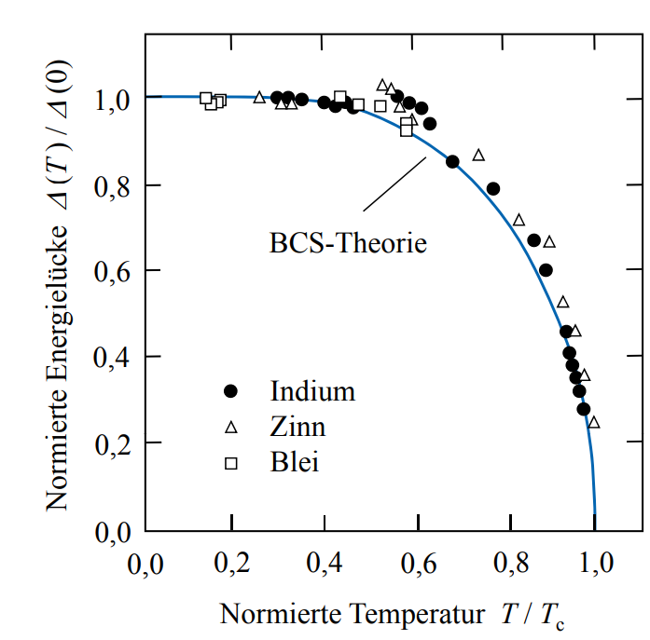
Comparison with measurement
2.5 Outlook and Summary
(Hunklinger 2018)
$$Δ=\frac{V_{0}}{N}\sum_{k≤k_{D}}{\frac{Δ}{2\sqrt{ε_{k}^{2}+{\left|Δ\right|}^{2}}}}tanh\left(\frac{1}{2}β\sqrt{ε_{k}^{2}+{\left|Δ\right|}^{2}}\right)$$
Good agreement with measurement (electron tunneling spectroscopy)

Slide 21
Bogoliubov transformation in AMO physics
2.5 Outlook and Summary
Example: Quantum spin ladder in a cavity (Hofmann 2020)
$$ℋ_{eff}=E_{0}+Ω a^{†}a+\left(c_{1}^{⊥}+c_{2}^{⊥} a^{†}a +c_{3}^{⊥} \left(a^{†}a^{†}+h.c.\right)\right)\left[−\frac{5}{4}N+\sum_{ν, α}{t_{α, ν}^{†}t_{α, ν}}\right]$$
$$+\frac{1}{2}\left(J_{ex}^{∥}+c_{1}^{∥}+c_{2}^{∥} a^{†}a +c_{3}^{∥} \left(a^{†}a^{†}+h.c.\right)\right)\left[−N+\sqrt{3}\sum_{ν}{\left({\left(t_{ν}^{†}t_{ν+1}^{†}\right)}_{S=0}+h.c.\right)}+\sum_{ν, α}{\left(t_{α, ν}^{†}t_{α, ν+1}+h.c.\right)}+2\sum_{ν}{\sum_{S,{ S}_{z}}{V_{S}{\left(t_{ν}^{†}t_{ν+1}^{†}\right)}_{S,{ S}_{z}}}}{\left(t_{ν}t_{ν+1}^{}\right)}_{S,{ S}_{z}}\right]$$
→ $ℋ_{eff} =ℋ_{0}+ℋ_{magn}+ℋ_{Ph}+ℋ_{LM}$
$$ℋ_{Ph}=ωa^{†}a +Γ(a^{†}a^{†}+h.c.)$$
$$a =ub+vb^{†}$$
$$a^{†}=ub^{†}+vb$$
$${\tilde{ℋ}}_{Ph}=\tilde{E}+\tilde{ω}b^{†}b$$

Slide 22
Summary
2.5 Outlook and Summary
Diagonalizing BCS Hamiltonian via mean-field approximation and Bogoliubov transformation
Energy gap for arbitrarily small attractive potential
New superconducting ground state: Cooper pairs
BCS theory in good agreement with measurements
$$H_{eff}=\sum_{k,σ}{E_{k}}γ_{kσ}^{†}γ_{kσ}^{}+E_{0}$$
$$Δ\left(T=0\right)≈2ℏω_{D}\exp\left(−\frac{1}{V_{0}ρ_{F}}\right)$$
$$\left.{|Ψ}_{BCS}\right\rangle =\prod_{k}{\left(u_{k}+v_{k}c_{k↑}^{†}c_{−k↓}^{†}\right)}\left.|0\right\rangle$$

Slide 23
Literature
Bardeen, J., et al. (1957). "Theory of Superconductivity." Physical Review 108(5): 1175-1204.
Bogoljubov, N. N. (1958). "On a new method in the theory of superconductivity." Il Nuovo Cimento (1955-1965) 7(6): 794-805.
Czycholl, G. (2017). Theoretische Festkörperphysik Band 2. Berlin, Heidelberg, Springer Spektrum.
Eisert, J. (2019). Advanced quantum mechanics, Lecture Notes.
Eremin, I. Superconductivity and BCS Theory. Dresden, Max-Planck Institut für Physik komplexer Systeme.
Fernandes, R. M. (2015). BCS theory of superconductivity, Lecture Notes.
Hofmann, M. (2020). Magnetische Anregungen einer Quantenspinleiter in einem optischen Resonator, FAU Erlangen-Nürnberg. Bachelor Thesis.
Hunklinger, S. (2018). Festkörperphysik, De Gruyter Oldenbourg.
Klingeler, R. (2021). Condensed Matter Physics, Lecture Notes.
Timm, C. (2021). Theory of Superconductivity, Lecture Notes.

Slide 24
Thank you for your attention!
Any questions?

Slide 25
Cooper pair momentum
2.1 BCS Hamiltonian
(Hunklinger 2018)
Energy conservation:
$$\left|ε_{k+q}−ε_{k}\right|≤ℏω_{D} →δk=\frac{mω_{D}}{ℏk_{F}}$$
Momentum conservation:
$$K=k_{1}+k_{2}=k_{1}´+k_{2}´=K´$$
Maximum overlap at $K=0$
$$ω_{D}$$
Source: https://ars.els-cdn.com/content/image/3-s2.0-B978044452748600033X-gr2.jpg

Slide 26
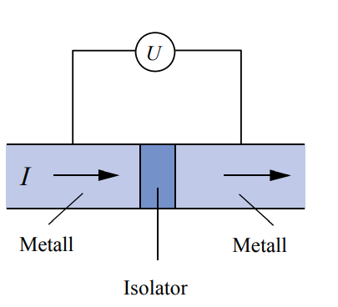
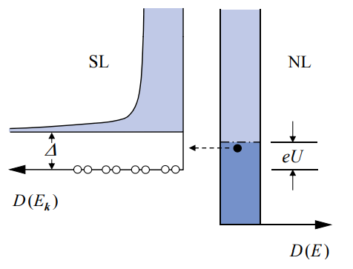
Tunneling spectroscopy
(Hunklinger 2018)

Slide 27
Bogoliubons
Quasi-particles, described by the operators $γ_{kσ}^{†}$
Superposition of electron and holes:
$γ_{k↑}^{†}=u_{k}^{∗} c_{k↑}^{†}−v_{k}^{∗} c_{−k↓}^{}$
Normal state ($Δ_{k}→0, E_{0}=0$)
${\left|u_{k}\right|}^{2}→1$, ${\left|v_{k}\right|}^{2}→0$ for $ε_{k}>0$
${\left|u_{k}\right|}^{2}→0$, ${\left|v_{k}\right|}^{2}→1$ for $ε_{k}<0$
Creation of Bogoliubon = creation of electron ($ε_{k}>0$) and creation of hole ($ε_{k}<0$)
Superconducting state ($Δ_{k}≠0, E_{0}<0$)
$$E_{0}=\sum_{k}{\left(ε_{k}^{}−E_{k}+Δ_{k}\left\langle c_{k↑}^{†} c_{−k↓}^{†}\right\rangle \right)}$$
$$E_{k}=\sqrt{ε_{k}^{2}+{\left|Δ_{k}\right|}^{2}}$$
$${\left|u_{k}\right|}^{2}=\frac{1}{2}\left(1+\frac{ε_{k}}{\sqrt{ε_{k}^{2}+{\left|Δ_{k}\right|}^{2}}}\right)$$
$${\left|v_{k}\right|}^{2}=\frac{1}{2}\left(1−\frac{ε_{k}}{\sqrt{ε_{k}^{2}+{\left|Δ_{k}\right|}^{2}}}\right)$$

Slide 28
Assumptions / Approximations
$$H=\sum_{k, σ}{ε_{k}c_{kσ}^{†}}c_{kσ}^{}+\frac{1}{N}\sum_{k,k´}{V_{k,k´}c_{k↑}^{†}}c_{−k↓}^{†}c_{−k´↓}^{}c_{k´↑}^{}$$
Electron-phonon interaction
→ (simplified) effective electron-electron interaction
No dependence on phonon momentum
K = 0, electrons with opposite momentum and spin
Resulting model solved only approximatly

