Slide 1
Master-Pflichtseminar Master Mandatory seminar (MVSEM) Your Passion for Physics: What are you curious about? Thomas Pfeifer, MPIK Heidelberg

Slide 2
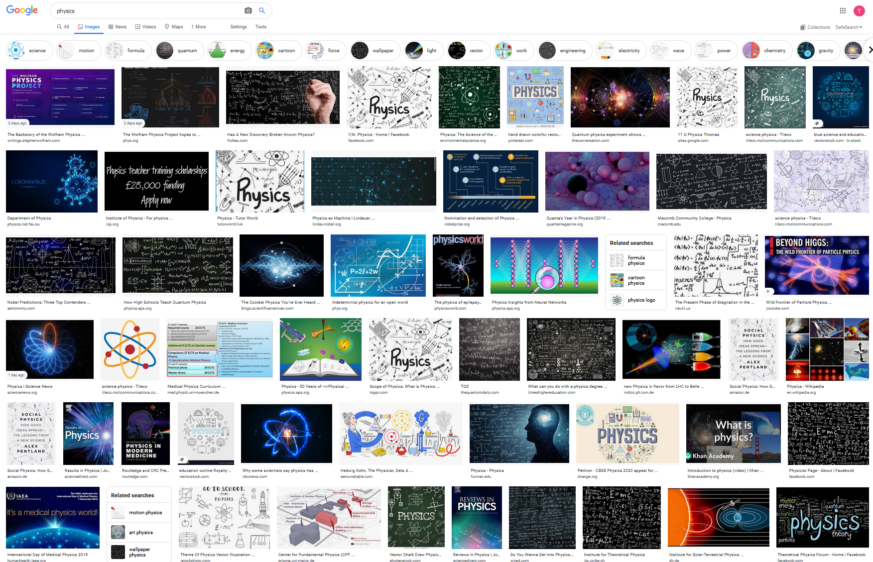

Slide 3
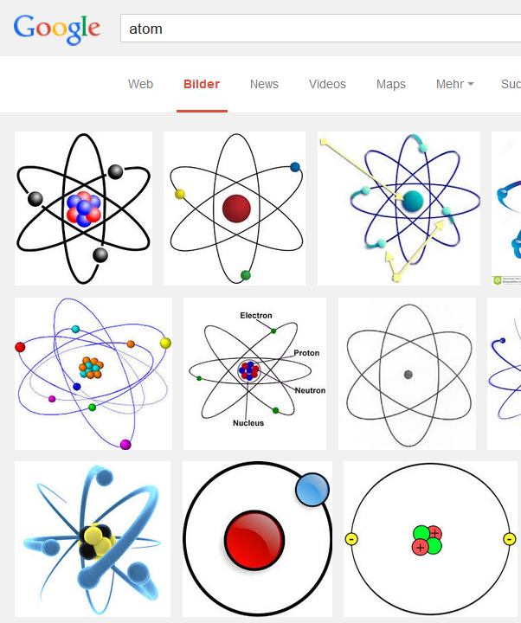
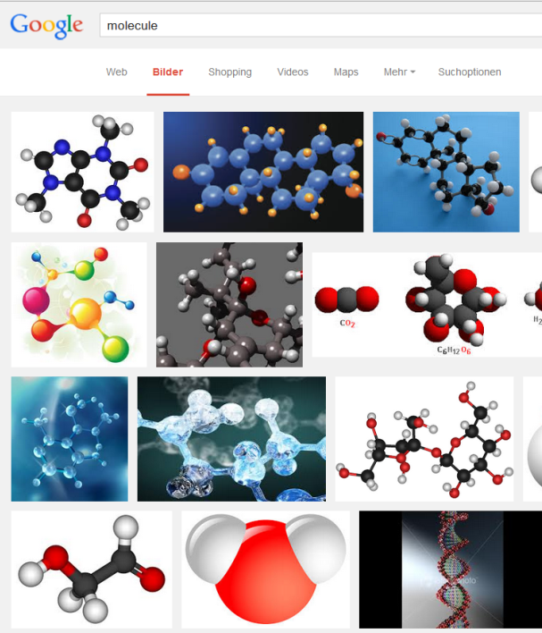
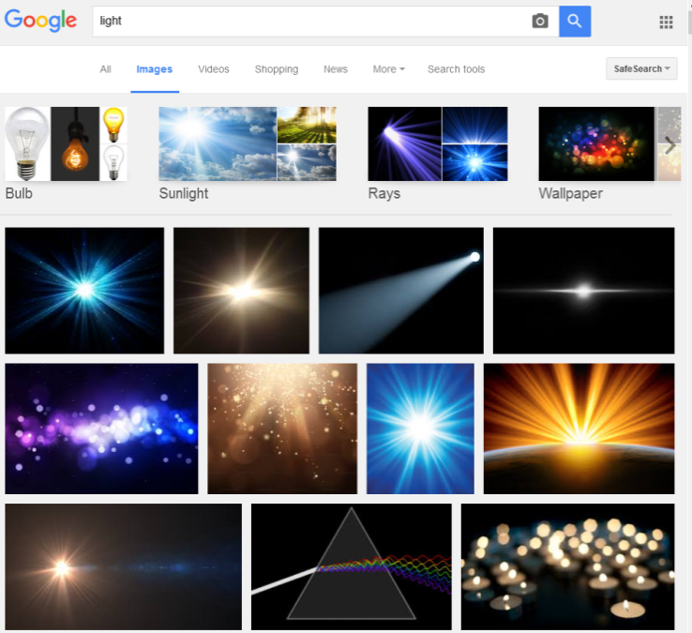
Atomic, Molecular, and Optical Physics (AMO Physics) What is it?
Understand
Quantum
Mechanics
Atoms
Molecules
Light

Slide 4
the language electrons speak...
+
+
e⁻
e⁻
The
quantum
few-body
problem
+
+
... only approximate,
special-case, or
numerical solutions
Time-dependent Schrödinger/Dirac equation
atoms and small molecules: well-defined Å-sized quantum "labs"

Slide 5
Some current AMO Focus Topics
Light
Matter
(Ultrafast)
Lasers
(Ultracold)
Gases or
(Cold) Ions
Entanglement&
Quantum
Information
Femto-/
Attosecond
Physics
Collision
Physics
Quantum
Dynamics&
Control
Strong-field
Laser Physics
Quantum
Metrology
Precision
Physics
Tests of
Fundamental
Theories

Slide 6
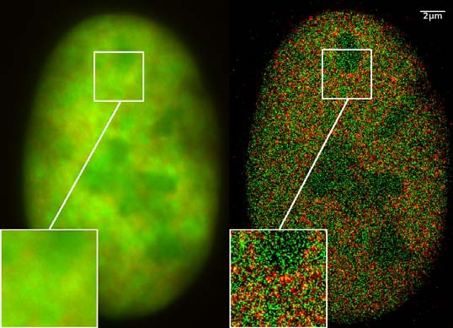
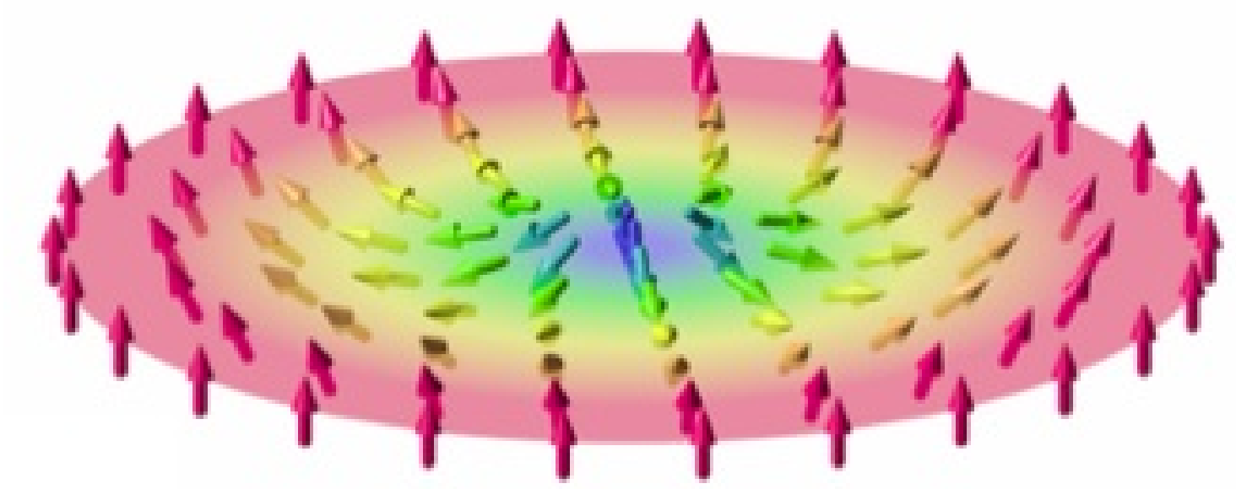
Atomic, Molecular, and Optical Physics (AMO Physics) Is it important?
Physics Nobel prize 2016
Chemistry Nobel prize 2014
”for theoretical discoveries of topological phase transitions and topological phases of matter"
"for the development of super-resolved fluorescence microscopy"
David Thouless
Duncan Haldane
Michael Kosterlitz
Eric Betzig
Stefan W. Hell
William E. Moerner
Picture source: wikipedia/ nobelprize.org

Slide 7
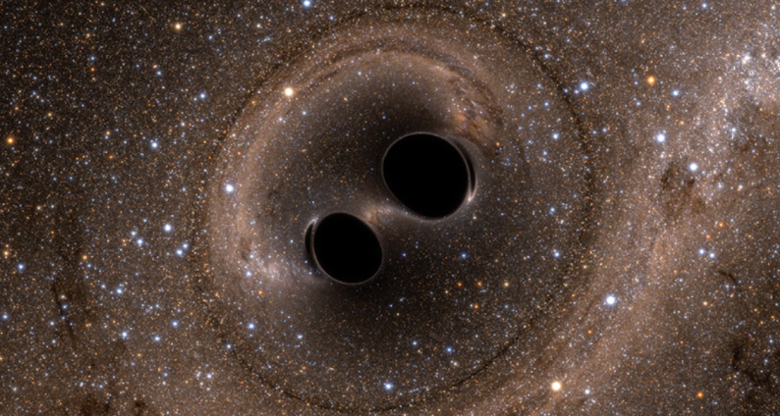
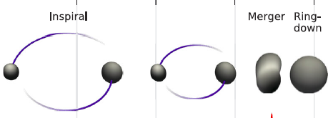
Another famous result (based on optics)
www.sciencenews.org
Strain (10⁻²¹)

Slide 8
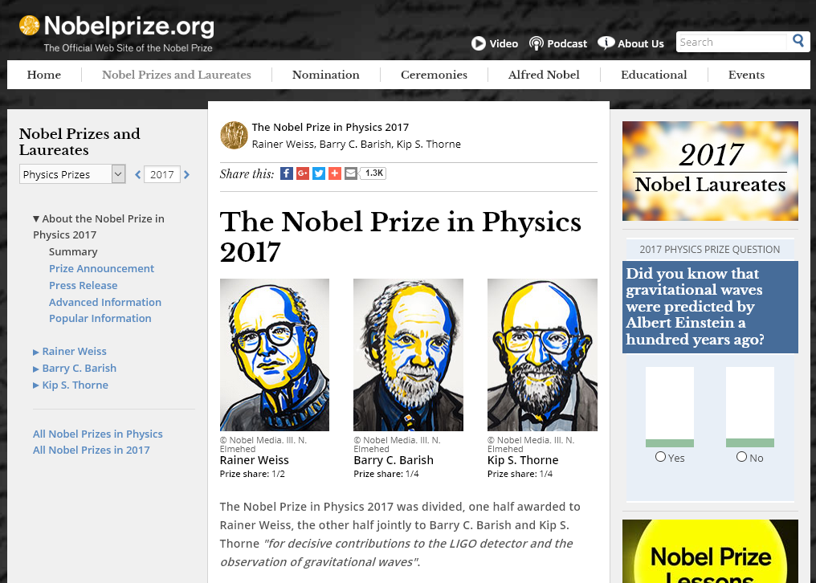
Optical-Physics driven Nobel

Slide 9
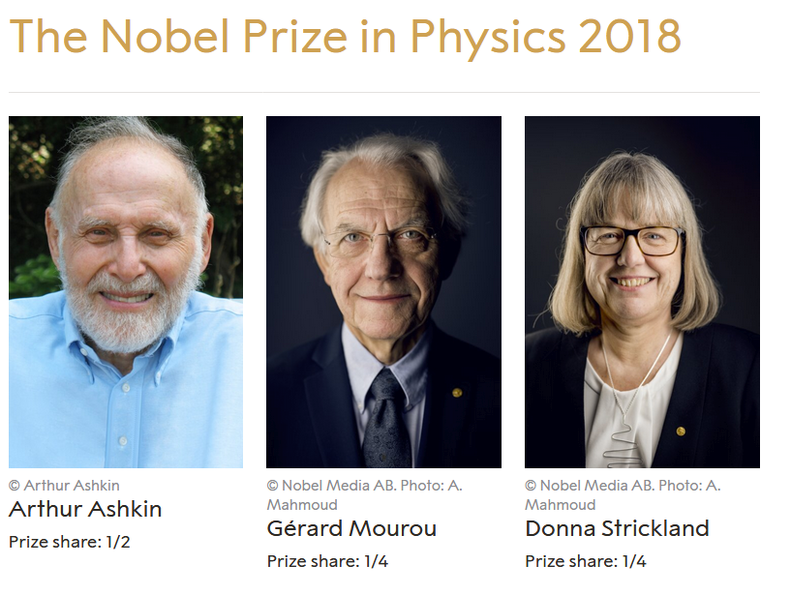
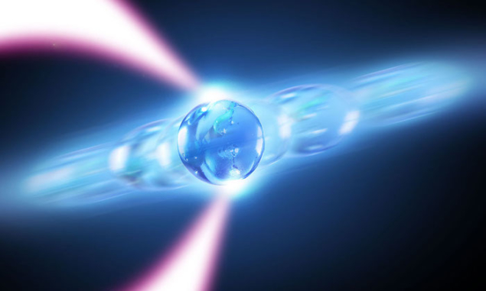
Optical tweezers
Chirped Pulse Amplification
laserfocusworld.com
physicsworld.com

Slide 10
Seminar Topics for Presentations
Generation of short laser pulses
Frequency combs
Optical Clocks
Time-resolved physics in atoms and molecules
(Low-energy) Electron collisions with atoms and molecules
Physics in strong laser fields
(Re-)collision physics
The Physics of Free-Electron Lasers
Physics with intense x-ray pulses at Free-Electron Lasers
Squeezed light for detection of gravitational waves
Photoionization of Hot Astrophysical Matter
Ultrafast quantum control with shaped laser pulses
Optical cooling and trapping
Laser Cooling of Ions in Coulomb Crystals
Physics in Rydberg gases
The g-factor of the electron: Stringent Test of QED, and weighing the electron
Test of the time variation of fundamental constants using highly-charged ions

Slide 11
Seminar Facts and Requirements (MVSEM, Master Seminar)
Language: English
ECTS points: 6
Prerequisites: basic knowledge of atomic physics from the bachelor program
Content: your physics topic of interest
Form of testing
and examination: 45 min talk on agreed topic, submission of presentation
and a short write-up, participation in discussions
Presentation: Understandable to a Master student with no special prior knowledge
Material: literature should be searched for independently, seed information can be provided if necessary, please send me your literature and a brief outline of what you want to talk about at least 2 weeks before your talk
Preparation Meeting: 1 week before presentation
show lineout/structure of presentation, discuss remaining questions
Slides: Please send me your slides at least 2 days before your presentation
Write-up: ~1 page structured summary of the topic
- What is the goal, why is it important?
- what are the scientific questions?
- what are the methods?
- what has been achieved, recent results?
- what’s next?

