Slide 1
Ultrafast Dynamics
Tracking motion on fs-timescales and below
Limpert, IAP Uni Jena
MVSEM - Your passion for (AMO-)physics: What are you curious about?
01.06.2021
Maximilian Klaus Müllenbach
Heidelberg University

Slide 2
Talk Outline
1. Scales of motion
2. Ultrafast Imaging Techniques
3. High-Harmonic Generation
4. X-Ray Free Electron Lasers
5. Conclusion and Outlook
Ultrafast Dynamics - Tracking motion on the fs-timescale and below

Slide 3
Timescales of motion
10s of ms
ns
Muybridge (1887)
https://www.specialised-imaging.com/about-us/news/Pushing-ultra-high-speed-photography-to-the-limit
Olbinado et al., Optics Express 25, 13857-13871 (2017)
Ultrafast Dynamics - Tracking motion on the fs-timescale and below
Notes:
Horse in Motion: shutter speed 0.5 ms, one picture every 40 ms
Fuse: X-ray imaging @ ESfR
Electrical Discharge: disc anode to plate cathode

Slide 4
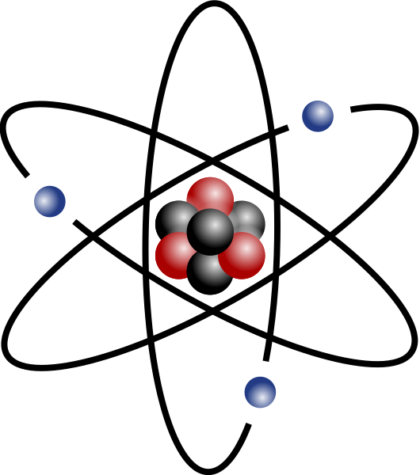
Timescales of motion
ps
fs
as
Liang et al., Light: Science & Applications 7, 42 (2018)
Wolf et al., Nature Chemistry 11, 504-509 (2019)
Wikimedia Commons
Ultrafast Dynamics - Tracking motion on the fs-timescale and below
Notes:
Light pulse: Multi-camera system, streak + static, 100 fs time intervals
Molecule:

Slide 5
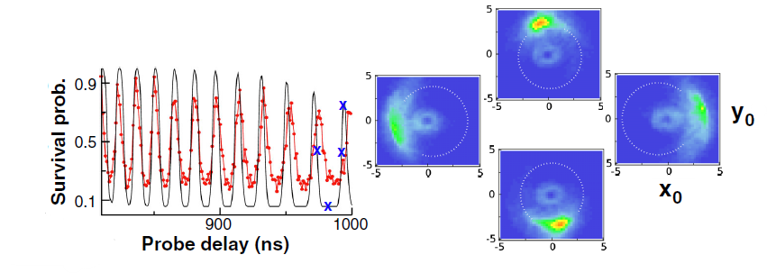
Idea: Exaggerate properties!
Physical Quantity | Scaling | H (n=2) | K (n=400)
Binding energy | n⁻² | 3.4 eV | 85 µeV
Mean Bohr radius | n² | 2 Å | 8.5 µm
Revolution period | n³ | 1.2 fs | 9.7 ns
Radiative lifetime | n³ Circular n⁵ | 5 ns | Effective: 0.2 s @ 10 K
Non-dispersive, so-called Trojan, states with n∼400
Potassium values calculated using ARC; Šibalić et al., Computer Physics Communications 220, 319 (2017)
Wyker et al., Physical Review Letters 108, 043001 (2012)
Ultrafast Dynamics - Tracking motion on the fs-timescale and below
Notes:
Trojans: phase-locking analogous to accompanying asteroids 60° behind Jupiter; polarized circular EM field
Visualization based on simulation, track x(t), y(t) by measuring survival probability after field step

Slide 6
Imaging requirements
We want to image:
(Sub)-fs processes in molecules and atoms, e.g.
Dissociation of molecules
Charge migration upon photoionization
Radiation damage
Movement of electron wave packets
HHG
FEL
To do so we need:
Short times (fs and below)
Small wavelengths (down to Å)
High intensities
Coherent light
Wikimedia Commons
Ultrafast Dynamics - Tracking motion on the fs-timescale and below
Notes:
- Rhodopsin in human eye (starts in 200 fs), Photosythesis (starts in 100 fs), solar panels

Slide 7
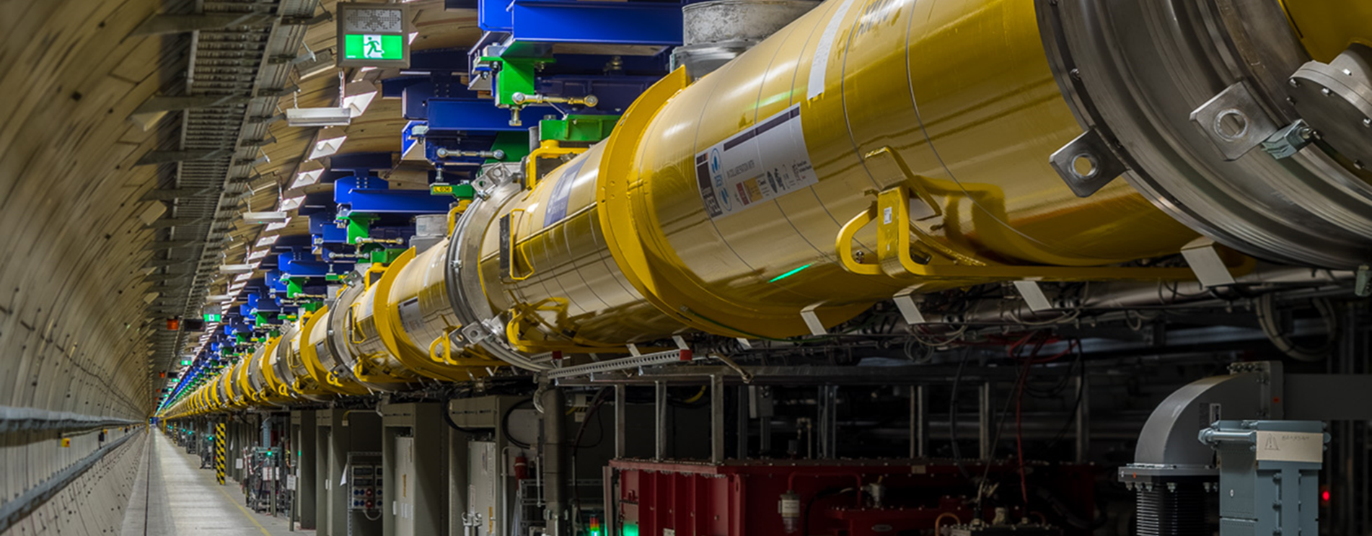
Ultrafast Imaging Techniques
Ultrafast Scanning Electron Microscopy
And many more…
Many different technologies for ultrafast imaging ranging from table-top experiments to large-scale facilities
(X-ray) Free Electron Lasers
X-ray diffraction
Electron diffraction
High-harmonic emission
RABBIT
Photoelectron holography
COLTRIMS
Quantum Stroboscope
Laser-induced electron diffraction
Self-probing spectroscopy
Attosecond Transient Spectroscopy
European XFEL @ DESY Hamburg
Ultrafast Dynamics - Tracking motion on the fs-timescale and below
Notes:
Phase problem

Slide 8
Ultrafast Imaging Techniques
Ultrafast Scanning Electron Microscopy
And many more…
Many different technologies for ultrafast imaging ranging from table-top experiments to large scale facilities
Focus on: High harmonics, XFELs
(X-ray) Free Electron Lasers
X-ray diffraction
Electron diffraction
High harmonic emission
RABBITT
Photoelectron holography
COLTRIMS
Quantum Stroboscope
Laser-induced electron diffraction
Self-probing spectroscopy
Attosecond Transient Spectroscopy
European XFEL @ DESY Hamburg
Ultrafast Dynamics - Tracking motion on the fs-timescale and below

Slide 9
Frame by frame: The pump-probe setup
© AG Krikunova and AG Möller, TU Berlin
Ultrafast Dynamics - Tracking motion on the fs-timescale and below
Notes:
Delay line

Slide 10
High-Harmonic Generation
Emission of high harmonics of an intense input laser beam
In rare gas targets first observed in 1987
Often used as source of coherent light in the XUV and X-ray domain
Approximately constant intensity over ranges of tens to hundreds of eV up to
Typical conversion efficiency of 10⁻⁶
$$E_{max}=I_{p}+3.17U_{p}$$
Hickstein et al., Optica 4, 1538-1544 (2017)
Notes:
Non-perturbative
Usually in gases, intensity 10^14-10^15 Wcm^-2, on the side you see an example from solid state physics
Often used for XUV and X-ray generation
Up typical 6 eV
Formula E_max, I_p ionization potential, Up ponderomotive energy = average kinetic energy of a free electron in oscillatory laser field; not valid for solid state targets

Slide 11
HHG – Three-Step Model
Samuel Beaulieu, INRS Bordeaux University
Ultrafast Dynamics - Tracking motion on the fs-timescale and below
Notes:
Proposed by Corkum in 1993
3 steps at different phases in the laser field
Every half-cycle there is emission
Linear polarization needed
Note: Not only happens at maxima/minima -> Next slide

Slide 12
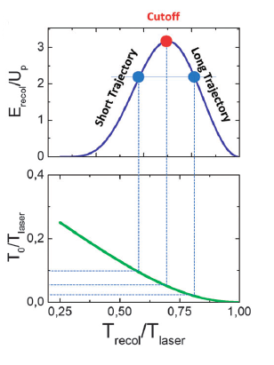
HHG – Three-Step Model
Two emission times for pulses of a given energy
Use a sophisticated filter to get either the short or the long trajectory
Attosecond Pulse Train (APT)
Peak values and delays of harmonics determine pulse shape
Vrakking, Phys. Chem. Chem. Phys. 16, 2775-2789 (2014)
Paul et al., Science 292, 1689-1692 (2001)
Ultrafast Dynamics - Tracking motion on the fs-timescale and below
Notes:
T0 time of ionisation, cutoff for T0 small, return near zero crossing
Short trajectories after cutoff trajectories, long trajectories before
APT 5 harmonics
Teaser: characterisation methods

Slide 13
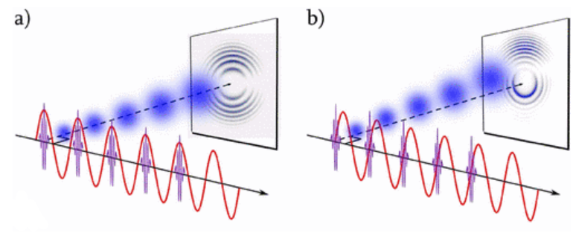
HHG – Motion in Laser Field
2008: Quantum Stroboscope
Ar was ionized using a 300 as XUV pulse
The recollision was driven by a delayed fs IR pulse
Observe clear up/down asymmetry in momentum space
Ultrafast Dynamics - Tracking motion on the fs-timescale and below
All figures from Mauritsson et al., Phys. Rev. Lett. 100, 073003 (2008)
Notes:
Momentum shifts for different delay times in movie, scattering VMI
Weak IR 5 * 10^12 W/cm^2, ca. 3 fs
Only one as pulse per IR cycle -> asymmetry
Achieved using 800 nm Ti:Sapphire lase and second harmonic 400 nm

Slide 14
Imaging – The reaction microscope
Cold Target Recoil Ion Momentum Spectroscopy (COLTRIMS)
Developed in cooperation by Frankfurt and Kansas
Position sensitive detectors and time of flight measurements allow calculation of 3D-momentum vectors
Check out: J. Ullrich et al., Reports on Progress in Physics 66, 1463 (2003)
© R. Doerner (2000), Goethe Universität Frankfurt
Ultrafast Dynamics - Tracking motion on the fs-timescale and below
Notes:
-Explain how COLTRIMS works

Slide 15
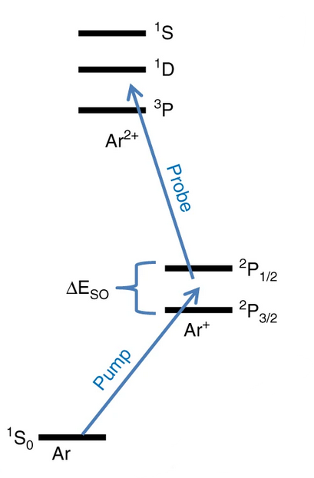
Electronic motion in Ar⁺
Kübel et. al. studied motion of electron-hole wave packets in Ar⁺ cation using a reaction microscope
3p⁻¹ electron-hole oscillating between different m states
Problem: Second photoelectron from pump beam
Kübel et al., Nature Communications 10, 1042 (2019)
https://chemistrycommunity.nature.com/posts/44625-watching-electrons-move-inside-atoms-and-molecules, adapted from Goulielmakis et al., Nature 466, 739-743 (2010)
Ultrafast Dynamics - Tracking motion on the fs-timescale and below
Notes:
Pump -> hole
Probe -> observe multi-electron wavepacket, oscillates at 23.3 fs

Slide 16
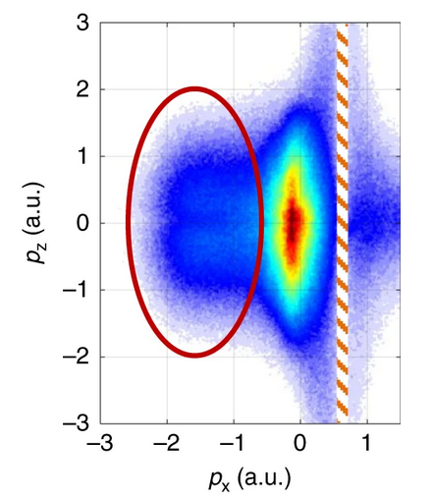
Electronic motion in Ar⁺
Kübel et. al. studied motion of electron-hole wave packets in Ar⁺ cation using a reaction microscope
3p⁻¹ electron-hole oscillating between different m states
Problem: Second photoelectron from pump beam
Deflect probe-beam generated electrons in strong laser field
Kübel et al., Nature Communications 10, 1042 (2019)
https://chemistrycommunity.nature.com/posts/44625-watching-electrons-move-inside-atoms-and-molecules
Ultrafast Dynamics - Tracking motion on the fs-timescale and below
Notes:
5 fs few-cycle pulses for pump/probe @730 nm, strong 6*10^14 W/cm^2
40 fs deflection @2330 nm, weak 3*10^13 W/cm^2

Slide 17
Electronic motion in Ar⁺
All figures from Kübel et al., Nature Communications 10, 1042 (2019)
Ultrafast Dynamics - Tracking motion on the fs-timescale and below
Notes:
Direct imaging
Few fs temporal resolution
Stretching
Autocorrelation function

Slide 18
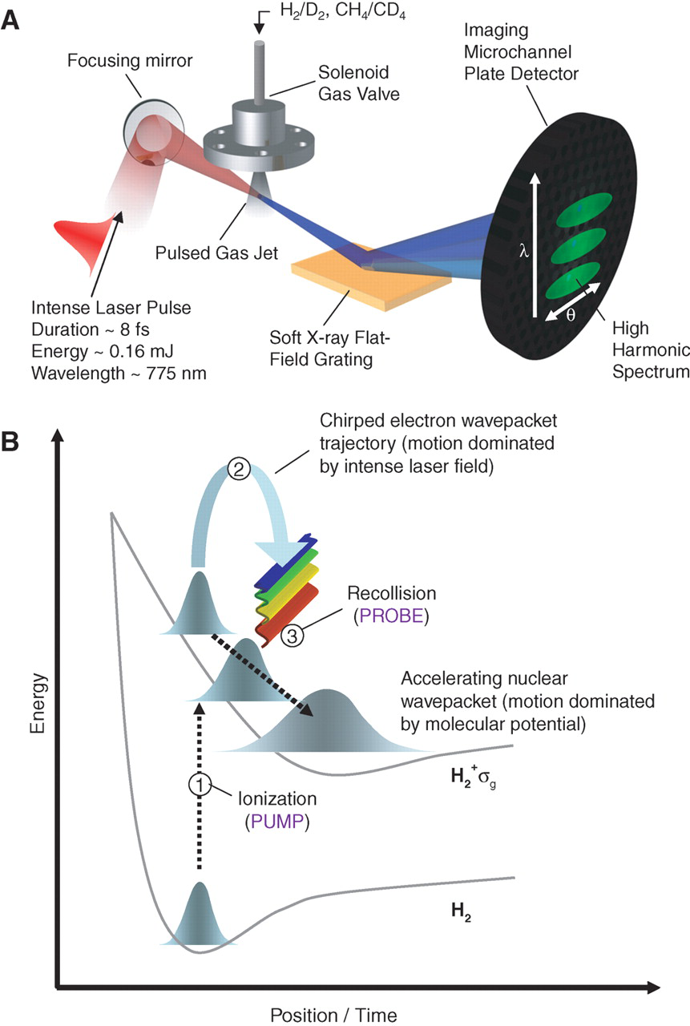
Imaging – Self-probing
Baker et al., Science 312, 424-427 (2006)
Temporal resolution 100 as
Spatial resolution $λ_{dB}≈1 \text{Å}$
Baker et al., Science 312, 424-427 (2006)
Ultrafast Dynamics - Tracking motion on the fs-timescale and below
Notes:
Different idea: Use recollision as „probe“ and analyze HH spectrum
Resolution
HHS dependent on dipole moment

Slide 19
H₂/D₂ dissociation
Vrakking, Phys. Chem. Chem. Phys. 16, 2775-2789 (2014)
Ultrafast Dynamics - Tracking motion on the fs-timescale and below
Notes:
Remember: Short & Long trajectories -> filtering
Reconstruction from autocorrelation function

Slide 20
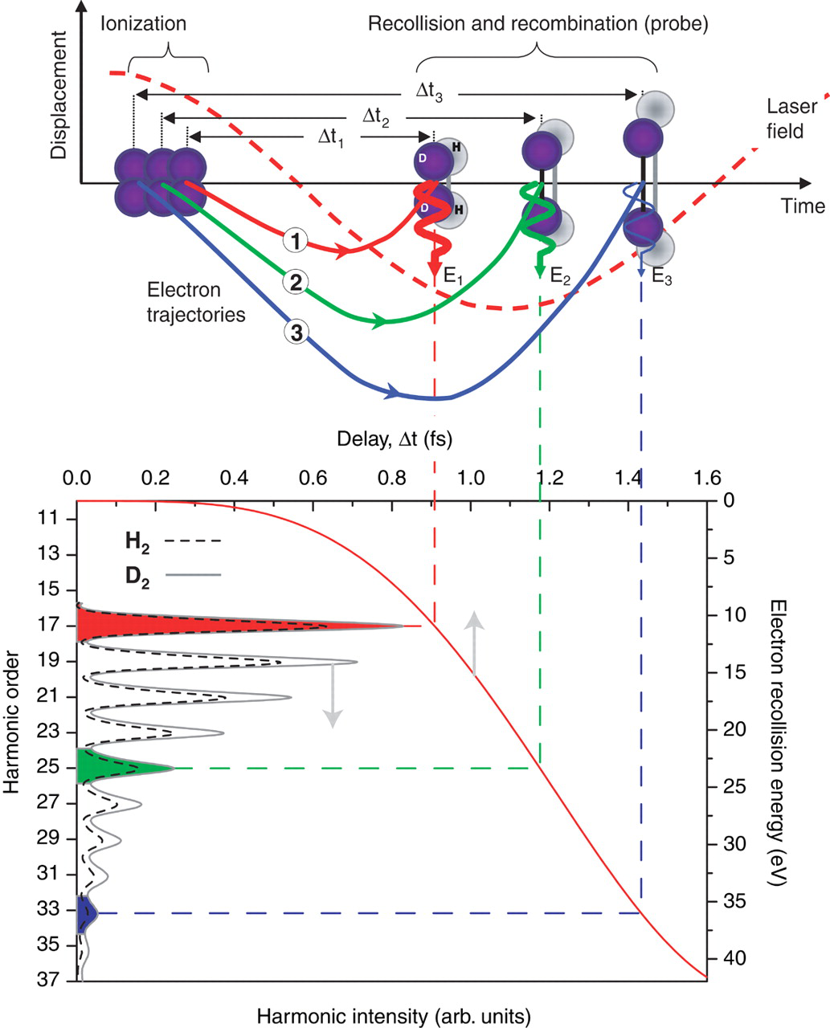
H₂/D₂ dissociation
After filtering there is a one-to-one correspondence of harmonic orders and time delays
The intensity of harmonics in a diatomic molecule is approximately proportional to the squared modulus of the nuclear autocorrelation function
$${\left|c\left(τ\right)\right|}^{2}={\left|\int{\overline{ χ}\left(R,0\right)χ\left(R,τ\right)dR}\right|}^{2}$$
Reconstruction
All figures from Baker et al., Science 312, 424-427 (2006)
Ultrafast Dynamics - Tracking motion on the fs-timescale and below
Notes:
Remember: Short & Long trajectories -> filtering
Reconstruction from autocorrelation function

Slide 21
Question Time I
Do you have any questions?
…?
…?
…?!
Ultrafast Dynamics - Tracking motion on the fs-timescale and below

Slide 22
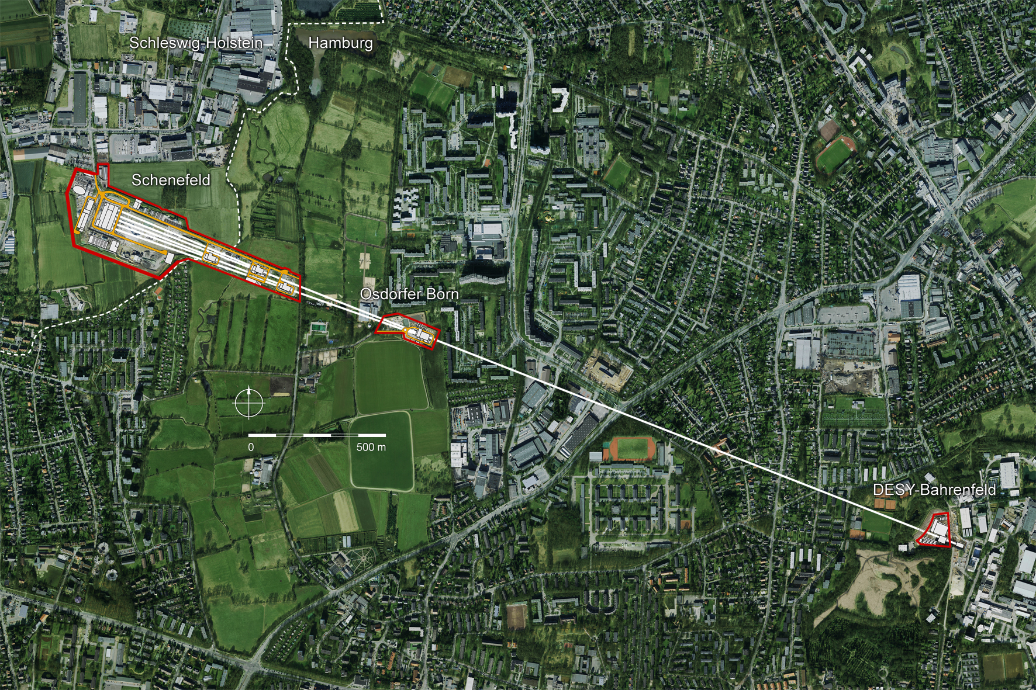
X-ray Free Electron Lasers
https://photon-science.desy.de/facilities/european_xfel/index_eng.html
3.4 km total length
27000 x-ray flashes per second
In operation since 2017
Ullrich et al., Ann. Rev. Phys. Chem. 63, 635 (2012)
Ultrafast Dynamics - Tracking motion on the fs-timescale and below
Notes:
Currently 6 endstations: Material Imaging, High Energy Density, Femtosecond Crystallography, Small Quantum Systems, Spectrsocopy, …
Focus 10^17 W/cm^2

Slide 23
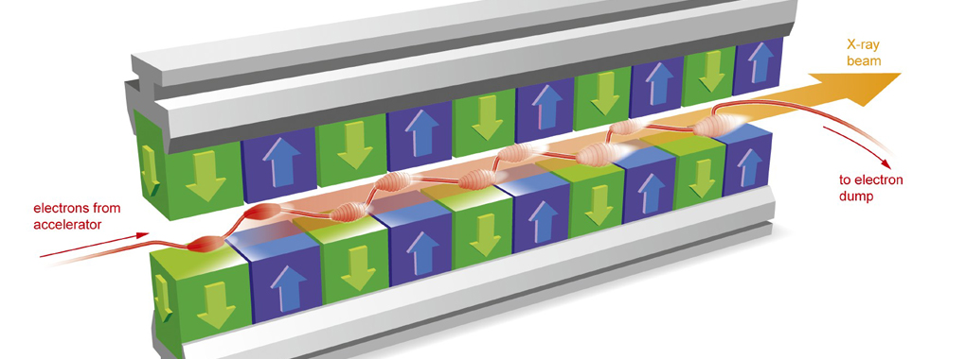
XFEL – Pulse Generation
Movement of electrons in periodic magnetic structure (wiggler, undulator) produces X-ray radiation
But is the light coherent?
© European XFEL
Ultrafast Dynamics - Tracking motion on the fs-timescale and below
Notes:
Undulator has smaller bending radius than wiggler, power spectrum
Undulator length @XFEL > 100 m

Slide 24
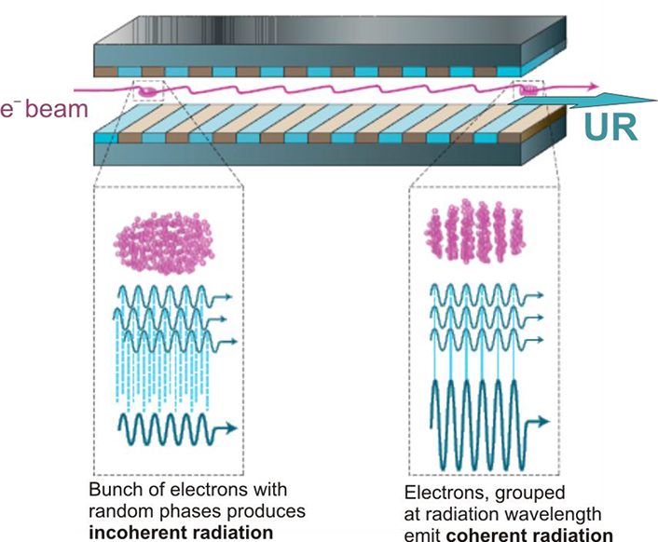
XFEL – Pulse Generation
Movement of electrons in periodic magnetic structure (wiggler, undulator) produces X-ray radiation
But is the light coherent?
Self-amplfied spontaneous emission (SASE):
Interaction with radiation leads to microbunching
This increases radiation intensity
Which in turn enhances microbunching
+ Seeding techniques
Coherent ultrashort X-ray pulses
Zhukovsky, IntechOpen (2016)
Ultrafast Dynamics - Tracking motion on the fs-timescale and below

Slide 25
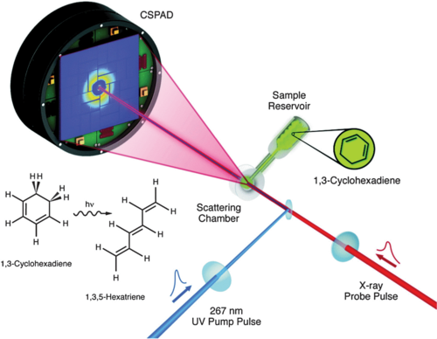
Photochemistry in motion
Photochemical ring opening of 1,3-cyclohexadiene
Minitti et al. 2015: X-ray diffraction
30 fs pulses, 1.5 Å spatial resolution
Wolf et al. 2019: Ultrafast Electron diffraction
160 fs instrument response function, < 1 Å spatial resolution
Ultrafast Dynamics - Tracking motion on the fs-timescale and below
Left figure from Minitti et al., Physical Review Letters 114, 255501 (2015) , right figure from Wolf et al., Nature Chemistry 11, 504-509 (2019)
Notes:
Pump 267 nm laser

Slide 26
Photochemistry in motion
Photochemical ring opening of 1,3-cyclohexadiene
Minitti et al. 2015: X-ray diffraction
30 fs pulses, 1.5 Å spatial resolution
Wolf et al. 2019: Ultrafast Electron diffraction
160 fs instrument response function, < 1 Å spatial resolution
Ultrafast Dynamics - Tracking motion on the fs-timescale and below
Left figure from Minitti et al., Physical Review Letters 114, 255501 (2015) , right figure from Wolf et al., Nature Chemistry 11, 504-509 (2019)
Notes:
Pump 267 nm laser

Slide 27
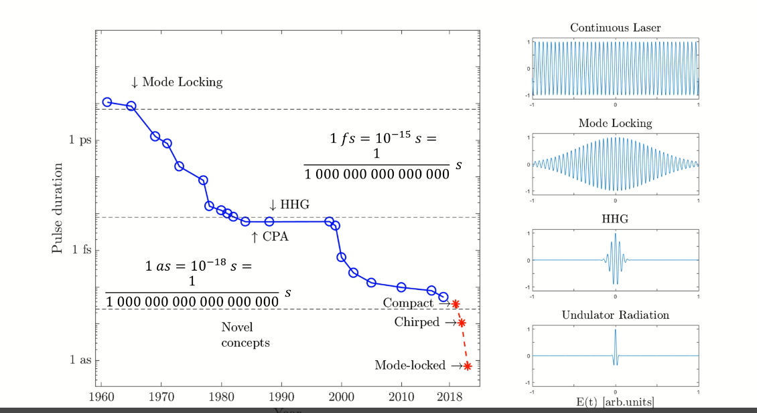
Conclusion and Outlook
Over the decades light pulses have become shorter and brighter
So far however there is a trade-off between temporal and spatial resolution
Current technologies allow us to study among others
Dissociation of molecules
First fs of photochemical processes
Some electronic movement in atoms
New technologies as well as breakthroughs from large scale facilities are on the horizon
In the near future we might resolve more electronic processes, allowing us to understand fundamental chemical reactions and maybe even control them
Mak et al., Reports on Progress in Physics 82, 025901 (2019)
Ultrafast Dynamics - Tracking motion on the fs-timescale and below

Slide 28
Thank you for your attention!
More questions?
…?
…?
…?!
Additional literature
Marc J. J. Vrakking, Attosecond Imaging, Physical Chemistry Chemical Physics 16, 2775-2789 (2014)
Pascal Salières et al., Imaging orbitals with attosecond and Angstrom resolutions: toward attochemistry?, Reports on Progress in Physics 75, 062401 (2012)

