Slide 1
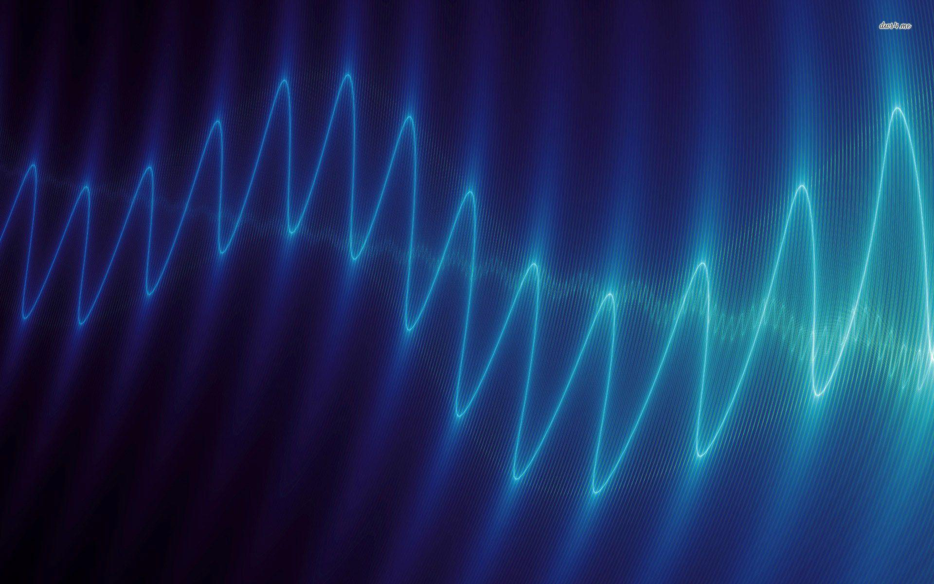
Music and sound from a physicist‘s point of view
A talk by Simon Brauburger

Slide 2
"Music is a hidden practice of the soul, which does not know that it is doing mathematics.“ - Leibniz

Slide 3
Outline
What is sound?
Sound wave equation
Different kinds of sound
Examples:
String
Pipe
Drum
Guitar
Conclusion
Discussion

Slide 4
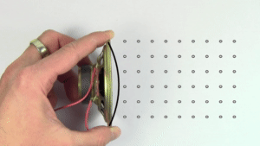
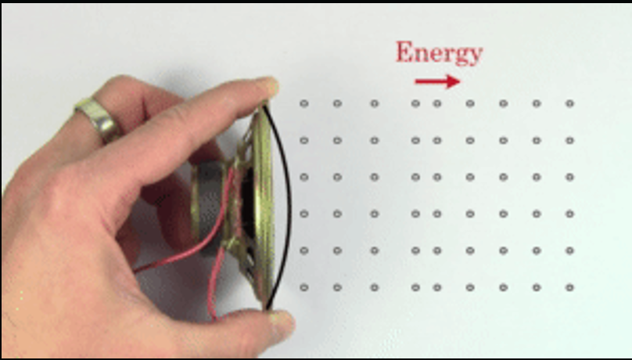
What is sound?
Particles moving into a certain direction
But: ambient air is densely packed, thus particles quickly collide with other ones and transfer their energy (Free path length for N₂ at 1 bar is around 60nm → >10⁵ collisions per cm)
Air at room temperature already moves by itself, but only has little fluctuations around the mean velocity of zero (thermodynamics)

Slide 5
What is sound?

Slide 6
Sound wave equation
The description of sound as a wave seems obvious, but is pretty significant and allows to use all tools available to deal with waves
Sound velocity $c=\sqrt{\frac{γ{ p}_{atm}}{ρ}}≈331 m/s$ (at 0°C, temperature-dependent)
For each medium $c=λ∗f$ constant and not frequency dependent, which makes the life of acousticians a lot easier
adiabatic coefficient $γ=1.4$ (for air), as sound actually is an adiabatic process: for audible frequencies pressure changes too fast for the temperature to adapt
Notes:
Usage of tools: Frequency spectrums, different modes, resistances and impedances known from electric circuits.
Central notion i want to share: It‘s always favorable to seek a wave description because there are so many tools to apply
c is constant, directly links wavelength and frequency
With this knowledge:

Slide 7
Different kinds of sound

Slide 8
Different kinds of sound
Easiest way to characterise sounds is their frequency spectrum
Each musical tone has a fundamental frequency $f_{0}$ more present in the spectrum. We perceive this as the pitch of the tone
What distinguishes tones of the same pitch from each other?
→ Different amplitudes of overtones, integer multiples of fundamental frequency: $n∗f_{0}$ (also called harmonics)
Notes:
Show flutes where we only have odd overtones?

Slide 9
Overtone examples: String

Slide 10
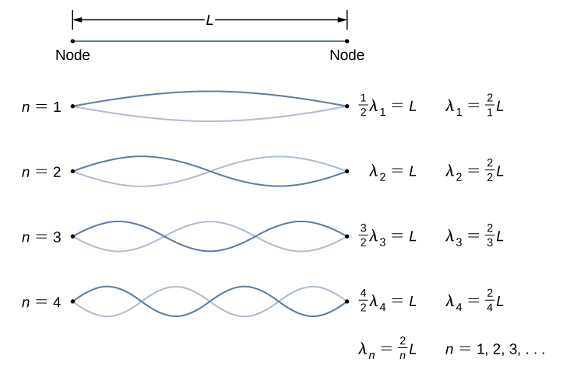
Overtone examples: String
Propagation velocity $c=\sqrt{\frac{T}{μ}}$
T: tension force
µ: linear mass density
Fixing at 0 and L implies $λ_{n}=\frac{2L}{n}$ → $f_{n}=\frac{c}{λ}=\frac{n}{2L}⋅\sqrt{\frac{T}{μ}}$
Thicker strings = lower frequency
Shortening string by playing increases frequency

Slide 11
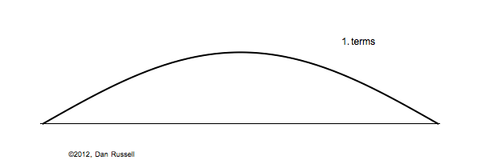
Overtone examples: String
Plucking string with pick or finger displaces string in triangular shape
Fourier decomposition of shape yields coefficients of respective harmonic, which then make up the frequency spectrum

Slide 12
Overtone examples: String

Slide 13
Overtone examples: String

Slide 14
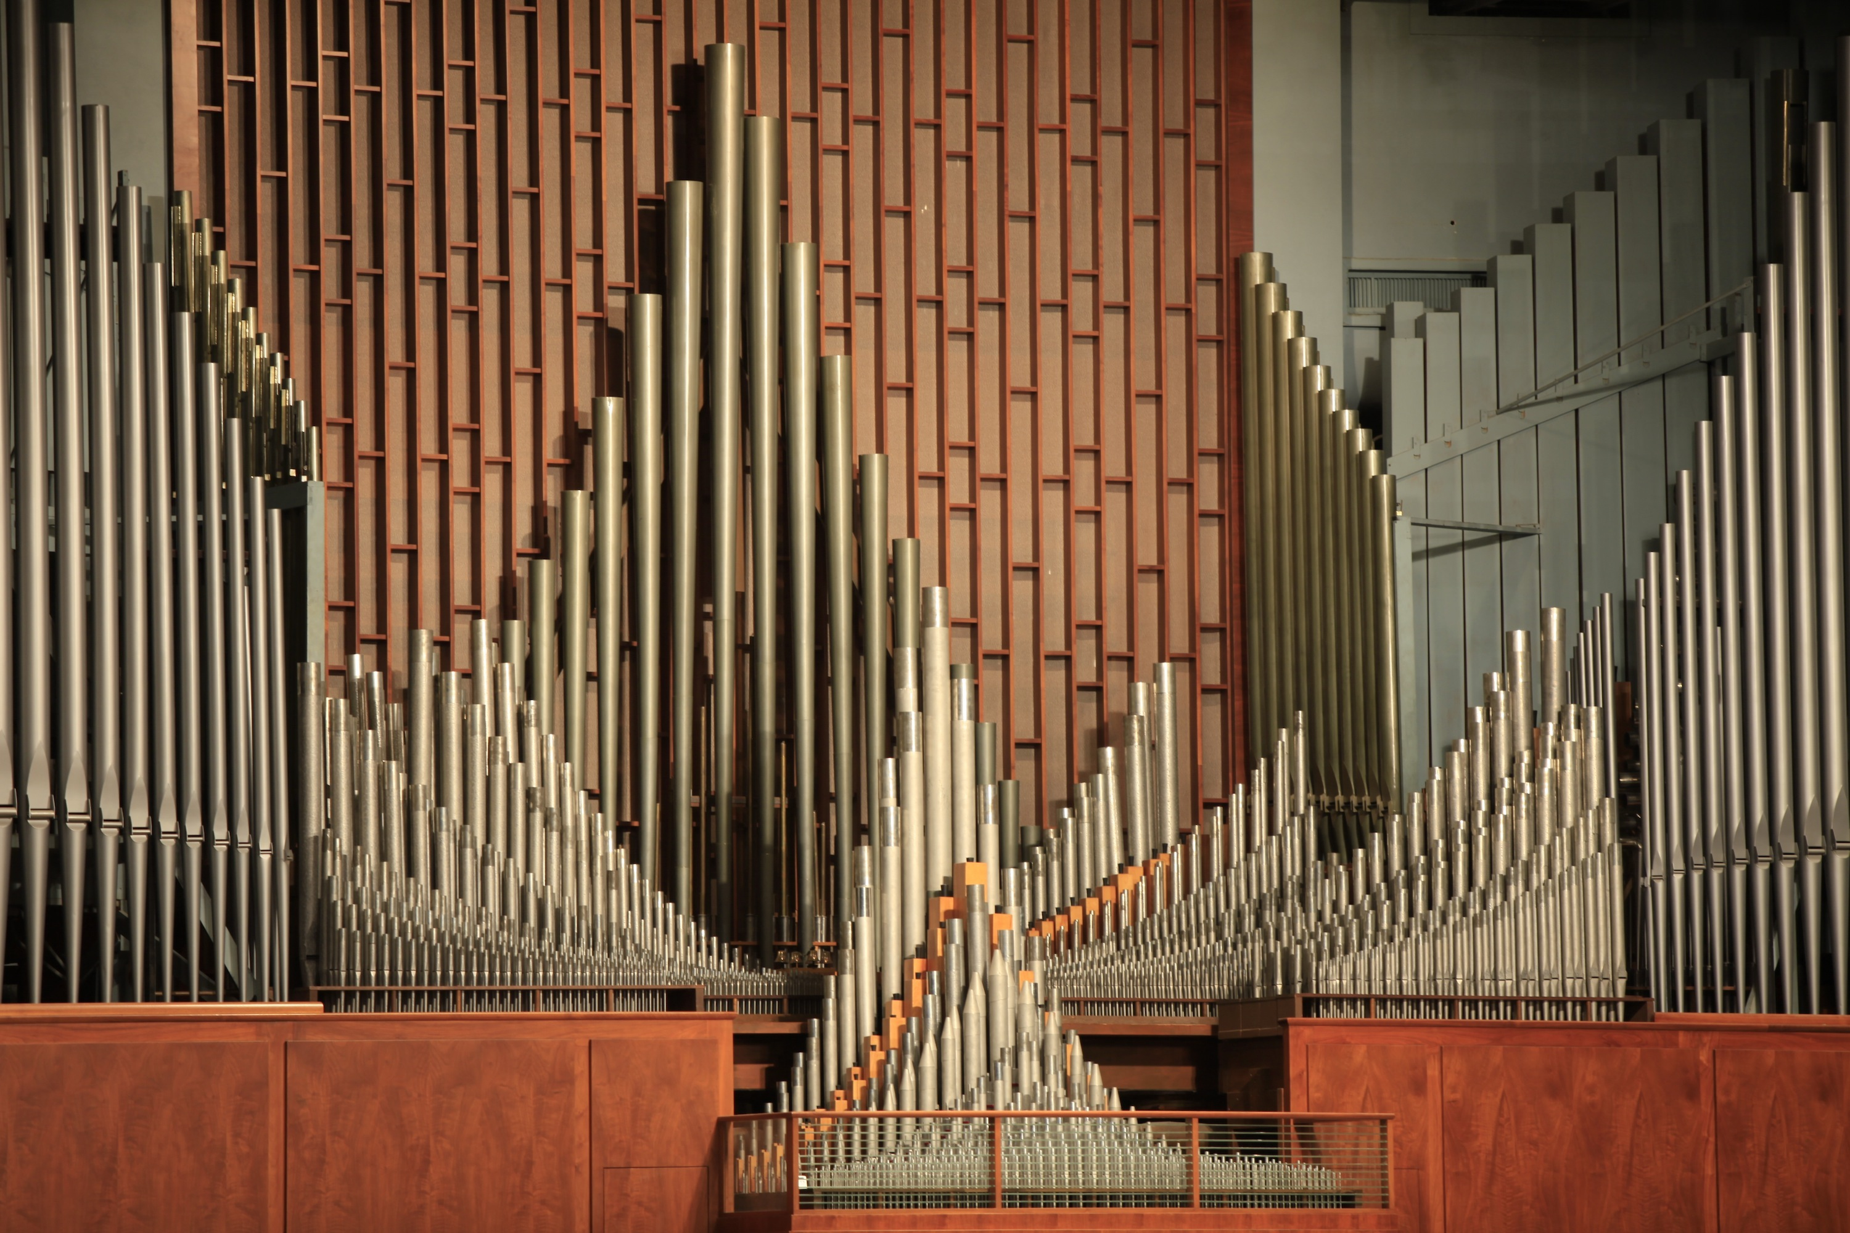
Overtone Examples: Pipes

Slide 15
Overtone Examples: Pipes
Resonance occurs when air is free to vibrate (constant waveform), stronger attenuation if it is not
Condititions:
Pressure zero at open ends
No movement at closed ends → pressure maximum/minimum
Resonance frequencies:
f_{open} = $\frac{c_{sound}}{2L}∗n$
f_{semi-open} = $\frac{c_{sound}}{2L}∗(n−\frac{1}{2})$
Even harmonics are absent

Slide 16
Overtone Examples: Flute (Open pipe)
Opening holes (white circles) of the flute forces pressure nodes and changes the allowed modes and the pitch of f₀:

Slide 17
Overtone Examples: Drum modes

Slide 18
Overtone Examples: Guitar modes

Slide 19
Frequency dependent sensitivity of human hearing

Slide 20
Conclusion
Sound consists of really tiny pressure and velocity fluctuations, leading to the description as a wave with constant velocity
Different musical sounds are distinguished by their frequency spectrum
This spectrum is a result of:
Different drivings/excitations (plucking, blowing...)
Resonances in different parts of the instrument (pipe, body, bridge,...)
The physics of sound is a really underrated approach of understanding wave mechanics (personal opinion)

Slide 21
Sources
Text Books
The Physics of Musical Instruments (2nd ed), Fletcher/Rossing, Springer 1998
Acoustics (3rd ed), Pierce, Springer 2019
Websites
https://www.acs.psu.edu/drussell/demos.html (highly recommended)
https://newt.phys.unsw.edu.au/jw/basics.html (also highly recommended, both websites have lots of very insightful animations)
Pictures
Beginning slide: http://wallpapercave.com/sound-wave-wallpaper
Organ Pipes: https://bagend.com/products/application/pipe-organ-supplemental-low-frequency-systems/
Pipe modes: https://newt.phys.unsw.edu.au/jw/flutes.v.clarinets.html
Question mark sign: https://www.oakemanor.com/events/music-bingo/question-mark-collage-of-music-notes-icons/
Guitar body modes, circuit analogy: Book by Fletcher (see above), page 251+254
Schlieren Photography: https://www.youtube.com/watch?v=px3oVGXr4mo
Videos/Gifs
Moving speaker: https://www.youtube.com/watch?v=nGKffdaI4Pg
Falling book: https://www.youtube.com/watch?v=px3oVGXr4mo
Wave propagation: https://www.youtube.com/watch?v=1PsGZq5sLrw
Plucking guitar string: https://www.youtube.com/watch?v=LNNQvG0jWtw
Drum modes: https://mglerner.github.io/posts/drum-head-normal-modes-with-movies.html
Cat song: https://www.youtube.com/watch?v=BHup81lEjqo
All other Gifs: https://www.acs.psu.edu/drussell/demos.html
All Websites accessed in between 13th and 20th December 2020

Slide 22
Time for Questions

Slide 23
Backup #1: Alternative description with Circuits

Slide 24
Backup #2: Stick-Slip motion of Violin
https://newt.phys.unsw.edu.au/jw/Bows.html

Slide 25
Backup #3: Schlieren Photography

Slide 26
Backup #4: Linear Acoustic Equations:

Slide 27
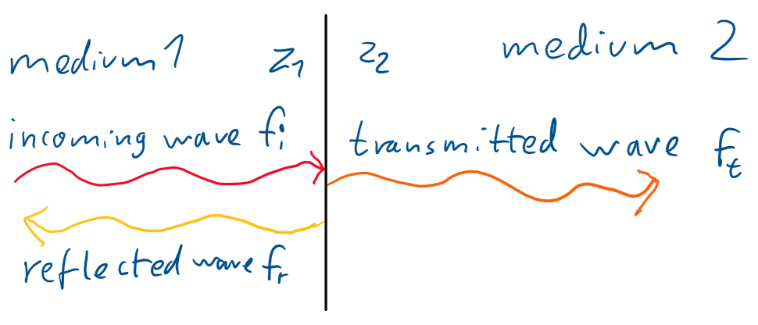
Transmission of sound
To understand transmission, we need the definition of Impedance: $z=\frac{p}{v}=ρ∗c$
„How much pressure difference is needed for a certain velocity“
Similar to electrodynamic impedance $R=\frac{U}{I}$
In 1D-case only material dependent
We consider the 1D-case here: wave traveling in one medium (with impedance z₁) and then entering a second medium (with impedance z₂)
Conditions at interface:
Continuity of pressure: $p_{i}+p_{r}=p_{t}$
Continuity of velocity: $v_{i}−v_{r}=v_{t}$ ↔ $\frac{p_{i}}{z_{1}}−\frac{p_{r}}{z_{1}}=\frac{p_{t}}{z_{2}}$

Slide 28
Transmission of sound
Percentage of transmitted intensity: $\frac{I_{t}}{I_{0}}=\frac{p_{t}v_{t}}{p_{i}v_{i}}=\frac{4z_{2}z_{1}}{{\left(z_{2}+z_{1}\right)}^{2}}$
The smaller the difference between impedances, the more transmission
Propagation in free space: 100% transmission
Reflection at a wall
Example: z₂=100 z₁ →$\frac{4z_{2}z_{1}}{{\left(z_{2}+z_{1}\right)}^{2}}=\frac{400}{{101}^{2}} ≈4\%$
„Impedance bridging“ can be used: inserting medium with impedance z₁₂ in between increases transmission
Example: z₁₂=10 z₁ → $\frac{4z_{1}z_{12}}{{\left(z_{1}+z_{12}\right)}^{2}}∗\frac{4z_{2}z_{12}}{{\left(z_{2}+z_{12}\right)}^{2}}=4∗\frac{10}{{11}^{2}}∗4∗\frac{1000}{{110}^{2}}≈16∗\frac{1}{{12}^{2}}≈11 \%$
instrument bodies decreasing impedance mismatch between oscillating parts and air
In 3D much more complicated, frequency dependent, antiproportional to surface A
Examples: Horns, cell phone on table, guitar

Slide 29
Cat song

Slide 32
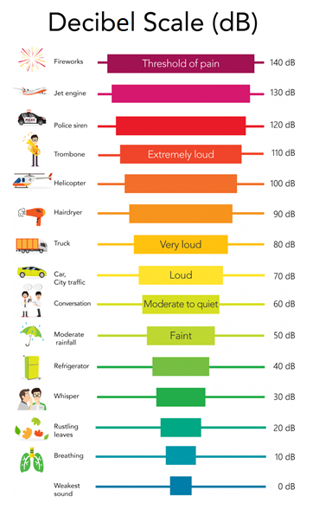
Pressure and decibels
reference value hearing treshold at p₀=10⁻⁵ pa
→ $\frac{p_{0}}{p_{atm}}={10}^{−10}$
→ linear approximation possible
Decibel scale is used to describe pressure difference magnitude
Hearing treshold is at 0 dB
20 dB is a difference of one order of magnitude
Brownian motion is around -23 dB, so only one magnitude below treshold!

