Slide 1
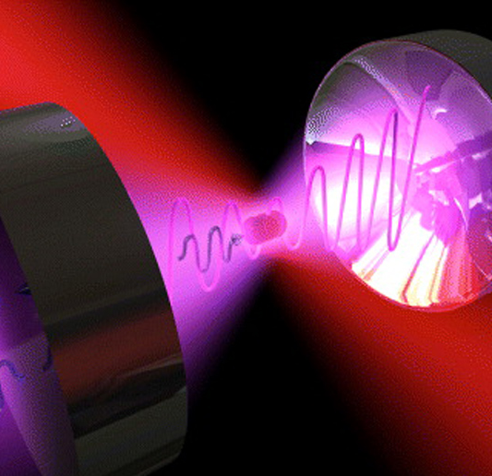
Optical tweezers in biophysical context
Seminar 21.12.21
Johanna Buck

Slide 2
Red blood cell moved by an optical tweezer

Slide 3
Red blood cell stretched by an optical tweezer

Slide 4
Laser
Spatially coherent
Temporally coherent
+
+
+
+
+
+

Slide 5
Laser
+
-

Slide 6
Laser
+
-

Slide 7
Laser
+
-

Slide 8
Laser
+
-

Slide 9
Laser
+
-

Slide 10
The Gaussian beam
$$Z_{r}=Rayleigh length$$
$$w_{0}=beam waist$$

Slide 11
Radiation pressure
Force on matter due to EM-wave
$$F_{mech}=q\left[E\left(r,t\right)+v\left(r,t\right) × B\left(r,t\right)\right]$$
Radiation pressure:
$P=\frac{I_{0}}{c} [ 1+ \left|R\right|$ ]
$$q=charge of single particle$$
$$v=velocity$$
$$R=reflection coefficient$$
$$I_{o}=Intensity$$

Slide 12
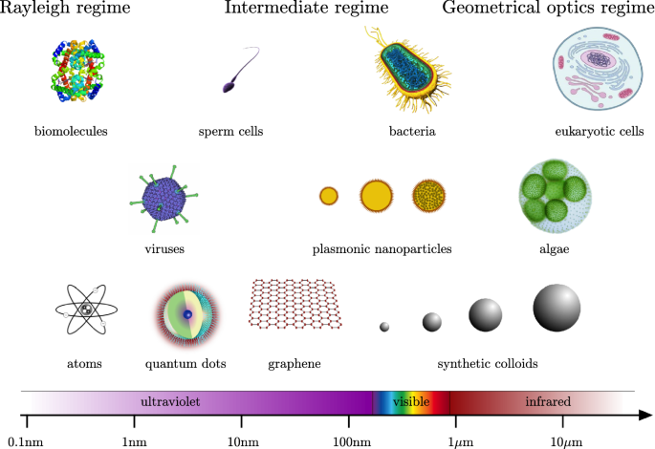
Radiation pressure in different regimes
Ray Optics Regime D>>λ
Rayleigh scattering D<<λ
Mie-Theory: D$≈$λ

Slide 13
Ray Optics Regime (D>>λ)
p_{B0}
B_{r1}
p_{B1}
∆p
B₀
p_{Br1}
B₁
p_{B1}
B_{r2}
B₂
n2
p_{B2}
n1
∆p
particle
p_{Br2}
Refraction indices:
$$n_{1}<n_{2}$$

Slide 14
Ray Optics Regime (D>>λ)
p_{B0}
F
∆p
B_{r1}
p_{B1}
B₀
p_{Br1}
B₁
F
p_{B1}
B_{r2}
B₂
n2
p_{B2}
n1
∆p
particle
p_{Br2}
Refraction indices:
$$n_{1}<n_{2}$$

Slide 15
Ray Optics Regime (D>>λ)

Slide 16
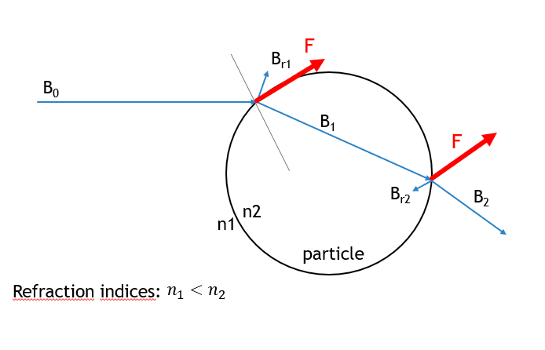
Why is this an optical trap?

Slide 17
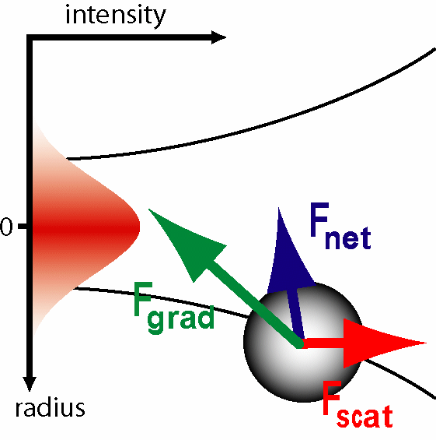
Rayleigh scattering (D << λ)
$F=α (\frac{1}{2} ∇E^{2}+\frac{d}{dt}(E x B$) )
$F_{grad}$ $F_{scat}$

Slide 18
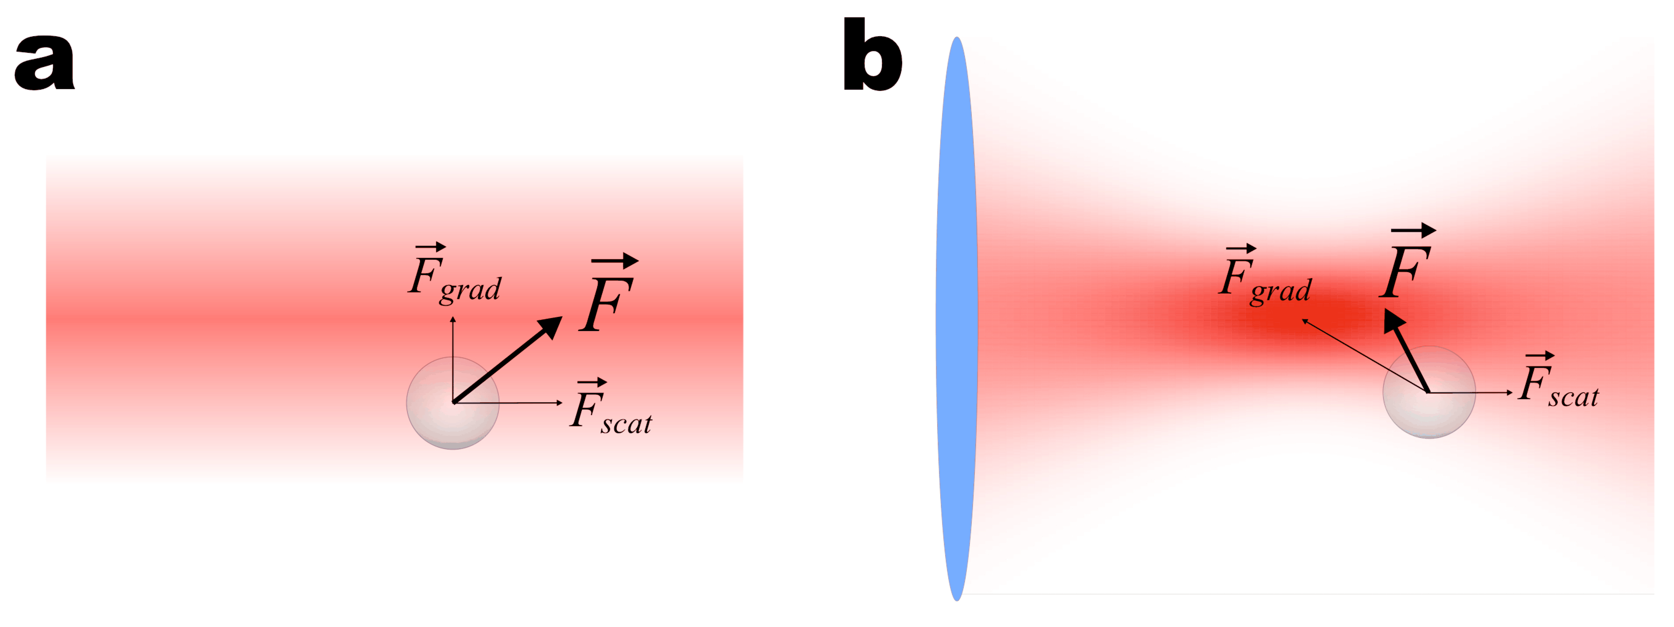
Rayleigh scattering (D << λ)

Slide 19
Mie Theory D $≈$λ
Solution with Lorentz-Mie Theory
Differences:
Laser beam is a vector field, no scalar description possible
Dielectric particle interacts with laser beam -> provokes another EM-field
Electromagnetic field no longer isotropic

Slide 20
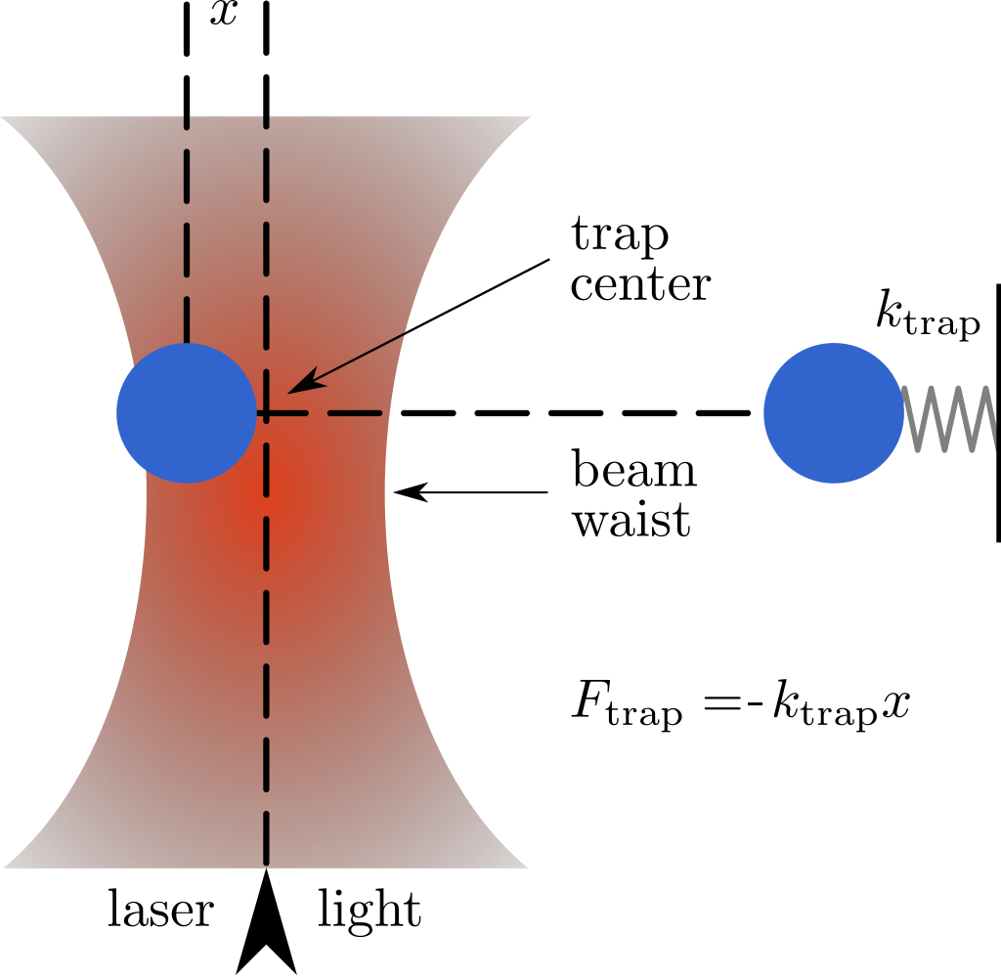
Measurement of forces

Slide 21
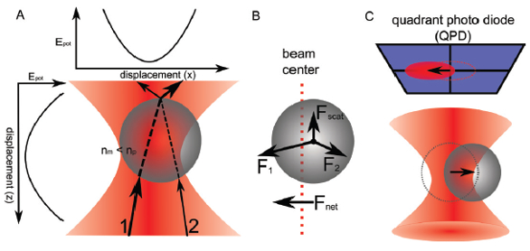
Biological application
Dynamic technique
In vivo possible but challenging
Diversity of particles
Many weak forces

Slide 23
Force of the motor protein kinesin
kinesin
filament

Slide 24
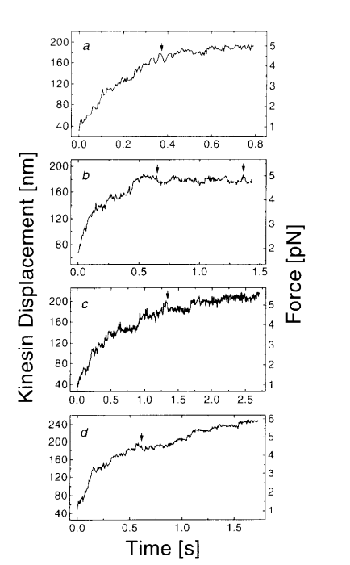
‘The value of 63 mW for the force of one motor translates into 2.6 x 10⁻⁷ dynes for the force generated by a single motor molecule’
1dyne = 10⁻⁵ N
K. Svoboda, S.M. Block Force and velocity measured for single kinesin molecules
Cell, 77 (1994), pp. 773-784
Ashkin, A et al. Force generation of organelle transport measured in vivo by an infrared laser trap. Nature 348, 346–348 (1990).

Slide 25
Mark J. Schnitzer & Steven M. Block, 1997. Kinesin hydrolyses one ATP per 8-nm step,Nature, vol. 388(6640), pages 386-390, July. <https://ideas.repec.org/a/nat/nature/v388y1997i6640d10.1038_41111.html>

Slide 26
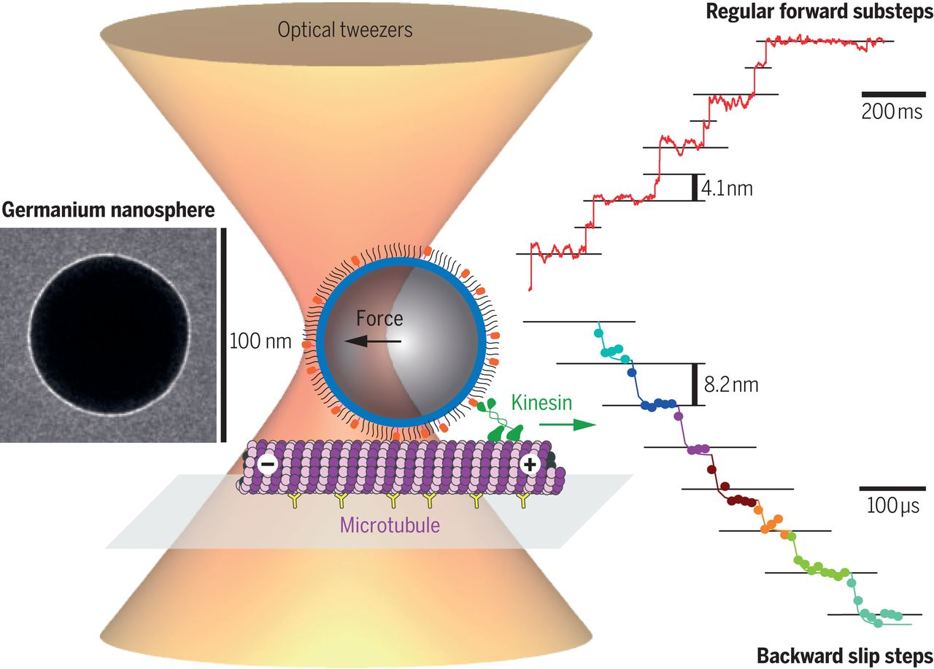
Swathi Sudhakar et al.: Germanium nanospheres for ultraresolution picotensiometry of kinesin motors, 2021.

Slide 27
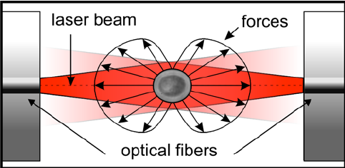
Optical stretcher

Slide 28
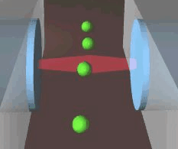
Video optical stretcher animation

Slide 29
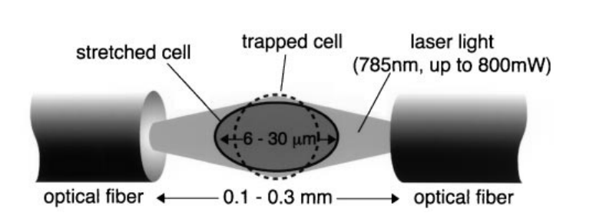
Stress by optical stretcher
p momentum of ray
A area
t time
n refraction index
c speed of light
a direction
P light power
a unit vector
T transmission coefficient
R reflection coefficient

Slide 30
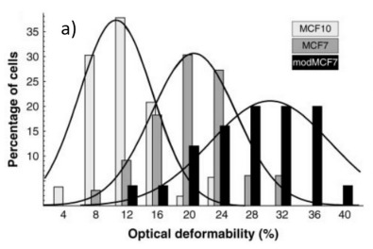
Optical stretching of a single MCF7 cell.
Optical deformability as an inherent cell marker for testing malignant transformation and metastatic competence.Guck J et al. Biophys J. 2005 May; 88(5):3689-98.
Optical deformability of normal, cancerous, and metastatic breast epithelial cells.

Slide 31
Conclusion
Radiation Pressure
Ray Optics Regime D>>λ
Rayleigh scattering D << λ
Mie-Theory: D $≈$λ
Force and stepsize measurement of the motor protein kinesin
Optical stretcher allows to distinguish cells

Slide 32
Questions?

Slide 33
References
A. Ashkin, Acceleration and trapping of particles by radiation pressure, Physical Review letter 24 (1970), available https://journals.aps.org/prl/pdf/10.1103/PhysRevLett.24.156, Access on 12.12.2021
A. Ashkin. The Pressure of Laser Light, Scientific American 226, pp. 62-71 (1972)
Arthur Ashkin, Bell Laboratories, emeritus. The 2018 Nobel Lecture in Physics: Optical Tweezers, Available: https://www.youtube.com/watch?v=vb58pd2ycKQ, Access on 12.12.2021
Ashkin, A., Schütze, K., Dziedzic, J. et al. Force generation of organelle transport measured in vivo by an infrared laser trap. Nature 348, 346–348 (1990). https://doi.org/10.1038/348346a0
Boisseau, P. (Hrsg.). Nanoscience: nanobiotechnology and nanobiology. Heidelberg [u.a.]. Springer (2010) — ISBN 978-3-540-88632-7
Bustamante, C.J., Chemla, Y.R., Liu, S. et al. Optical tweezers in single-molecule biophysics. Nat Rev Methods Primers 1, 25 (2021). https://doi.org/10.1038/s43586-021-00021-6
Carlos J. Bustamante,Yann R. Chemla,Shixin Liu,Michelle D. Wang, Optical tweezers in single-molecule biophysics, Nature Reviews Methods Primers (2021). https://doi.org/10.1038/s43586-021-00021-6
Guck J., Ananthakrishnan R., Mahmood H., Moon T.J., Cunningham C.C., Käs J. The optical stretcher: A novel laser tool to micromanipulate cells. Biophys. J. (2001); 81:767–784. doi: 10.1016/S0006-3495(01)75740
JM Huguet, Physics of optical trapping, (2014) Available: http://www.tesi.mintrada.com/node55.html, Access on 12.12.2021

Slide 34
Yang T, Bragheri F, Minzioni P. A Comprehensive Review of Optical Stretcher for Cell Mechanical Characterization at Single-Cell Level. Micromachines, Basel (2016) ;7(5):90. doi:10.3390/mi7050090
K. Svoboda, S.M. Block, Force and velocity measured for single kinesin molecules, Cell, 77 (1994), pp. 773-784
Mark J. Schnitzer, Steven M. Block et al. Kinesin hydrolyses one ATP per 8-nm step, letters to nature vol 388 (1997)
Noy, A. (Hrsg.). Handbook of molecular force spectroscopy. New York, NY : Springer (2008) — ISBN 0-387-49987-3
Optical society, OSA, (2013). Available: https://www.osa.org/en-us/history/biographies/bios/arthur-ashkin/. Access on 12.12.2021
R. Nave, Quantum properties of light, Available: http://hyperphysics.phy-astr.gsu.edu/hbase/optmod/qualig.html. Access on 12.12.2021
Steve Wasserman and Steven Nagel. An Introduction to Optical Trapping, Available: https://www.youtube.com/watch?v=13VXGX2yR3k, Access on 12.12.2021
Swathi Sudhakar, Mohammad Kazem Abdosamadi, Tobias Jörg Jachowski, Michael Bugiel, Anita Jannasch, Erik Schäffer, Germanium nanospheres for ultraresolution picotensiometry of kinesin motors, Science 371, eabd994 (2021). doi: 10.1126/science.abd9944
The Nobel Committee for Physics 2018. Groundbreaking Invention in Laser Physics optical Tweezers and Generation of High-Intensity, Ultrashort Optical Pulses, (Scientific Background on the Nobel Prize in Physics 2018), Available: https://www.nobelprize.org/uploads/2018/10/advanced-physicsprize2018.pdf, Access on 12.12.2021
University of Florida, Department of Physics PHY4803L Advanced Physics Laboratory, Optical Tweezers, 2020, https://www.phys.ufl.edu/courses/phy4803L/group_IV/optical_tweezers/OT.pdf, Access on 19.12.2021
University of Leipzig. Introduction to Optical Stretcher, Available: https://home.uni-leipzig.de/pwm/web/index.php?section=introduction&page=opticalstretcher, Access on 12.12.2021
University of Leipzig. Introduction to Optical Traps, Available: https://home.uni-leipzig.de/pwm/web/?section=introduction&page=opticaltraps, Access on 12.12.2021

Slide 35
Sources of images
Titlepage: optical-tweezers_1.jpg (660×528) (labcritics.com), Access on 12.12.2021
Page 2: Red blood cell transportation, https://youtu.be/6XcVddSbBxc, Access on 12.12.2021
Page 3: Red blood cell deformation, https://youtu.be/6-fPaGbBQLU, Access on 12.12.2021
Page 10: Gaussian laser beam https://www.youtube.com/watch?v=MU4eOJw2sBQ, Access on 12.12.2021
Page 10: https://www.researchgate.net/profile/Fusong-Yuan/publication/301732677/figure/fig3/AS:362418841636865@1463418793046/Mathematic-model-of-the-Gaussian-laser-beam-distribution-used-in-the-development-of-the.png, , Access on 12.12.2021
Page 12: https://media.springernature.com/full/springer-static/image/art%3A10.1140%2Fepjp%2Fs13360-020-00843-5/MediaObjects/13360_2020_843_Fig1_HTML.png?as=webp, Access on 19.12.2021
Page 15,16,17,18: JM Huguet, Physics of optical trapping, 2014, http://www.tesi.mintrada.com/node55.html, Access on 12.12.2021
Page 21: http://media.americanlaboratory.com/m/20/article/180081-fig1.jpg, Access on 12.12.2021
Page 22: Kinesin walking on a Microtubule, https://www.youtube.com/watch?v=y-uuk4Pr2i8, Access on 12.12.2021
Page 23: Animation of optical trapping nanometry of kinesin https://www.youtube.com/watch?v=worQXekfT4k, Access on 12.12.2021
Page 24: Ashkin, A et al. Force generation of organelle transport measured in vivo by an infrared laser trap. Nature 348, 346–348 (1990).
Page 24: K. Svoboda, S.M. Block Force and velocity measured for single kinesin molecules Cell, 77 (1994), pp. 773-784
Page 25: Mark J. Schnitzer & Steven M. Block, 1997. Kinesin hydrolyses one ATP per 8-nm step, Nature, vol. 388(6640), pages 386-390, July. <https://ideas.repec.org/a/nat/nature/v388y1997i6640d10.1038_41111.html>
Page 26: Swathi Sudhakar, Mohammad Kazem Abdosamadi, Tobias Jörg Jachowski, Michael Bugiel, Anita Jannasch, Erik Schäffer, Germanium nanospheres for ultraresolution picotensiometry of kinesin motors, 2021. doi: https://doi.org/10.1101/2020.06.18.159640;
Page 27: Yang T, Bragheri F, Minzioni P. A Comprehensive Review of Optical Stretcher for Cell Mechanical Characterization at Single-Cell Level. Micromachines (Basel). 2016;7(5):90. 2016. doi:10.3390/mi7050090
Page 28: https://home.uni-leipzig.de/pwm/web/index.php?section=introduction&page=opticalstretcher, Access on 12.12.2021
Page 29: J. Guck, R. Ananthakrishnan, H. Mahmood, T. J. Moon, C. C. Cunningham, J. Käs: The Optical Stretcher: A Novel Laser Tool to Micromanipulate Cells, Biophys. J. 81(2):767-784 (2001)
Page 30: Optical deformability as an inherent cell marker for testing malignant transformation and metastatic competence.Guck J et al. Biophys J. 2005 May; 88(5):3689-98.
Page 35: An Introduction to Optical Trapping, https://www.youtube.com/watch?v=13VXGX2yR3k, Access on 12.12.2021
Page 36: Bustamante, C.J., Chemla, Y.R., Liu, S. et al. Optical tweezers in single-molecule biophysics. Nat Rev Methods Primers 1, 25 (2021). https://doi.org/10.1038/s43586-021-00021-6
Page 38_ H. Y. R. L. J. G. S. M. B. Michelle D.Wang, „Stretching DNA with Optical Tweezers,“ Biophysical Journal 72, 03 1997

Slide 36
Approximate tweezer with Hooke´s law
$$α=\frac{k_{b}T}{<x^{2}>}$$
from equipartition theorem and Hooke‘s law
More precise: Also consider viscous damping force

Slide 38
Base-pair-stepping of RNA-Polymerase
D
N
A
handle
RNA-Polymerase
R
N
A
Notes:
Hallo hallo

Slide 39
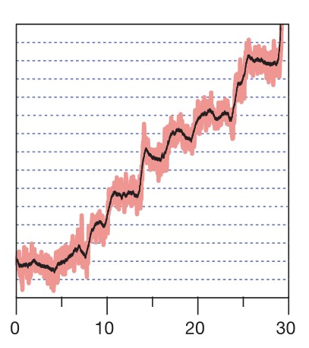
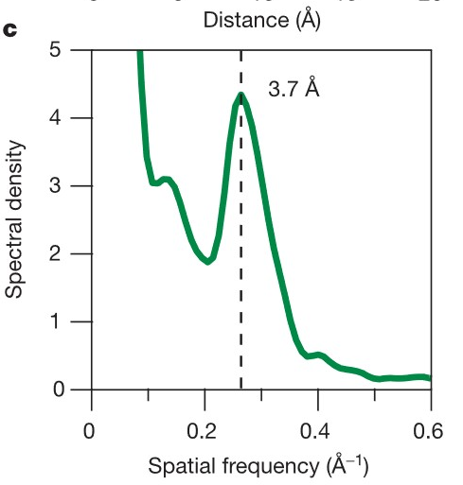
Result of stepping experiment
Distance between base-pairs: (3,4 +- 0,5) Å
Distance (lines are at 3,4 Å intervals)
Time [s]
Result of stepping experiment
Result of stepping experiment 2

Slide 41
a) Ray Optics Regime (D>>λ)
b) Rayleigh Optics Regime (D>>λ)

