Slide 1
Molecular Dynamics Simulations
“Everything that living things do can be understood in terms of the jiggling and wiggling of atoms.”
-Richard Feynman (1963)
Fabian Egersdörfer, 14.12.21

Slide 2
Why bother ?
?
Simulation
Theory
fundamental
microscopic
QM: wavefunctions, electrons, protons,…
Human experience
complex
macroscopic
classical physics: molecules, chemical complexes
Nature
scientific
method
Reduce/
„civilize“
Experiment
controlled
small-scale

Slide 3
Starting at the QM-level
-
-
-
+
+
+
+
$H$-atom
+ $H$-atom
- e
= $H_{2}^{+}$ -molecule
Born-Oppenheimer approximation:
E
R

Slide 4
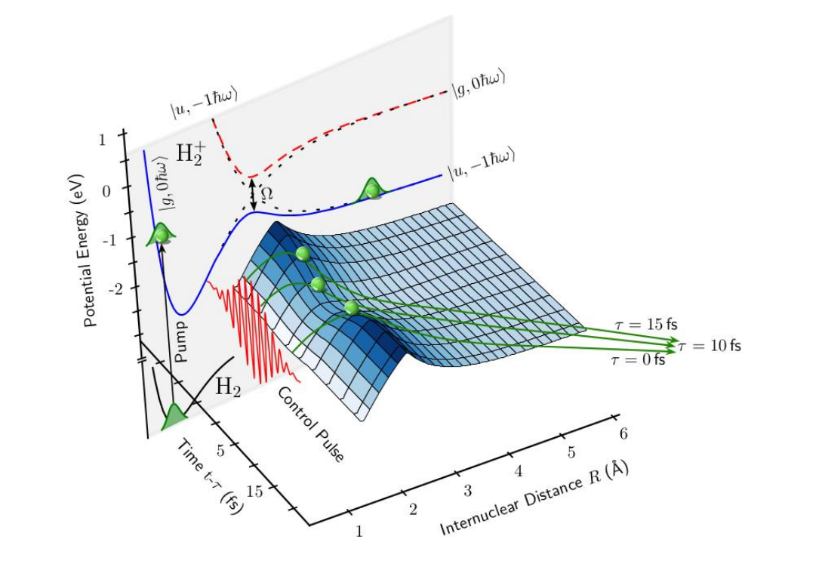
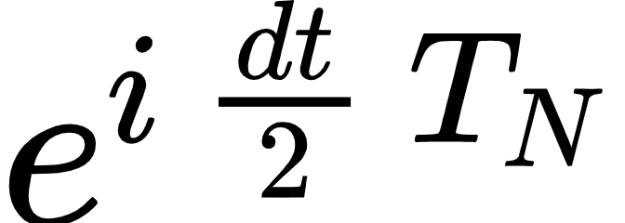
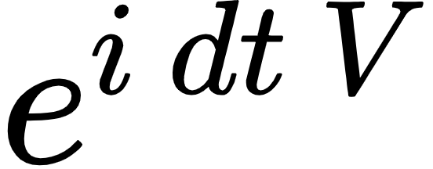
Example: Laser-induced $H_{2}^{+}$-dissociation
FFT
apply
inv. FFT
apply
FFT
Fischer et al. 2014
apply

Slide 5
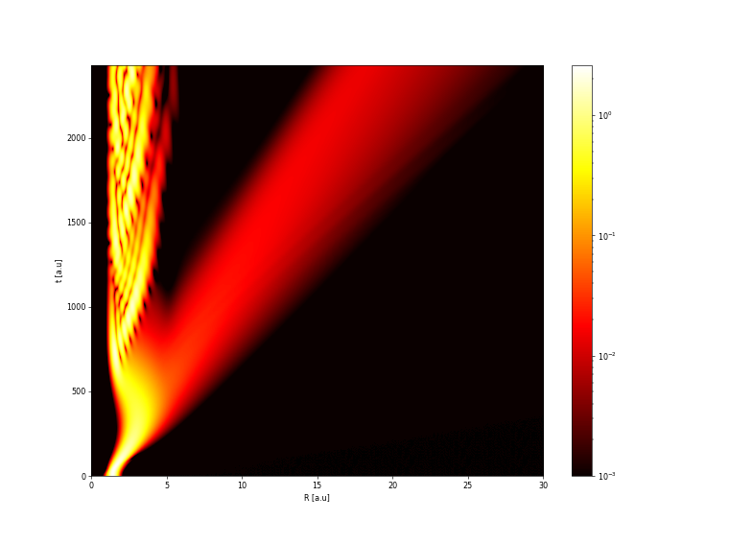
Example: Laser-induced $H_{2}^{+}$-dissociation

Slide 6
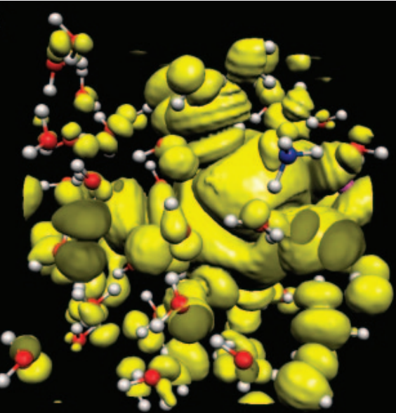
Can we save some QM? – ab initio Molecular Dynamics
Semiclassical approach:
Iftimie et al. (2010)
Classical approach:
Density Functional Theory
(BOMD)
mature method
professional Software Libraries available
up to $N= {10}^{2}$ atoms
?
Recently:
Machine Learning approaches
(Deep Potential, GANs, DeepMind 21)
mostly in experimental stage
2020: proposed implementation for up to $N= {10}^{8}$atoms
not for now !

Slide 7
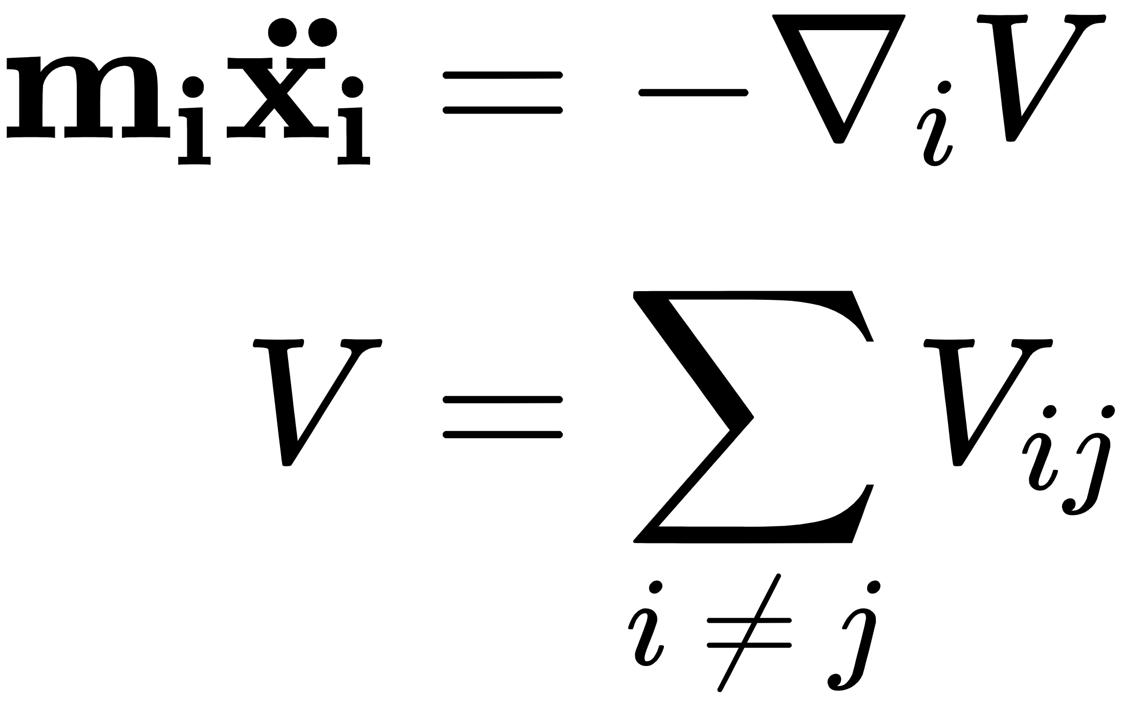
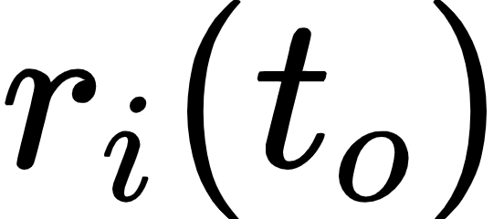
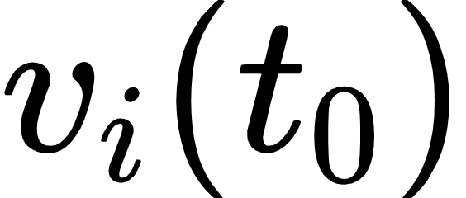
Let it go - MD Simulations
Initialization
Time step
Crucial Design Choices
naive:
much better:
Don’t do this!
Symplectic integrator respects conservation laws

Slide 8
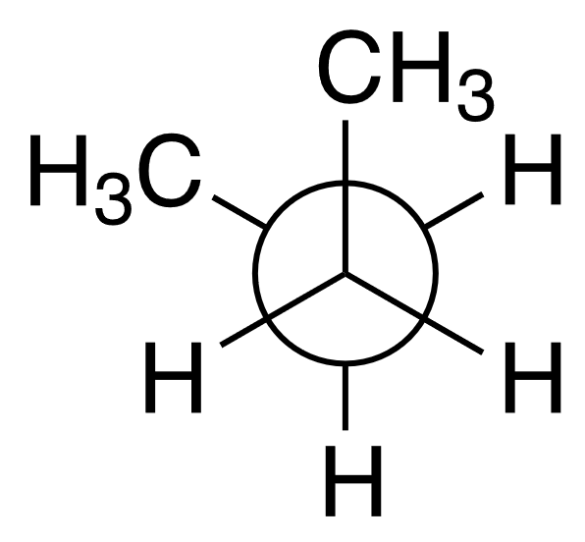
Potentials in MD
Interaction | QM fundamentals | MD modelation
Chemical bonds | Molecular bond-orbitals /electron localization | Spring
Van der Waals forces (non-bonded interactions) | Induced dipoles; Electron cloud repulsion | Lennard-Jones potential
Electrostatic interaction | QEM | Coulomb potential:
Dihedrals | -
-
+

Slide 9
Example: All-Atom MD

Slide 10
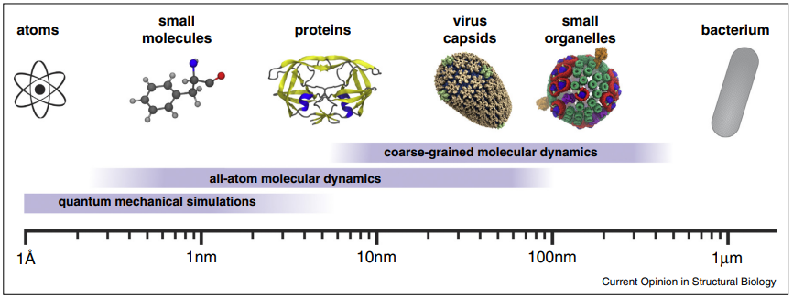
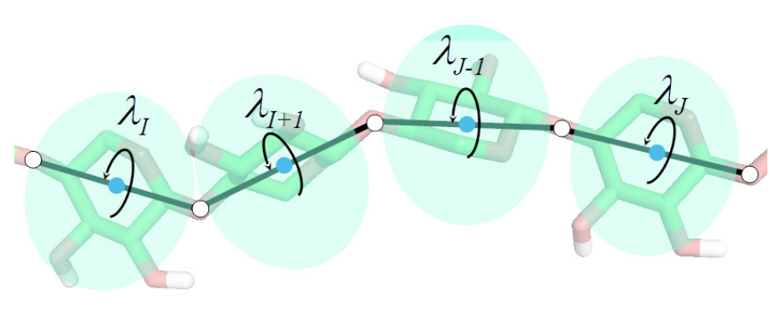
Scaling it up
use parallelization !?
Perilla et al. (2015)
Liwo et al. (2021)

Slide 11
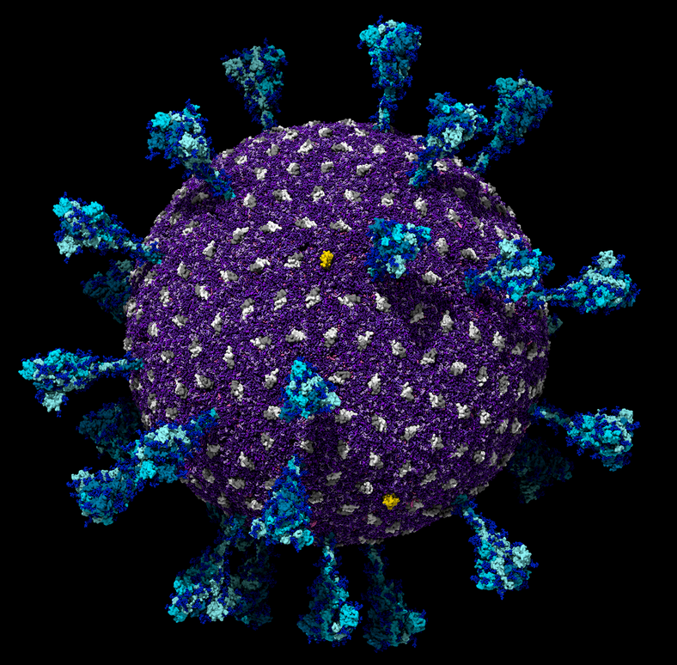
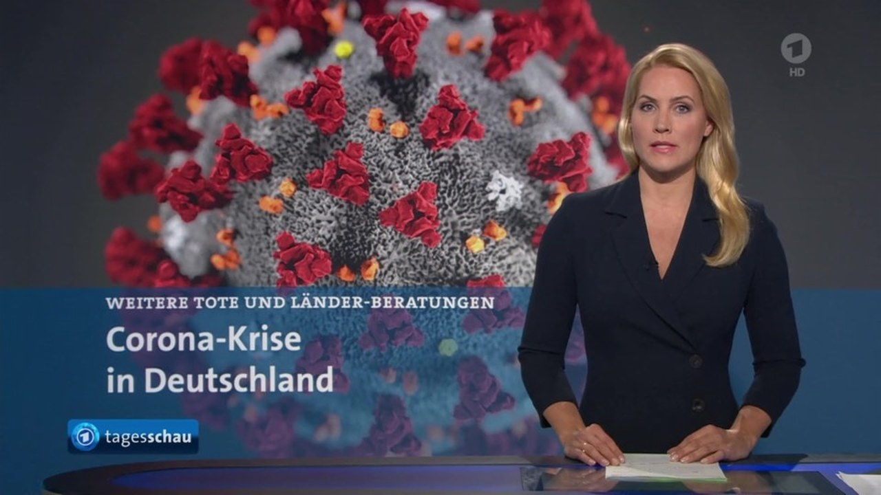
see sources 6.

Slide 12
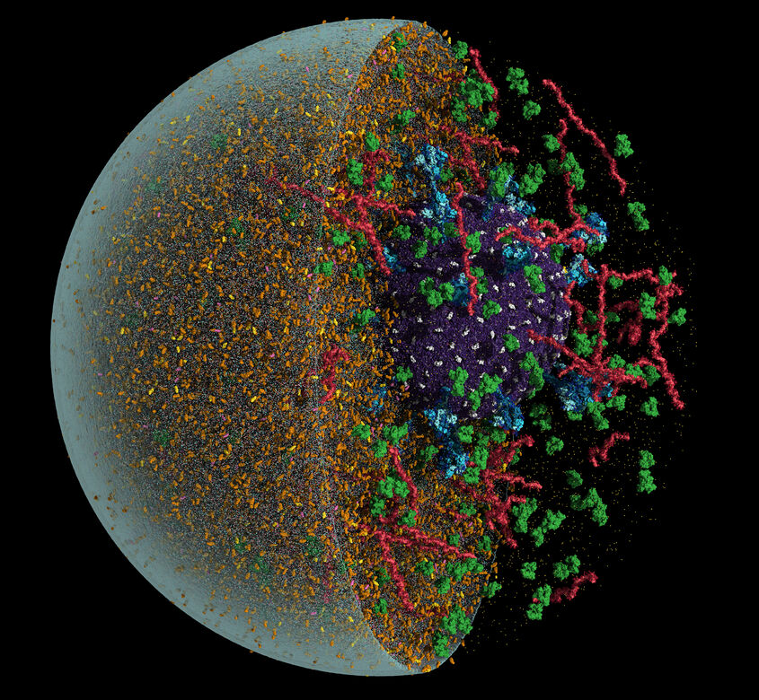
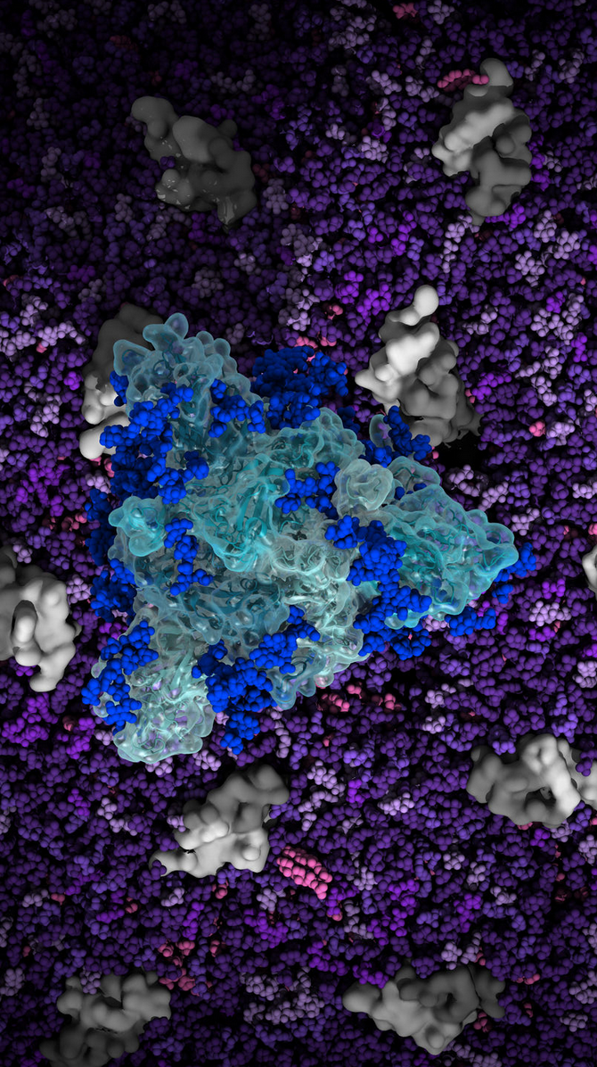
MD in COVID-Research
see sources 6.
mutations
dynamics
drug design

Slide 13
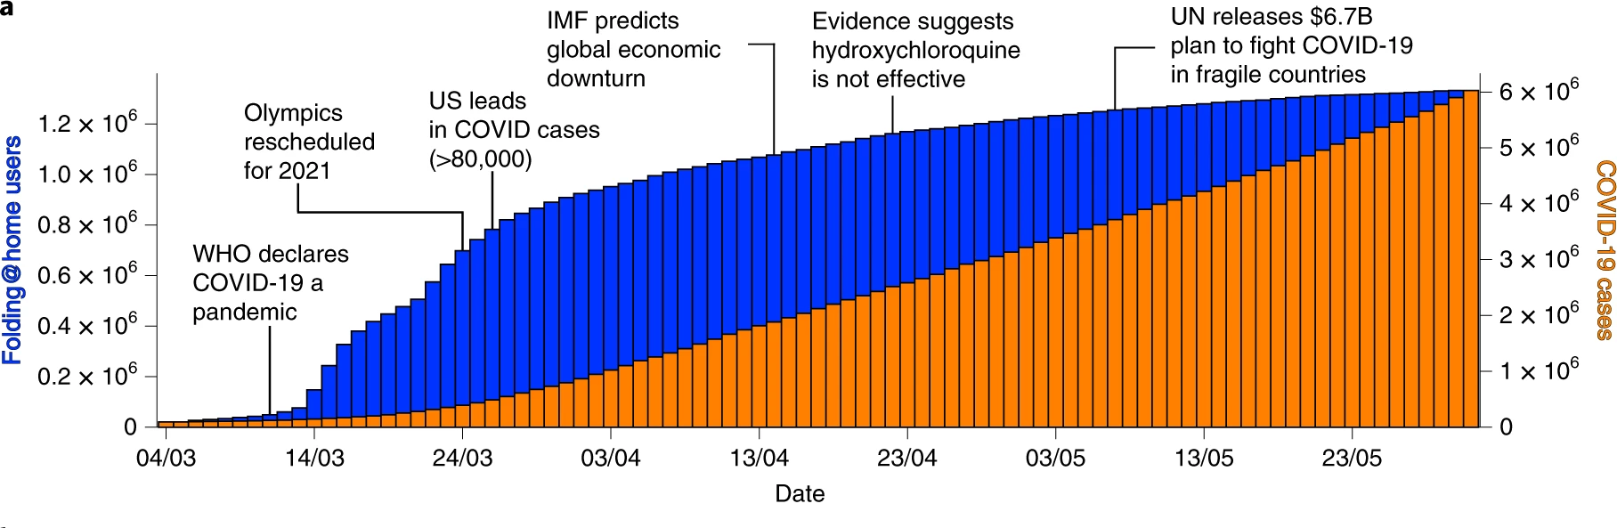
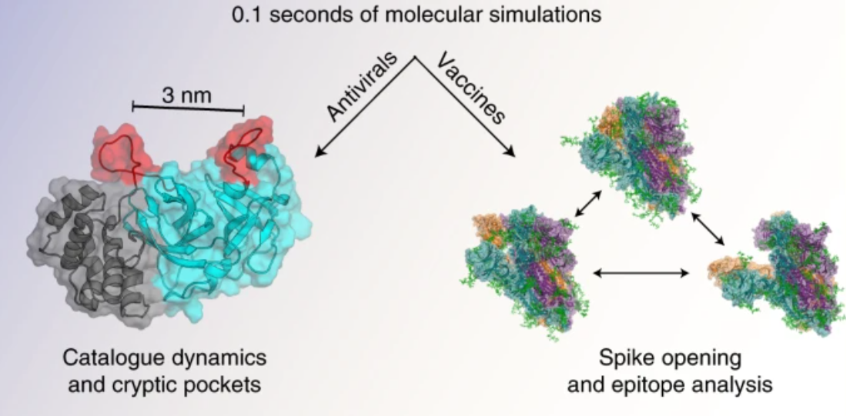
MD in COVID-Research
mutations
dynamics
drug design
Zimmerman et al. (2021)

Slide 14
MD in COVID-Research
mutations
dynamics
drug design
Padhi et al. (2021)

Slide 15
Conclusions
Theory
?
Human experience
Were we able to transfer our fundamental QM knowledge to the macroscopic world?
Did we get a useful tool, that
allows us to study complex systems beyond experiments
helps us to develop new technologies and therapies
Sometimes efficiency beats accuracy !

Slide 16
Thank you !
Sources
Vollmayr-Lee, K. (May 2020). Introduction to molecular dynamics simulations
Fischer et al. (Oct 2014). Molecular wave-packet dynamics on laser-controlled transition states. Phys. Rev. A 93, 012507
Iftimie et al. (May 2010). Ab initio molecular dynamics: Concepts, recent developments, and future trends. PNAS vol. 102 no. 19
Perilla et al. (April 2015). Molecular dynamics simulations of large macromolecular complexes. Current Opinion in Structural Biology 2015, 31:64–74
Liwo et al. ( September 2021). Theory and Practice of Coarse-Grained Molecular Dynamics of Biologically Important Systems. Biomolecules 2021, 11, 1347.
From New York Times Article (December 2021): The Coronavirus in a Tiny Drop, simulations by Amaro Labs, U.C. San Diego
Padhi et al. (July 2021). Accelerating COVID-19 Research Using Molecular Dynamics Simulation. The Journal of Physical Chemistry B 2021 125 (32), 9078-9091
Zimmerman et al. (July 2021). SARS-CoV-2 simulations go exascale to predict dramatic spike opening and cryptic pockets across the proteome. Nature Chemistry , vol. 13 651–659
Allen et al. (2004). Introduction to Molecular Dynamics Simulation. Lecture Notes published in Computational Soft Matter: From Synthetic Polymers to Proteins. John von Neumann Institute for Computing, Julich, NIC Series, Vol. 23, ISBN 3-00-012641-4, pp. 1-28

