Slide 1
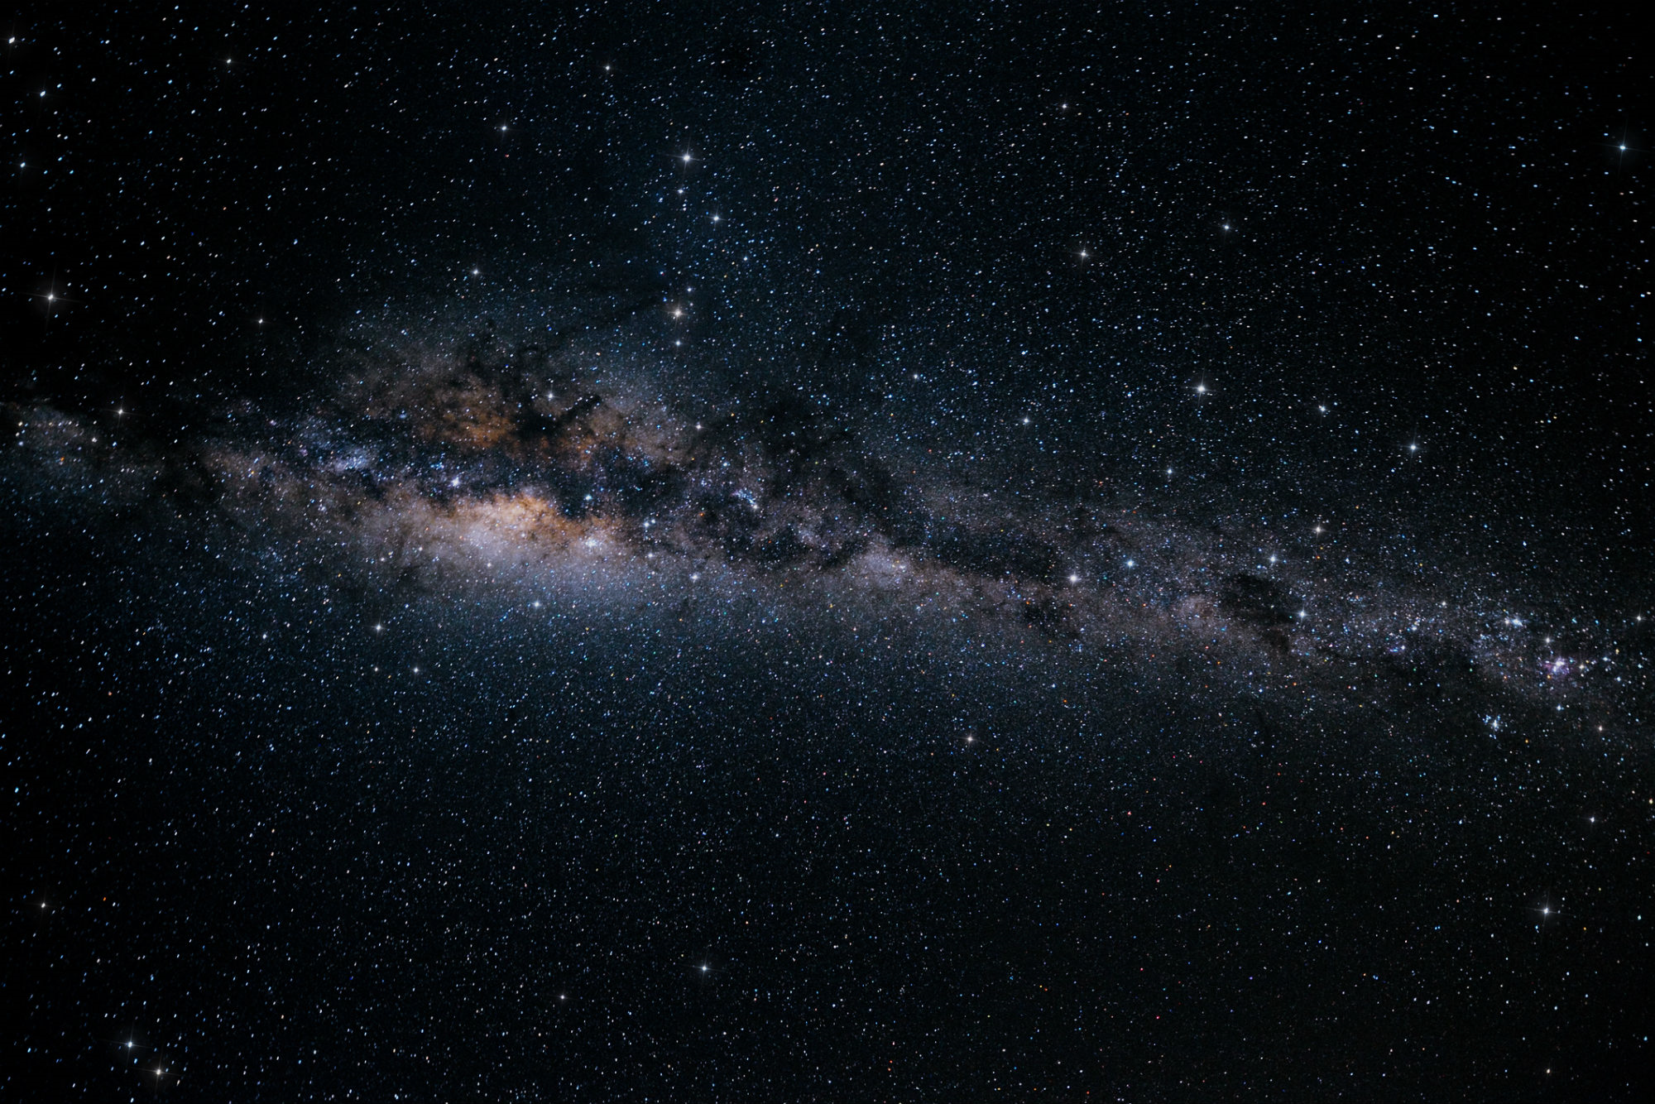
Cosmology
vast
distances
(field)

Slide 2
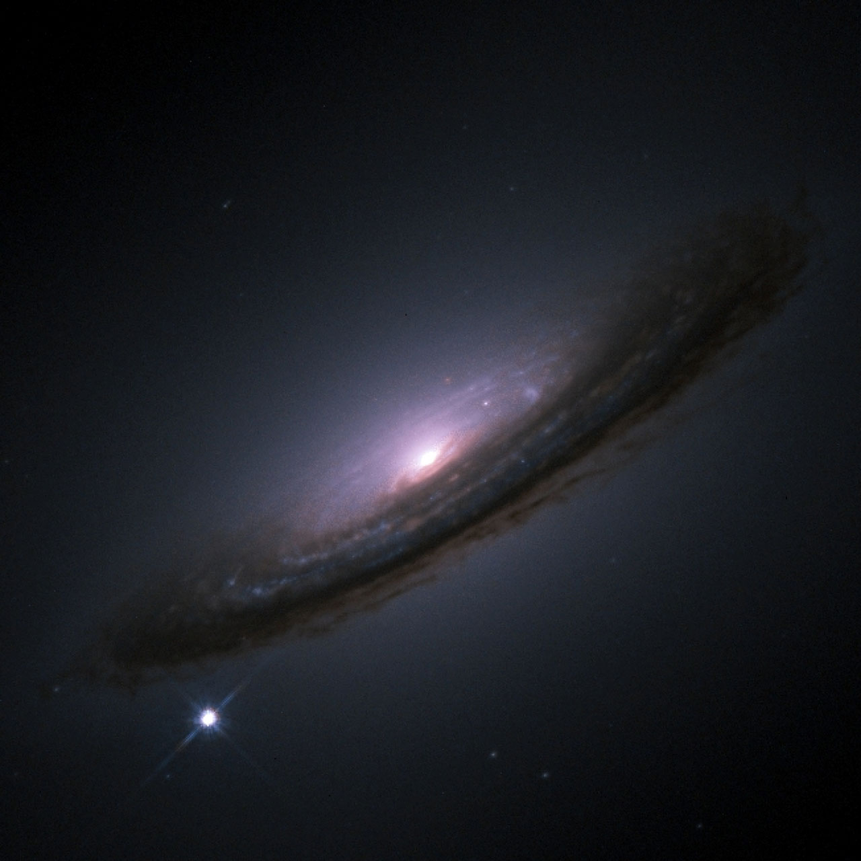
Seminar presentation
Cosmic distance measurements
Their importance for cosmology and how they are measured
importance for cosmology
how
measured
In what way are distance measurements important for cosmology?
What are the conceptual ideas that let us measure cosmic distances?
(Concrete example)
Ruprecht-Karls-Universität Heidelberg
Department of Physics
Leopold Reiche

Slide 3
Outline
Prevailing view of
the universe
ΛCDM-model
Question 1
Question 1
a(t)
what are we interested in?
1.
In what way are distance measurements important for cosmology?
Hubble diagram
how do we obtain it?
a(t) d(z)
Quantities z and d
Question 2
2.
How are they measured?
d d_{L}
Conceptual idea of obtaining d_{L}
Cosmic distance ladder
Standard candles
Supernovae Ia
Supernovae Ia
Concrete example

Slide 4
The current model of the universe
ΛCDM-model
Object of study
3 assumptions
(> 500 million ly)
Hubble diagram
Entire modern cosmology
Superclusters
Solar system
Groups
Galaxies
The universe at large scale
Cosmological principle
Quantities z and d
10 millon ly
0,00095 ly
100.000 ly
500 millon ly
universe
1. Homogeneity
Cosmic distance ladder
2. Isotropy
universe at large scales
3 assumptions
(≈ 30 million ly)
3. General relativity
is correct
Standard candles
Supernovae Ia

Slide 5
The current model of the universe
ΛCDM-model
universe at large scales
scale with a factor of
1.8
(> 500 million ly)
Analogies
Hubble diagram
scale factor
a(t)
d₀
≈ rubber band
Quantities z and d
∙ 1.8
today
∙ 1.8
d₀
d₀(t) = scale factor(t) ∙
∙ 1.8
Cosmic distance ladder
d₂
special
d₁
d₁(t) = scale factor(t) ∙
d₁
d₂
Multiplicative scaling of distances
d₂(t) = scale factor(t) ∙
Standard candles
scale factor(t₀) = 1
Supernovae Ia
(t) = scale factor(t) ∙

Slide 6
The current model of the universe
ΛCDM-model
universe at large scales
(> 500 million ly)
Analogies
Hubble diagram
scale factor
a(t)
≈ perfect fluid
Quantities z and d
All thermodynamic quantities depend on:
Cosmic distance ladder
p ρ
a(t)
proportionality factor of energy density decrease
Standard candles
relation
?
Supernovae Ia
different energy components Ω_{i}
ρ(p) equation of state

Slide 7
The current model of the universe
ΛCDM-model
p
ρ
4 unknowns:
3 unknowns:
a(t)
ΛCDM
d(z)
Hubble diagram
3 assumptions of modern cosmology
3 equations
≈ perfect fluid
≈ rubber band
Quantities z and d
3 unknowns
p ρ
a(t) d(z)
Einstein field
equation
Homogeneity
Isotropy
Cosmic distance ladder
+
equation of state for each component
p, ρ a(t)
Cosmological Hubble law
Standard candles
nothing measurable
Supernovae Ia
Friedman equations
$$\frac{\dot{a}\left(t\right)}{a\left(t\right)}=\dot{a}\left(t_{0}\right)⋅\sqrt{Ω_{m,0}⋅a{\left(t\right)}^{−3}+Ω_{γ,0}⋅a{\left(t\right)}^{−4}+Ω_{Λ,0}+Ω_{k,0}⋅a{\left(t\right)}^{−2}}$$

Slide 8
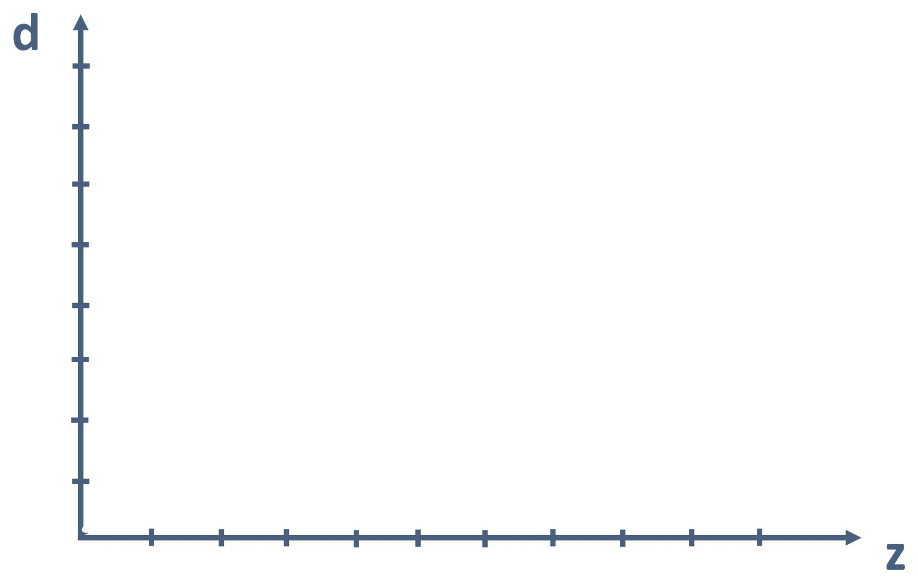
The tool of choice – Hubble diagram
ΛCDM-model
Hubble diagram
Hubble diagram
Distance measurements the only way to constrain
$Ω_{m,0}$ and $Ω_{γ,0}$
Quantities z and d
Cosmic distance ladder
Standard candles
Supernovae Ia
v_{intr} << v_{exp}

Slide 9
The observables – Redshift and distance
ΛCDM-model
Redshift z
ridiculously convenient
t_{emi}
Hubble diagram
Observable
Cause?
Relative shift in wavelength of light
t_{obs}
t₀
$$z=\frac{λ_{obs}−λ_{orig}}{λ_{orig}}$$
Quantities z and d
velocity
Doppler effect
a(t)
Stretching of space
Cosmic distance ladder
$$\frac{1}{a\left(t_{em}\right)}=(1+z)$$
ridiculously convenient
Standard candles
Supernovae Ia

Slide 10
The observables – Redshift and distance
ΛCDM-model
Distance d
d_{L}
Hubble diagram
luminosity distance
Quantities z and d
Cosmic distance ladder
really?
Standard candles
Luminosity L
Flux $Ƒ$
$$d_{L}^{ }=\sqrt{\frac{L}{4π∙Ƒ}}$$
$$Ƒ=\frac{L}{4π∙d_{L}^{ 2}}$$
= amount of light energy per second
= number of photons per second
= number of observed photons per second per m²
Supernovae Ia
= amount of detected light energy per second per m²

Slide 11
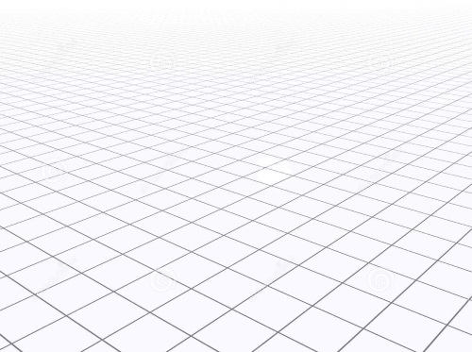
The observables – Redshift and distance
ΛCDM-model
Distance d
d_{L}
Hubble diagram
d_{L} t_{emi}
luminosity distance
Quantities z and d
Cosmic distance ladder
Standard candles
$$d_{L}^{ }=\sqrt{\frac{L}{4π∙Ƒ}}$$
Supernovae Ia

Slide 12
The key to distance measurements
ΛCDM-model
1. Measure z
$$d_{L}^{ }=\sqrt{\frac{L}{4π∙Ƒ}}$$
Hubble diagram
2. Measure d_{L}
Quantities z and d
Class of objects with fixed L
Standard candles
= known
= measurable
Cosmic distance ladder
How many Watts?
Identify individuals
Cosmological distance ladder
Standard candles
Calibrate the class
Which brand?
Supernovae Ia
Use other individuals to get d_{L}

Slide 13
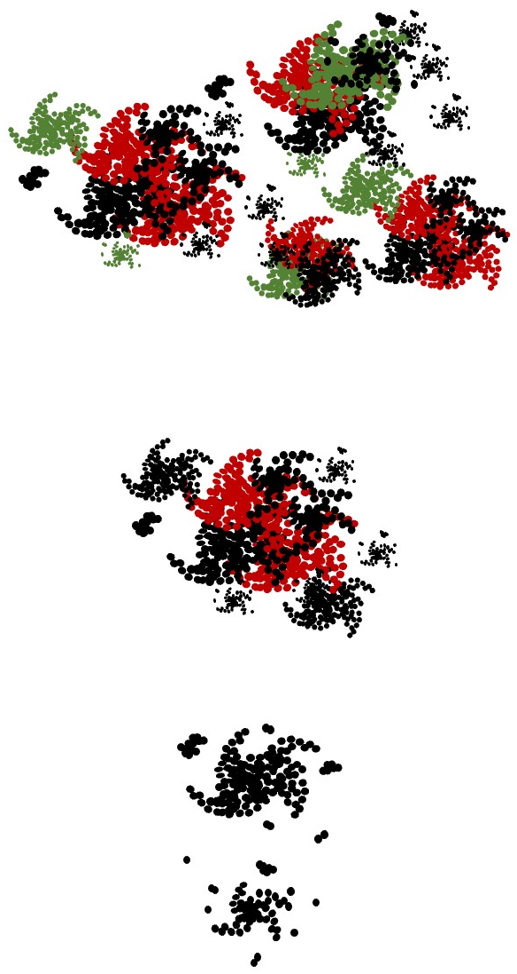
The steps of the ladder
ΛCDM-model
Hubble diagram
Superclusters
(100s of Mly)
Hubble flow
Quantities z and d
Start of cosmology
Other clusters
(10s of Mly)
Cosmic distance ladder
M31
Standard candles
Local group
(1s of Mly)
us
Supernovae Ia
Solar system
(1000th of ly)

Slide 14
The steps of the ladder – Step 1
ΛCDM-model
Hubble diagram
Quantities z and d
Cosmic distance ladder
Standard candles
Supernovae Ia
Solar system
(0,001 ly)

Slide 15
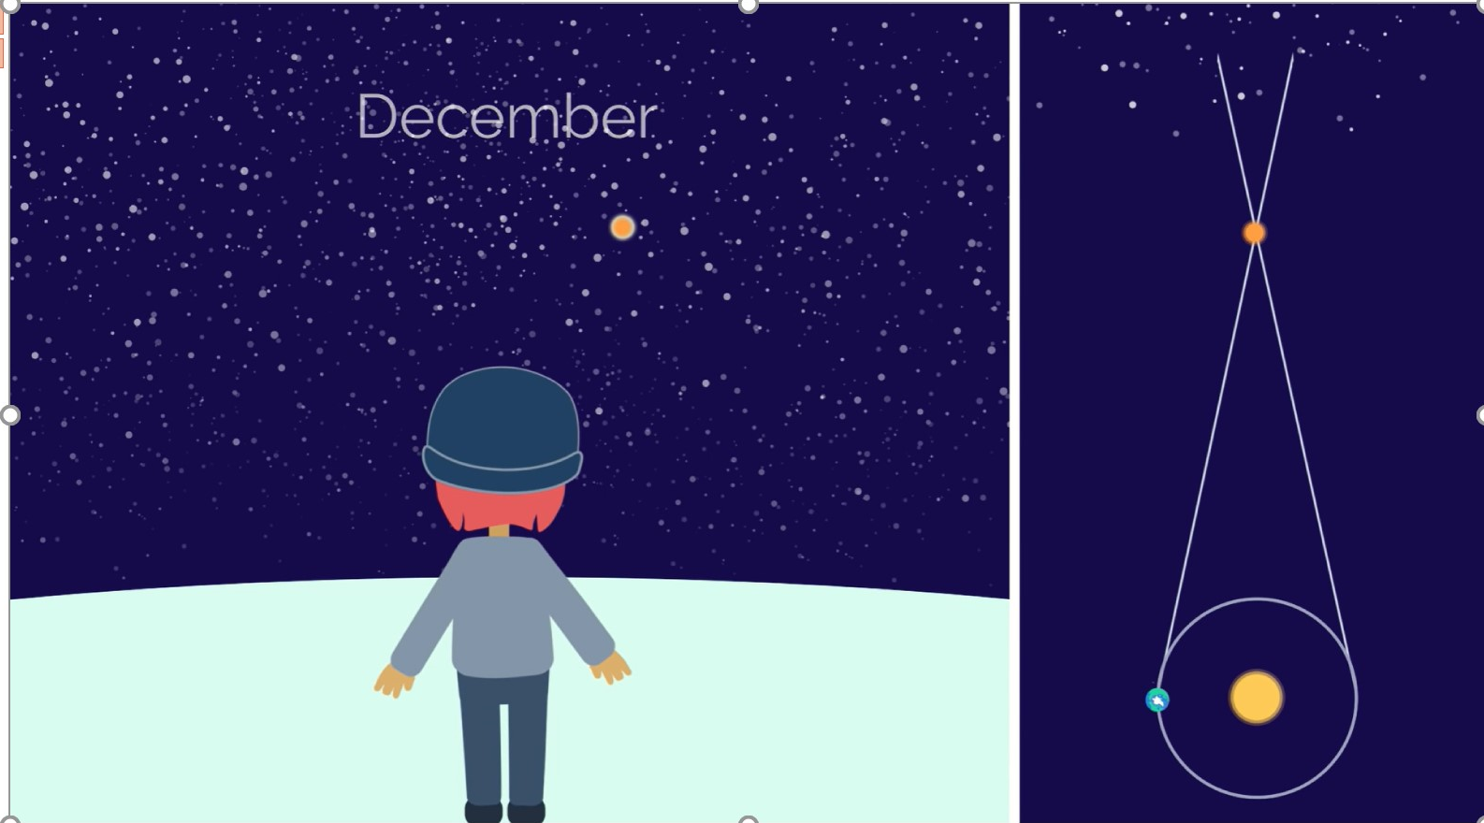
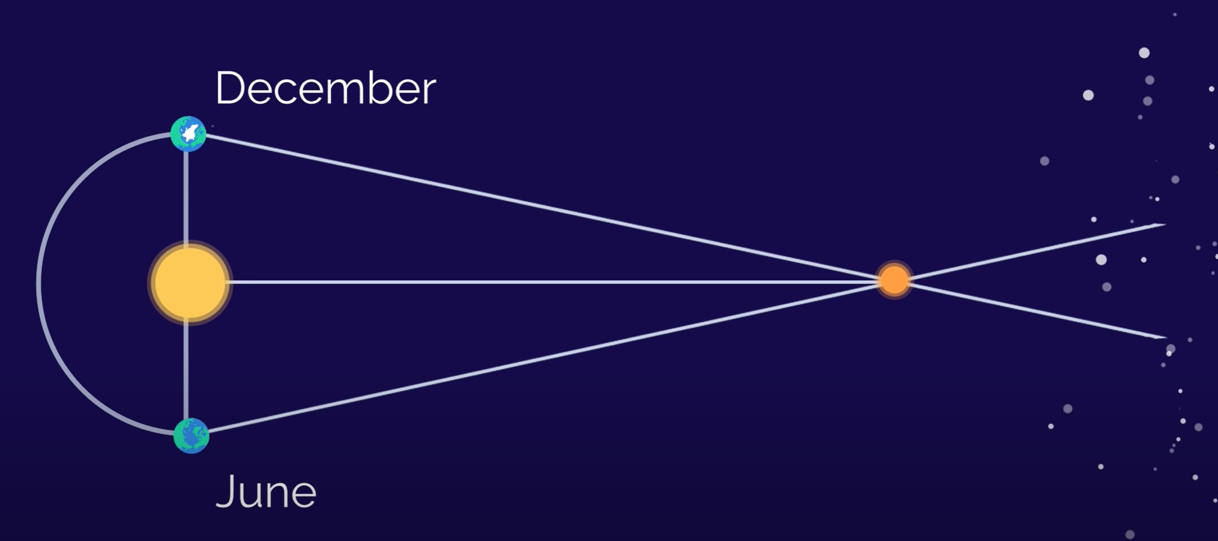
The steps of the ladder – Step 2
ΛCDM-model
Stellar parallax
$d=$ $\frac{1AU}{θ}$
15
Hubble diagram
2θ
parallax angle
Quantities z and d
1 AU
2θ
θ
2θ
Cosmic distance ladder
2θ
2θ
Standard candles
Parts of milkyway and close surrounding
(10.000 ly)
Supernovae Ia
Precision:
depending strongly on distance
Solar system
for 10.000 ly ≈ 12%
(0,001 ly)
$σ_{d}=$ $\frac{σ_{θ}}{θ²}$
$d[pc]=$ $\frac{1}{θ[arcsec]}$

Slide 16
The steps of the ladder – Step 2
ΛCDM-model
Hubble diagram
Quantities z and d
Cosmic distance ladder
Standard candles
Parts of milkyway and close surrounding
(10.000 ly)
Supernovae Ia
Solar system
(0,001 ly)

Slide 17
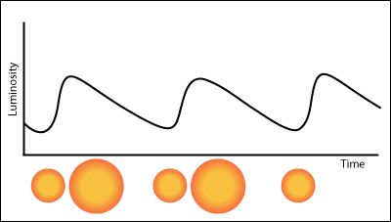
The steps of the ladder – Step 3
Direct distance measurement to near galaxies (1.6 Mly) ≈ 0,2%
Direct distance measurement to near galaxies (51 Mly) ≈ 2,5%
ΛCDM-model
Cepheid variable stars
Hubble diagram
The resulting geometric calibration of Cepheid luminosities has 1.0% precision, better than any alternative geometric anchor.
Cosmic Distances Calibrated to 1% Precision with Gaia EDR3 Parallaxes and Hubble Space Telescope Photometry of 75 Milky Way Cepheids Confirm Tension with ΛCDM - IOPscience
Quantities z and d
unstable stars
very characteristic curve
Cosmic distance ladder
Other close by clusters
(10s of Mly)
Precision:
Standard candles
Expand and shrink periodically
at 1,6 Mly ≈ 0,2%
at 51 Mly ≈ 2,5%
Milkyway and close surrounding
(0,01s of Mly)
Supernovae Ia
Solar system
(0,001 ly)
A NEW CEPHEID DISTANCE MEASUREMENT AND METHOD FOR NGC 6822 - IOPscience
very characteristic curve

Slide 18
The steps of the ladder – Step 3
ΛCDM-model
Hubble diagram
Quantities z and d
Cosmic distance ladder
Other close by clusters
(10s of Mly)
Standard candles
Milkyway and close surrounding
(0,1s of Mly)
Supernovae Ia
Solar system
(0,001 ly)

Slide 19
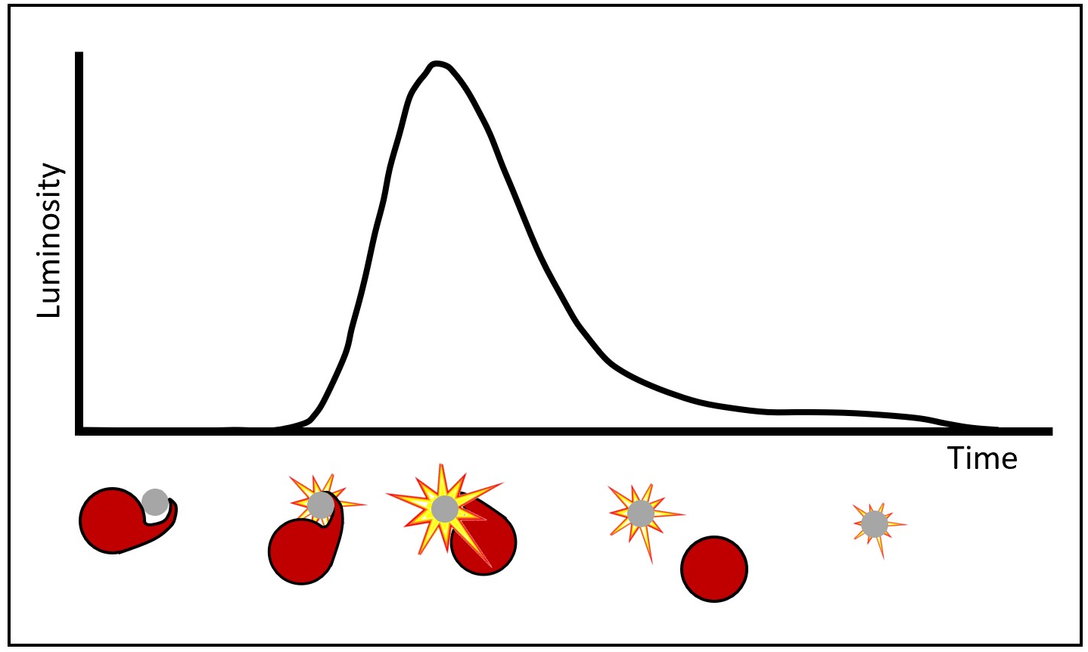
The steps of the ladder – Step 4
Distance measurements < 8%
hardin_moriond.ppt (in2p3.fr)
Distance measurements ≈ 3%
Doubling the accuracy of measuring distances to supernova explosions - Tech Explorist
ΛCDM-model
Supernovae Ia
Hubble diagram
The Hubble flow
(11 Gly)
Hubble constant value ≈ 1.9%
Quantities z and d
Special type of star explosion
very characteristic curve
Cosmic distance ladder
and absorption lines
Other close by clusters
(100 Mly)
Standard candles
Precision: from 8% to 3%
Milkyway and close surrounding
(300.000 ly)
Supernovae Ia
$Ω_{i,0}$ determination: ≈ 5%
Solar system
(0,001 ly)
4%
An estimate of the dark matter density from galaxy clusters and supernovae data - IOPscience
Luminosity
Time

Slide 20
The steps of the ladder – Step 4
ΛCDM-model
Hubble diagram
The Hubble flow
(11 Gly)
Quantities z and d
Cosmic distance ladder
Other close by clusters
(100 Mly)
Standard candles
Milkyway and close surrounding
(300.000 ly)
Supernovae Ia
Solar system
(0,001 ly)

Slide 21
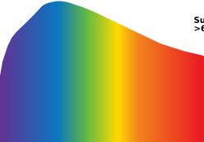
Concrete example – SALT fits for SNe Ia
We present a new calibration of the peak absolute magnitude of Type Ia supernovae (SNe Ia) based on the surface brightness fluctuations (SBF) method, aimed at measuring the value of the Hubble constant. We build a sample of calibrating anchors consisting of 24 SNe hosted in galaxies that have SBF distance measurements. Applying a hierarchical Bayesian approach, we calibrate the SN Ia peak luminosity and extend the Hubble diagram into the Hubble flow by using a sample of 96 SNe Ia in the redshift range 0.02 < z < 0.075, which was extracted from the Combined Pantheon Sample.
A new measurement of the Hubble constant using Type Ia supernovae calibrated with surface brightness fluctuations | Astronomy & Astrophysics (A&A) (aanda.org)
the small remaining variations in the intrinsic maximum brightness limited the precision with which dark energy could be tested
The team studied hundreds of such nearby supernovae in exquisite detail. Each supernova was measured a number of times, at intervals of a few days. Each measurement examined the spectrum of the supernova, recording its intensity across the wavelength range of visible light.
ΛCDM-model
SNLS
“The results from the […] SNfactory collaboration […] will enable scientists to study dark energy with greatly improved precision and accuracy, and provide a powerful crosscheck of the technique across vast distances and time”
- Boone, K. et al. (2021). The Twins Embedding of Type Ia Supernovae. I. The Diversity of Spectra at Maximum Light. The Astrophysical Journal, 912 (1): 70 DOI: 10.3847/1538-4357/abec3c
“The new results announced by the SNfactory come from a multi-year study devoted entirely to increasing the precision of cosmological measurements made with supernovae.”
- Boone, K. et al. (2021). The Twins Embedding of Type Ia Supernovae. I. The Diversity of Spectra at Maximum Light. The Astrophysical Journal, 912 (1): 70 DOI: 10.3847/1538-4357/abec3c
(Supernova Legacy survey)
GAIA
SALT2
Hubble diagram
Measure angular positions
Regularities of spectral sequences
Provides SNe data
Quantities z and d
Vera C. Rubin Observatory
Pan-STARRS
Accuracy and everything
Supernovae twins open up new possibilities for precision cosmology: Findings will enhance dark energy experiments at major telescopes -- ScienceDaily
BTS
What can we measure from a supernova?
Cosmic distance ladder
large data volume supernova search
SN factory
expected to discover over 100,000 SNe Ia
4-telescope large-field survey system to look for transient and variable sources
Identify new correlations for close SNe
Standard candles
Supernovae Ia
DOE/Lawrence Berkeley National Laboratory. (2021, May 7). Supernovae twins open up new possibilities for precision cosmology: Findings will enhance dark energy experiments at major telescopes. ScienceDaily. Retrieved December 13, 2021 from www.sciencedaily.com/releases/2021/05/210507093944.htm
Identify regularities of SNe Ia
Wir fassen die grundlegenden Eigenschaften dieser Population zusammen, identifizieren ausgeprägte Korrelationen zwischen Dauer und Leuchtkraft in einer Vielzahl von Supernova (SN)-Klassen und ordnen die Mehrheit der schnellen optischen Transienten gut etablierten spektroskopischen SN-Typen zu (hauptsächlich SN Ibn und II/IIb)
[2009.01242] The Zwicky Transient Facility Bright Transient Survey. II. A Public Statistical Sample for Exploring Supernova Demographics (arxiv.org)
SALT2
SALT2: using distant supernovae to improve the use of type Ia supernovae as distance indicators | Astronomy & Astrophysics (A&A) (aanda.org)

Slide 22
Summary
ΛCDM-model
3 assumptions
scale factor
ΛCDM-model
Hubble diagram
GR
d_{L}
distances
Hubble diagram
+
+
Quantities z and d
Quantities z and d
Cosmological principle
energy densities
Cosmic distance ladder
Cosmic distance ladder
Luminosity distance
Standard candles
Standard candles
tool for constraining
$Ω_{m}$ and $Ω_{Λ}$
Supernovae Ia
Supernovae Ia
redshift

Slide 23
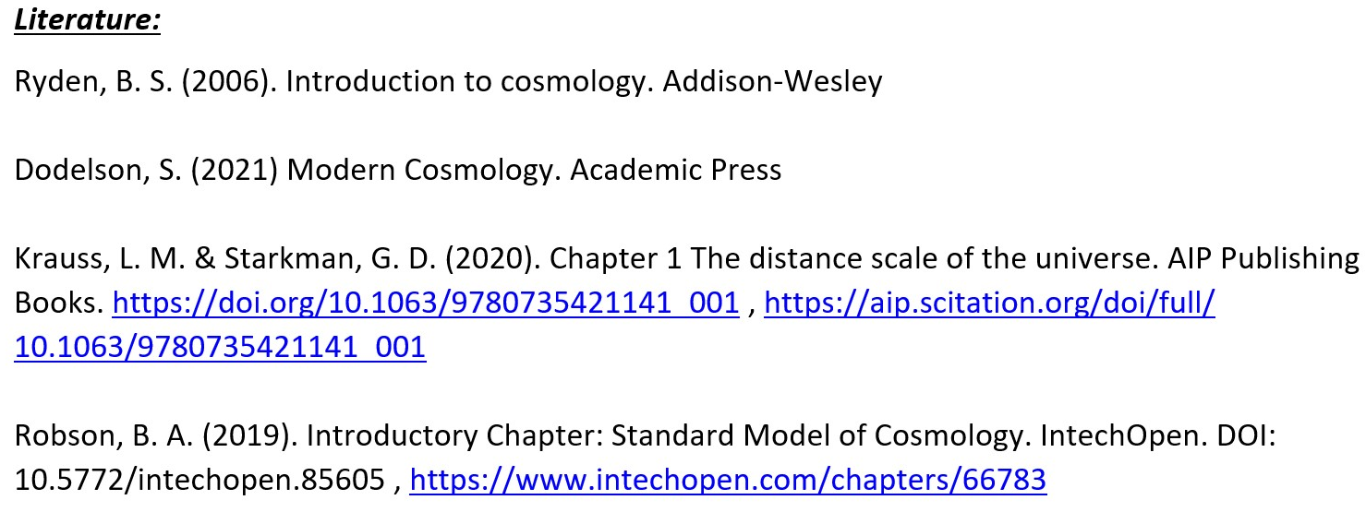
Sources

Slide 24
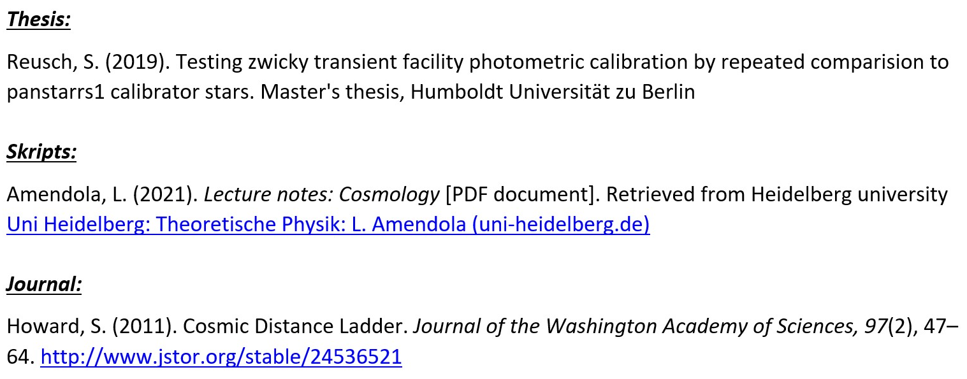
Sources

Slide 25
Sources

Slide 26
Sources
DOE/Lawrence Berkeley National Laboratory. (2021, May 7). Supernovae twins open up new possibilities for precision cosmology: Findings will enhance dark energy experiments at major telescopes. ScienceDaily. Retrieved December 13, 2021 from www.sciencedaily.com/releases/2021/05/210507093944.htm

Slide 27
Sources
Boone, K. et al. (2021). The Twins Embedding of Type Ia Supernovae. I. The Diversity of Spectra at Maximum Light. The Astrophysical Journal, 912 (1): 70 DOI: 10.3847/1538-4357/abec3c

Slide 28
Seminar presentation
Questions
Ruprecht-Karls-Universität Heidelberg
Department of Physics
Leopold Reiche

