Slide 1
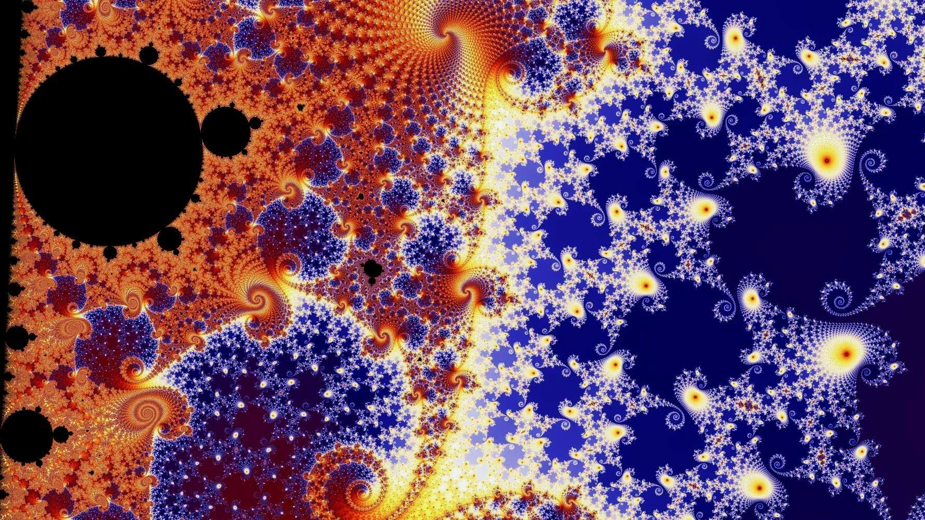
Titellayout
Untertitel
Sources: (5)

Slide 2
Fractals in AMO Physics
Maximilian Winterer
Your Passion For Physics – 23.11.2021
University Heidelberg

Slide 3
Outline
Introduction to Fractals
Fractional QM
Brownian Motion vs Lévi Flight Process
Results
Applications
Outlook

Slide 4
What is a Fractal?
Sources: (1)
‘A rough or fragmented geometric shape that can be split into parts, each of which is a reduced-size copy of the whole’ ~ Benoît Mandelbrot
4/27

Slide 5
What is a Fractal?
Sources: (1,3)
‘A rough or fragmented geometric shape that can be split into parts, each of which is a reduced-size copy of the whole’ ~ Benoît Mandelbrot
Correct, but not what we are aiming for
Measure for roughness of objects when looking closer
=> Fractal Dimension
5/27

Slide 6
Sources: (2,3)
Decrease sidelenght by 1/2
Decrease sidelenght by 1/3
6/27

Slide 7
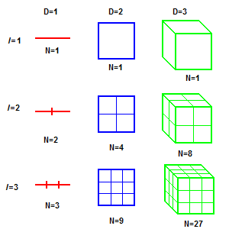
Fractal Dimension
Sources: (2,3)
Assign mass to each object (not formal, but intuitive derivation)
=> How does the mass scale?
7/27

Slide 8
Fractal Dimension
Sources: (2,3)
Relative Sidelength | Relative Mass
1 | 1
$$\frac{1}{2}$$ | $$\frac{1}{8}={\left(\frac{1}{2}\right)}^{3}$$
$$\frac{1}{3}$$ | $$\frac{1}{27}={\left(\frac{1}{3}\right)}^{3}$$
8/27

Slide 9
Fractal Dimension
Sources: (2,3)
Relative Sidelength | Relative Mass
1 | 1
$$\frac{1}{2}$$ | $$\frac{1}{4}={\left(\frac{1}{2}\right)}^{2}$$
$$\frac{1}{3}$$ | $$\frac{1}{9}={\left(\frac{1}{3}\right)}^{2}$$
9/27

Slide 10
Fractal Dimension
Sources: (2,3)
Relative Sidelength | Relative Mass
1 | 1
$$\frac{1}{2}$$ | $$\frac{1}{2}={\left(\frac{1}{2}\right)}^{1}$$
$$\frac{1}{3}$$ | $$\frac{1}{3}={\left(\frac{1}{3}\right)}^{1}$$
10/27

Slide 11
Fractal Dimension
Sources: (2,3)
Relative Sidelength | Relative Mass
$$\frac{1}{2}$$ | $$\frac{1}{2}={\left(\frac{1}{2}\right)}^{1}$$
$$\frac{1}{3}$$ | $$\frac{1}{3}={\left(\frac{1}{3}\right)}^{1}$$
Dimension of Object
10/27

Slide 12
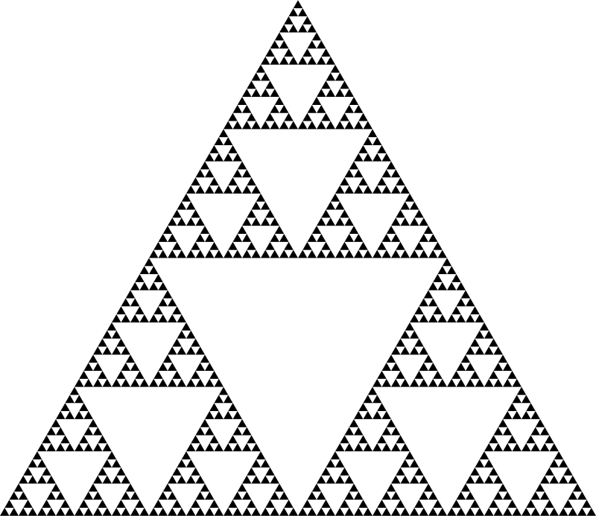
Fractal Dimension – Sierpinski Triangle
Sources: (3,4)
Scale sidelenght by $\frac{1}{2}$ => ‘Mass’ scales by $\frac{1}{3}={\left(\frac{1}{2}\right)}^{?}$ => $? = \frac{log⁡(3)}{log⁡(2)} =\log_{2}\left(3\right)=1,584962…$
Fractal Dimension: How much more detail can I see when I zoom in/ when my resolution increases?
11/27

Slide 13
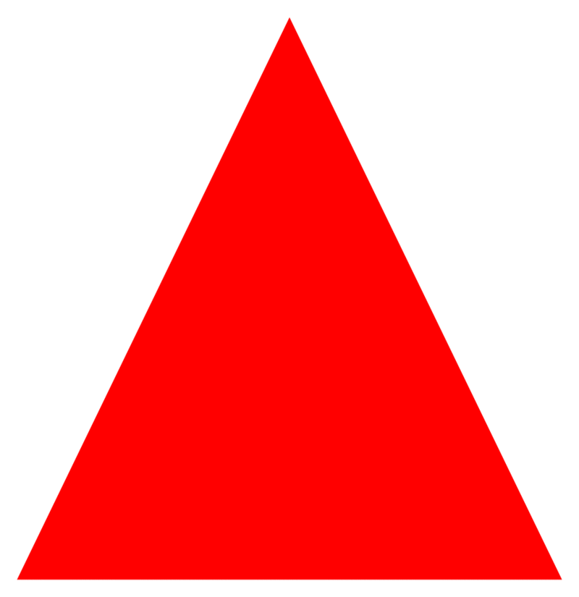
Fractal Dimension – Sierpinski Triangle
Sources: (3,4)
Why is a ‚Fractal Dimension‘ necessary?
$$length=∞$$
$$area=0$$
12/27

Slide 14
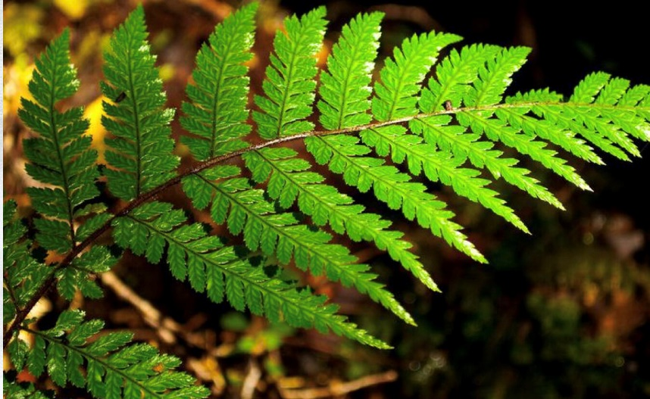
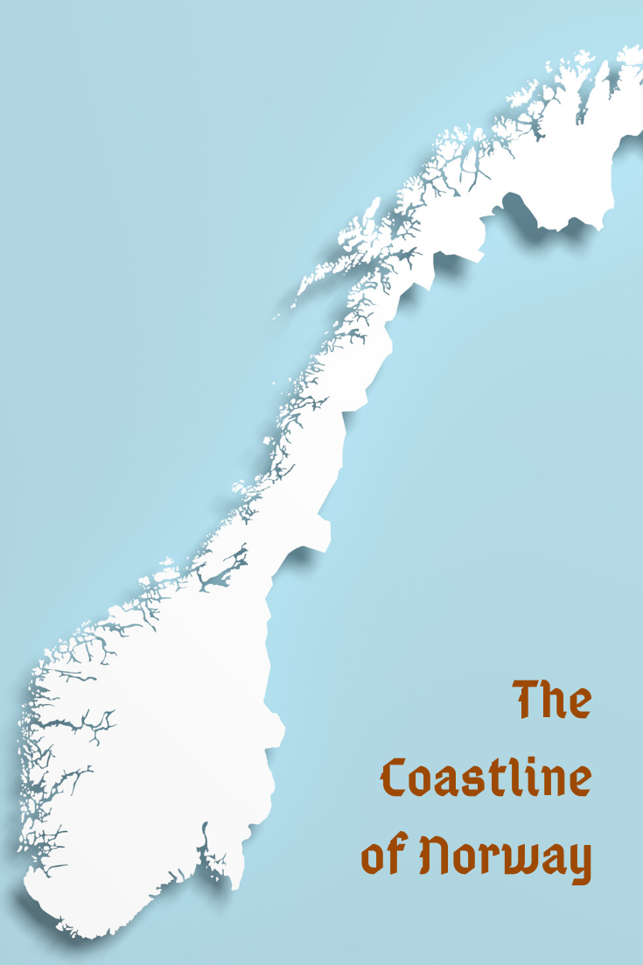
Why would one care about Fractals?
Sources: (3,5,6)
1,51
2,3
1,45
1,37
13/27

Slide 15
Questions?

Slide 16
Fractional Quantum Mechanics
Sources: (9,10)
Quantum Mechanics
Heisenberg Matrix Algebra
Schrödinger Equation
Feynman Path Integral
15/27

Slide 17
Fractional Quantum Mechanics
Sources: (9,10)
Quantum Mechanics
Heisenberg Matrix Algebra
Schrödinger Equation
Feynman Path Integral
15/27

Slide 18
Fractional Quantum Mechanics
Sources: (7,8,9,10)
Feynman Path Integral: Integrates over all Brownian Paths from Initial State to Final State
Recap Brownian Path: Trajectory following the Brownian Motion (Normal Distribution)
Generalized Motion: Lévi Flight (Normal Distribution $→$ Lévi Distribution)
16/27

Slide 19
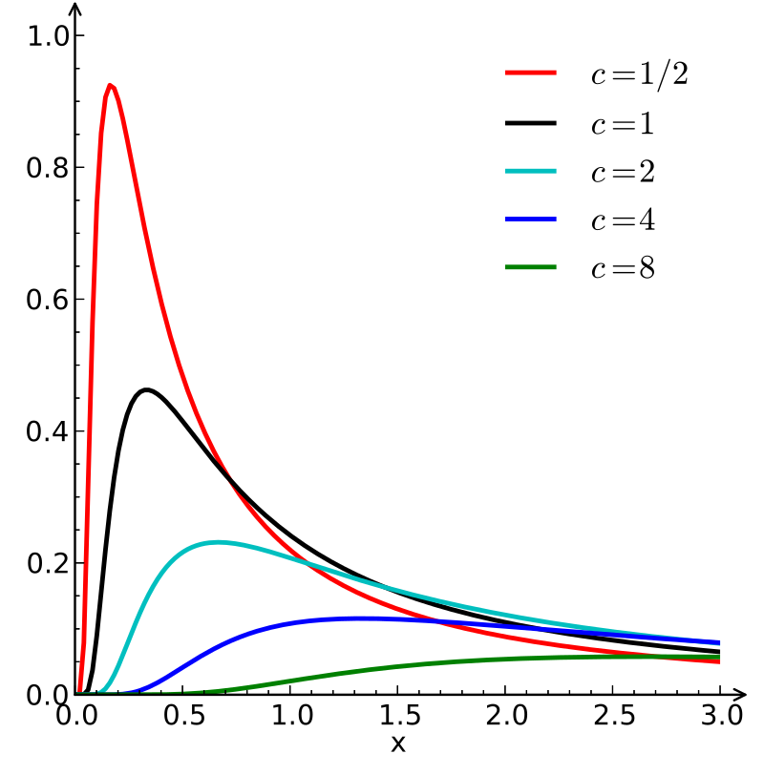
Fractional Quantum Mechanics
Sources: (7,8)
Lévi Flight (Normal Distribution $→$ Lévi Distribution)
Probability Density Function (heavy-tailed):
Figure 1: Probabilty Density function for a Lévi Distribution with different parameters c
17/27

Slide 20
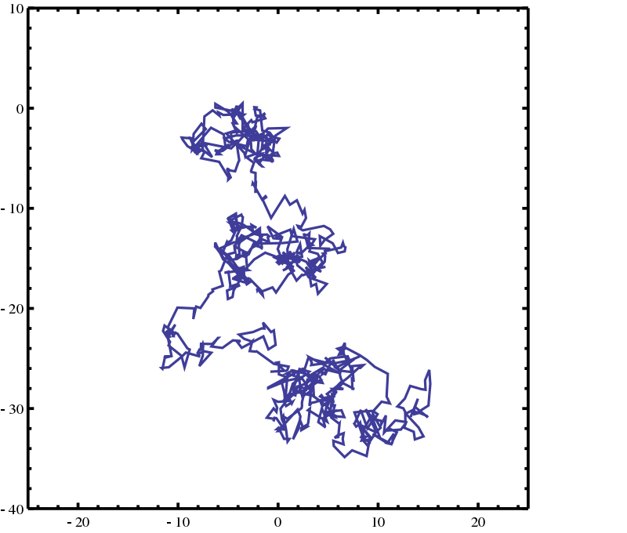
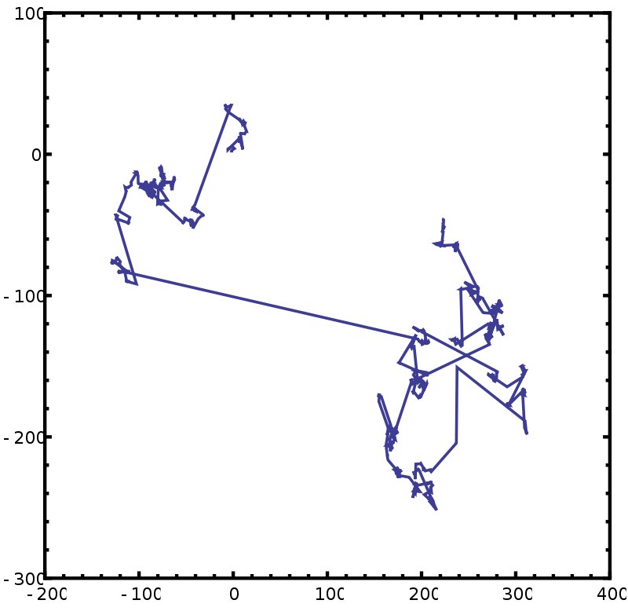
Fractional Quantum Mechanics
Sources: (7,8,9,10)
Lévi Flight
Lévi Index/ Stability Parameter $α$ ‘defines’ path
Lévi Flights are self-similar (Fractals!)
$$α=2$$
(Normal Distribution)
Figure 2: Lévi Flight Trajectories for different Stability Parameters $α$
$$α=1$$
(Cauchy Distribution)
18/27

Slide 21
Sources: (9,10)
Fractional Quantum Mechanics?
Stability Parameter $α$
Stability Parameter 𝛼
Feynman Path Integral
Lévi Flights/ ‘Generalized Brownian Motion’
19/27

Slide 22
Fractional Quantum Mechanics
Sources: (7,9,10)
Feynman Path Integral over Brownian Paths $→$ Quantum Mechanics
Feynman Path Integral over Lévi Flights $→$ Fractional Quantum Mechanics
Stability Parameter $α→$ Fractal Dimension $α$ (with $0<α≤2$)
Fractal Dimension $α$ characterizes Fractional Quantum Mechanics
20/27

Slide 23
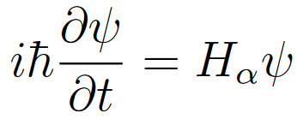
Fractional Quantum Mechanics
Sources: (9,10)
Dispersion Relation for Fractional Quantum Mechanical Particle:
Fractional Schrödinger Equation:
Fractional Hamiltonian:
21/27

Slide 24
Fractional Quantum Mechanics
Sources: (9,10)
Set $α=2$ $→$ Brownian Motion Paths, Quantum Mechanics, Schrödinger Equation
Set $0<α<2$ $→$ Lévi Flight Paths, Fractional Quantum Mechanics, Fractional Schrödinger Equation with $α$ as Fractal Dimension
22/27

Slide 25
Applications of Fractional Quantum Mechanics
Sources: (9,10,11)
Fractional systems reproduce well known QM systems when $α→2$ (potential well, delta potential, oscillator, Bohr atom, … )
Potential Realizations for Experimental Tests have been developed
One Experimental Result: ‘The fractional symmetric rigid rotor’ by Richard Herrmann in Journal of Physics G (2006)
23/27

Slide 26
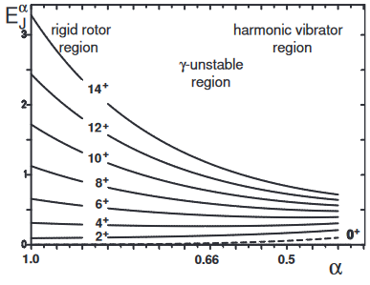
Applications of Fractional Quantum Mechanics
Sources: (11)
‘The fractional symmetric rigid rotor’
Treat nuclids as rigid rotor
Use Fractional QM to calculate Eigenenergies (with $α≠2$)
Figure 3: Eigenenergies of the Fractional Symmetric Rigid Rotor for different angular momenta J and different fractal dimensions $α$
24/27

Slide 27
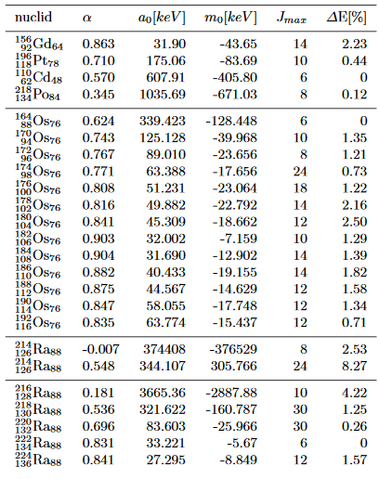
Applications of Fractional Quantum Mechanics
Sources: (11)
‘The fractional symmetric rigid rotor’
$ΔE$ mostly $<2\%$
Table 1: Root mean square errors $ΔE$ between experimental data and predictions, and fitting parameters including Fractal Dimension $α$ for different nuclids
25/27

Slide 28
Applications of Fractional Quantum Mechanics
Sources: (11)
‘The fractional symmetric rigid rotor’
$ΔE$ mostly $<2\%$ => Result is better by factor of 3 to 6 compared to results from Taylor expansion up to second order in J
Table 1: Root mean square errors $ΔE$ between experimental data and predictions, and fitting parameters including Fractal Dimension $α$ for different nuclids
25/27

Slide 29
Summary
Sources: (1,3,9,10,11)
Fractals:
Mandelbrot: Fractals = Self similar Objects
Fractal Dimension describes roughness of Object
Fractals describe our world without unnecessary simplifications
Fractional QM:
Lévi Flights in Feynman Path Integral => Fractional QM
Result: Well known QM equations, but adjusted by Fractal Dimension
Potential Realizations were developed
Fractional Symmetric Rigid Rotor for heavy nuclides shows agreement
26/27

Slide 30
Outlook
Sources: (9,10,12,13,14)
One Dimensional Lévi Crystal for further Tests
Further Applications of Fractals:
Molecular Complexity/ Drug Discovery (Appendix)
Diffraction by an Optical Fractal Grating (Appendix)
Fractals and Chaotic Scattering of Atoms in the Field of a Standing Light Wave
27/27

Slide 31
Sources
(1) ‘The Fractal Geometry of Nature’, Benoît B. Mandelbrot, 1982
(2) https://en.wikipedia.org/wiki/Fractal_dimension
(3) https://www.youtube.com/watch?v=gB9n2gHsHN4
(4) https://en.wikipedia.org/wiki/Sierpi%C5%84ski_triangle
(5) Google Images
(6) ‘Classification and dynamics of tropical clouds by their fractal dimension’, Batista-Tomás
(7) https://en.wikipedia.org/wiki/L%C3%A9vy_flight
(8) https://en.wikipedia.org/wiki/L%C3%A9vy_distribution
(9) ‘Fractional quantum mechanics’, Nick Laskin, Physical Review E, 6th April 2000
(10) ‘Fractional quantum mechanics’, Nick Laskin (book), 2018
(11) ‘The fractional symmetric rigid rotor’, Richard Herrmann, Journal of Physics G, 15th September 2006
(12) ‘Molecular Complexity Calculated by Fractal Dimension’, Modest von Korff, Scientific Reports, 30th January 2019
(13) ‘Diffraction by an optical fractal grating’, Bo Hou, Applied Physics Letters, 20th December 2004
(14) ‘Fractals and Chaotic Scattering of Atoms in the Field of a Standing Light Wave’, V. Yu. Argonov,
Journal of Experimental and Theoretical Physics, 25th November 2002

Slide 32
Questions?

Slide 33
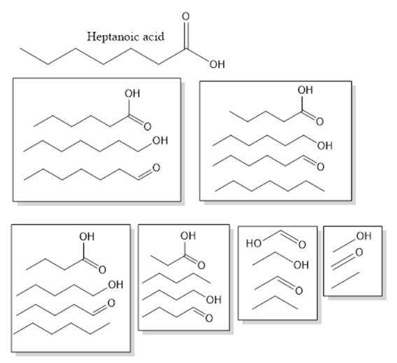
Appendix: Molecular Complexity/ Drug Discovery
Sources: (12)
Figure 4: Heptanoic acid and its distinct substructures, grouped by bond counts

Slide 34
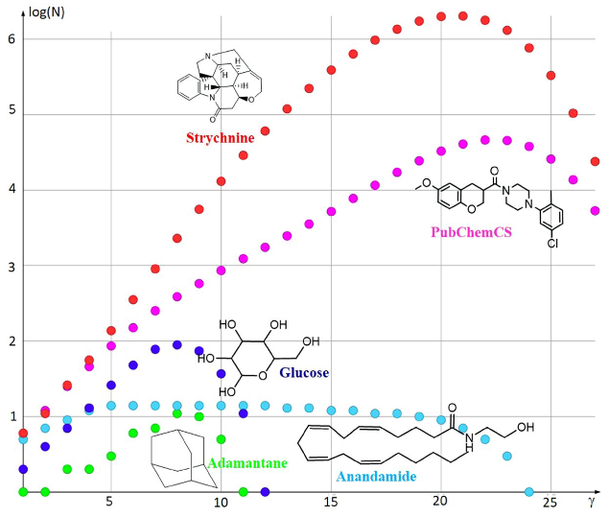
Appendix: Molecular Complexity/ Drug Discovery
Sources: (12)
Figure 5: Number of distinct subgraphs in logarithmic scaling for five different example molecules over the bond count of the subgraphs

Slide 35
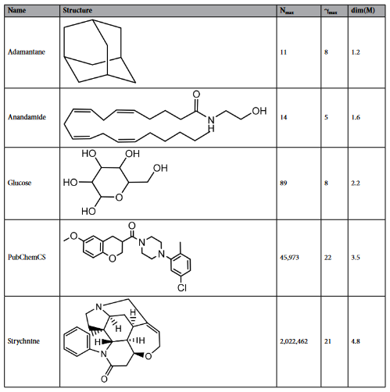
Appendix: Molecular Complexity/ Drug Discovery
Sources: (12)
Table 2: The maximum number of distinct fragments $N_{max}$, the corresponding bond count $γ_{max}$, and the fractal dimension $\dim\left(M\right)$ of the five example molecules.

Slide 36
Appendix: Molecular Complexity/ Drug Discovery
Sources: (12)
Abstract of ‘Molecular Complexity Calculated by Fractal Dimension’ by Modest von Korff in Scientific Reports (30th January 2019)

Slide 37
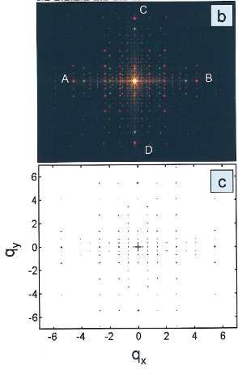
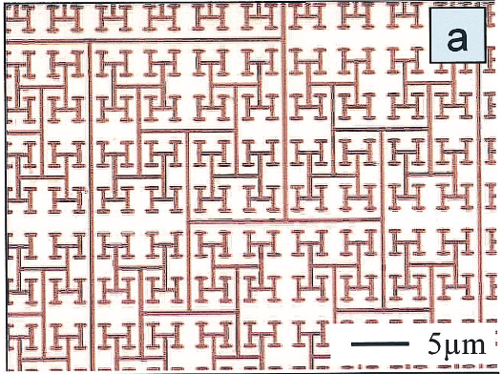
Appendix: Diffraction by an Optical Fractal Grating
Sources: (13)
Figure 6:
A part of the 15-level H-fractal grating
The experimental Fraunhofer diffraction pattern under two illuminating wavelengths: 532 nm (green) and 633 nm (red)
The calculated diffraction spectrum of the fractal grating.

Slide 38
Appendix: Diffraction by an Optical Fractal Grating
Sources: (13)
Abstract of ‘Diffraction by an optical fractal grating’ by Bo Hou in Applied Physics Letters (20th December 2004)

