Slide 1
Atomic Clocks
Claudia Volk
9.11.21

Slide 2
Contents
Clocks in General
Microwave Clocks
Rabi Method
Ramsey Interferometry
Caesium Fountain
Optical Clocks
Frequency Comb
Single Ion Clocks
Outlook
Notes:
Will talk about
General clocks, what they need, why we need then and why atoms are a good choice in clocks
Working principle of MW clocks and their current realisation
Optical clocks and the measurements of these fast frequencies
At the end an outlook with where atomic clocks go fom here

Slide 3
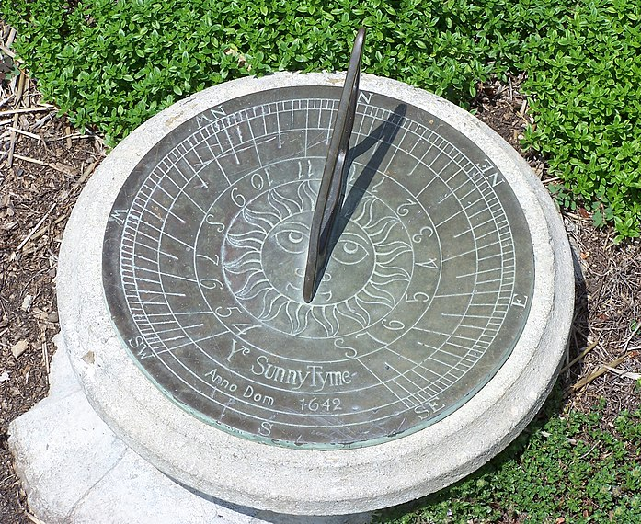
Clocks in General
Frequency standard
Clockwork
By SEWilco - Own work, CC BY-SA 3.0, https://commons.wikimedia.org/w/index.php?curid=2263164
Readout mechanism
By Rauantiques - Own work, CC BY-SA 4.0, https://commons.wikimedia.org/w/index.php?curid=70326695
Notes:
Keeping time always been important, some kinds of clocks found throughout history
Timekeeping done with counting recurring events => frequency
Clock needs a frequency standard and a setup to interpret the freq.
Will focus on the freq and ist measurement

Slide 4
Clocks in General
Cs ground state
$$6^{2}S_{1/2}$$
$$F=4$$
$9192631770$Hz
Clock Transition
$$F=3$$
Atoms as frequency standards:
Well-defined behaviour = long-term stability
Forbidden transitions have small natural linewidth
First atomic (molecular) clock in 1949 (ammonia)
First Cs clock in 1955
Since 1967: ¹³³Cs ground state hyperfine transition defines the second
Hyperfine Structure
Notes:
Why atoms as freq standards make sense?
Every atom of same species behaves the same (in same env), well described with QM
Freq of radiation from atomic transitions large and narrow natural linewidth
1st prove of principle of an atomic clock w/ freq standard supplied by a molecule in this case, in 1945
1st clock with transition in groundstate Cs as freq standard in 1955
Cs offers hyperfine slptting in its groundstate in MW range
As Cs get more precise, redefinition of second as
„The second is the duration of 9,192,631,770 periods of the radiation corresponding to the transition between the two hyperfine levels of the ground state of the cesium 133 atom.“

Slide 5
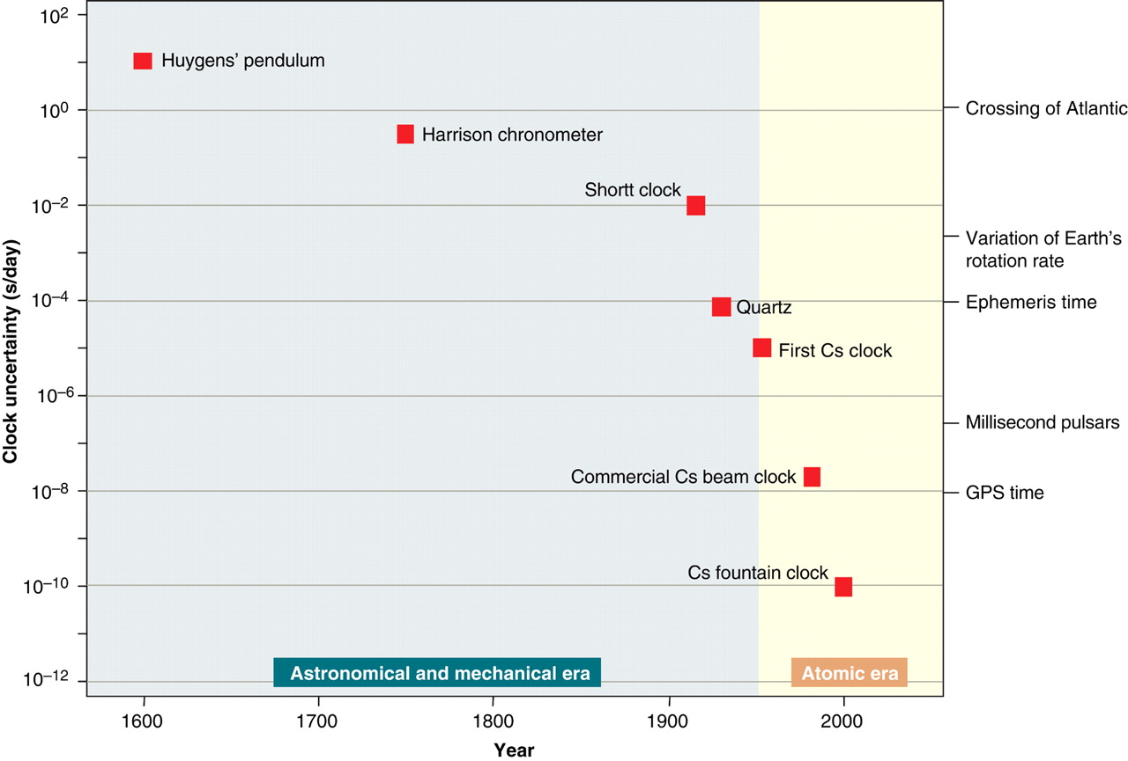
Clocks in General
Clock performance
$$σ∝\frac{1}{(f/Δf)(S/N)}$$
S.A. Diddams, J.C. Bergquist,S.R. Jefferts, C.W. Oates. Standards of Time and Frequency at the Outset of the 21st Century. Science Vol 306 5700, pp. 1318-1324 (2004)
Notes:
Clock performance is relative uncertainty of the clock frequency
Measure of precision and stability of clock
Desirable to have lange freq bc inversly proportional
See the evolution of the clock precisions over the years (log -> orders of magnitude, scale in s/day, 6 orders of magnitude different from sigma)
Uncertainty gets lower
Why do we need the precision? Not just physics, where we need precision on time for other precise measurement and getting more precise to probe for physics beyond SM
Also in technology, see standard example GPS
First discuss MW freq standards/measurements

Slide 6
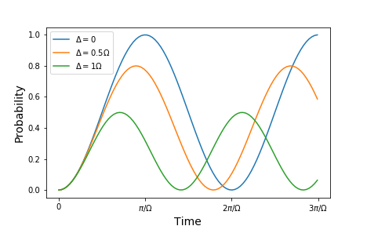
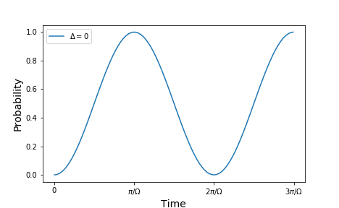
Microwave Clocks – Rabi Method
$$\left.|1\right\rangle$$
$$ℏω_{0}$$
Rabi oscillations in two-state system
$$\left.|0\right\rangle$$
$$Δ=|ω−ω_{0}|$$
$P_{0→1}\left(t\right)=\frac{1}{1+{\left(\frac{Δ}{Ω}\right)}^{2}}\sin^{2}\left(\frac{\sqrt{Ω^{2}+Δ^{2}}}{2}t\right)$
Notes:
To understand, fist remember 2 state system with certain energy difference, and Rabi oscillations
(also seen last week)
So: have 2 states and if external osc. driving field, induce Rabi oscillations between the 2 states
For system in ground state -> probability of being in either state oscillates
Oscillation of prob. depends on rabi freq (determined by the interaction of system with ext. osc. field) and detuning of osc. field and transition freq
For osc. Field freq=transition freq -> see first picture
For detuning, no 100% chance to go to the other side

Slide 7
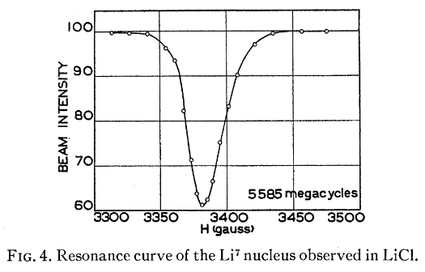
Microwave Clocks – Rabi Method
Interaction zone
State selector
State dependent detector
oven
beam
T
Used to measures nuclear magnetic moments
Resolution limited by E-t-uncertainty
Problems with making T very large → other solution
Notes:
Use this to measure freq
Have atom w 2 levels in beam
Select ground state
Have osc. field (here mag field) for interaction time T
Detect how many are in state 1 vs. 2
Signal depending on detuning
Less used for freq measurements , more measure mag moment
Resolution limited by interaction time
Time cant be made very large

Slide 8
Microwave Clocks – Ramsey Interferometry
1
2
3
IZ 1
$$\frac{π}{2}$$
IZ 2
$$\frac{π}{2}$$
State selector
State dependent detector
oven
beam
T
π/2-pulse: superposition state from pure state
Propagation: accumulate phase according to detuning
π/2-pulse: outcome depending on phase
Notes:
Ramsey came up with method using 2 seperate osc field interaction zones and field free propagation in between
Called Ramsey interferometry
Start the same,
In IZ1 apply pi/2 pulse -> create superposition state (see plot)
After: free flight, naturally osc w natural freq
Then comes to IZ2, another pi/2 pule applied to system, outcome depends on relative phase between superpos and osc field

Slide 9
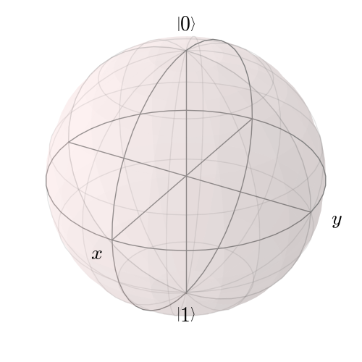
Microwave Clocks – Ramsey Interferometry
Probability $P_{0→1}$
detuning $Δ$
[By Geek3 - Own work, CC BY 3.0, https://commons.wikimedia.org/w/index.php?curid=35518170]
Notes:
This can be visualised w vectors on a bloch sphere (all possible superpos on surface)
Start in ground state, pi/2 brings into equitorial plane
In free TOF
If no detuning: state oscillates in phase with ext. em field => no phase difference
If detuning : difference in oscillation, accumulate phase ange in TOF
2nd pi/2
What happend depends sensitively on phase difference acquired in TOF
Resonant: no phase, state 1
Detuning: state with P \ne 1
Signal looks like picture, envelope from Rabi, structure due to TOF phase
Width of structure now with 1/T TOF time
Next to middle peak is where phase is 2 pi

Slide 10
Microwave Clocks – Ramsey Interferometry
Caesium ground state
$$6^{2}S_{1/2}$$
$$F=4$$
$9192631770$Hz
Clock Transition
$$F=3$$
Hyperfine Structure
Best precision: 3.5 × 10⁻¹⁵
[Lombardi, Michael. (2012). The evolution of time measurement, Part 4: The atomic second [Recalibration]. IEEE Instrum. Meas. Mag.. 15. 47-51. 10.1109/MIM.2012.6145262. ]
Notes:
Setup for a Cs clock, see level structure for 2 states
See same components as before
State selector is stern gerlach type
MW cavity has 2 IZ and field free propatgation in middle
Clockwork shown,
Stabilises MW freq w detector feedback & transforms freq into usable range
Highels precision with beam clock (more refined setup, but very similar) was 3.5 10^-15

Slide 11
Microwave Clocks – Caesium Fountain
Ramsey cavity
Magneto-optical trap
Best precision: 1.5 × 10⁻¹⁶
[https://www.nist.gov/pml/time-and-frequency-division/time-realization/primary-standard-nist-f1]
Notes:
More current way to realise Ramsey setup for a clock, is Cs fountain
Principle same as before, with 2 pi/2 pulses and propagation inbetween
Start in MOT, atoms accelerated upwards,
State selection (not pictured)
Through MW cavity 1st time
Propagate upwards, slowed by grav pull, fall back down
Pass though MW 2nd time
Detection
Precision more than order of mag better at 1.5 10^-16
Main advantage: lot longer TOF time with rel short setup

Slide 12
Microwave Clocks – Caesium Fountain
[https://cdnapisec.kaltura.com/index.php/extwidget/preview/partner_id/684682/uiconf_id/31013851/entry_id/0_3lizxjj6/embed/dynamic]
Notes:
Viedo shows measurement sequence

Slide 13
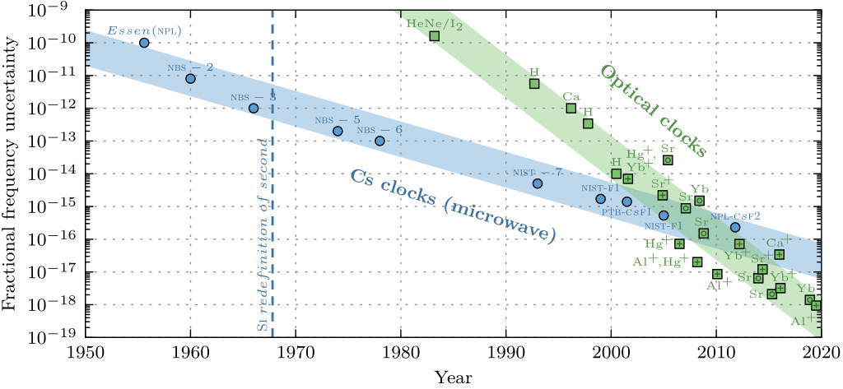
Optical Clocks
Remember: Clock performance
$$σ∝\frac{1}{(f/Δf)(S/N)}$$
Higher frequencies can lead to higher clock precisions
[Dijck, E. (2020). Spectroscopy of Trapped ¹³⁸Ba⁺ Ions for Atomic Parity Violation and Optical Clocks. University of Groningen.]
Frequency comb (1998)
Notes:
Remember freq dependance of clock precision
Possibility to be more precise with highter freqs
Problem with measuring fast frequencies, not electronically possible (visible light 400 – 800 THz vs. MW ~GHz)
First try with harmonic frequency chain (phase locked oscillator, starting from Cs clock) but thechnical problems, and only one frequency can be measured
Significant discovery→ Frequency comb (1998), started being used in clocks in 2000

Slide 14
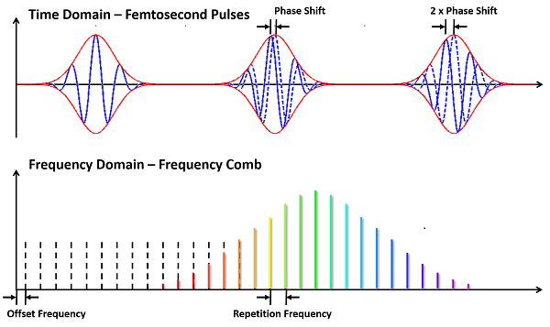
Optical Clocks – Frequency Comb
Mode-locked femtosecond laser
„Ruler in frequency space“
Link between microwave and optical frequencies
$$f_{n}=nf_{r}+f_{o}$$
[https://vahala.caltech.edu/research/applications/freqdiv]
Notes:
Freq comb is mode locked femtosec laser
Calles ruler in freq space
Provides link between mw and optical freq
Picture:
See pulses in time, with a fixed repetition rate, but also phase relation
With applying FT (or rather FS), see distinct, evenly spaced lines in spectrum
Contributing freqs in the spectrum can all be expressed with formula, from 2 freqs in the MW regime
Repetition freq is pulse rate
Offset freq is related to phase shift between adjacent pulses

Slide 15
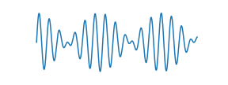
Optical Clocks – Frequency Comb
[https://vahala.caltech.edu/research/applications/freqdiv]
$$nf_{r}+f_{o}$$
$$2nf_{r}+f_{o}$$
beat $Δf$
×2
beat $f_{o}$
Notes:
Have freq comb -> how to get the MW freqs
Rep freq easiest, straight forward, is pulse rate
For easiest offset measurement, need comb to span an octave, nth freq on lower end, 2nth on higher end
Freq double lower, overlap the 2, get beat with offset freq
Remember, when 2 waves w/ slightly different
Last but not least, monochromatic laser can be measured with a freq comb, eg by getting the difference to the neighbouring tooth with a beat

Slide 16
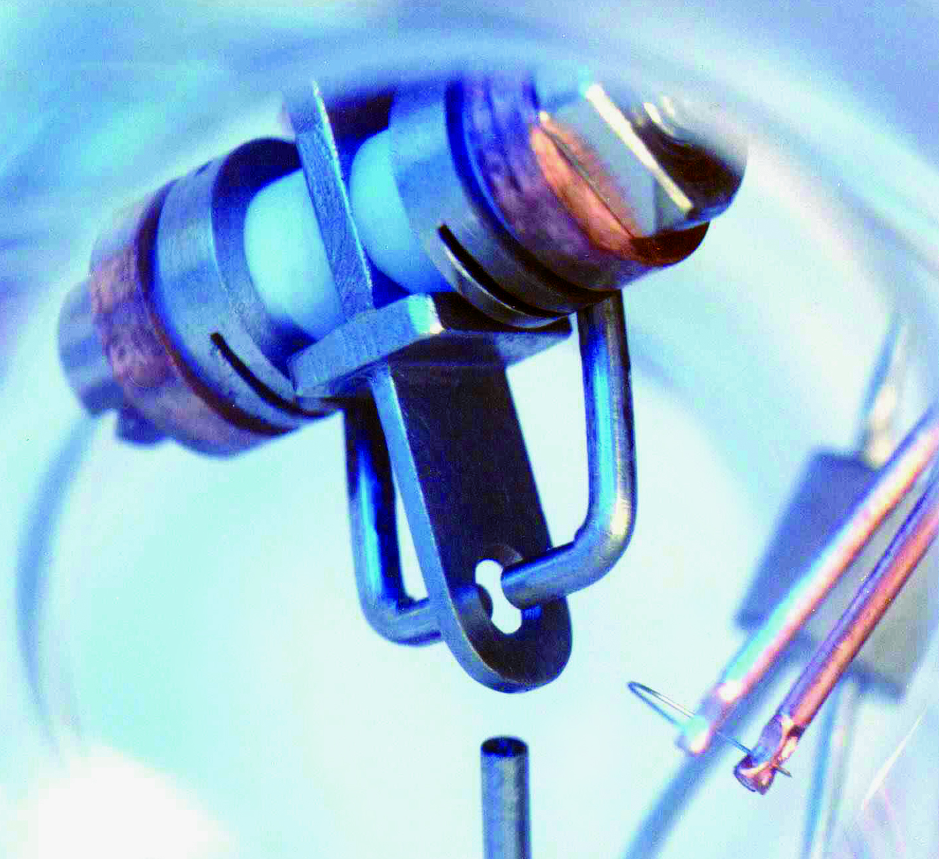
Optical Clocks – Single Ion Clocks
Detection
Time signal
Single Yb⁺ ion in a trap
Electronics,
Recording and
Processing
[Physikalisch-Technische Bundesanstalt/www.ptb.de]
Clock laser
Best precision:
3.2 × 10⁻¹⁸
Frequency comb
MW measurement
Notes:
Now we can finally use this in an optical atomic clock
For example a single ion clock
Single ion (for instance Yb+) in an ion trap, usually a Paul trap
Clock laser probes clock transition of ion, and is stabilisedwith /locked to freq comb
Combs mw freqs are measured and compared to Cs clock which by definition provides exact value of second

Slide 17
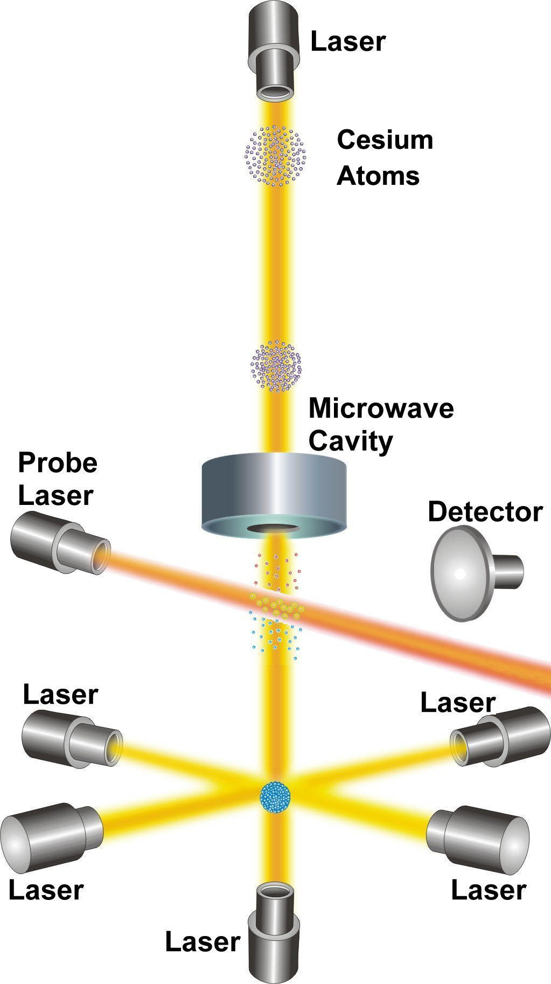
Summary
Type of frequency standard | Clock frequency | Highest precision
Atomic beam – ¹³³Cs | 9.192 631 770 GHz | 3.5 × 10⁻¹⁵
Caesium fountain | 9.192 631 770 GHz | 1.5 × 10⁻¹⁶
Single ion clock – ¹⁷¹Yb⁺ (octupole) | 642.121 496 772 THz | 3.2 × 10⁻¹⁸
Optical lattice clock (⁸⁷Sr) | 429.228 004 229 THz | 2.1 × 10⁻¹⁸
Notes:
Heard about 3 different methods how freq standards are used in atomic clocks, and their best precisions achieved to date
There are many more, included in this table is optical lattice clock w neutral Sr, bc it is the most precise so far
Where do we go from here?

Slide 18
Outlook
Highly charged ion frequency standards
Nuclear excitation frequency standards (^{229m}Th)
→ Towards 10⁻¹⁹ precision
[Micke, P., Leopold, T., King, S.A. et al. Coherent laser spectroscopy of highly charged ions using quantum logic. Nature 578, 60–65 (2020)]
Notes:
Possible higher precisions with
HCIs as freq standards (hyperfine structure in optical range due to high charge, less susceptive to external perturbations, sensitive to changes in alpha)
Nuclear transitions as freq standard (usually too high energy, but optical found in 229Th nucleus)

Slide 19
Thank you for your attention

Slide 20
References
W. Nawrocki. Introduction to Quantum Metrology. 2nd Ed., Springer Nature Switzerland AG 2019, pp. 217-244
N.F. Ramsey. A Molecular Beam Resonance Method with Separated Oscillating Fields. Phys. Rev. 78, 695 (1950)
N.F. Ramsey. History of atomic clocks. Journal of Research of the National Bureau of Standards 88, pp. 301–320 (1983)
K. Szymaniec, W. Chalupczak, P.B. Whibberley, S.N. Lea and D. Henderson. Evaluation of the primary frequency standard NPL-CsF1. Metrologia 42 49 (2005)
T. Udem, R. Holzwarth, T. Hänsch. Optical frequency metrology. Nature 416, 233–237 (2002)
N. Poli, C.W. Oates, P. Gill, G.M. Tino. Optical Atomic Clocks. Rivista Del Nuovo Cimento, 36, 555–624. (2013)
N. Huntemann, C. Sanner, B. Lipphardt, Chr. Tamm, E. Peik. Single-Ion Atomic Clock with 3×10⁻¹⁸ Systematic Uncertainty. Phys. Rev. Lett. 116, 063001 (2016)

Slide 21
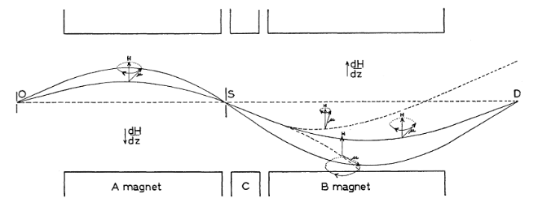
Microwave Clocks – Rabi Method
[I. I. Rabi, S. Millman, P. Kusch, and J. R. Zacharias, Phys. Rev. 55, 526, 1939]

Slide 22
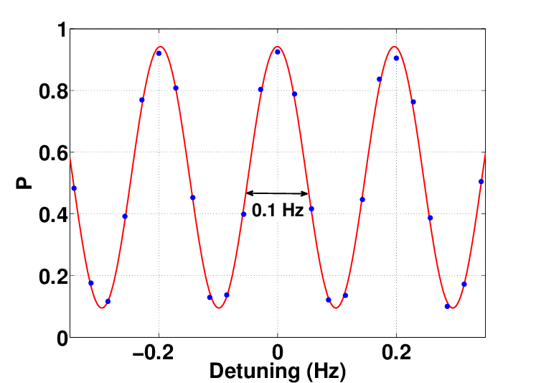
Microwave Clocks – Ramsey Interferometry
Examples of Ramsey fringes
Szmuk, Ramon & Dugrain, Vincent & Maineult, Wilfried & Reichel, Jakob & Rosenbusch, Peter. (2015). Stability of a Trapped-atom Clock on a Chip. Physical Review A. 92. 10.1103/PhysRevA.92.012106.

Slide 23
Microwave Clocks – Ramsey Interferometry
Caesium levels
$$F=5$$
$$6^{2}P_{1/2}$$
$$F=4$$
$$F=3$$
$$F=2$$
$$6^{2}S_{1/2}$$
$$F=4$$
$9192631770$Hz
Clock Transition
$$F=3$$
Fine Structure
Hyperfine Structure

Slide 24
Optical Clocks – Single Ion Clocks
¹⁷¹Yb⁺ energy levels
[Gill, Patrick. (2011). When should we change the definition of the second?. Philosophical transactions. Series A, Mathematical, physical, and engineering sciences. 369. 4109-30. 10.1098/rsta.2011.0237. ]

Slide 25
Main errors
Atomic beam | Cs fountain | Single ion clock
2nd order Doppler | Collisions | 2nd order Doppler
Microwave effects | BBR | BBR
 | Microwave effects | Light shift (Probe)

