Slide 1
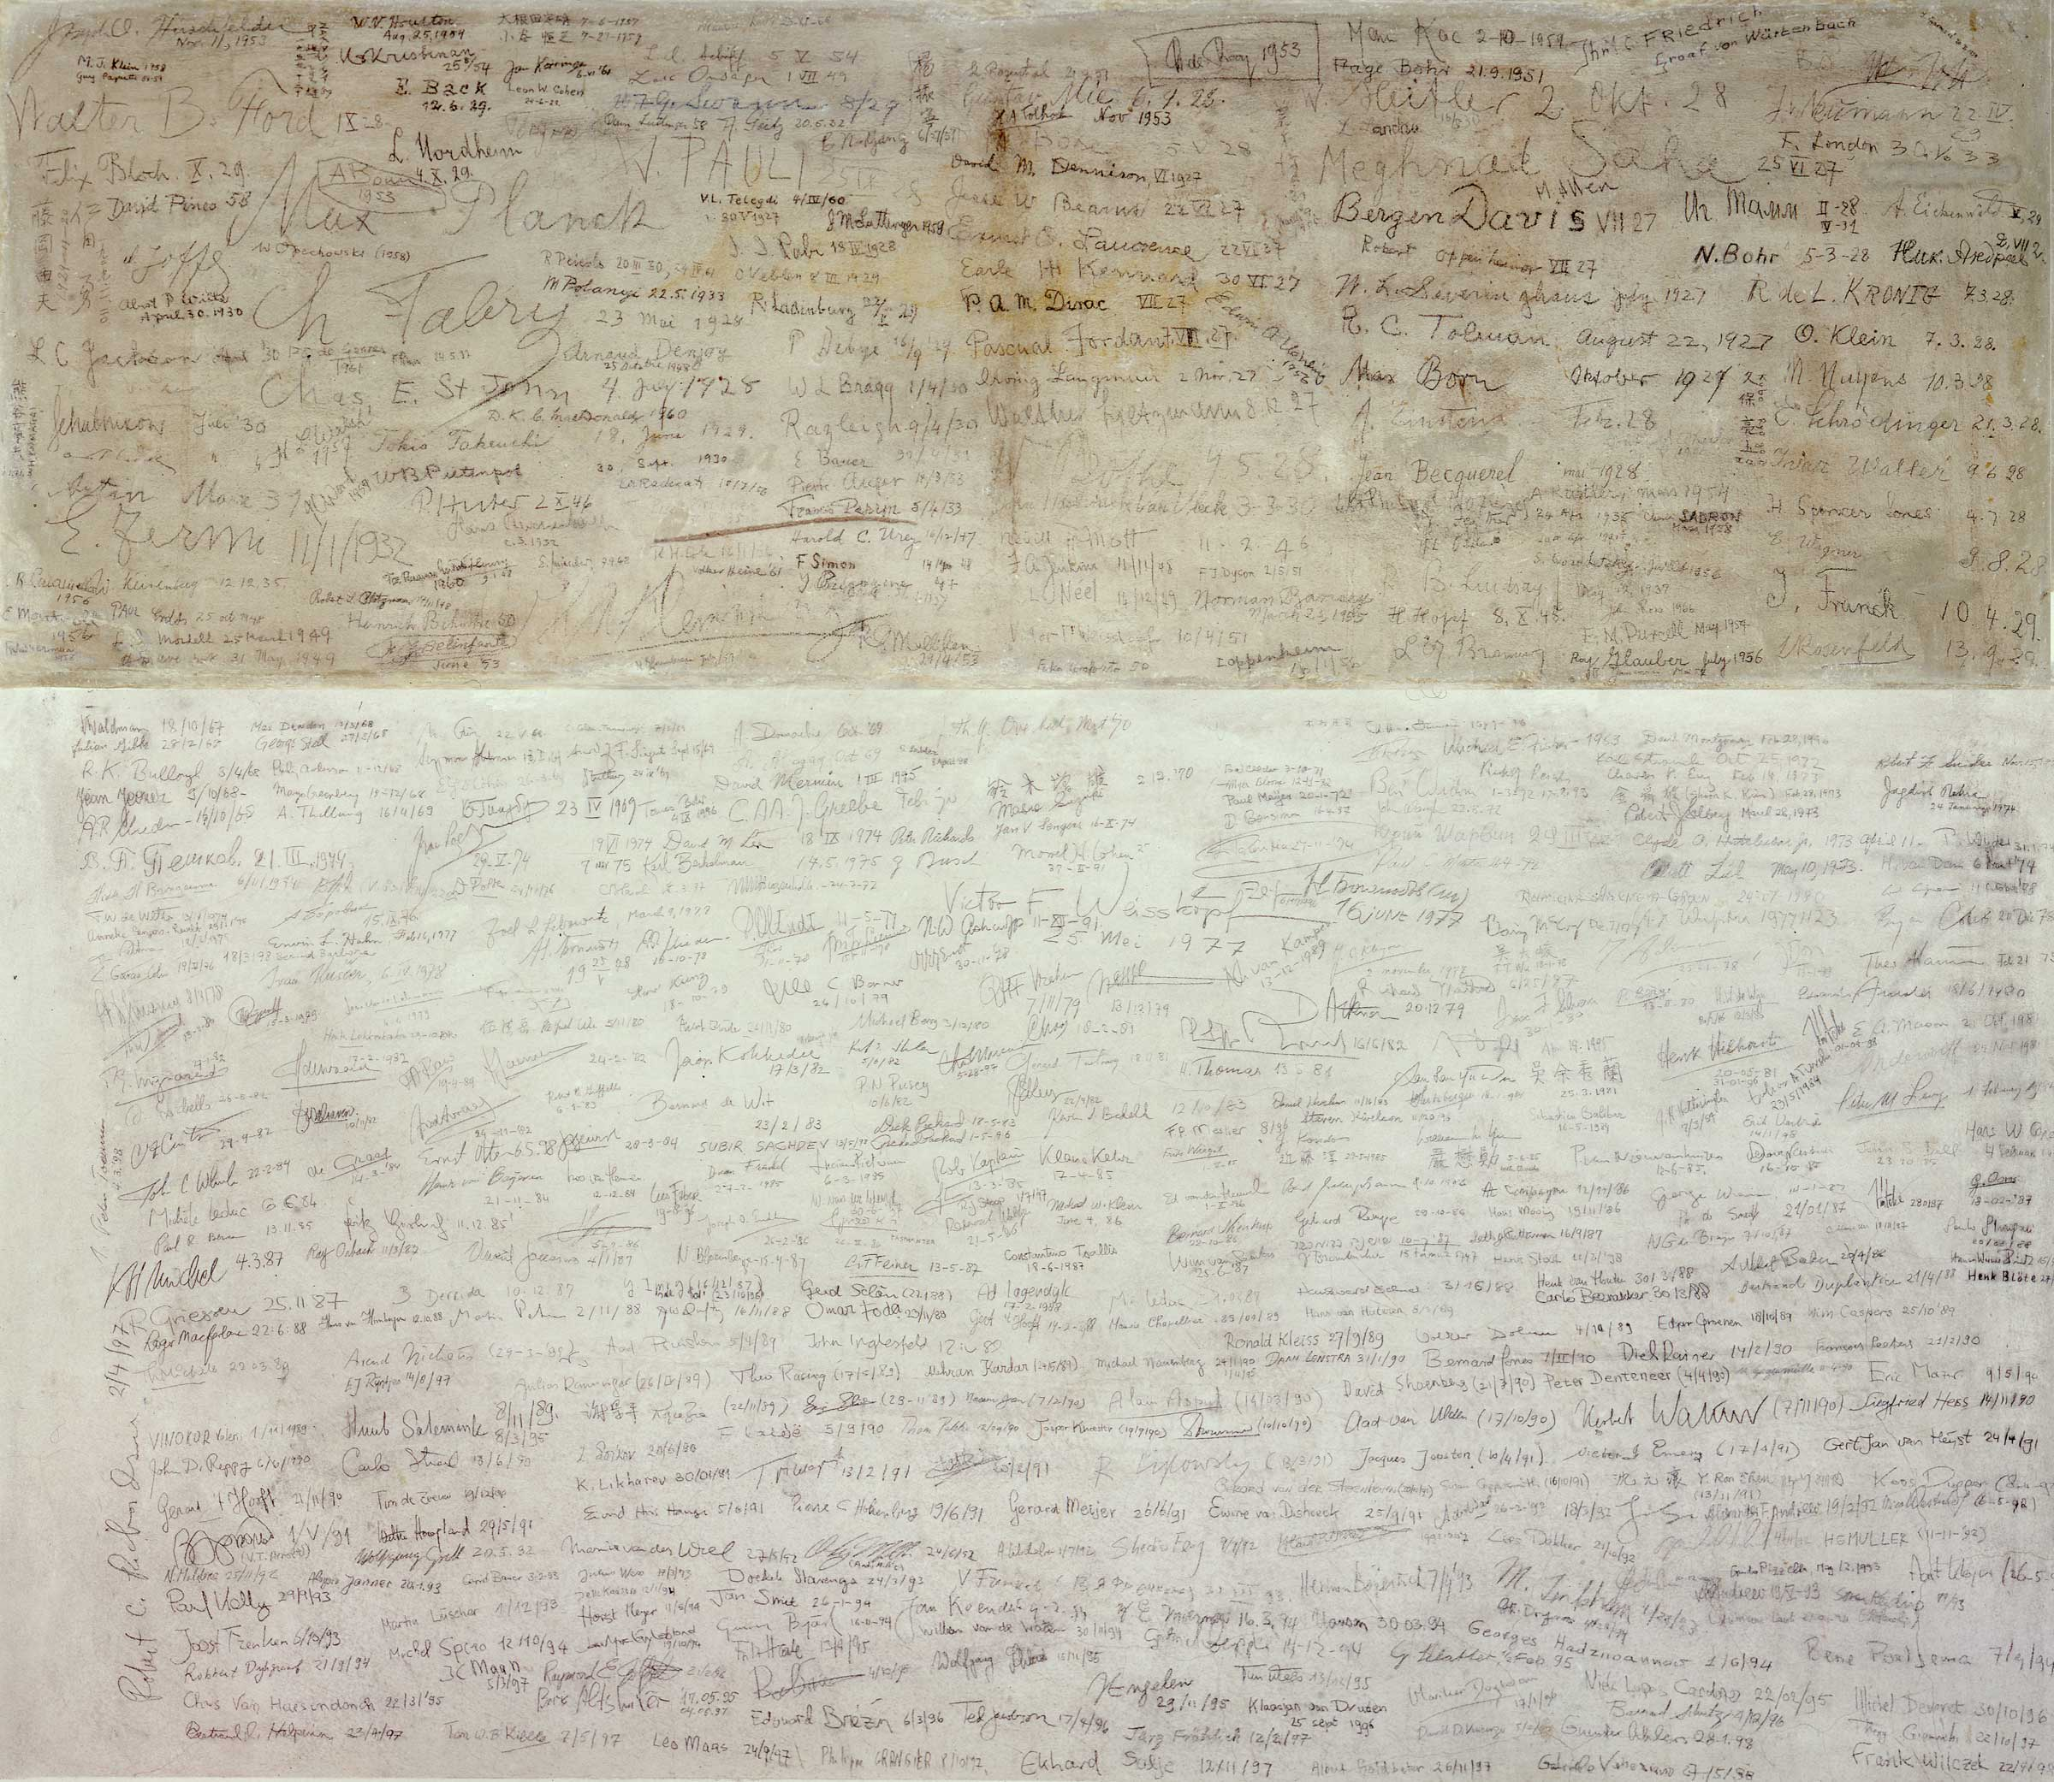
Reaching low temperatures
Lukas Berger
2021
https://www.lorentz.leidenuniv.nl/history/colloquium/muur_2004/muur_2004_heel_gr.jpg?w=400

Slide 2
Table of Content
Why low temperatures
A historical view
Expansion Engines
Joule-Thomson Expansion
Dilution Refrigeration
Nuclear Demagnetization
Summary and where it is used now
Lukas Berger
2

Slide 3
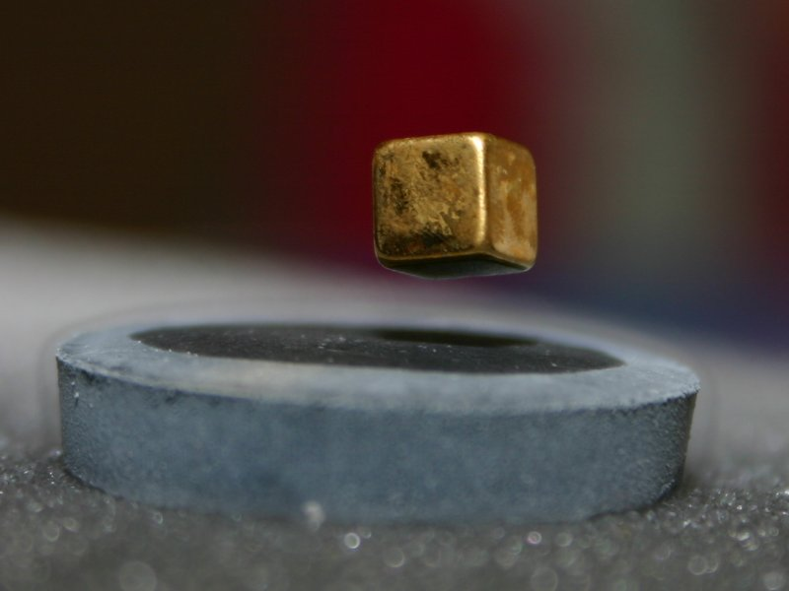
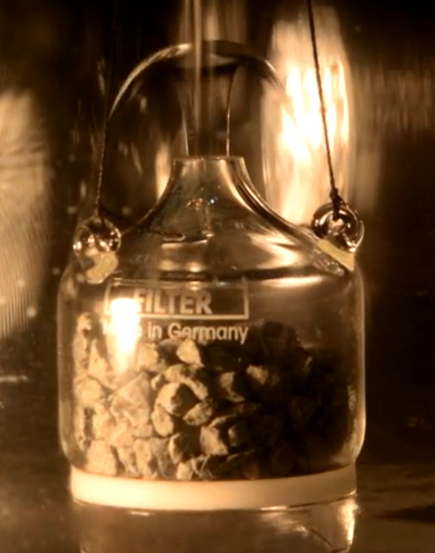
Why low temperatures
Low noise measurements
Different timescales
Freezing out degrees of freedom
Superconductivity
Superfluidity
https://de.wikipedia.org/wiki/Supraleiter#/media/Datei:Magnet_4.jpg
LTP Vorlesung Enss Heidelberg 2020
Lukas Berger
3

Slide 4
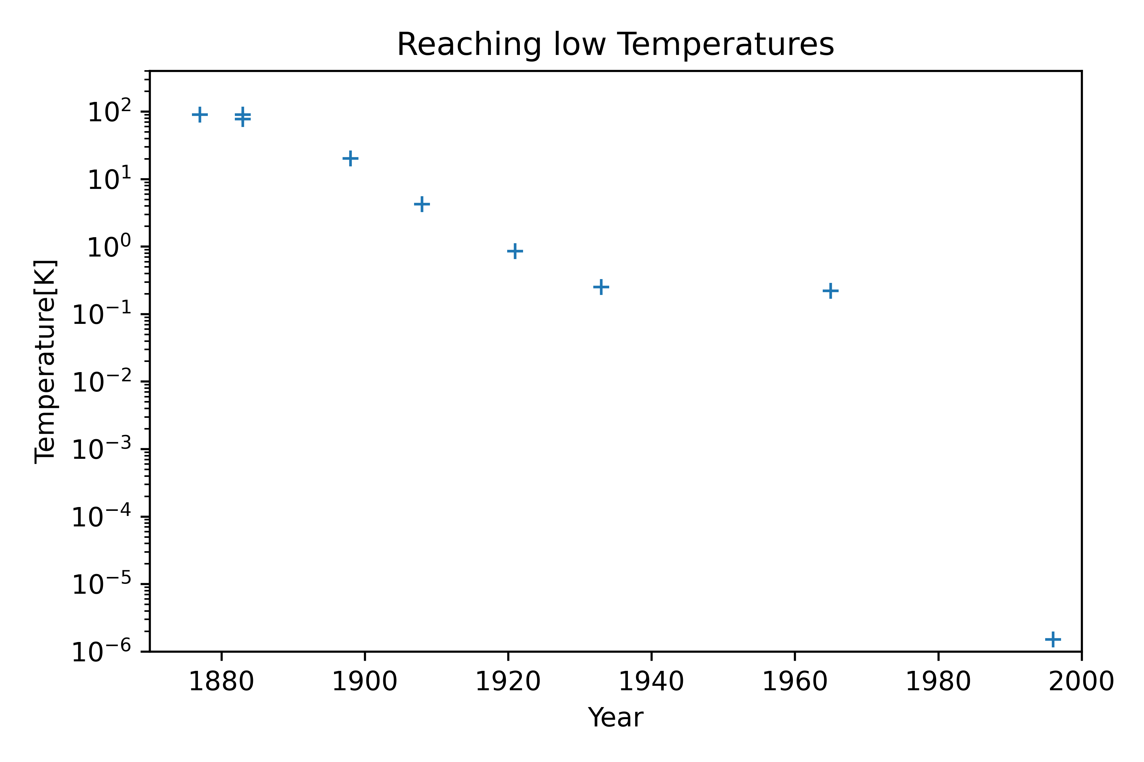
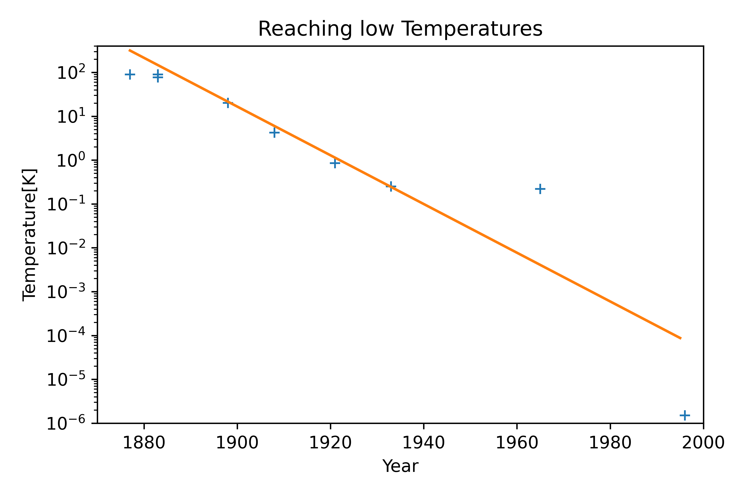
O₂
N₂
H₂
⁴He
⁴He pumping
paramagnetic demagnetization
dilution refrigeration
nuclear demagnetization
Lukas Berger
4
Notes:
1877 first Fog of O₂
Usable amounts of

Slide 5
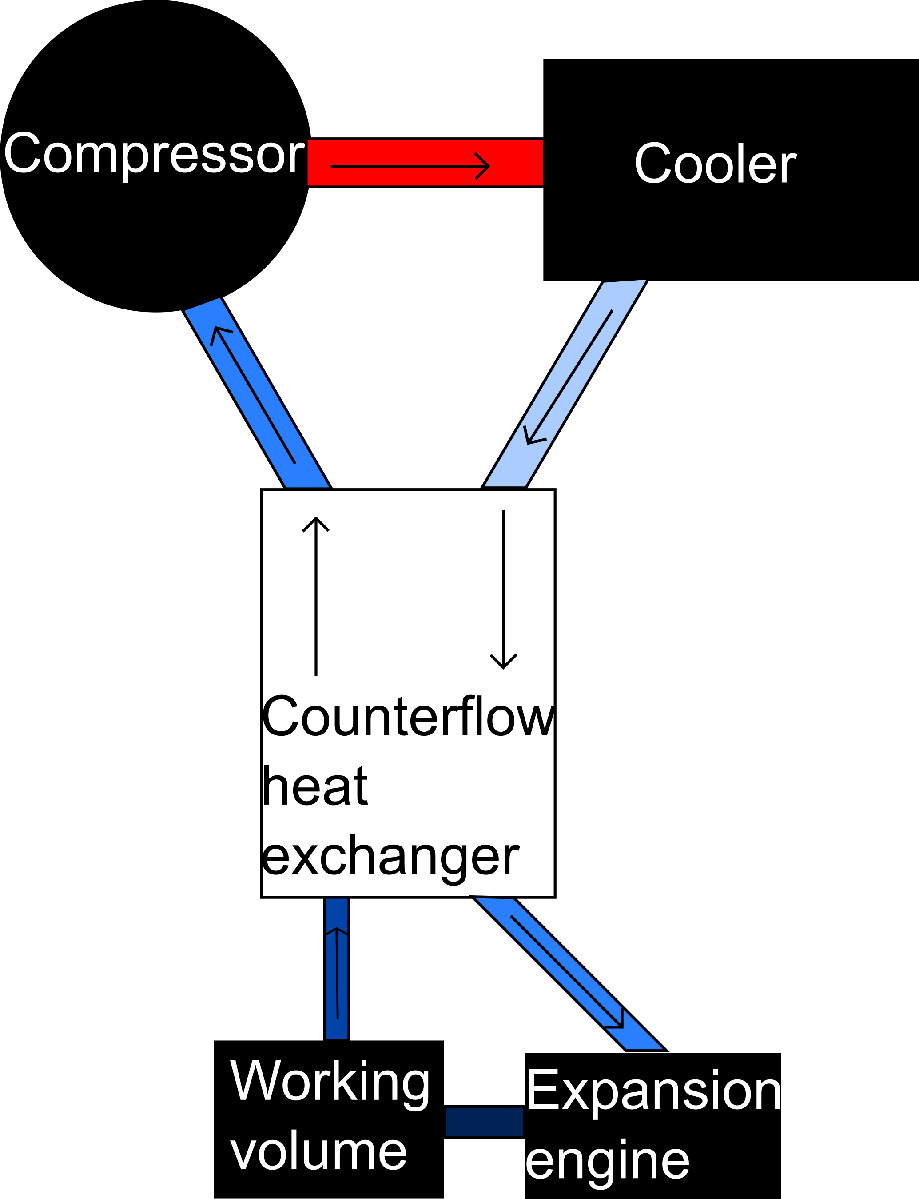
Expansion engines
Compressing at room temperature
Approximately adiabatic process
Cooling gas has to be above critical temperature
Lukas Berger
5
Notes:
Often used for precooling
Kappa=5/3 monoatomic gas
Kappa= 7/5 diatomic gas
Often multistage configuration
Problems: expanding gas drives a slightly braked turbine (lubricating)
Counterflow exchanger not impede gas flow but very large surface

Slide 6
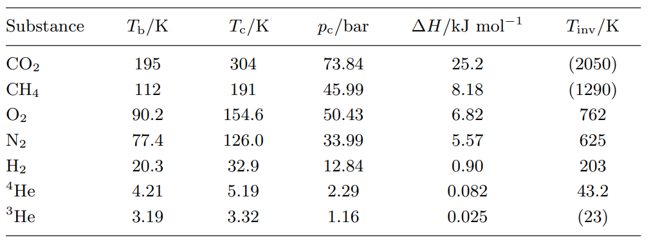
Low temperature physics Enss Hunklinger
Lukas Berger
6

Slide 7
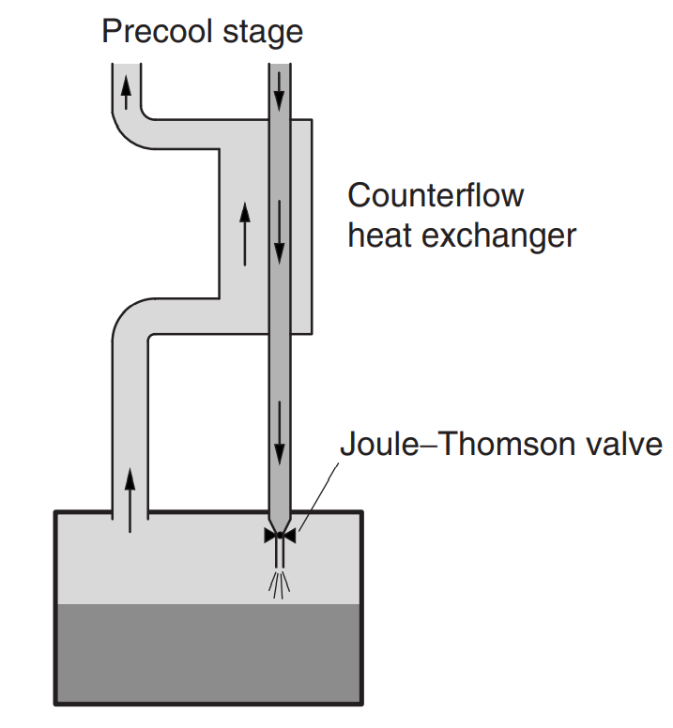
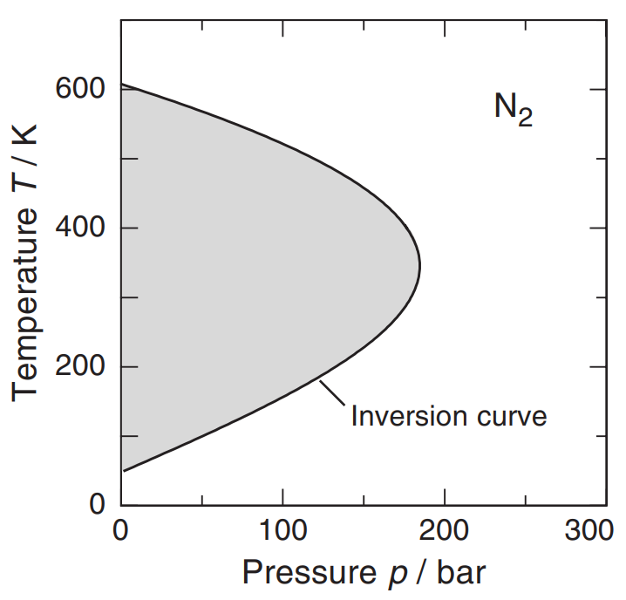
Joule-Thomson Expansion
Gas performs work against internal forces
no temperature reduction with ideal gases
Isenthalp pressure reduction
Heating or cooling
Joule-Thomson-coefficient
Low temperature physics: Enss; Hunklinger
Low temperature physics: Enss; Hunklinger
Lukas Berger
7
Notes:
Constant enthalpie, no work,H1= H2
Inner energy is volume dependend
Joule Thomson koefficient > 0 for cooling
Under inversion temp and inversion pressure
Combination with expansion engines are called claude cycle

Slide 8
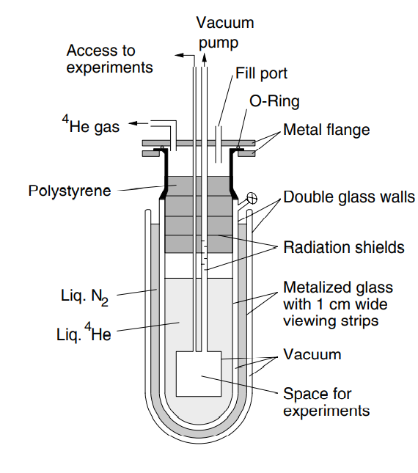
(Helium-)Bath Cryostats
Clausius-Clapeyron
Vacuum-isolated glass vessels (Dewar vessels) (down to 4.2 K)
Can be pumped to reach lower temperatures
→ Evaporation Cryostats (down to 1.3 K)
High consumption of Helium (40%)
Low temperature physics: Enss; Hunklinger
Lukas Berger
8
Notes:
Enthalpy change of 300K to 4.2K: 200 kJ/l latent heat of evaporation: 2.6 kJ/l helium can defuse through glas at room temp-> Dewar vacuum has to be pumped regularly
To safe helium use of smaller system that can be refilled via small capillary
Clausius Clapeuron L is latent heat, V is volume change from liquid to gas

Slide 9
⁴He vs. ³He
⁴He:
Boson(I=0)
Liquid at T=0 (and normal p)
He-I, normalfluid
He-II, superfluid
Boilingtemperature: 4.21
Density at boiling point: 0.055 g/cm³
³He:
Fermion(I=1/2)
Liquid at T=0 (and normal p)
He-N, normalfluid
He-A, He-A1, He-B, superfluid
Boilingtemperature: 3.19
Density at boiling point: 0.145 g/cm³
Lukas Berger
9
Notes:
Evaporation cooling Helium 3 (0.24 K)

Slide 10
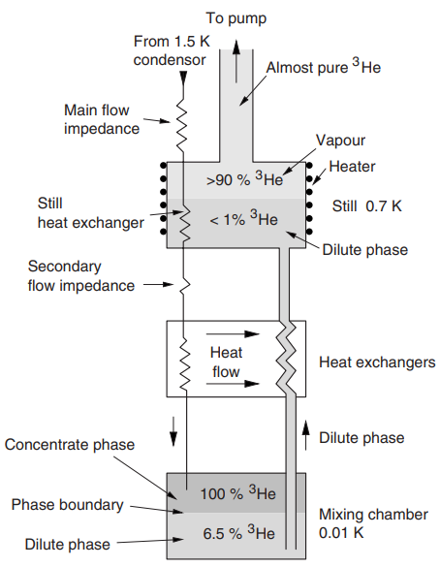
Dilution Refrigeration
Kinetic Energy of ³He rises with density of ³He (Fermi-statistics)
effective binding energy is reduced
At 6.5% ³He in ⁴He binding energy vanishes (T→0)
Phase separation in ⁴He/³He-mixtures (0.86K)
A light ³He-rich phase and a heavy mixed phase
³He has lower entropy in the ³He-rich phase
Low temperature physics: Enss; Hunklinger
Lukas Berger
10

Slide 11
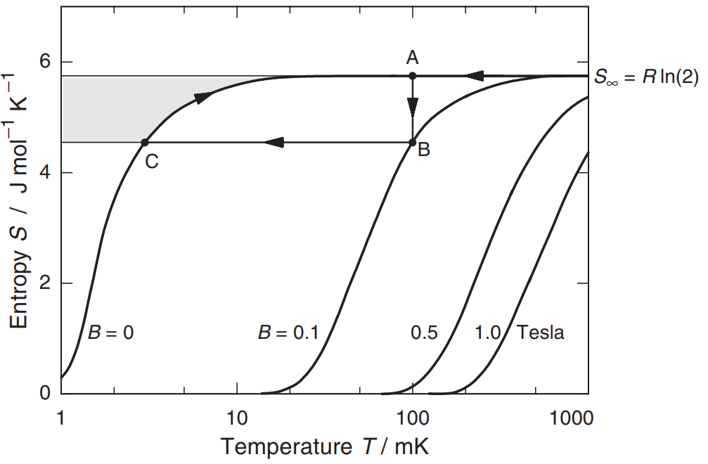
Magnetic refrigeration
spin entropy is magnetic field dependent
Cooled magnetization
Adiabatic demagnetization
Isomagnetic entropic transfer
Low temperature physics: Enss; Hunklinger
LTP Vorlesung Enss Heidelberg 2020
Lukas Berger
11

Slide 12
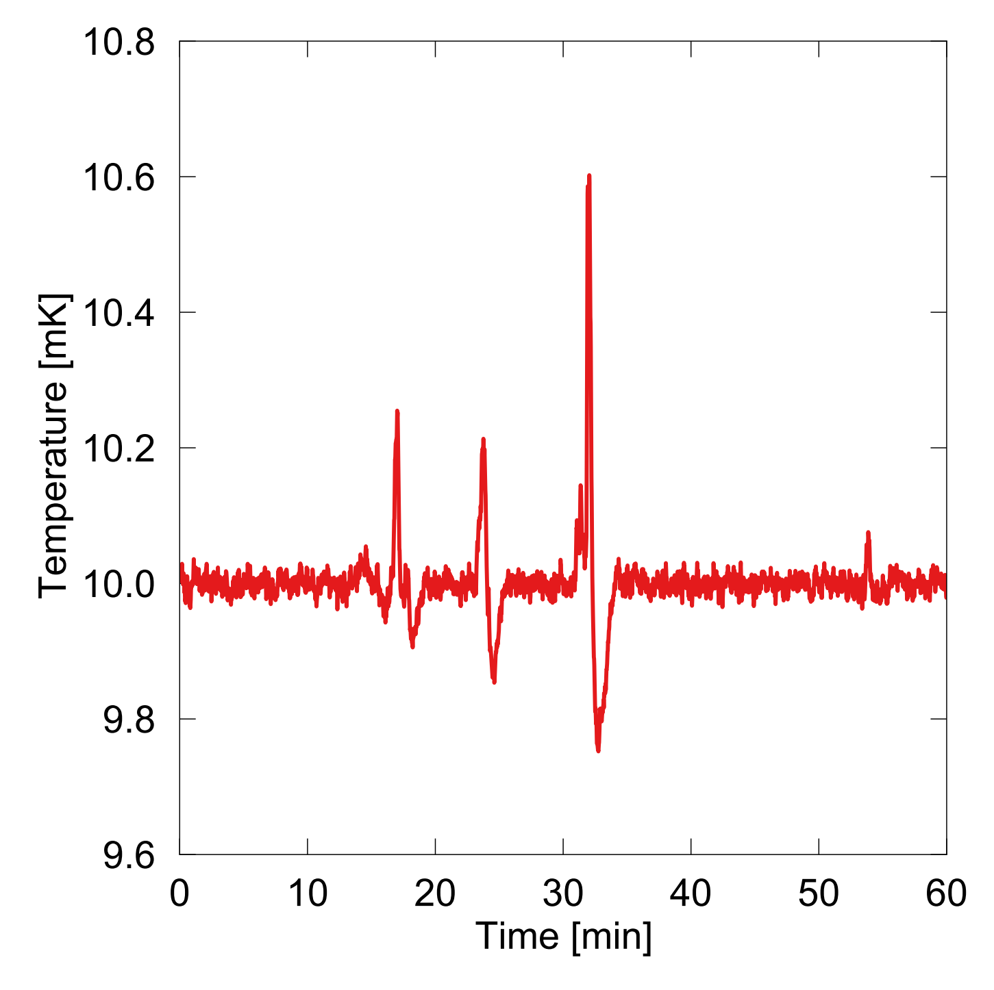
Technical Problems magnetic refrigeration
Nuclear spin
Heat switch (superconducting)
Thermally isolated for long time
T<100 µK, a leak has to be smaller than 10⁻⁹ W
(eg. 2 × 10⁻⁶ W for a typical watch)
Vibrations (eddy currents in magnetic field)
Cosmic rays (10⁻¹¹ W)
Jan Blickberndt
Lukas Berger
12

Slide 13
Summary
Expansion Engine
Joule-Thomson Expansion
(Helium-)Bath Cryostats
Dilution Refrigeration
Magnetic refrigeration
T>5.19K
T≈4.2K
T≈1K
T≈0.01K
T≈10⁻⁶K
Lukas Berger
13

Slide 14
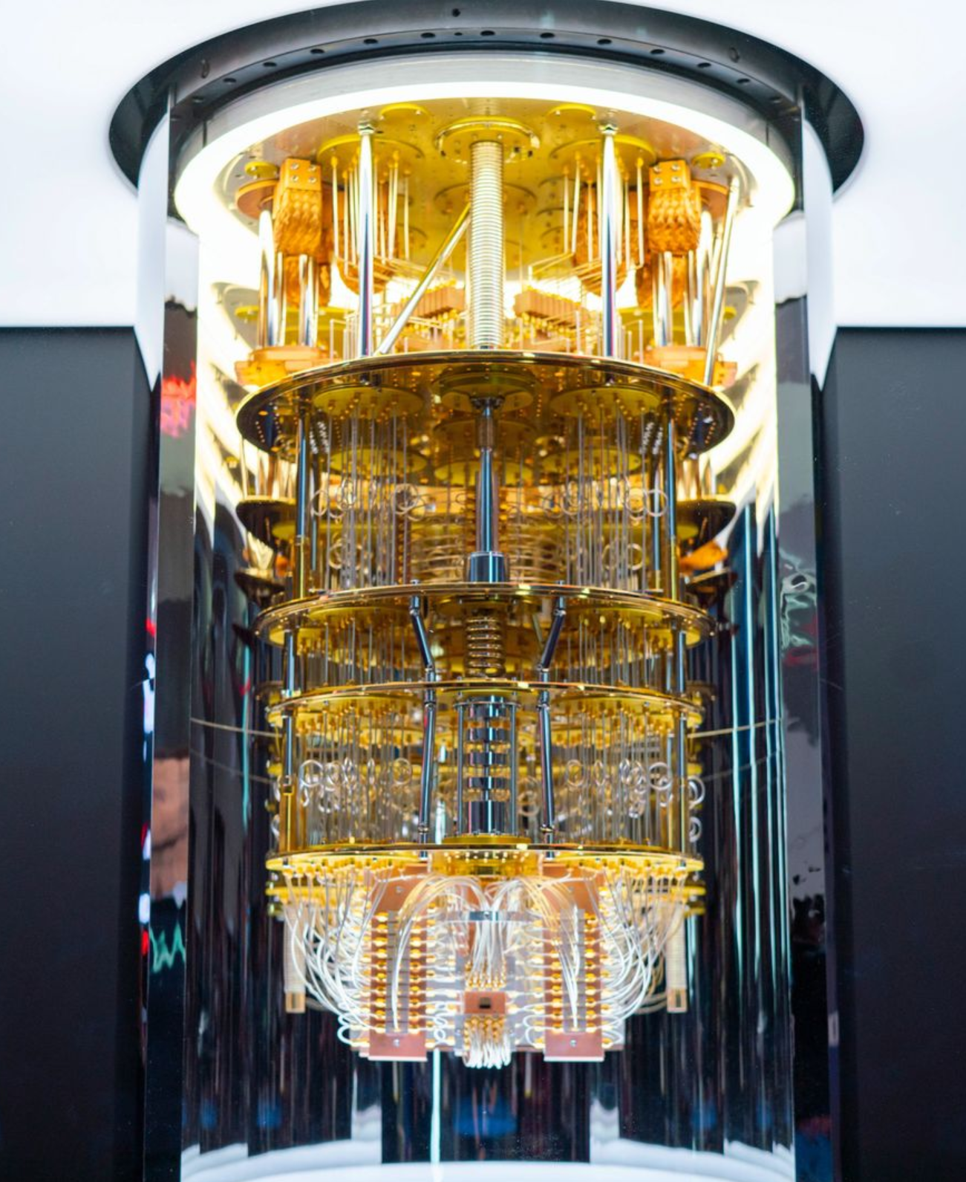
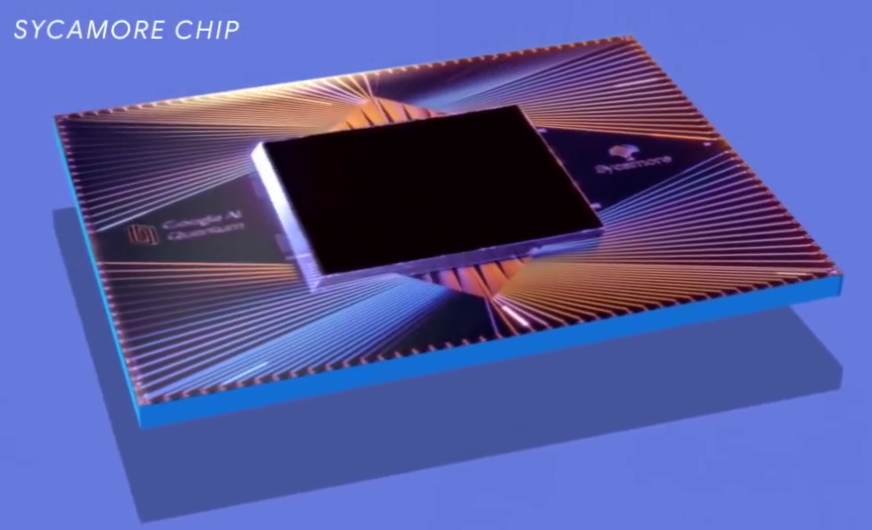
Where is it used now?
Quantum processors
Josephson-junctions
→Superconducting
Dilution Refrigeration
https://cdn.prod.www.spiegel.de/images/00e7eacb-ae92-4b00-90aa-303d03558082_w1600_r1.4992503748125936_fpx52.67_fpy44.98.jpg
Lukas Berger
https://en.wikipedia.org/wiki/Sycamore_processor#/media/File:Google_Sycamore_Chip_002.png
14

Slide 15
Citations
Enss, Hunklinger: Low-Temperature Physics, 2005
Pobell: Matter and Methods at Low Temperatures, 2007
Lecture: Enss, Reiser: Low temperature physics Heidelberg, 2020
Lecture: Klingeler: Condensed Matter Physics Heidelberg, 2021
Frossati, G. Experimental techniques: Methods for cooling below 300 mK. J Low Temp Phys 87, 595–633 , 1992
Lukas Berger
15

Slide 16
Thank you for the attention
Questions?
Lukas Berger
https://www.lorentz.leidenuniv.nl/history/colloquium/muur_2004/muur_2004_heel_gr.jpg?w=400

