Slide 1
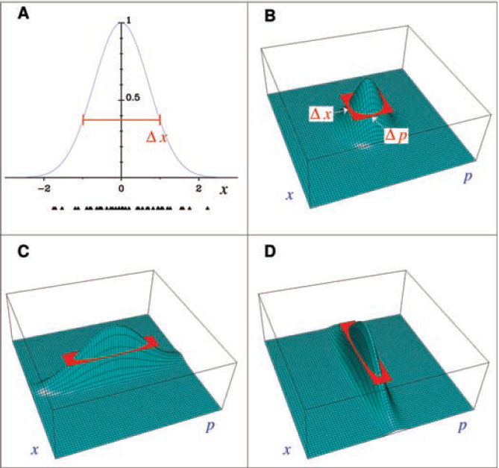
Quantum Metrology
Beyond the Standard Quantum Limit
Lee Junhee
Vittorio Giovannetti. (2004) Quantum-Enhanced Measurements:
Beating the Standard Quantum Limit

Slide 2
Outline
1. Measurements Limits
Familiar limit: Rayleigh’s criteria.
Heisenberg uncertainty & Standard Quantum limit
2. Standard Quantum Limit
Definition
Typical Example in Optical Experiment set up
3. Classical Measurement Scheme
Mach-Zehnder Interferometer

Slide 3
Outline
4. Quantum Measurement Scheme (Squeezed State)
Definition
Experimental realization
Beyond SQL
Application Ex: LIGO
5. Quantum Measurement Scheme (N00N State)
Definition
Experimental Realization
Advantages
Application Ex: Protein Concentration
6. Summary and Back to Heisenberg uncertainty

Slide 4
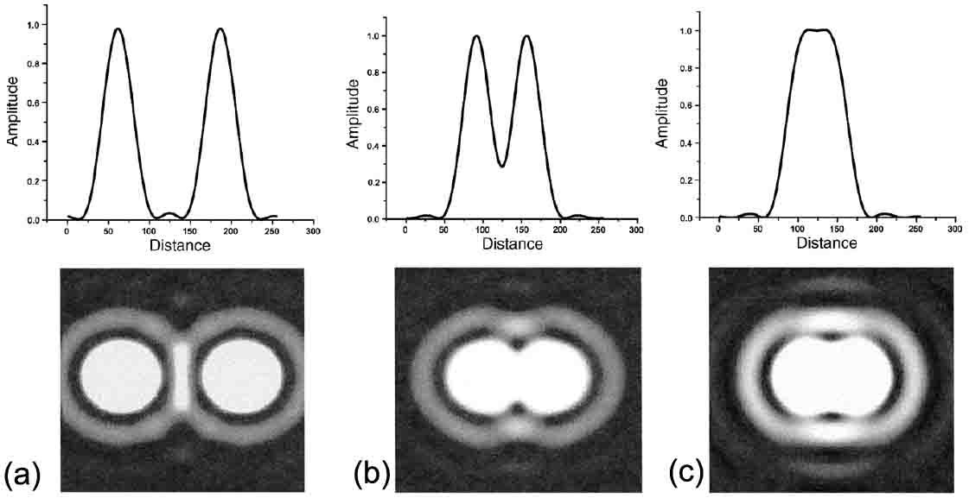
1.Optical Microscopy
https://www.sciencedirect.com/topics/engineering/optical-microscope
https://www.globalsino.com/EM/page1982.html

Slide 5
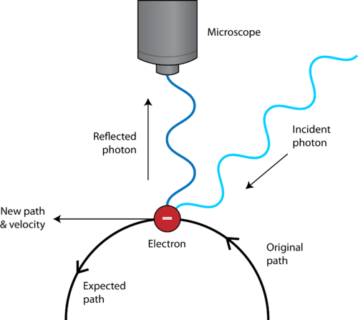
1. Heisenberg Uncertainty
Fundamental limits of Nature
No matter the way you measure the system
Action of Measurement affects to state
https://www.ck12.org/c/chemistry/heisenberg-uncertainty-principle/lesson/Heisenberg-Uncertainty-Principle-CHEM/

Slide 6
2. (Standard) Quantum Limit
1. Back Action
Max. Accuracy at
quantum scale
2. Intensity noise
Standard Quantum Limit
3. Phase noise
4. Reduceable error

Slide 7
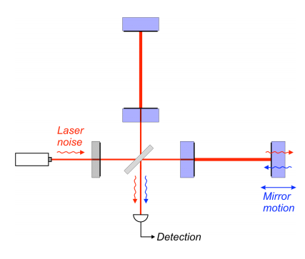
2. Ex) SQL in interferometer
Non-fundamental limits for measurement
Relevant to quantum system
and difficult to reduce
Relevant to classical measurement scheme
Particle nature: Shot noise
Phase noise: Radiation pressure
http://moriond.in2p3.fr/J07/trans/saturday/heidmann.pdf

Slide 8
2.5 Questions
1. Rayleigh’s Criteria
2. Standard Quantum Limit
3. SQL in Interferometer

Slide 9
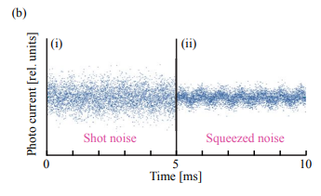
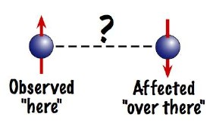
3.Beyond the SQL
Quantum Enhanced Measurement
Quantum Non-Demolition Detection
a. Squeezed state
$σ_{A_{1}}σ_{A_{2}}≥| \frac{1}{2}$[$\hat{A}(t_{1})$,$\hat{A}(t_{2})$]| =0
No backaction
→ Enable consequent measurement
b. N00N State
(Left)
R.Schnabel (2017) Squeezed states of light
and their applications in laser interferometers
(right) https://www.nasa.gov/audience/forstudents/postsecondary/features/23jan_entangled_prt.htm

Slide 10
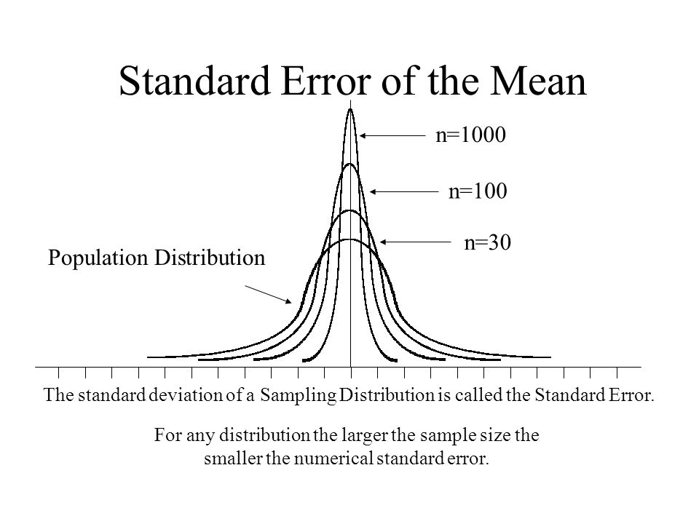
3. Classical vs Quantum Measurement
Classical Measurement
Vittorio Giovannetti. (2004) Quantum-Enhanced Measurements:
Beating the Standard Quantum Limit
N Independent physical system
N separate measurement → Stat.
$$σ∝\frac{1}{\sqrt{N}}$$

Slide 11
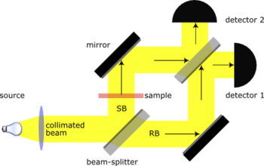
3. Classical measurement
Classical MZI
$φ_{1}=\frac{1}{\sqrt{2}}(\hat{R}\hat{T}+\hat{T}\hat{S}\hat{R})$ $|φ_{0}>$= $\frac{i}{\sqrt{2}}(1+e^{iθ}) |φ_{0}>$
$φ_{2} =\frac{1}{\sqrt{2}}(\hat{R}\hat{S}\hat{R}+\hat{T}\hat{T})|φ_{0}>$=$\frac{1}{\sqrt{2}}(1−e^{iθ}) |φ_{0}>$
$p_{1}$(t)=$\left|<φ_{1}\right|φ_{0}>|^{2}$=$\cos^{2}\left(\frac{θ}{2}\right)$
$p_{2}$(t)=$\left|<φ_{2}\right|φ_{0}>|^{2}$=$\sin^{2}\left(\frac{θ}{2}\right)$
https://en.wikipedia.org/wiki/Mach%E2%80%93Zehnder_interferometer

Slide 12
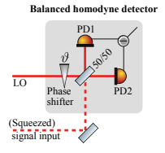
3. Classical measurement(Conti.)
$I=I_{1}−I_{2} is used to decode \text{information}$.
$N_{1}={Np}_{1}$(t)=${Ncos}^{2}\left(\frac{θ}{2}\right)→I_{1} is intensity at det.1$
${N_{2}=Np}_{2}$(t)=${Nsin}^{2}\left(\frac{θ}{2}\right)→I_{2} is intensity at det.2$
$\text{→}$ $I=I_{1}−I_{2}∝$ $Ncos\left(θ\right)$
R.Schnabel (2017) Squeezed states of light
and their applications in laser interferometers

Slide 13
3. Classical measurement(Conti.)
Information is encoded in $θ, not intensity$ $∎$Error propagation → $∆θ=\frac{∆I}{\frac{∂I}{∂θ}}=\frac{1}{\sqrt{N}}$
$∴∆I$=$\sqrt{<I^{2}>−<I>^{2}}$
$$σ∝\frac{1}{\sqrt{N}}$$

Slide 14
4. Classical vs Quantum Measurement
Highly correlated input
Entangled or Squeezed state
Collective measurement
Encompasses all the systems
Vittorio Giovannetti. (2004) Quantum-Enhanced Measurements:
Beating the Standard Quantum Limit

Slide 15
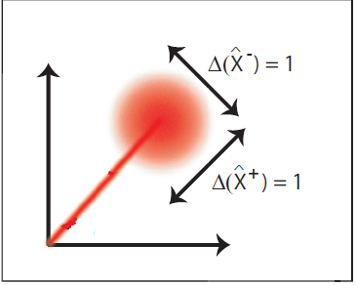
4. Coherent state
Definition
Phase space
The coherent state refers to a super -position of states of the quantized EM field.
Often, coherent light is thought of as light emitted by sources in-phase.
$$|α> =e^{− \frac{|α|^{2}}{2}}\sum{\frac{α^{n}}{\sqrt{n!}}|n>}$$
(Left) https://physik.uni-paderborn.de/en/silberhorn/forschung/quantum-networking/continuous-variables

Slide 16
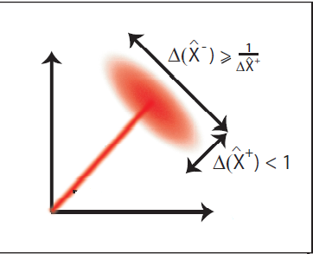
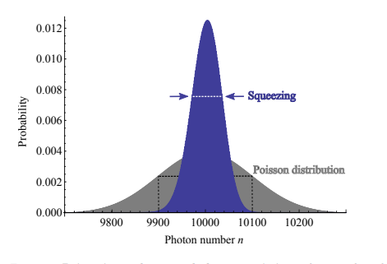
4. Squeezed state
$$\sqrt{N}$$
$${\sim e}^{−γ}\sqrt{N}$$
$${\sim e}^{+γ}$$
$${\sim e}^{−γ}$$
(Left) https://physik.uni-paderborn.de/en/silberhorn/forschung/quantum-networking/continuous-variables
(For middle & right) R.Schnabel (2017) Squeezed states of light
and their applications in laser interferometers

Slide 17
4.Generation of Squeezed States
${1. ε}^{input}=ε_{ν}^{in}+ε_{2v}^{in}$
2. $P\left(ε\right)=ε_{0}(x^{\left(1\right)}ε+x^{\left(2\right)}ε^{2}$)
(dielectric polarization)
3. $ε^{out}=ε_{sqz,ν}^{out}+ε_{2v}^{out}+ε_{4v}^{out}$
R.Schnabel (2017) Squeezed states of light
and their applications in laser interferometers

Slide 18
4. Squeezed state
$→\left(Coherent\right) ∆θ=\frac{∆I}{\frac{∂I}{∂θ}}∝\frac{∆N}{\frac{∂N}{∂θ}}=\frac{1}{\sqrt{N}}$ $→\left(Squeezed\right) ∆θ∝\frac{∆N_{squeezed}}{\frac{∂N}{∂θ}}=\frac{e^{−γ}∆N}{\frac{∂N}{∂θ}}=\frac{e^{−γ}}{\sqrt{N}}$
$$\sqrt{N}$$
$${\sim e}^{−γ}\sqrt{N}$$
R.Schnabel (2017) Squeezed states of light
and their applications in laser interferometers
$$c.f) \left(Squeezed\right) ∆\left(θ\right)≥\frac{1}{2\sqrt{2}}[\frac{1}{<n>^{2}+<n>}]^{1/2}$$
Vittorio Giovannetti. (2004) Quantum-Enhanced Measurements:
Beating the Standard Quantum Limit

Slide 19
4. Application Ex: LIGO
Shot noise
6dB
L.Barsotti (2017) Quantum noise reduction in the LIGO gravitational wave interferometer with squeezed states of light

Slide 20
5. N00N State
Definition
Realization (low N)
$|N00N>=\left|N>_{A}\right|0>_{B}+$ $\left|0>_{A}\right|N>_{B}$
$$A_{out}$$
$\left|1>_{A}\right|0>_{B} =\left|1>_{A′}\right|0>_{B′}+\left|0>_{A′}\right|1>_{B′}$
A superposition of N particles in one mode A with zero particles in another mode B
Usually, particles are photons
$$B_{out}$$
$\left|1>_{A}\right|1>_{B} =\left|2>_{A′}\right|0>_{B′}+\left|0>_{A′}\right|2>_{B′}$
$$A_{in}$$
$$B_{in}$$
50:50 Beam Splitter

Slide 21
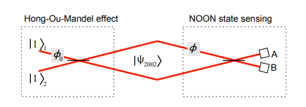
5. N00N state (Entangled states)
$|N00N>=\left|N>_{A}\right|0>_{B}+$ $\left|0>_{A}\right|N>_{B}$
$|N00N>_{sig}=e^{iNφ}\left|N>_{A}\right|0>_{B}+$ $\left|0>_{A}\right|N>_{B}$
$|φ>_{A or B} =$ $\hat{HOM} |N00N>_{sig}$
$|φ>_{A}=e^{iNφ}\left|N>_{A}\right|0>_{B}+$ $\left|0>_{A}\right|N>_{B}$
$|φ>_{B}=e^{iNφ}\left|N>_{A}\right|0>_{B}−$ $\left|0>_{A}\right|N>_{B}$
(Above) Vittorio Giovannetti. (2004) Quantum-Enhanced Measurements:
Beating the Standard Quantum Limit
(Below) Michael A. Taylor (2016) Quantum metrology and its application in biology

Slide 22
5. N00N state (Entangled states)
$p_{A}$= $\left|<N00N\right|φ>_{A}|^{2}=\cos^{2}\left(\frac{Nφ}{2}\right)$
$p_{B}$= $\left|<N00N\right|φ>_{B}|^{2}=\sin^{2}\left(\frac{Nφ}{2}\right)$
$I={I_{a}−I}_{B}=I_{0}cos(Nφ$)
$∆φ=\frac{∆I}{\frac{∂I}{∂φ}}=\frac{1}{N}$
$∴∆I$=$\sqrt{<I^{2}>−<I>^{2}}$
(Above) Vittorio Giovannetti. (2004) Quantum-Enhanced Measurements:
Beating the Standard Quantum Limit
(Below) Michael A. Taylor (2016) Quantum metrology and its application in biology

Slide 23
5. Advantages
$∆φ=\frac{1}{N}$
1. Super-sensitivity (minimum detectable signal $≡SNR=1$)
2. Super-resolution (below Rayleigh Criteria)
Jonathan P. Dowling. (2008) Quantum Optical Metrology — The Lowdown on High-N00N States,

Slide 24
5. Application Ex: Protein Concentration
(Both) A.Crespi (2012) Measuring protein concentration with entangled photons
2002 states increases sensitivity by 2

Slide 25
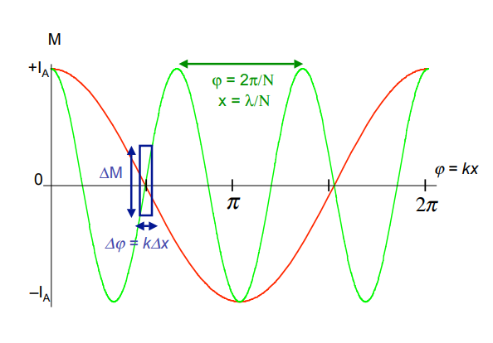
6. Summary
Squeezed state
N00N state
(Left) Vittorio Giovannetti. (2004) Quantum-Enhanced Measurements:
Beating the Standard Quantum Limit
(Right) Jonathan P. Dowling. (2008) Quantum Optical Metrology — The Lowdown on High-N00N States,

Slide 26
7. Questions
1. Classical Measurement Scheme
Standard Quantum Limit
2. Squeezed Light for Meas.
3. N00N States for Meas.

Slide 27
References (in year) 1. Vittorio Giovannetti. (2004) Quantum-Enhanced Measurements: Beating the Standard Quantum Limit 2. Jonathan P. Dowling. (2008) Quantum Optical Metrology — The Lowdown on High-N00N States 3. A.Crespi (2012) Measuring protein concentration with entangled photons 4. Michael A. Taylor (2016) Quantum metrology and its application in biology 5. L.Barsotti (2017) Quantum noise reduction in the LIGO gravitational wave interferometer with squeezed states of light 6. Roman Schnabel. (2017) Squeezed states of light and their applications in laser interferometers

Slide 28
A.1 Error propagation
Measured data $≠$(directly) Desired Parameter($φ)$
Data
$$φ$$
Data = Signal + Noise
Function f does honestly transform (S+N) to $φ−space$
Relation of noise in data and noise in $φ$
$φ =φ_{0}+\frac{∂φ}{∂a}da → σ_{φ}^{2}≈{|\frac{∂φ}{∂a}|}^{2}σ_{a}^{2}$
$$∀ function s.t$$ $f\left(data\right)=$ $φ$

Slide 29
A.2 N00N-State Measurement
1. Coherent state (usual laser) $|α_{f}> =U_{θ}|α_{i}>={e^{iθ\hat{n}} (e}^{− \frac{|α|^{2}}{2}}\sum{\frac{α^{n}}{\sqrt{n!}}|n>}$)= $|{e^{iθ}α}_{i}>$
2. N00N state
$|N_{f}> =U_{θ}|N_{i}>= e^{iθ\hat{n}}$ $|N_{i}>$=$e^{iθN}$ $|N_{i}>$
Michael A. Taylor (2016) Quantum metrology and its application in biology
$\left|φ_{f}> = U_{θ}\right|φ_{i}>$
On the signal arm, sample transforms incident light$|φ_{i}>$ to $U_{θ}|φ_{i}>$

Slide 30
A.3 Hong-Ou-Mandel effect
Two optical modes are mixed at the B.S and turn to new modes
$\left({a′ \atop b′}\right)=\frac{1}{\sqrt{2}}\left(\begin{matrix}1 & 1 \\ 1 & −1\end{matrix}\right)\left({a \atop b}\right)$ →(N00N state) $\left({a′ \atop b′}\right)=$ $\frac{1}{\sqrt{2}} \left({e^{iNφ}+1 \atop e^{iNφ}−1}\right)$
1. The photon(up) is reflected and the photon(down) is transmitted.
2. Both are transmitted.
3. Both are reflected.
4. The photon(up) is transmitted and the photon(down) is reflected
https://en.wikipedia.org/wiki/Hong%E2%80%93Ou%E2%80%93Mandel_effect

Slide 31
A.4 Fisher-Info. & C.R bound
Unknown Parameter $θ$ is estimated by observations of x → $prob. density f(x;θ$)
Var($θ$) $≥\frac{1}{I\left(θ\right)} , where I\left(θ\right)\text{= −}\text{n}\text{ <}∂_{θθ}log⁡(f(x;θ\text{)}\text{)>}$
In Quantum measurement,
$I=4\left(<φ_{f}^{′} | φ_{f}^{′}>− \left|<φ_{f}^{′}\right|φ_{f}>|^{2} \right)$

Slide 32
A.4 Fisher-Info. & C.R bound (cont)
$I$=4$\left(<n^{2}>− | <n>|^{2}\right)$ (for observation of N)
For N00N state $<n>$=$<a^{+}a> =\frac{N}{2}, <n^{2}>\text{=}<a^{+}aa^{+}a> =\frac{N^{2}}{2}$,
$I$=4($<n>^{2}−\left|<n>|^{2}\right)=N^{2}$ → $∆\left(θ\right)≥\frac{1}{N}$

