Slide 1
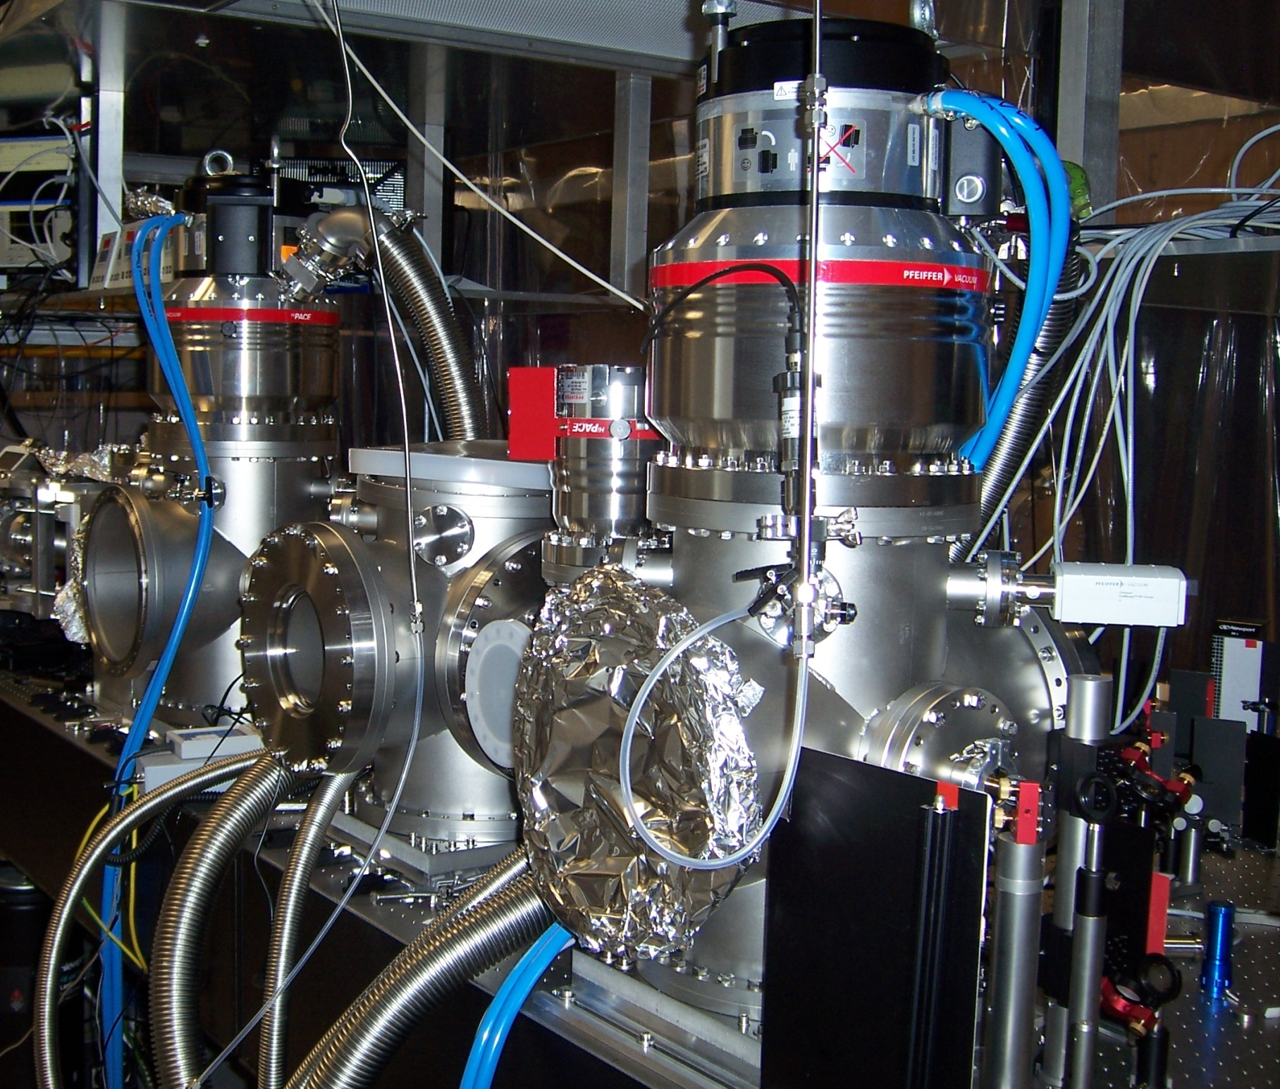

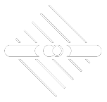
MVSem--Masterseminar
2021-04-20
The sound of the phase:
Atoms&molecules
respond to intense
laser flashes
sound
Thomas Pfeifer
MPIK Heidelberg

Slide 2
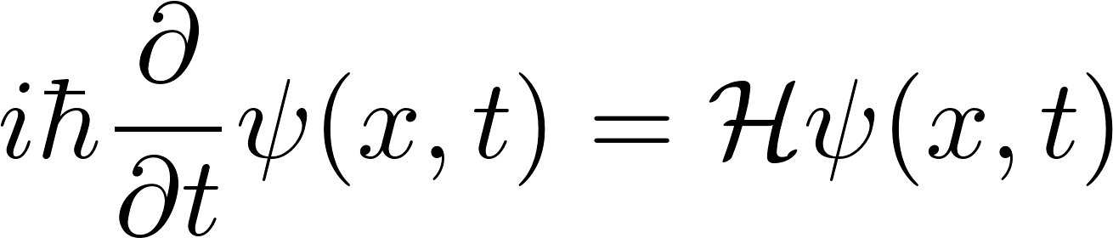
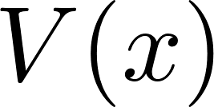
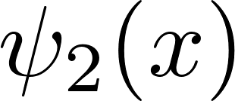
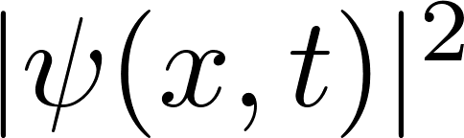
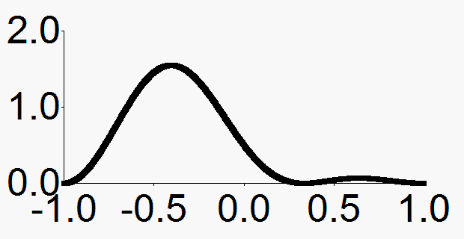
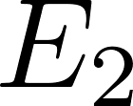
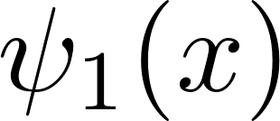




Fundamental Quantum Dynamics
Interference of quantum states
Potential
Feynman: "... the only mystery [at the heart of quantum mechanics]."
position
position
Phase
Phase

Slide 3

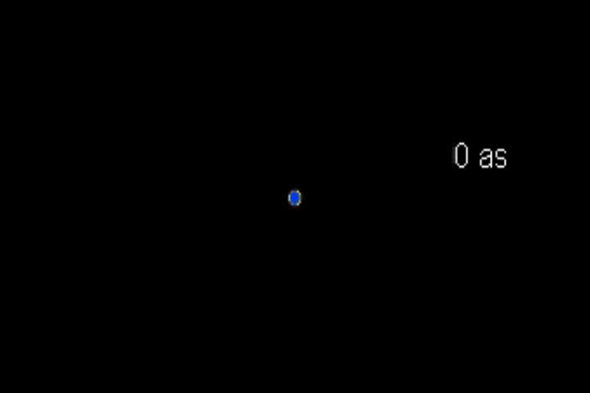
few-body quantum dynamics
a fundamental scientific question:
“how do excited electrons move and interact
in atoms and molecules?”
two or more
spatial scale
R ~ sub/few Å
The
“quantum
few-body
problem”
temporal scale
T ~ sub/few fs
e⁻
e⁻
in strong fields
Science goal:
measure / understand / control
the quantum dynamics of
small systems
in strong fields
(x-ray) movies of
single molecules
Laser control of
chemical reactions
Petahertz-clocked
computing
x-ray precision
spectroscopy

Slide 4
Electron Facts
e⁻
lightest charged elementary particle
'chemical glue', holding molecules together
  -> making and breaking of bonds in chemical reactions
carriers of electric current
  -> electricity generation/conversion/transport
carriers of information
  -> electronics, computing, data storage
mediating interactions of matter with light
  -> role in photosynthesis, photovoltaics, vision, ...
'Electron Correlation' dynamics
-> time-dependent electron–electron interaction
and coupling among configuration states
most importantly: coupling of bound and continuum states
...typically more than one electron involved...

Slide 5
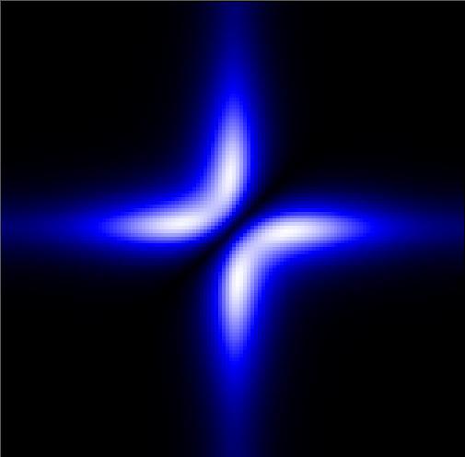
What is the problem?
(with two or more electrons)
Correlated lectron dynamics
e⁻
e⁻
e⁻
interaction (Coulomb)
symmetry (Fermions)
Correlation
Ψ( ₁, ₂) ≠ Ψ( ₁) ×Ψ ( ₂)
e⁻
e⁻
e⁻
e⁻
'interacting'
'non-interacting'
1
e⁻
location ₂
|Ψ( ₁, ₂)|²
e⁻
e⁻
problem for:
- Hartree–Fock methods
- DFT
(exchange-correlation
potential not known)
0
location ₁
e⁻

Slide 6
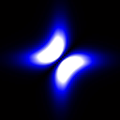

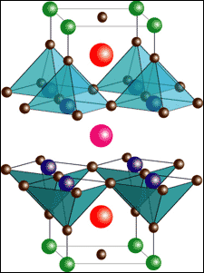
Why is it important?
Time-dependent correlated lectron dynamics
e⁻
e⁻
e⁻
interaction (Coulomb)
symmetry (Fermions)
Correlation
Ψ( ₁, ₂) ≠ Ψ( ₁) ×Ψ ( ₂)
e⁻
e⁻
e⁻
e⁻
'interacting'
'non-interacting'
any bonding orbital in matter
typically occupied
by 2 electrons
Giant Magnetoresistance
High T_{c} superconductivity
e⁻
location 2
e⁻
e⁻
fundamental role in
chemical reactions
excitation transfer, e⁻ transport
energy conversion, radiation damage
importance in
many branches of science
location 1
e⁻
Sept. 2007

Slide 7

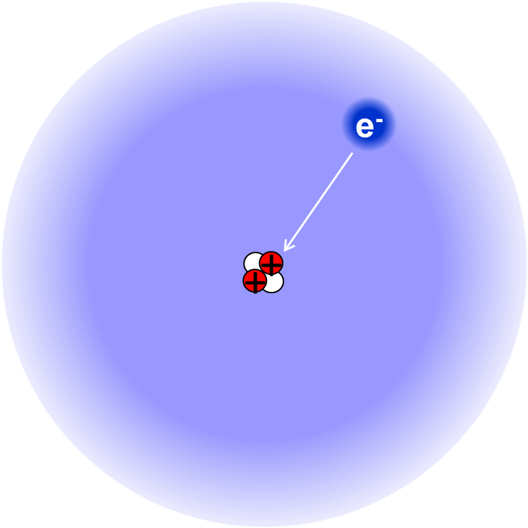


the language electrons speak ...
e⁻
+
+
... and why is it so fast?
Energy
|εp⟩
$$\left|\left.Ψ_{2}\right\rangle \right.$$
$$\left|\left.Ψ_{1}\right\rangle \right.$$
|2p⟩
position x
|1s⟩

Slide 8
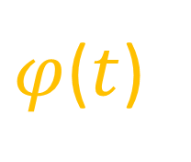
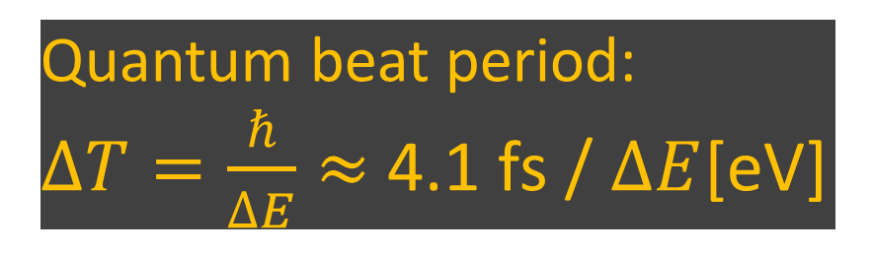



Wavepacket dynamics and observation
Energy
Quantum beat period:
$∆T=\frac{ℏ}{∆E}≈$ 4.1 fs / $∆E$[eV]
$$\left|\left.Ψ_{2}\right\rangle \right.$$
$$\left|\left.Ψ_{1}\right\rangle \right.$$
$$Ψ\left(t\right)\sim Ψ_{1}e^{\frac{−i}{ℏ}E_{1}t}+Ψ_{2}e^{\frac{−i}{ℏ}E_{2}t}$$
position x
e.g. time-dependent position/dipole:
$x\left(t\right)$ $=\left\langle Ψ(t) | \hat{x} | Ψ(t)\right\rangle$
$=\frac{1}{2}\left\langle Ψ_{1}e^{\frac{−i}{ℏ}E_{1}t}+Ψ_{2}e^{\frac{−i}{ℏ}E_{2}t} | \hat{x} | Ψ_{1}e^{\frac{−i}{ℏ}E_{1}t}+Ψ_{2}e^{\frac{−i}{ℏ}E_{2}t}\right\rangle$
$=\left|\left\langle Ψ_{1} | \hat{x} | Ψ_{2})\right\rangle \right| \cos\left[\frac{{(E}_{1}−E_{2})}{ℏ}t+φ0\right]$
$φ$($t$)

Slide 9

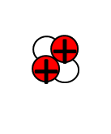
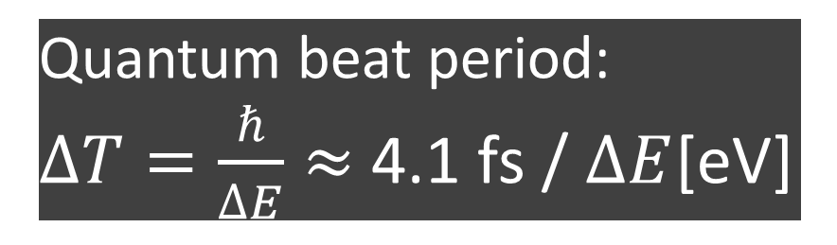
the language electrons talk ...
e⁻
+
+
... and why is it so fast?
Quantum beat period:
$∆T=\frac{ℏ}{∆E}≈$ 4.1 fs / $∆E$[eV]
|εp⟩
Oscillation period:
|2p⟩
Hydrogen:
T = 0.4 fs (10⁻¹⁸ s)
Hydrogen:
hν=10.2 eV
and the way we "listen"...:
Spectroscopy
Iron (H-like):
T = 0.6 as (10⁻¹⁸ s)
Iron (Z=26, H-like):
hν= 6.9 keV
Uranium (H-like):
T = 48.0 zs (10⁻²¹ s)
Uranium (Z=92, H-like):
hν=86.3 keV
|1s⟩

Slide 10
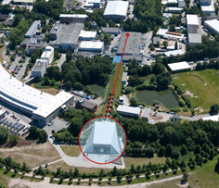
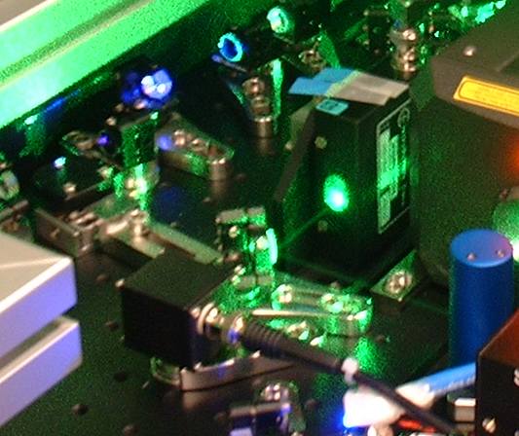
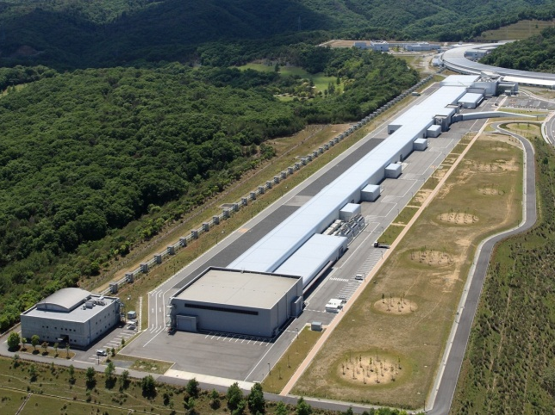

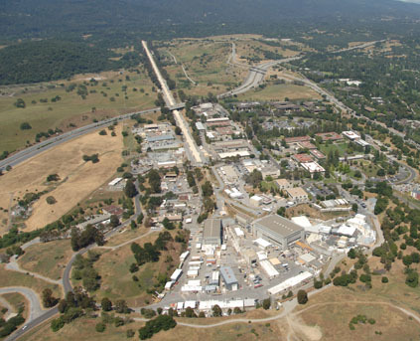
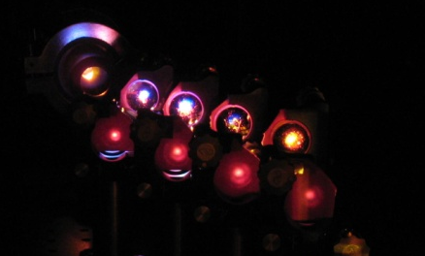
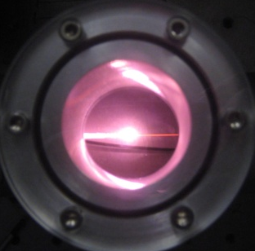
The light sources: Provided by two parallel revolutions in ultrashort x-ray/XUV laser science
MPIK Heidelberg
Ultrafast Quantum Dynamics
FreeElectronLasers
and HighHarmonicGeneration
SACLA
@Japan
specifications demonstrated thus far:
~1 Å
lowest wavelength
~1 nm
FLASH
@Germany
~5 mJ
largest pulse energy
~1 μJ
~0.5 fs
partially
coherent
shortest pulse duration
~50 as
fully
coherent
LCLS
@USA
http://www.psi.ch/swissfel/historical-introduction
http://www.iruvx.eu/about_us/national_fel_facilities/

Slide 11
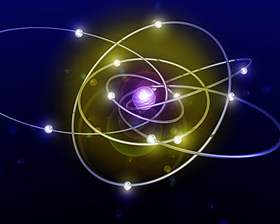
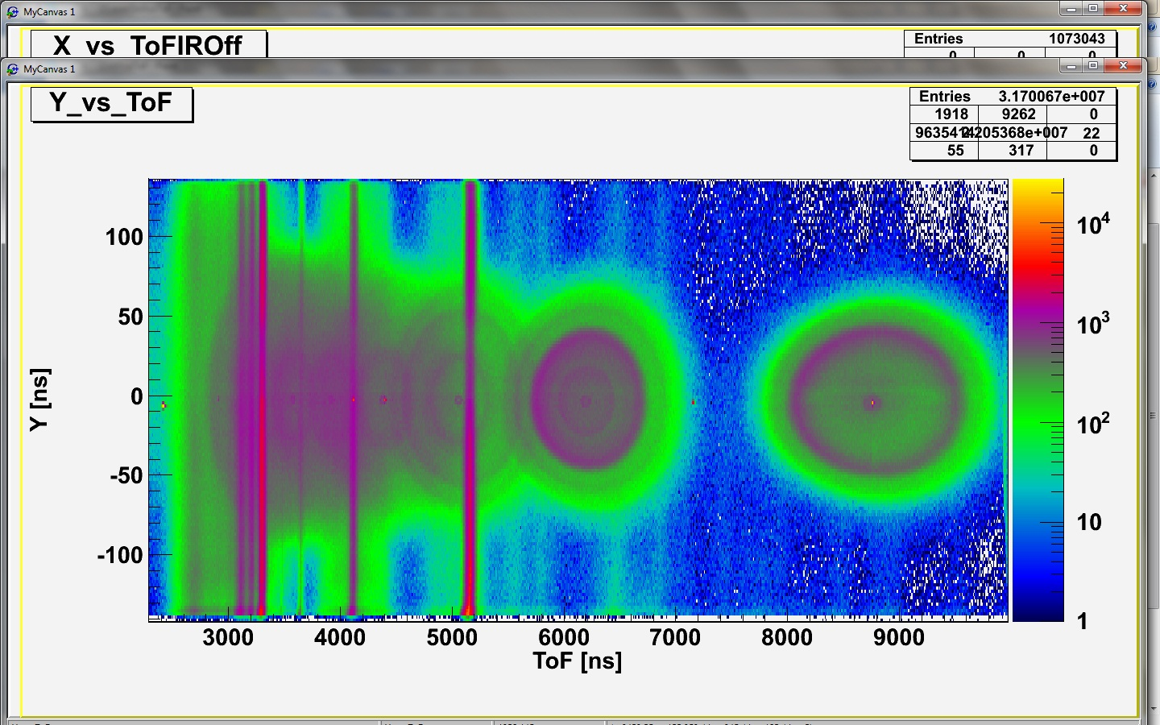
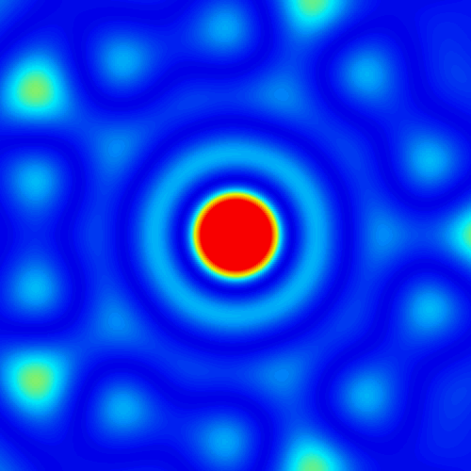
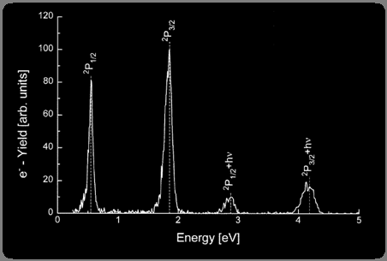
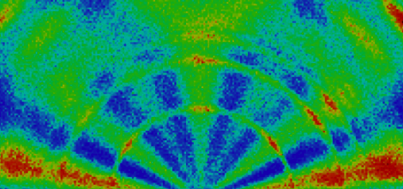
Quantum dynamics
imaging and spectroscopy
Our “Eyes” … and “Ears” …
time delay
small (!)
quantum system
τ
γ
photon spectra
γ
I⁺
e⁻
I⁺⁺
e⁻
γ
energy
ions
A-B⁺
photon images
electrons
momentum
Δ momentum
momentum
atom picture from: http://startswithabang.com/?p=1795

Slide 12
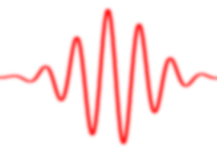
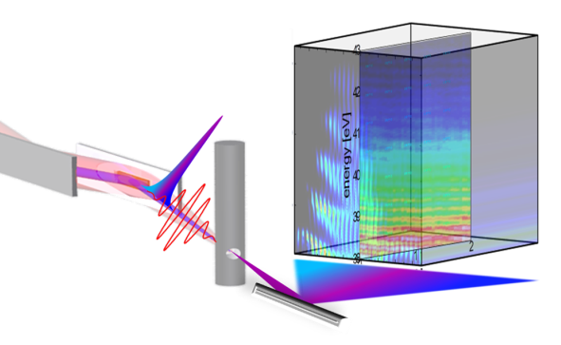
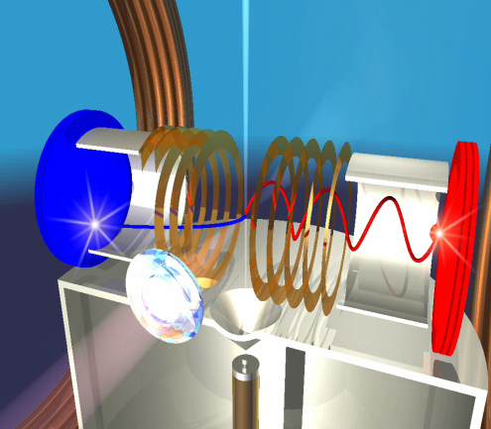
Our Experimental Focus
MPIK Heidelberg
Ultrafast Quantum Dynamics
Employing
(FreeElectron)Lasers
and HighHarmonicGeneration
Bright
Light
to understand
&control
Atoms, Ions & Molecules
"listening"
"imaging"
Multidim. optical spectroscopy
Reaction microscope/COLTRIMS
Goal: extract
complete
information
time&energy-resolved
detection of photons
coincidence
detection of electrons/ions
atom image from: http://startswithabang.com/?p=1795
http://www.psi.ch/swissfel/historical-introduction
http://www.iruvx.eu/about_us/national_fel_facilities/

Slide 13
Our Experimental Focus
(FreeElectron)Lasers
and HighHarmonicGeneration
Bright
Light
to understand
&control
Atoms, Ions & Molecules
"listening"
"imaging"
Multidim. optical spectroscopy
Reaction microscope/COLTRIMS
Goal: extract
complete
information
time&energy-resolved
detection of photons
coincidence
detection of electrons/ions

Slide 14
Experimental observation of few-body dynamics
Multidim. optical spectroscopy
Reaction microscope/COLTRIMS
Goal: extract
complete
information
time&energy-resolved
detection of photons
coincidence
detection of electrons/ions
dynamics of bound states
dynamics of continuum states
Energy
Energy
e⁻
e⁻
e⁻
e⁻
measure
photons
bound-bound
transitions
bound-free
transitions
Position
Position

Slide 15
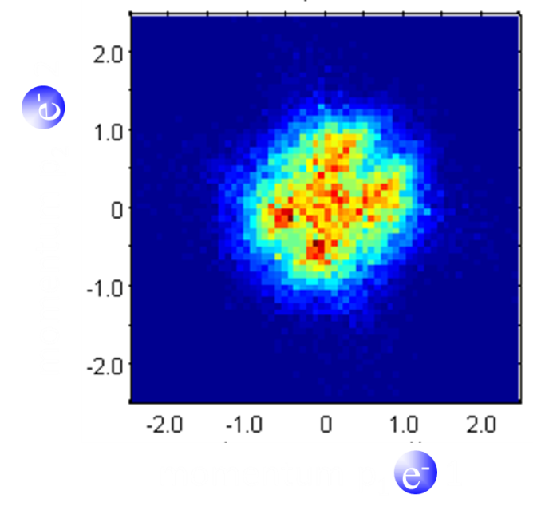

Strong-field Recollision Physics
in “nonsequential” double ionization
N. Camus et al. Phys. Rev. Lett. 108, 073003
high intensity
large recollision energy
low intensity
low recollision energy
?
are the electrons
field ionized
at the same time
or with a
characteristic time delay
?
Ar
200 asec
e⁻
e⁻
e⁻
e⁻
e⁻
e⁻
e⁻
e⁻

Slide 16
Experimental observation of few-body dynamics
Multidim. optical spectroscopy
Reaction microscope/COLTRIMS
Goal: extract
complete
information
time&energy-resolved
detection of photons
coincidence
detection of electrons/ions
dynamics of bound states
dynamics of continuum states
Energy
Energy
e⁻
e⁻
e⁻
e⁻
measure
photons
bound-bound
transitions
bound-free
transitions
Position
Position

Slide 17
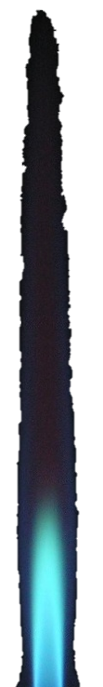
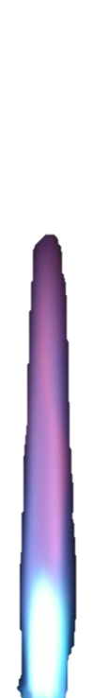
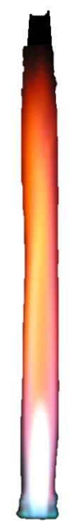
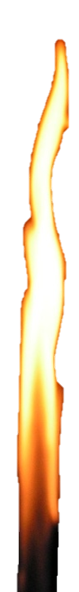



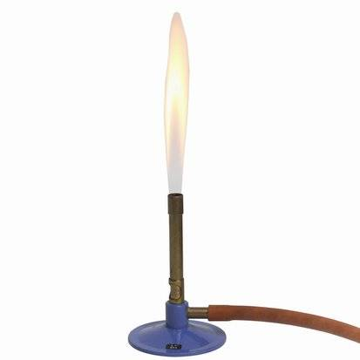
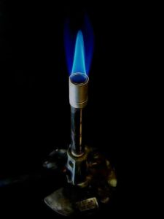
traditional spectroscopy
(Kirchhoff, Bunsen, et al. @Heidelberg ∼1860)
Electrons in atoms already
taught us a lot of
fundamental physics!
γ
γ
e.g. Fraunhofer et al.
bunsen burner picture from:http://chemistry.about.com/od/firecombustionchemistry/ig/Fire---Flames-Photo-Gallery/Bunsen-Burner.-1PF.htm
Phase
Phase
atom image from: http://startswithabang.com/?p=1795
bunsen burner image from: http://www.west-michigan-family.com/holiday-archives-march.html
flame image from: http://commons.wikimedia.org/wiki/File:Bunsen_burner_flame_types_.jpg

Slide 18
time-dependent absorption spectroscopy
time delay
τ
gas-phase
isolated atoms
Time-dependent
absorption spectrum
τ
near-VIS
femtosecond
pulse
XUV
attosecond
pulse
XUV photon energy
Phase
Phase

Slide 19
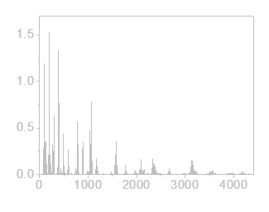

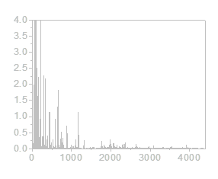
Listening to phases
Mozart
amplitude
Mozart
amplitude
Mozart
amplitude
spectral intensity
Frequency [Hz]
Frequency [Hz]
Frequency [Hz]
spectral phase by
by W. A. Mozart (1787)
(Eine kleine Nachtmusik)
spectral phase
by Chance
(randomized)
spectral phase
by
Metallica (1992)
(Nothing else matters)
Metallica
amplitude
Metallica
amplitude
Frequency [Hz]
Frequency [Hz]

Slide 20
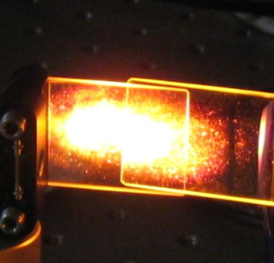
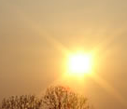
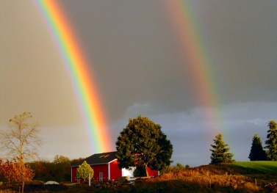

Properties of different light sources
spectral
phase
spectral
phase
solar spectrum
cw laser spectrum
fs pulse laser spectrum
Bild-Quellen: http://www.bhakti-love.com/fotos/sonnenlicht.jpg, http://climate.met.psu.edu/www_prod/data/frost/images/rainbow.jpg

Slide 21
time-dependent absorption spectroscopy
What's the dynamics of bound states and resonances
in short and strong fields?
time delay
τ
Time-dependent
absorption spectrum
τ
near-VIS
femtosecond
pulse
XUV
attosecond
pulse
XUV photon energy
Phase
Phase

Slide 22
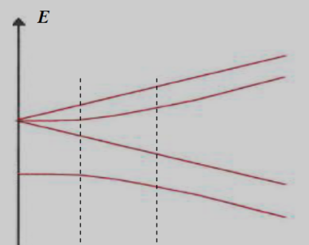






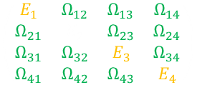
General: coupling of states
coupling of one to
one other state
coupling of one to
multiple states
coupling of one to a
continuum of states
Quite well understood for cases of
time-independent (or adiabatic) couplings
What happens when the coupling is ultrashort ?
B
U. Fano (1935)
Phys. Rev. 124, 1866 (1961)
Nuovo Cim. 12, 154 (1935)
Rabi oscillation
in strong coupling
Breit-Rabi
e.g. Paschen-Back regime
$$\left(\begin{matrix}E_{1} & Ω_{12} \\ Ω_{21} & E_{2}\end{matrix}\right)$$
$$\left(\begin{matrix}E_{1} & Ω_{12} & Ω_{13} & Ω_{14} \\ Ω_{21} & E_{2} & Ω_{23} & Ω_{24} \\ Ω_{31} & Ω_{32} & E_{3} & Ω_{34} \\ Ω_{41} & Ω_{42} & Ω_{43} & E_{4}\end{matrix}\right)$$
$$\left(\begin{matrix}E & & Ω(ε) & \\ & & & \\ Ω(ε) & & ε & \\ & & & \end{matrix}\right)$$
spectral intensity
photon energy hν
photon energy hν
photon energy hν

Slide 23
fundamental e⁻–e⁻ correlation in atoms
prototypical target: He atom
|cont.,2e-⟩
|εs,εp⟩
excitation
by XUV/soft-x-ray
|cont.,1e-⟩
|2s,εp⟩
e⁻
...
|3⟩
|2s3p⟩+|2p3s⟩
e⁻
|2⟩
|2p2p⟩
|1⟩
|2s2p⟩
|1s,εp⟩
He
He⁺
discrete states coupled to continuum
by configuration interaction
single-photon
double excitation
e⁻
|0⟩
|1s1s⟩
e⁻
e⁻
|2s2p⟩
|1s²⟩
e⁻

Slide 24
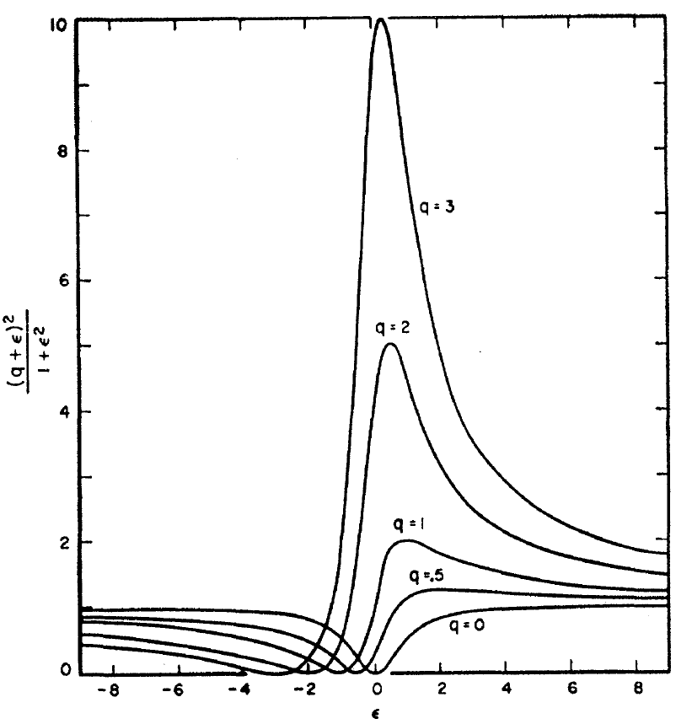


doubly excited helium: Fano resonance
$$σ_{Fano}\sim \frac{{(q+ε)}^{2}}{1{+ε}^{2}}$$
|cont.,2e-⟩
|εs,εp⟩
$$q=$$
Ugo Fano
Phys. Rev.
124, 1866
(1961)
Nuovo
Cimento
12, 154
(1935)
|cont.,1e-⟩
|2s,εp⟩
...
|3⟩
|2s3p⟩+|2p3s⟩
|2⟩
|2p2p⟩
|1⟩
|2s2p⟩
|1s,εp⟩
He
He⁺
coupled
by configuration interaction
single-photon
double excitation
e⁻
|0⟩
|1s²⟩
e⁻
e⁻
|2s2p⟩
|1s²⟩
e⁻

Slide 25


doubly-excited helium, in a strong laser field
$$σ_{Fano}\sim \frac{{(q+ε)}^{2}}{1{+ε}^{2}}$$
Nature builds her own
quantum interferometers:
|cont.,2e-⟩
|εs,εp⟩
“coupling”-
“control”-
$$q=$$
Ugo Fano
Phys. Rev.
124, 1866
(1961)
Nuovo
Cimento
12, 154
(1935)
pulse
(VIS)
|cont.,1e-⟩
|2s,εp⟩
...
|3⟩
|2s3p⟩+|2p3s⟩
|2⟩
|2p2p⟩
|1⟩
|2s2p⟩
|1s,εp⟩
attosecond
pulse
60-70 eV
coupled
by configuration interaction
single-photon
double excitation
e⁻
|0⟩
|1s²⟩
e⁻
e⁻
|2s2p⟩
|1s²⟩
e⁻

Slide 26
doubly-excited helium, in a strong laser field
|cont.,2e-⟩
|εs,εp⟩
“coupling”-
“control”-
Previous work
(on laser coupling of
doubly-excited helium):
pulse
(VIS)
|cont.,1e-⟩
...
Theory:
- Madsen, Themelis, Lambropoulos
- Zhao, Chu, Lin et al.
...
Experiment:
- Loh, Greene, Leone, et al.
- Gilbertson, Chang et al.
...
Experimental challenge:
- high (asec) temporal and
- high (meV) spectral resolution
required at the same time
e.g. Phys. Rev. A 24, 379 (1981)
|3⟩
|2s3p⟩+|2p3s⟩
|2⟩
|2p2p⟩
e.g. Phys. Rev. A 87, 013415 (2013)
|1⟩
|2s2p⟩
Chem. Phys. 350, 7 (2008)
|1s,εp⟩
attosecond
pulse
60 eV
single-photon
double excitation
Phys. Rev. Lett. 105, 263003 (2010)
|0⟩
|1s1s⟩

Slide 27
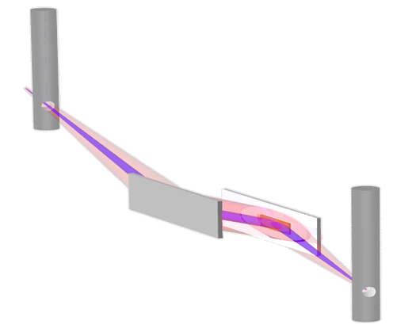

Experimental setup
for XUV absorption spectroscopy
Fano resonances
of autoionizing states
U. Fano
Phys. Rev.
124, 1866
(1961)
Photon energy [eV]
XUV
light
Absorption
Spectrum [OD]
2s2p
e⁻
e⁻
plane
mirror
Optical density [OD]
sp2,3+
toroidal
focusing mirror
sp2,n+(4,5,6,7)
target gas cell:
Helium .
Variable Line Spacing
(VLS) grating
flat-field spectrometer
Experimental key challenge: High resolution
In photon energy ... : ΔE = 20 meV (@60 eV)

Slide 28




Experimental setup
for XUV absorption spectroscopy
time-resolved
neon cell
for high-harmonic
generation
Photon energy [eV]
XUV
pulse
Absorption
Spectrum [OD]
2s2p
VIS
pulse
split
mirror
Optical density [OD]
sp2,3+
toroidal
focusing mirror
sp2,n+(4,5,6,7)
target gas cell:
Helium .
Variable Line Spacing
(VLS) grating
flat-field spectrometer
Experimental key challenge: High resolution
In photon energy ... : ΔE = 20 meV (@60 eV)
... and time delay : Δτ = 10 as

Slide 29



Experimental Setup in the Lab
Flat-Field XUV Spectrometer,
home built,
for broadband high resolution
experimental specs:
high interferometric stability
10 attoseconds
high spectral resolution
20 meV s.d. @ 60 eV
5 meV s.d. @ 20 eV
(E/ΔE ~ 3000-4000)
Grazing-Incidence Split Mirror
for broadband XUV throughput

Slide 30



Time-resolved doubly-excited 2e⁻ dynamics in He
Experimental data
XUV
first
quantum
interference
⇒phase $φ(t)$

Slide 31



comparison experiment and theory
XUV
first
quantum-state interference
⇒ phase $φ(t)$
Probing a time-dependent superposition state:
⇒ Wavepacket

Slide 32



Measuring the time-dependent phase difference
of 2s2p and sp₂₃₊ autoionization states
cooperation with Javier Madroñero (Theory, TU München)
1D cut through atom (along laser polarization)
20
1.0
10
0.5
location electron 2 [a.u.]
0
0.0
-10
-20
-20
-10
0
10
20
Ott et al. Nature 2014
location electron 1 [a.u.]

Slide 33

Testing ab-initio theory of e⁻ correlation dynamics
cooperation: Luca Argenti & Fernando Martín (UAM Madrid, Spain) Javier Madroñero (TU Munich)
experimentally reconstructed (2s2p & sp_{2,3+} only):
e⁻
position ₂
position ₁
e⁻
ab-initio simulation, all excited states:
e⁻
position ₂
position ₁
e⁻
first experimental observation
of two-electron wavepacket motion
Ott et al.
Nature 2014

Slide 34
Time-resolved doubly-excited 2e⁻ dynamics in He
XUV
first
Ott et al. Nature 2014

Slide 35

Time-resolved doubly-excited 2e⁻ dynamics in He
high temporal
and
high spectral
resolution
are
required
simultaneously
1.2 fs
20 meV
Ott et al. Nature 2014

Slide 36
Hold on, can I ask you a few questions?
e⁻
e⁻
What is absorption?
And how does it respond to intense pulsed light?

Slide 37

Control the electrons, and measure their response
"Ask"
"listen"
Intensity
2p²
laser
photon
energy

Slide 38
Intensity, the control knob
Autler-Townes doublet
(Rabi cycling of autoionizing states)
tuning from weak perturbative to strong fields
2p2p
laser
photon
energy
Ott et al. Nature 2014

Slide 39


Intensity, the control knob
Autler-Townes doublet
(Rabi cycling of autoionizing states)
tuning from weak perturbative to strong fields
2p2p
U. Fano
Phys. Rev.
124, 1866
(1961)
laser
photon
energy
Ott et al. Nature 2014

Slide 40
General: coupling of states
coupling of one to
one other state
coupling of one to
multiple states
coupling of one to a
continuum of states
What happens when the coupling is ultrashort ?
B
U. Fano (1935)
Phys. Rev. 124, 1866 (1961)
Nuovo Cim. 12, 154 (1935)
Rabi oscillation
in strong coupling
Breit-Rabi
e.g. Paschen-Back regime
$$\left(\begin{matrix}E_{1} & Ω_{12} \\ Ω_{21} & E_{2}\end{matrix}\right)$$
$$\left(\begin{matrix}E_{1} & Ω_{12} & Ω_{13} & Ω_{14} \\ Ω_{21} & E_{2} & Ω_{23} & Ω_{24} \\ Ω_{31} & Ω_{32} & E_{3} & Ω_{34} \\ Ω_{41} & Ω_{42} & Ω_{43} & E_{4}\end{matrix}\right)$$
$$\left(\begin{matrix}E & & Ω(ε) & \\ & & & \\ Ω(ε) & & ε & \\ & & & \end{matrix}\right)$$
spectral intensity
photon energy hν
photon energy hν
photon energy hν

Slide 41









Resonance absorption in the Time Domain
free (induction)
polarization decay
|1⟩
Dipole moment$D\left(t\right)$
|0⟩
$$D\left(t\right)$$
Delta-like excitation
Fourier transform
Time
$$\text{Im}(d\left(ω\right))$$
Lorentzian
line shape
refractive index change:
$$n(ω)\text{∝}χ\left(ω\right)\text{∝}d(ω)$$
refractive index change:
$$n(ω)\text{∝}χ\left(ω\right)\text{∝}d(ω)$$
Absorption [OD]
susceptibility $χ$ $\text{} \text{a}$ (polarizability)
susceptibility $χ$ $\text{} \text{a}$ (polarizability)
Energy

Slide 42








Resonance absorption in the Time Domain
Science 340, 716 (2013)
Duration
$$Δt$$
not "kicked"
"kicked"
$$ΔE$$
|1⟩
Dipole moment$D\left(t\right)$
$$∆φ=\frac{1}{ℏ}ΔEΔt$$
|0⟩
$$D\left(t\right)$$
"kick"
laser
Delta-like excitation
+
Fourier transform
Time
$$\text{Im}(d\left(ω\right))$$
Lorentzian
line shape
...it IS a
Fano line shape!
refractive index change:
$$n(ω)\text{∝}χ\left(ω\right)\text{∝}d(ω)$$
Absorption [OD]
$$φ\left(q\right)=2 \text{arg}\text{(}q−i\text{)}$$
Looks like a
Fano line shape …
$$q\left(φ\right)=−cot⁡(\frac{φ}{2})$$
susceptibility $χ$ $\text{} \text{a}$ (polarizability)
Energy

Slide 43







The Fano dipole phase
Exact mapping from Fano $q$ parameter to temporal phase shift $φ$
cooperation with C. Greene (Purdue), J. Evers and C. Keitel (MPIK)
$$σ_{Fano}\sim \frac{{(ε+q)}^{2}}{ε^{2}+1}$$
$$=$$
Im$\left(\frac{−1}{i+ε}exp⁡(iφ)\right)+const.$
Fano$q$ parameter
Phase-shifted Lorentzian
...it IS a
Fano line shape!
Phase-Shifted Fano
turns Lorentz
and vice versa
$$φ\left(q\right)=2 \text{arg}\text{(}q−i\text{)}$$
$$q\left(φ\right)=−cot⁡(\frac{φ}{2})$$
C. Ott et al. Science 340, 716 (2013)
dipole phase $φ$

Slide 44


Fano to Lorentz
, and Lorentz to Fano
doubly-excited Helium
originally Fano lineshape
singly-excited Helium
originally Lorentzian
-
+
no laser
-
+
Laser Intensity:
2·10¹² W/cm²
Science 340, 716 (2013)

Slide 45






Laser Control of Fano and Lorentzian resonances
'2s4p'
'2s5p'
'2s6p' ...
Helium
doubly excited
(above the
continuum
threshold)
turning
original 'Fano'
into 'Lorentz'
1s6p
1s7p
1s8p ...
Helium
singly excited
(below the
continuum
threshold)
turning
original 'Lorentz'
into 'Fano'
$$q=−cot⁡\left(\frac{φ}{2}\right)$$
$$q=\text{−2.55}⇒φ=0.24 π$$
Science 340, 716 (2013)

Slide 46










Extracting the laser-induced phase shift
Cooperation with J. Madronero, L. Argenti, F. Martín
I = 3
experiment
I = 2
Ι
I = 1
I = 0
exp. line shape fit
at fixed elapsed time, e.g. t = 15.6 fs
Line Shape Analysis
φ ~ ΔE Δt
theo. line shape fit
theo. phase coeff.
ab-initio theory
(Argenti/Martin)
I = 3
I = 2
I = 1
I = 0
Control of a
two-electron
wavepacket
C. Ott et al. Nature 2014

Slide 47

Phase control of "real molecules"
Can we change the (spectral) shape
of complex molecules?

Slide 48



Fano control of molecules in the liquid phase
cooperation with J.-M. Mewes, A. Dreuw, T. Buckup, M. Motzkus@Univ. Heidelberg
Kristina Meyer et al., PNAS (2015)
Laser Dye IR144 in methanol
Intensity [arb. units]

Slide 49





Recent measurements in
Aluminum-phthalocyanine-chloride (AlPhCl)
Carina da Costa Castanheira et al. (in preparation)

Slide 50




Time-domain, impulsive, resonance control
Variation of intensity: tuning of coupling strength, phase
Science 340, 716 (2013)
Duration
$$Δt$$
Atom
2-level system
not "kicked"
"kicked" ⇒ $φ=\frac{1}{ℏ}ΔEΔt$
|1⟩
$$ΔE$$
|0⟩
Dipole moment
-
+
"kick"
laser
Delta-like excitation
+
Time
Lorentz
line shape
Tuning from
absorption to gain!
Absorption [OD]
Fano line shape
... in the "impulsive" limit!
(much shorter than the lifetime)
Energy

Slide 51

Proof-of-Principle: Observation of Resonant Gain
in singly-excited helium
-
+
absorption transformed into emission
within <10 fs
-
+
Science 340, 716 (2013)

Slide 52
The Beauty of a Fundamental Mechanism
Duration
$$Δt$$
Atom
2-level system
not "kicked"
"kicked" ⇒ $φ=\frac{1}{ℏ}ΔEΔt$
|1⟩
$$ΔE$$
|0⟩
Dipole moment
-
+
"kick"
laser
Delta-like excitation
+
[μs]
[as]
Time
[fs]
Lorentz
line shape
applies to all
time scales and
photon energies...
Absorption [OD]
Fano line shape
[eV]
[keV]
[neV]
Energy

Slide 53


Resonant gain for hard x-rays
14.4 keV,
⁵⁷Fe Mössbauer
phase shift $φ\left(t\right)$ at $t=0$
FEL or synchrotron pulse
(m)eV bandw.
14.412497 keV
5 neV bandw.
Spectrometer
or experiment
⁵⁷Fe absorber
Laser-like
narrowband
line emission
at hard x-rays

Slide 54





Resonant Mössbauer "gain" @ ESRF (May 2015)
Resonant Mössbauer "gain" @
ESRF,ID18
Heeg et al. Science (2017)
cooperation with groups of J. Evers, R. Röhlsberger, R. Rüffer
phase shift $φ\left(t\right)$ at $t=0$
using a Mössbauer Coherent Control method
pioneered by Kocharovskaya group
(Vagizov et al. Nature (2014))
FEL or synchrotron pulse
(m)eV bandw.
14.412497 keV
5 neV bandw.
Avalanche
detector
array
⁵⁷Fe absorber on
Mössbauer drive
⁵⁷Fe absorber
on piezo drive
synched to bunch clock
Now: Mechanical motion for phase shift
=> nanosecond response
Future: Optical control of phonons
=> femtosecond response
X-ray pulse ?
shaping
PETRAIII
Experiment@

Slide 55




Towards x-ray frequency combs
Cooperation with group of C. H. Keitel (MPIK): Cavaletto, Harman et al., Nat. Photonics (2014)
Liu, Ott, et al., New. J. Phys. (2014)
Duration
$$Δt$$
Atom
2-level system
|1⟩
$$ΔE$$
|0⟩
-
+
"kick"
laser
"kick"
laser
"kick"
laser
Delta-like excitation
+
+...
+
+
Using a pulse train for periodic phase shifting ...
... creates a
frequency comb
precisely locked to
an atomic transition

Slide 56


Towards x-ray precision metrology
of highly-charged ions
Crespo group (MPIK)
(image modified from:
Bernitt et al. Nature 492, 225 (2012))
High-resolution spectroscopy of long-lived
transitions in highly-charged ions:
- Precision tests of theories in heavy ions
(QED, nuclear&relativistic-electronic structure)
- linking nuclear/electronic x-ray transitions:
variation of coupling "constants"?
Notes:
The time-domain understanding of resonance line-shape control [previous slide] also has additional exciting scientific potential: a similar phase-control mechanism [periodic driving of temporal phase variations] allows to create frequency combs locked to arbitrary resonance frequencies, including x- and gamma-ray ranges. A proof-of-principle experiment using Moessbauer nuclear transitions as a reference has been submitted in the recent ERC consolidator call for proposals. This opens the door to precision metrology in the hard-x-ray range when combined with ion-beam traps (José Crespo group) available at Heidelberg. In addition to precision tests of QED and relativistic atomic structure theories in highly-charged ions, this would enable a direct link between nuclear and electronic transitions at x-ray frequencies, exploring with high resolution the potential relative variation of strong-force vs. fine-structure constants.

Slide 57



time scales in science
shortest man-made
flash/pulse of light
~50 attoseconds
age of the universe
14 billion years
1 second
electronic
timescale
human/biological
timescale
nuclear/atomic
timescale
molecular
timescale
geological/astronomical
timescale
cameras
laser pulses

Slide 58






Ultra s l o w dynamics…
The Fine structure constant:
$$α≈\frac{1}{137.035999139(31)}$$
$α$ fundamental constant ?
$$+\dot{α}×t$$
Godun et al. PRL 113, 210801 (2014)
Huntemann et al. PRL 113, 210802 (2014)

Slide 59








The highly charged ion (HCI) advantage:
Enhanced sensitivity to α variation
Dzuba, Flambaum, Webb
PRL 82, 888 (1999)
$$ΔE_{n}=\frac{E_{n}}{ν}{(Zα)}^{2}\left[\frac{1}{j+1/2}−C( j,l)\right]$$
$$ΔE_{1}$$
|1⟩
$$ΔE_{2}$$
|2⟩
|0⟩
|0⟩
$$α$$
$$(α_{0}−ε)$$
$$α_{0}$$
($α_{0}+ε)$

Slide 60



The highly charged ion (HCI) advantage:
Enhanced sensitivity to α variation
Dzuba, Flambaum, Webb
PRL 82, 888 (1999)
$$ΔE_{n}=\frac{E_{n}}{ν}{(Zα)}^{2}\left[\frac{1}{j+1/2}−C( j,l)\right]$$
  Hg⁺ : $q$ ~ 52 200 cm⁻¹
  Ir¹⁷⁺: $q$ ~ 740 000 cm⁻¹
$=2 q Δα/α+$ $const.$
$$ΔE_{1}$$
|1⟩
$$ΔE_{2}$$
|2⟩
|0⟩
|0⟩
$$α$$
$$(α_{0}−ε)$$
$$α_{0}$$
($α_{0}+ε)$
At some point,
controlled/precision VUV/XUV/xray light may be helpful…
Can we generate VUV frequency combs?

Slide 61


Design of enhancement/HHG cavity
Enhancement cavity mounted on high- stiffness titanium frame on optical table
Pump vibrations absorbed through mechanical low-pass filter, factor 10 reduction in amplitude

Slide 62


VUV-Comb-in-a-box (planning: -3 yrs)
Container enclosure for
Temperature stabilization
Noise isolation
Lisa Schmöger et al., Science (2015)
HCI deceleration/transfer line
Mini-EBIT
Comb-Laser (in operation)
+ Amplifier (under construction)
CryPTEx Paul Trap for Ion Crystal
HHG-comb enhancement cavity on stabilized optical table
mechanically decoupled from vacuum system
(under construction)

Slide 63

VUV-Comb-in-a-box

Slide 64
VUV-Comb-in-a-box
EBIT Hall Area

Slide 65

Assembling the cavity vacuum chamber

Slide 66

Design of the HHG interaction region

Slide 67


VUV-comb experimental results
25th harmonic observed with high-density jet on fluorescent screen (Janko Nauta, Jan-Hendrik Oelmann, José Crespo et al. )

Slide 68


VUV-comb experimental results
17t^{th} harmonic observed with high-density jet on fluorescent screen (Janko Nauta, Jan-Hendrik Oelmann et al., José Crespo et al. )

Slide 69



Next-step VUV-Spectroscopy of HCIs
In-vacuo enhancement cavity
In 15 µm focus: ≈ 10¹³ W/cm²
100 MHz repetition rate
Decceleration
VUV frequency comb
EBIT
RF linear trap
Lisa Schmöger et al., Science (2015)

Slide 70


























Acknowledgements
Christian Ott
Alexander Blättermann
Andreas Kaldun
Thomas Ding
Veit Stooß
Quantum Dynamics&Control Division @ MPIK
Robert Moshammer
Claus Dieter Schröter
Kirsten Schnorr
Nicolas Camus
Sven Augustin
Patrick Froß
Ana Denhi
Frans Schotsch
Georg Schmid
Yifan Liu
Severin Meister
Hannes Lindenblatt
Florian Trost
Patrizia Schoch
Christian Ott
Andreas Kaldun
Alexander Blättermann
Thomas Ding
Veit Stooß
Yonghao Mi
Martin Laux
Marc Rebholz
Max Hartmann
Paul Birk
Lennart Aufleger
Patrick Rupprecht
Gergana Borisova
Carina Da Costa Castaneira
Stephan Görttler
Alexander Magunia
Anne Harth
Divya Bharti
Farshad Shobeiry
Hemkumar Srinivas
Alexander Dorn
Xueguang Ren
Enliang Wang
Marvin Weyland
Niels Kurz
Silva Mezinska
Deepthy Mootheril
José Crespo
Lisa Schmöger
Hendrik Bekker
Sven Bernitt
Chintan Shah
Janko Nauta
Peter Micke
Stepan Dobrodey
Michael Blessenohl
Julian Stark
Jan-Hendrik Oelmann
Steffen Kühn
Alexander Ackermann
Sandra Bogen
Michael Rosner
Christian Warnecke
Dr. Anne
Harth
Dr. Claus Dieter
Schröter
Dr. José
Crespo
Dr. Christian
Ott
Dr. Robert
Moshammer
Dr. Alexander
Dorn
Alexander Blättermann
Kristina Meyer
Christian Ott
Alexander Blättermann
Andreas Kaldun
Thomas Ding
Veit Stooß
Kristina Meyer
Martin Laux
Yonghao Mi
Marc Rebholz
Max Hartmann
Paul Birk
Lennart Aufleger
Stephan Görttler
Gergana Borisova
Main Cooperators: Thanks to … and many more !
C. Keitel, J. Evers, Z. Harman, S. Cavaletto and groups (MPIK): Fano physics
C. Greene (Purdue Univ., USA): Fano physics
L. Argenti, F. Martín (Univ. A. Madrid, Spain): 2e⁻ WP, 2D spec
J. Madroñero (TUM&Univ. del Valle, Cali, Colombia): 2e⁻ WP
A. Brown, H. Van der Hart (Queens University, Belfast): 2d spec Neon
J. M. Mewes, A . Dreuw, T. Buckup, M. Motzkus (U. Heidelberg): Liquid phase
S. Roling, H. Zacharias (Univ. Münster): FLASH FEL Split and Delay
S. Düsterer, R. Treusch, N. Stojanovich,
G. Brenner, M. Braune (DESY): FLASH FEL exp.
A. Attar (UC Berkeley, USA): FLASH exp.
Z.-H. Loh (NTU, Singapore): FLASH exp.
T. Gaumnitz (ETH Zurich, Switzerland): FLASH exp.
C. P. Schulz, A. Rouzee, M. Vrakking and group (MBI Berlin): C₆₀@LCLS FEL
T. Osipov, R. Coffee, D. Ray, and groups (LCLS/SLAC): C₆₀@LCLS FEL
N. Berrah, R. Obaid (Univ. Connecticut, USA): C₆₀@LCLS FEL
K. Motumura, Y. Kumagai, K. Ueda, (Tohoku Univ., Japan): C₆₀@LCLS FEL
R. Pazourek, S. Donsa, J. Burgdörfer (Vienna Univ.): Fano birth
H. Wei, C.-D. Lin (Kansas State Univ., USA): Fano birth
D. Rolles (Kansas State Univ., USA): C₆₀
Funding:
Jose Crespo
Maria Schwarz
Renate Hubele
Sven Bernitt
Lisa Schmöger
Andrii Borodin
Janko Nauta
Jan-Hendrik Oelmann
Peter Micke
Stepan Dobrodey
Michael Blessenohl
Julian Stark
Alexander Dorn
Niels Kurz
Xueguang Ren
Marvin Weyland
Robert Moshammer
Claus Dieter Schröter
Nicolas Camus
Patrick Fross
Sofia Botsi
Frans Schotsch
Farshad Shobeiry
Sven Augustin
Georg Schmid
Yifan Liu
Severin Meister
Hannes Lindenblatt
Florian Trost
Hemkumar Srinivas
Rajagopalan Subramanian
Grant #PF790
Paul Birk
Heidelberg Center for
Quantum Dynamics
X-MuSiC
Sven Augustin

Slide 71





Small quantum systems in the time domain
Summary
Ultrafast Laser quantum control of
small atomic/molecular quantum systems
(natural, well-defined "Å-labs")
for fundamental-physics experiments
- Phase information is key to quantum dynamics
and can be retrieved by time-"resolved" experiments
- qualitatively new insights into fundamental processes
  (e.g. Fano ↔ Lorentz, Absorption ↔ Gain)
  => New ideas…
e⁻
e⁻
Understand, and modify, general mechanisms of Quantum Dynamics
Unifying Ultrafast Control and Precision Physics

